Slide 1

Brechiadau i bobl ifanc yn eu harddegau
Helpu i’ch diogelu chi rhag clefydau
Mae proses rheoli fersiynau’n gysylltiedig â’r sleidiau hyn ac maent yn destun adolygiad
Rhagfyr 2025 (Fersiwn 3)
Notes:
Material contained in this document may be reproduced without prior permission provided it is done so accurately and is not used in a misleading context.
Acknowledgement to Public Health Wales NHS Trust to be stated.
© 2025 Public Health Wales NHS Trust

Slide 2
Nodiadau i nyrsys ysgol
Mae’r templed set sleidiau hwn wedi'i gynhyrchu i gynorthwyo wrth gyflwyno sesiynau gwybodaeth am frechlynnau i bobl ifanc yn eu harddegau.
Nid yw'r cynnwys yn gynhwysfawr a dylid ei wirio cyn ei ddefnyddio a'i ddiwygio fel y bo’n briodol.
Mae gwefannau a ffynonellau gwybodaeth bellach wedi'u cynnwys yn yr adrannau nodiadau drwy’r holl gyflwyniad hwn.
Mae'r adran nodiadau yn y templed hwn wedi'i chynllunio i roi gwybodaeth ychwanegol i nyrsys gyfeirio ati eu hunain ac nid o reidrwydd i'w chyflwyno i ddisgyblion fel rhan o'r cyflwyniad hwn.
Mae'n bwysig gwerthuso’n feirniadol y ffynonellau gwybodaeth cyn eu defnyddio yn y sesiwn.
Gellir atgynhyrchu deunydd sydd wedi'i gynnwys yn y ddogfen hon heb ganiatâd ymlaen llaw ar yr amod ei fod yn cael ei wneud yn gywir ac nad yw'n cael ei ddefnyddio mewn cyd-destun camarweiniol.
Dylid cydnabod Rhaglen Frechu yn erbyn Clefydau Ataliadwy Iechyd Cyhoeddus Cymru.

Slide 3
Pam mae brechu'n bwysig?
Mae brechu (a elwir weithiau'n imiwneiddio) yn ffordd effeithiol iawn o helpu i'ch amddiffyn chi rhag clefydau neu salwch difrifol fel llid yr ymennydd, y frech goch, difftheria, tetanws, polio a rhai mathau o ganser.
Ar ôl i chi gael eich brechu, bydd eich corff yn fwy abl i ymladd yn erbyn y clefydau hyn os byddwch chi'n dod i gysylltiad â nhw.
Pan fydd digon o bobl yn cael eu brechu, bydd yn helpu i ddiogelu’r rhai na allant gael y brechlyn, fel babanod newydd-anedig a phobl â chyflyrau iechyd penodol. Gelwir hyn yn imiwnedd torfol.
Imiwneiddio yw’r ffordd fwyaf effeithiol o achub bywydau, ac eithrio sicrhau cyflenwadau dŵr glân.
Amcangyfrifir bod brechiadau'n achub 3.5 - 5 miliwn o fywydau ledled y byd bob blwyddyn.
Notes:
https://www.who.int/health-topics/vaccines-and-immunization#tab=tab_1

Slide 4
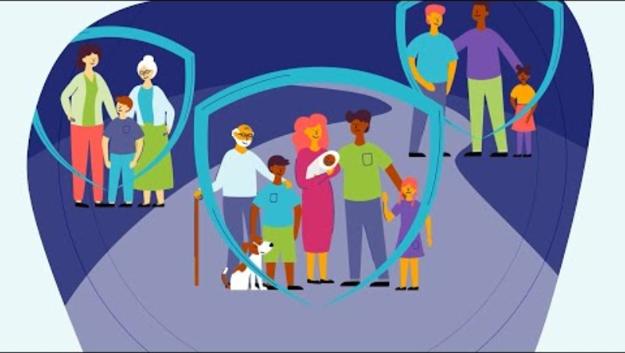
Pwysigrwydd Brechlynnau
Fideo animeiddiedig Iechyd Cyhoeddus Cymru (2023)
Pwysigrwydd Brechlynnau | Iechyd Cyhoeddus Cymru - YouTube
Notes:
Welsh language version: Pwysigrwydd Brechlynnau | Iechyd Cyhoeddus Cymru - YouTube

Slide 5
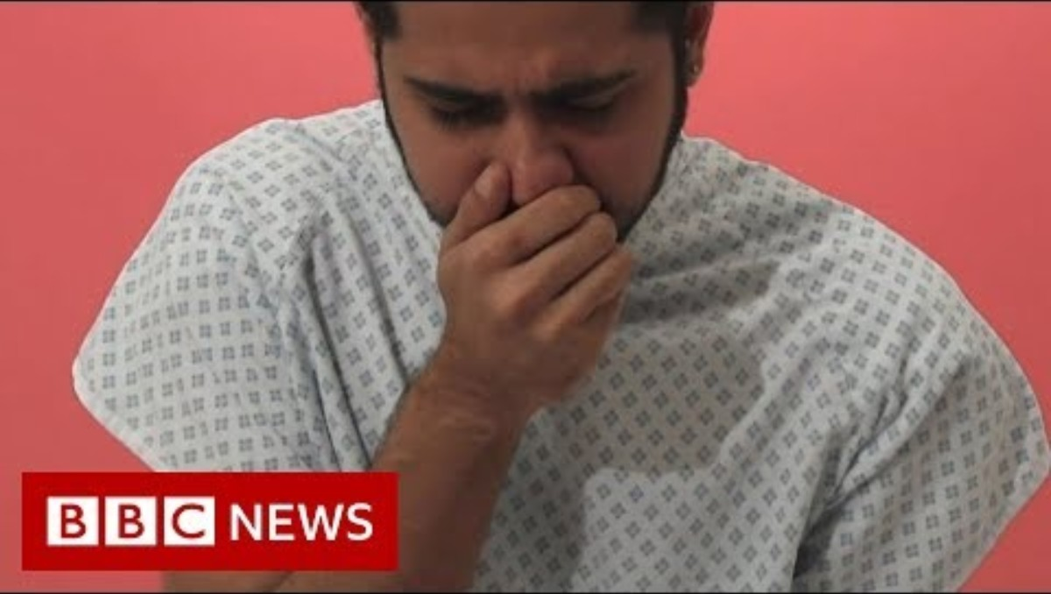
Imiwneiddio: Pam gwneud hyn
Fideo BBC news (2019)
Imiwneiddio: Pam gwneud hyn a sut mae 'imiwnedd torfol' yn gweithio - BBC News (youtube.com)

Slide 6
Pa frechiadau fydd yn cael eu cynnig i chi?
*Brechiad rhag y ffliw - Blynyddoedd 7 i 11.
*Brechiad y feirws papiloma dynol (HPV) - Blwyddyn 8.
Pigiad atgyfnerthu 3 mewn 1 i bobl ifanc yn eu harddegau (Tetanws, difftheria a pholio (Td/IPV)) - Blwyddyn 9.
Brechiad Llid yr Ymennydd ACWY (MenACWY) - Blwyddyn 9.
Brechiad rhag y frech goch, clwy'r pennau a rwbela (MMR) - unrhyw oedran os byddwch chi wedi methu 1 neu 2 ddos.
Os byddwch chi'n methu brechlyn yn ystod y flwyddyn ysgol y mae’n cael ei gynnig fel arfer, gallwch chi ei gael o hyd mewn blynyddoedd ysgol diweddarach.
* Yn ysgolion Caerdydd a'r Fro - mae’r brechiadau HPV a ffliw yn cael eu rhoi yn yr ysgol. Mae’r rhai eraill yn cael eu rhoi gan eich meddyg teulu.
Notes:
National immunisation schedule for Wales is available at: https://phw.nhs.wales/topics/immunisation-and-vaccines/routine-immunisation-schedules-for-wales/

Slide 7
Pa frechiadau eraill allai fod eu hangen arnoch?
Efallai y cynigir brechlynnau eraill i chi:
  Cyn dechrau rhai cyrsiau prifysgol neu goleg
  Ar gyfer eich gyrfa ddewisol
  Cyn i chi deithio i rai gwledydd yn y byd
  Os oes gennych chi neu rywun rydych chi'n byw gydag ef/hi rai cyflyrau meddygol neu ffactorau risg
  Os bydd brigiad o achosion o glefyd

Slide 8
Brechlyn ffliw

Slide 9

Brechlyn ffliw
Gall unrhyw un gael ffliw ond mae’r gyfradd heintio uchaf ymhlith plant ac mae’n gallu bod yn ddifrifol iawn iddyn nhw.
Gall plant a phobl ifanc hefyd drosglwyddo'r feirws ffliw i ffrindiau neu aelodau o'r teulu. Mae hyn yn gallu bod yn ddifrifol i bobl sy'n agored i niwed fel neiniau a theidiau, pobl â chyflyrau iechyd, neu bobl sy'n cael triniaethau sy'n effeithio ar eu system imiwnedd (e.e. cemotherapi).
Fel arfer, bydd y rhan fwyaf o blant a phobl ifanc yn cael eu brechlyn ffliw yn yr ysgol. Bydd gwybodaeth a ffurflen gydsynio yn cael eu hanfon adref (naill ai ar bapur neu'n ddigidol).
Bydd y rhan fwyaf o blant a phobl ifanc yn cael chwistrell trwyn, sy’n ffordd gyflym a di-boen o’i gael. Os nad yw'r chwistrell trwyn yn addas oherwydd bod cyflwr meddygol neu am ei fod yn cynnwys gelatin moch, yna mae brechlyn y gellir ei roi drwy bigiad ar gael.
Mae angen cael brechiad rhag y ffliw bob hydref/gaeaf er mwyn rhoi’r amddiffyniad gorau.
I gael rhagor o wybodaeth, ewch i icc.gig.cymru/brechlynffliw.
Notes:
More information about flu and the vaccine is available at www.phw.nhs.wales/fluvaccine

Slide 10
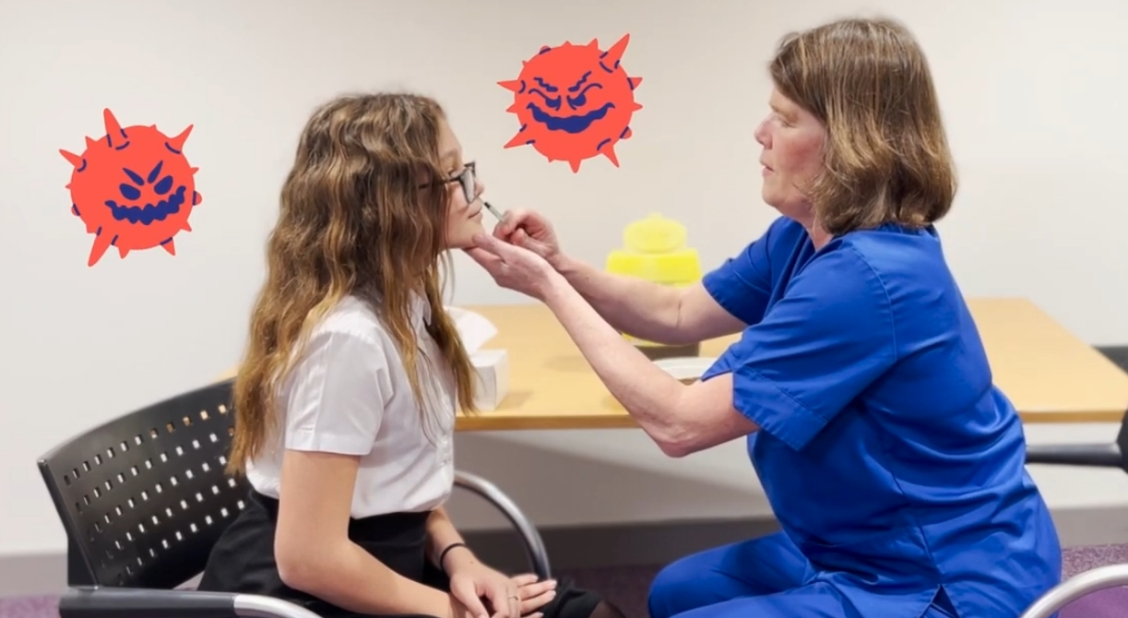
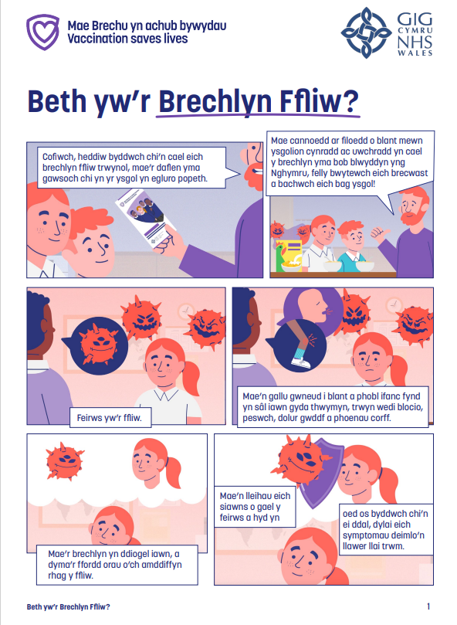
Fideo animeiddiedig a chomic a gyd-gynhyrchwyd: Brechlyn ffliw
Fideo animeiddiedig Iechyd Cyhoeddus Cymru (2023)
'Beth yw'r Brechlyn Ffliw', cynnwys clyweledol (youtube.com)
Comic Iechyd Cyhoeddus Cymru (2023)
Beth yw'r Brechlyn Ffliw (Comic)
Notes:
Welsh language animation: Beth yw’r Brechlyn ffliw
Welsh language comic: Comig: Beth yw’r Brechlyn ffliw

Slide 11
Brechlyn HPV

Slide 12

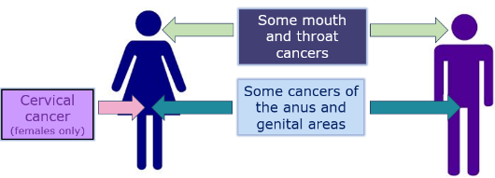
Brechlyn HPV
Mae HPV (feirws papiloma dynol) yn gyffredin iawn a gellir ei drosglwyddo drwy gysylltiad croen i groen.
Bydd y rhan fwyaf o bobl yn dod i gysylltiad â'r feirws HPV rywbryd yn ystod eu bywydau.
Gall y brechlyn HPV helpu i leihau eich risg o rai mathau o ganser a achosir gan y feirws HPV, yn cynnwys canser ceg y groth, a chanser y pen a'r gwddf (sy’n fwyaf cyffredin ymhlith dynion).
Yn y rhan fwyaf o achosion, rhoddir y brechlyn HPV fel 1 dos. Pigiad yn rhan uchaf y fraich ydyw.
Mae rhagor o wybodaeth ar gael yn icc.gig.cymru/brechlyn-hpv
Rhai canserau’r geg a’r gwddf
Canser ceg y groth (merched yn unig)
Rhai canserau’r anws a’r organau cenhedlu
Notes:
More information about HPV and the vaccine can be found at: www.phw.nhs.wales/HPVvaccine
The previous HPV vaccine used in the UK offered protection against 4 types of HPV infection. Types 16 and 18 (high-risk types) and types 6 and 11 (low-risk types). Gardasil 9 is now the vaccine of choice for the HPV programme. It offers protection against an additional 5 types 31, 33, 45, 52, 58.
Since the HPV programme started in 2008, evidence from the UK shows:
Fewer HPV infections with the main cancer causing HPV types
A fall in the number of cases of genital warts
A big reduction in pre-cancer and cancer of the cervix
Low-risk HPV types 6 and 11 are responsible for causing approximately 90% of genital warts
Genital warts are the most common viral sexually transmitted infection (STI) in the UK
They are small growths or bumps that appear on or around the genital area (private parts)
Genital warts can take months or years to develop after infection and can be passed on even if they are not visible
Human papillomavirus (HPV): the green book, chapter 18a - GOV.UK (www.gov.uk)

Slide 13
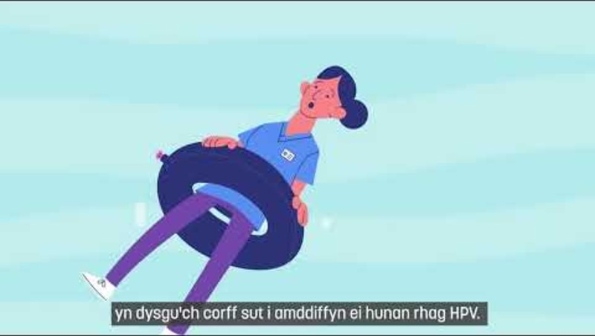
Fideo Iechyd Cyhoeddus Cymru
'Beth yw'r Brechlyn HPV', cynnwys clyweledol - YouTube

Slide 14
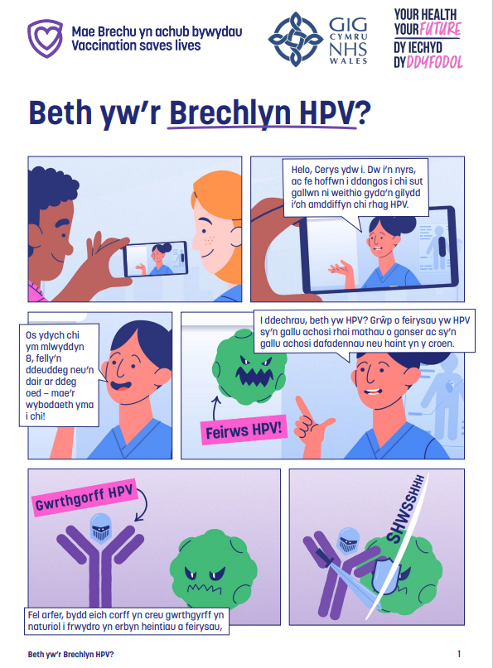
Comic Iechyd Cyhoeddus Cymru
Comic Iechyd Cyhoeddus Cymru
Beth yw'r Brechlyn HPV (Comic)

Slide 15
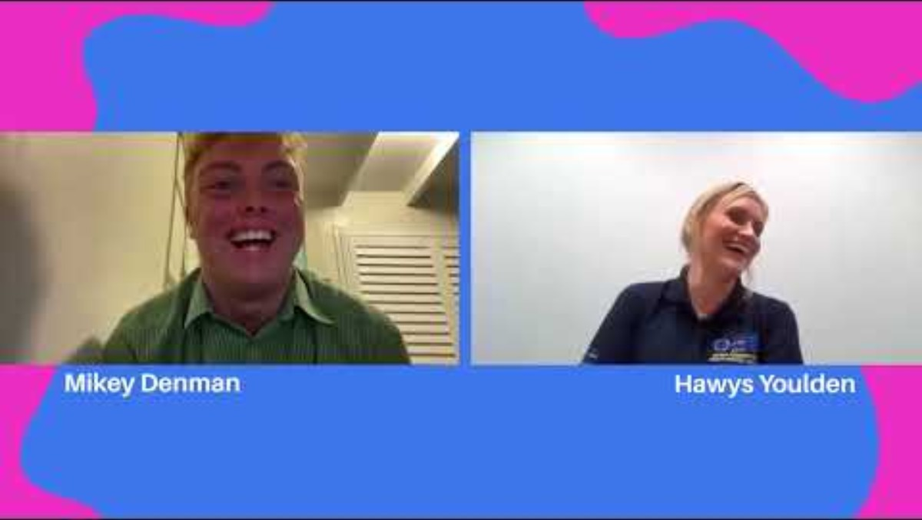
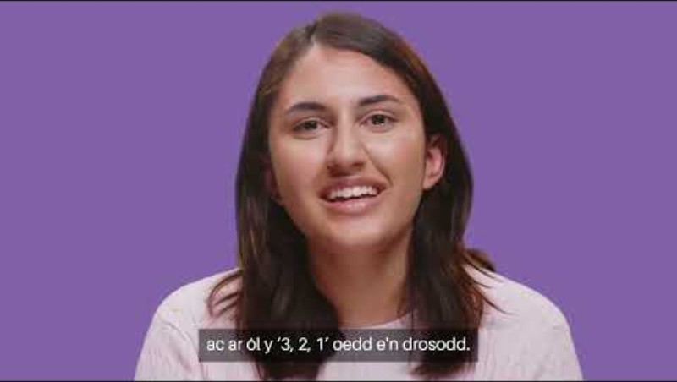
Fideos Iechyd Cyhoeddus Cymru
Sgwrs: Dylanwadwr X Clinigydd
Fideo Iechyd Cyhoeddus Cymru (2023) HPV - Cyngor fyddwn i'n ei roi i'r fi ifanc (youtube.com)
Notes:
Welsh language animation: 'Beth yw'r Brechlyn HPV' (youtube.com)
Welsh language video: HPV - Cyngor fyddwn i'n ei roi i'r fi ifanc (youtube.com)

Slide 16
Pigiad atgyfnerthu 3 mewn 1 ar gyfer pobl ifanc yn eu harddegau

Slide 17
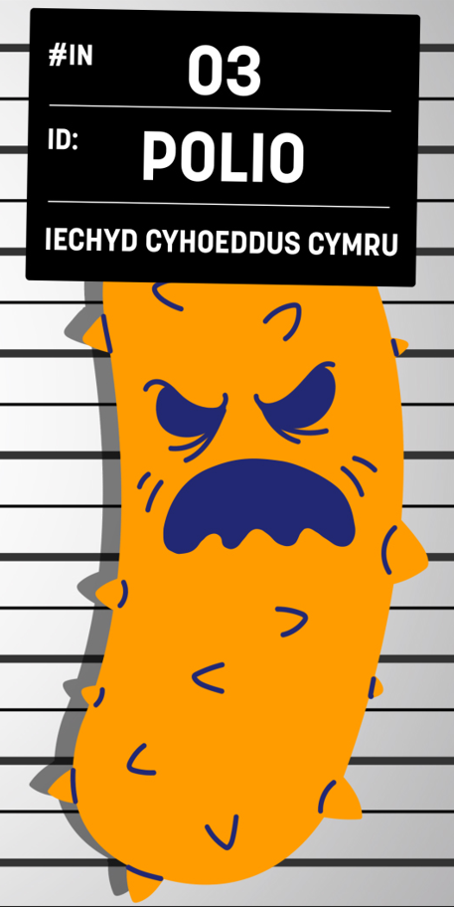
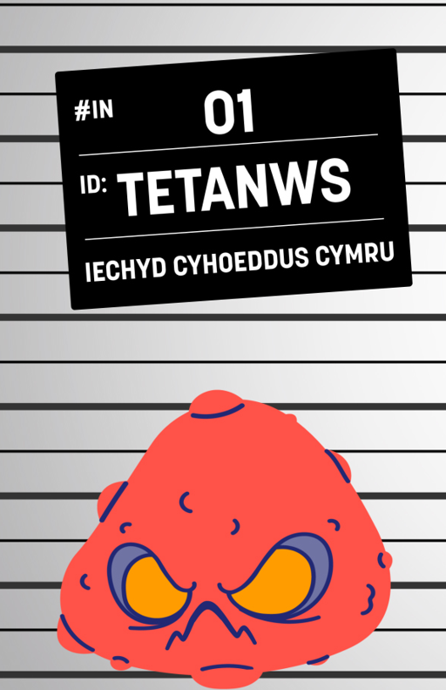
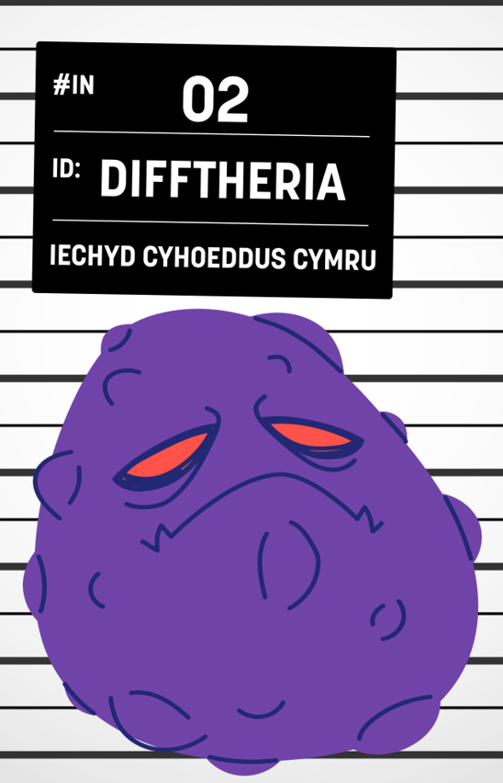
Pigiad atgyfnerthu 3 mewn 1 i bobl ifanc yn eu harddegau (Td/IPV)
Brechlyn cyfun sy'n diogelu rhag 3 chlefyd:
  Tetanws – “T”. Mae bacteria i'w cael mewn pridd fel arfer. Mae’n cal ei ddal drwy glwyfau croen agored ac mae’n effeithio ar y nerfau yn eich corff.
  Difftheria – “d”. Mae bacteria'n lledaenu drwy besychu a thisian a gallant achosi problemau difrifol i’r galon ac wrth anadlu.
  Feirws Polio wedi’i Anactifadu “IPV”. Mae'r feirws yn lledaenu o berson i berson, a gall achosi salwch difrifol, anabledd parhaol, a marwolaeth mewn rhai achosion.
Notes:
5 doses are offered for life long protection but further doses may be required for example travel, work and for people with a weakened immune system
More information about tetanus, diphtheria, polio and the 3-in-1 vaccine can be found at: www.phw.nhs.wales/3in1vaccine

Slide 18

Pigiad atgyfnerthu 3 mewn 1 i bobl ifanc yn eu harddegau (Td/IPV)
Byddwch wedi cael cynnig 4 dos rheolaidd cyn i chi ddechrau yn yr ysgol gynradd.
Mae'r dos rheolaidd hwn i bobl ifanc yn eu harddegau’n gweithio i roi hwb i’ch imiwnedd wrth i chi groesi’r trothwy i fyd oedolion.
Rhoddir y brechlyn fel pigiad yn rhan uchaf y fraich ar yr un pryd â'r brechlyn MenACWY fel arfer.
Mae rhagor o wybodaeth ar gael yn icc.gig.cymru/atgyfnerthiad-3-mewn-1
Notes:
5 doses are offered for life long protection but further doses may be required for example travel, work and for people with a weakened immune system
More information about tetanus, diphtheria, polio and the 3-in-1 vaccine can be found at: www.phw.nhs.wales/3in1vaccine

Slide 19

Animeiddiad Pigiad atgyfnerthu 3 mewn 1 i bobl ifanc yn eu harddegau
Beth yw'r pigiad Atgyfnerthu 3 mewn 1 i Bobl Ifanc?
19
Notes:
MenACWY and 3-in-1 animations
We’ve been working in partnership with Social Change UK to support the development of new educational resources focused on the MenACWY and Teenage 3-in-1 Booster vaccines.
The aim was to better understand the existing knowledge, attitudes, and experiences of young people aged 13 to 14, and to explore their preferences around how vaccination information is presented. This work helped inform the design and distribution of two new coproduced animations and comics, building on the suite of existing resources.
As part of the insight phase, two focus groups were conducted with a total of 17 Year 9 and 10 pupils from schools within the CTM and Swansea Bay University Health Board areas.
We gathered information regarding the structure of animations, considering aspects such as pacing, language and paralinguistics in order to really maintain attention.
Importantly, the test phase of the MenACWY/3in1 animations indicated that they were easy to understand, and they encouraged vaccination intention suggesting that the core information was effectively delivered.
The reasons students gave, including clarity, safety, and relevance reinforced the value of using animations to support vaccine communication – which is a key finding for us when we look to convey future vaccination information
Specifically referring to language, we found that terms such as ‘booster’ and ‘teenage’ resonated well with the audience and helped them better understand the content. We found that ‘Booster’ sounded positive and safe, while ‘teenage’ also made the vaccine feel more relevant to their age group. Based on this, and in alignment with the language young people found most accessible, we’re now using the term “Teenage 3-in-1 Booster” within PHW’s school-age vaccination programme.
Where are we now?: The animations, along with comic strips, are now complete and live on the Web Shop. The accompanying insights report featuring recommendations is currently being finalised and will be available soon on the Public Engagement insights web page

Slide 20
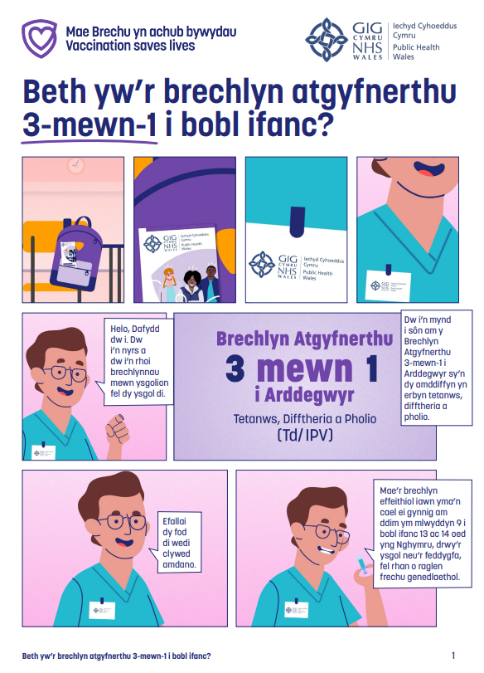
Comic pigiad atgyfnerthu 3 mewn 1 i bobl ifanc yn eu harddegau
Comic Iechyd Cyhoeddus Cymru
Beth yw’r brechlyn atgyfnerthu 3-mewn-1 i bobl ifanc?
20
Notes:
MenACWY and 3-in-1 animations
We’ve been working in partnership with Social Change UK to support the development of new educational resources focused on the MenACWY and Teenage 3-in-1 Booster vaccines.
The aim was to better understand the existing knowledge, attitudes, and experiences of young people aged 13 to 14, and to explore their preferences around how vaccination information is presented. This work helped inform the design and distribution of two new coproduced animations and comics, building on the suite of existing resources.
As part of the insight phase, two focus groups were conducted with a total of 17 Year 9 and 10 pupils from schools within the CTM and Swansea Bay University Health Board areas.
We gathered information regarding the structure of animations, considering aspects such as pacing, language and paralinguistics in order to really maintain attention.
Importantly, the test phase of the MenACWY/3in1 animations indicated that they were easy to understand, and they encouraged vaccination intention suggesting that the core information was effectively delivered.
The reasons students gave, including clarity, safety, and relevance reinforced the value of using animations to support vaccine communication – which is a key finding for us when we look to convey future vaccination information
Specifically referring to language, we found that terms such as ‘booster’ and ‘teenage’ resonated well with the audience and helped them better understand the content. We found that ‘Booster’ sounded positive and safe, while ‘teenage’ also made the vaccine feel more relevant to their age group. Based on this, and in alignment with the language young people found most accessible, we’re now using the term “Teenage 3-in-1 Booster” within PHW’s school-age vaccination programme.
Where are we now?: The animations, along with comic strips, are now complete and live on the Web Shop. The accompanying insights report featuring recommendations is currently being finalised and will be available soon on the Public Engagement insights web page

Slide 21
Brechlyn MenACWY

Slide 22
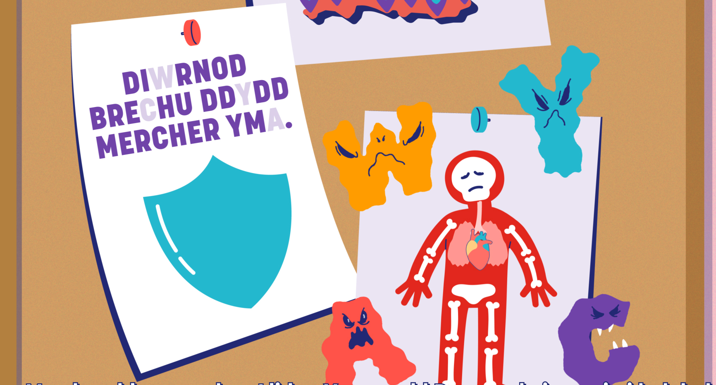
Brechlyn MenACWY
Mae’r brechlyn MenACWY yn diogelu rhag rhai o'r mathau mwyaf cyffredin o facteria meningococol – A, C, W ac Y. Nid yw'n diogelu’n llawn rhag pob math o glefydau meningococol.
Gall clefyd meningococol achosi:
  Llid yr Ymennydd - haint yn leinin yr ymennydd;
  Sepsis – adwaith sy’n peryglu bywyd i haint ac sy’n gallu niweidio eich corff cyfan
  Mae'r ddau glefyd yn ddifrifol iawn, yn enwedig os na chânt eu diagnosio'n gynnar – mae’r ddau glefyd yn gallu lladd.
Notes:
1 in 10 people carry the bacteria without experiencing illness, this increases to 1 in 4 older teenagers. So, vaccinating teenagers should also help protect other people, including babies and older people, against meningococcal disease through herd immunity
If a dose of a MenACWY conjugate vaccine has already been given after 10 years of age a further teenage dose is not needed
Vaccination of individuals with uncertain or incomplete immunisation - GOV.UK (www.gov.uk)
If young people have older family members under the age of 25 that have not had their MenACWY vaccine please encourage them to make an appointment with their GP surgery
For more information about the meningococcal disease A, C, W & Y and the MenACWY vaccine, visit: www.phw.nhs.wales/MenACWYvaccine

Slide 23

Brechlyn MenACWY
Mae pobl ifanc yn eu harddegau hŷn yn fwy tebygol o gario'r bacteria ac maent mewn mwy o berygl o ddal haint.
Mae’r clefyd meningococol yn lledaenu drwy ddod i gysylltiad agos â rhywun. Mae byw mewn cysylltiad agos ag eraill, fel llety prifysgol, yn cynyddu'r risg.
Mae brechu yn helpu i leihau'r risg o ddal haint ac atal y clefyd rhag lledaenu.
Mae’r brechlyn yn cael ei roi fel pigiad yn rhan uchaf y fraich ar yr un pryd â'r pigiad atgyfnerthu 3 mewn 1 i bobl ifanc yn eu harddegau fel arfer.
Mae rhagor o wybodaeth ar gael yn icc.gig.cymru/brechlynmenacwy
Notes:
1 in 10 people carry the bacteria without experiencing illness, this increases to 1 in 4 older teenagers. So, vaccinating teenagers should also help protect other people, including babies and older people, against meningococcal disease through herd immunity
If a dose of a MenACWY conjugate vaccine has already been given after 10 years of age a further teenage dose is not needed
Vaccination of individuals with uncertain or incomplete immunisation - GOV.UK (www.gov.uk)
If young people have older family members under the age of 25 that have not had their MenACWY vaccine please encourage them to make an appointment with their GP surgery
For more information about the meningococcal disease A, C, W & Y and the MenACWY vaccine, visit: www.phw.nhs.wales/MenACWYvaccine

Slide 24
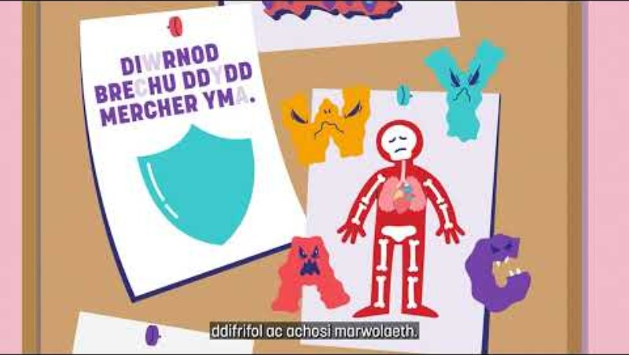
Animeiddiad MenACWY
Beth yw'r brechlyn MenACWY? - YouTube
Notes:
MenACWY and 3-in-1 animations
We’ve been working in partnership with Social Change UK to support the development of new educational resources focused on the MenACWY and Teenage 3-in-1 Booster vaccines.
The aim was to better understand the existing knowledge, attitudes, and experiences of young people aged 13 to 14, and to explore their preferences around how vaccination information is presented. This work helped inform the design and distribution of two new coproduced animations and comics, building on the suite of existing resources.
As part of the insight phase, two focus groups were conducted with a total of 17 Year 9 and 10 pupils from schools within the CTM and Swansea Bay University Health Board areas.
We gathered information regarding the structure of animations, considering aspects such as pacing, language and paralinguistics in order to really maintain attention.
Importantly, the test phase of the MenACWY/3in1 animations indicated that they were easy to understand, and they encouraged vaccination intention suggesting that the core information was effectively delivered.
The reasons students gave, including clarity, safety, and relevance reinforced the value of using animations to support vaccine communication – which is a key finding for us when we look to convey future vaccination information
Specifically referring to language, we found that terms such as ‘booster’ and ‘teenage’ resonated well with the audience and helped them better understand the content. We found that ‘Booster’ sounded positive and safe, while ‘teenage’ also made the vaccine feel more relevant to their age group. Based on this, and in alignment with the language young people found most accessible, we’re now using the term “Teenage 3-in-1 Booster” within PHW’s school-age vaccination programme.
Where are we now?: The animations, along with comic strips, are now complete and live on the Web Shop. The accompanying insights report featuring recommendations is currently being finalised and will be available soon on the Public Engagement insights web page

Slide 25
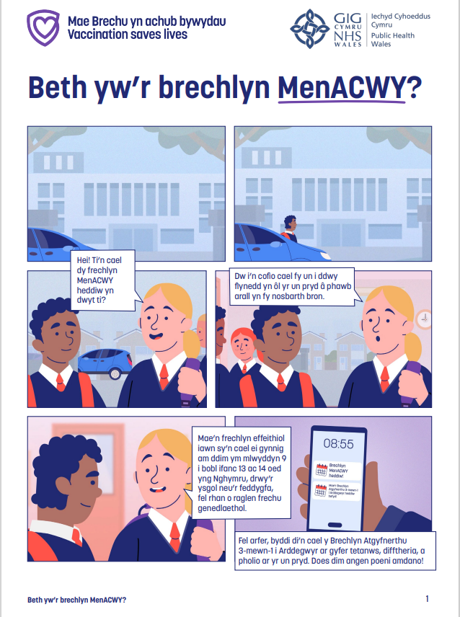
Comic MenACWY
Comic Iechyd Cyhoeddus Cymru
'Beth yw'r brechlyn MenACWY??

Slide 26
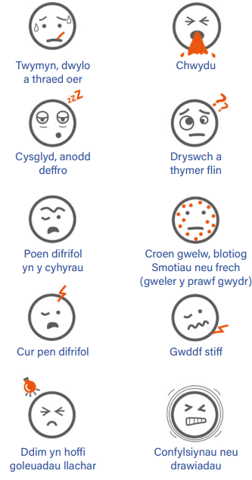
Llid yr Ymennydd a Sepsis
Mae’r brechlyn MenACWY yn diogelu rhag rhai achosion o lid yr ymennydd a sepsis, ond nid pob un. Nid yw’r un brechlyn yn 100% effeithiol.
Mae'n bwysig iawn eich bod chi’n adnabod arwyddion llid yr ymennydd a sepsis.
Gallwch chi fynd yn sâl yn gyflym iawn, ac mae llid yr ymennydd a sepsis yn gallu lladd.
Gall symptomau ymddangos mewn unrhyw drefn. Efallai na fydd rhai yn ymddangos o gwbl.
Mae’n bwysig eich bod yn adnabod yr arwyddion, yn cadw llygad ar eich gilydd ac yn ymddiried yn eich greddf.
Ffynhonnell: MeningitisNow
Notes:
https://www.meningitisnow.org/

Slide 27
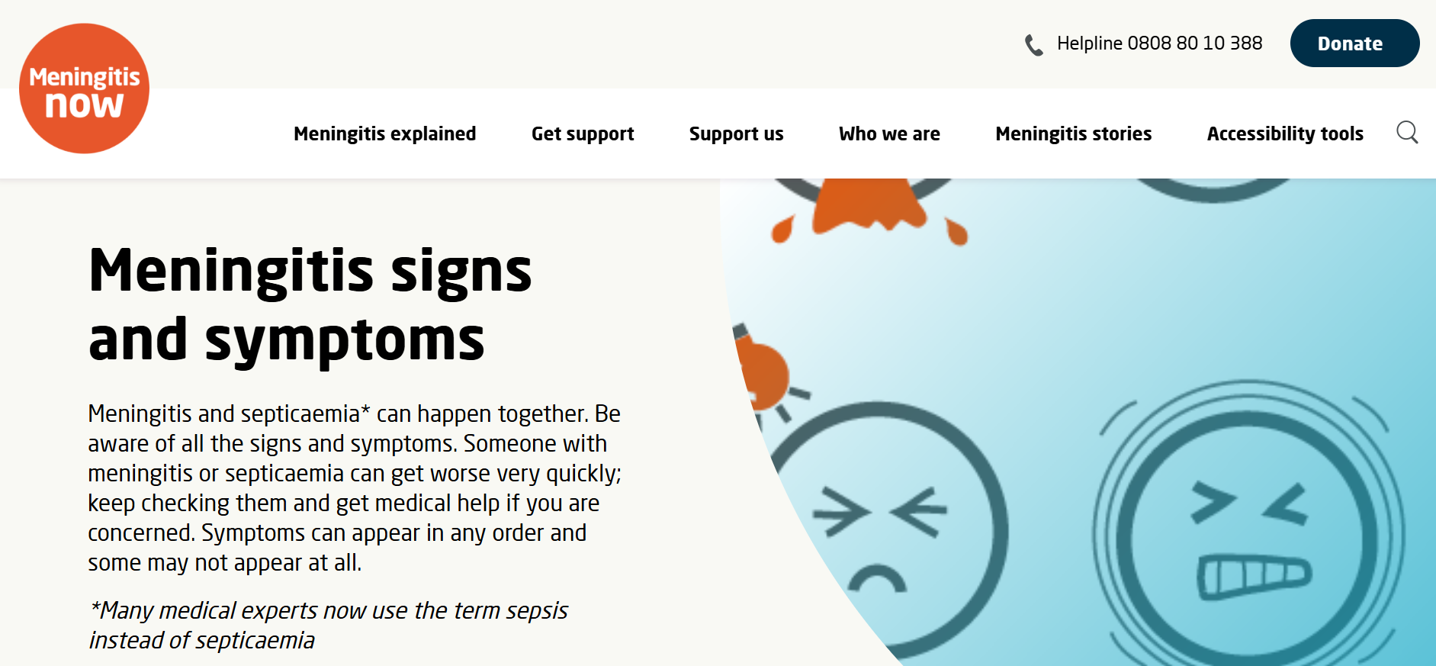
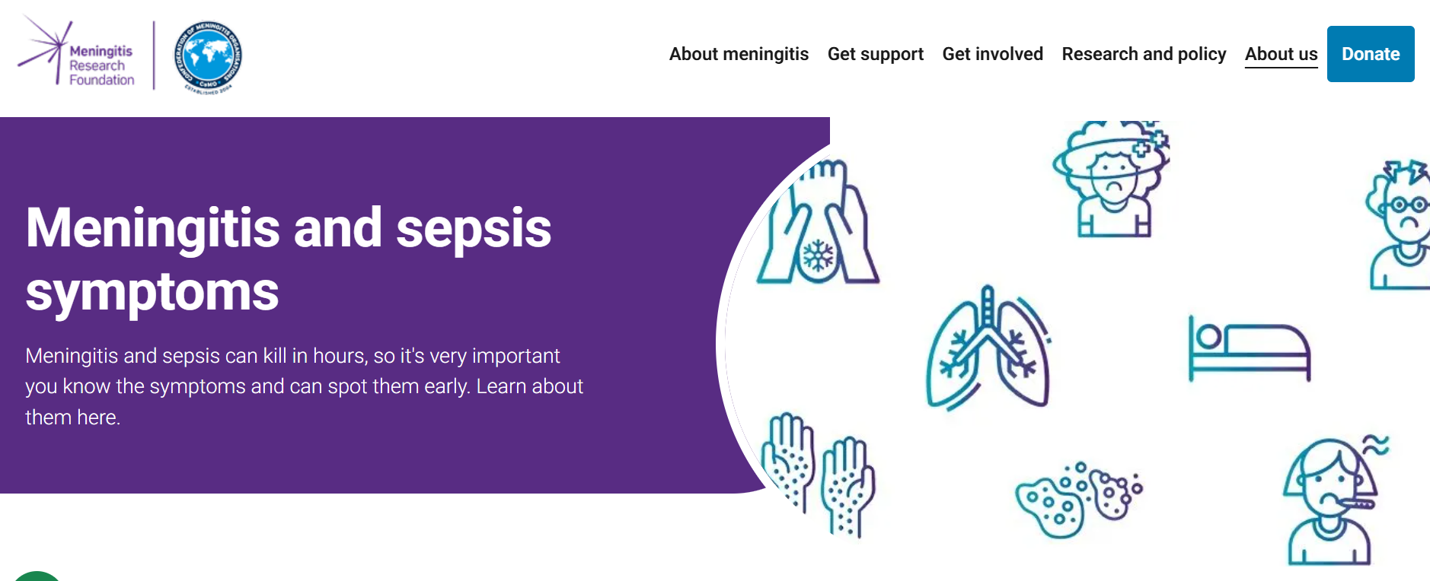
Llid yr Ymennydd a Sepsis
Os ydych chi'n meddwl bod gennych chi neu rywun rydych chi'n ei adnabod lid yr ymennydd neu sepsis, peidiwch â gwastraffu amser, ceisiwch gymorth meddygol ar unwaith.
Mae rhagor o wybodaeth am arwyddion a symptomau llid yr ymennydd a sepsis ar gael gan:
Arwyddion a symptomau meningitis | Meningitis Now
Sefydliad Ymchwil Llid yr Ymennydd
Notes:
https://www.meningitisnow.org/

Slide 28
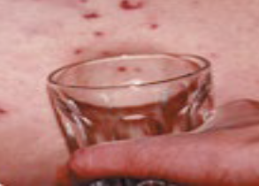
Llid yr ymennydd a sepsis – y prawf gwydr
Gall rhywun â sepsis ddatblygu brech “pigiadau pin” bach a all droi'n gleisio porffor. Nid yw'r frech hon yn pylu dan bwysau.
Gwasgwch ochr gwydr clir yn gadarn yn erbyn y croen. Gall y smotiau/brech bylu i ddechrau.
Gall y smotiau/brech fod yn anoddach i'w gweld ar groen tywyll. Edrychwch ar rannau goleuach eich corff fel cledrau'r dwylo neu wadnau'r traed.
Daliwch ati i wirio.
Mae twymyn â smotiau/brech nad ydynt yn pylu dan bwysau yn argyfwng meddygol.
Ffynhonnell: Meningitis Now
Peidiwch ag aros nes y bydd brech yn ymddangos. Ceisiwch gymorth meddygol ar unwaith os yw rhywun yn sâl ac yn gwaethygu.

Slide 29
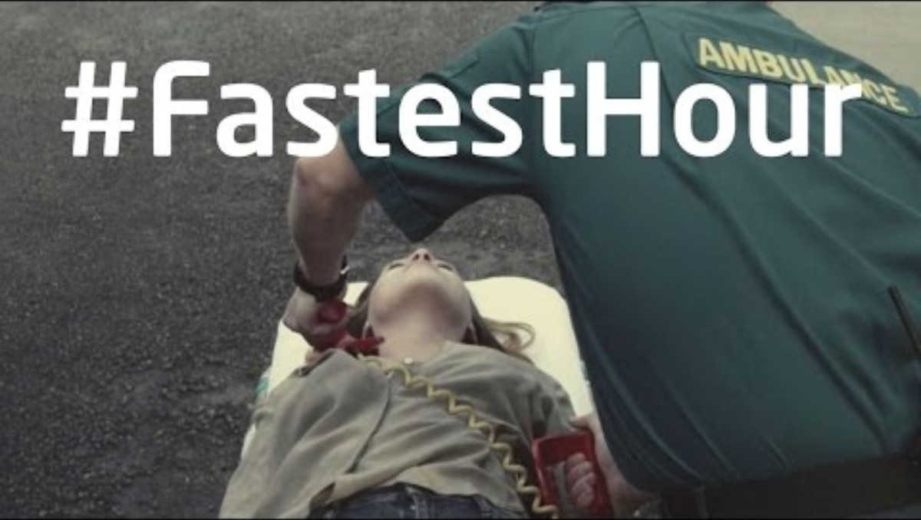
Yr Awr Gyflymaf
Fideo Meningitis Now (2017)
Meningitis Now: #FastestHour - Ymwybyddiaeth | Meningitis Now (youtube.com)

Slide 30
Brechlyn MMR

Slide 31
Brechlyn rhag y frech goch, clwy'r pennau a rwbela (MMR)
Mae'r frech goch, clwy'r pennau a rwbela yn 3 haint difrifol.
Maent yn cael eu hachosi gan feirysau sy'n lledaenu drwy besychu a thisian.
Gall pob un o'r 3 haint achosi cymhlethdodau difrifol.
Bydd sicrhau eich bod wedi cael 2 ddos ​​o’r brechlyn MMR yn helpu i'ch diogelu chi a'ch ffrindiau a'ch teulu.
Mae 2 ddos ​​o'r brechlyn MMR yn cael eu cynnig i blant cyn iddynt ddechrau yn yr ysgol gynradd. Os ydych chi wedi methu'r rhain, dydy hi ddim yn rhy hwyr!
Notes:
If one dose has already been given only one further dose is required no matter how long ago it was given. If two doses are required they can be given one month apart.
Anyone born after 1970 who has not had two doses of MMR vaccine can be vaccinated at their GP practice for free

Slide 32
Brechlyn rhag y frech goch, clwy'r pennau a rwbela (MMR)
Y Frech Goch
- Bydd gan bawb sydd wedi'u heintio dwymyn uchel, brech a byddant yn teimlo'n sâl iawn.
- Mae cymhlethdodau oherwydd y frech goch yn cynnwys haint yn yr ysgyfaint, yr ymennydd a gall achosi marwolaeth weithiau.
Clwy'r pennau
- Mae’n achosi chwarennau poenus, chwyddedig yn yr wyneb, y gwddf, yr ên, yn ogystal â thwymyn uchel a chur pen/pen tost. Gall cymhlethdodau gynnwys haint ar yr ymennydd a gorchudd yr ymennydd.
- Gall hefyd achosi chwyddo poenus yn yr ofarïau mewn menywod a’r ceilliau mewn gwrywod
- Gall clwy'r pennau achosi marwolaeth weithiau.
Rwbela (a elwir hefyd yn frech goch yr Almaen).
- Mae symptomau fel arfer yn ysgafn.
- Gall dal rwbela yn ystod beichiogrwydd fod yn ddifrifol iawn i fabanod yn y groth. Mae’n gallu achosi camesgoriad a niwed i olwg, clyw, calon ac ymennydd y baban.
Notes:
If one dose has already been given only one further dose is required no matter how long ago it was given. If two doses are required they can be given one month apart.
Anyone born after 1970 who has not had two doses of MMR vaccine can be vaccinated at their GP practice for free

Slide 33
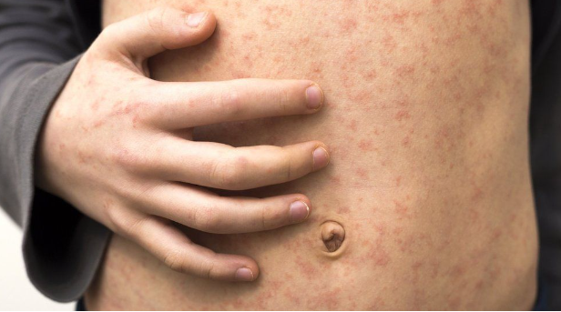
Y Frech Goch yng Nghymru
Mae'r frech goch yn un o glefydau mwyaf heintus y byd.
Mae'n lledaenu drwy besychu a thisian, drwy gysylltiad personol agos neu gysylltiad uniongyrchol â secretiadau heintiedig y trwyn neu’r gwddf.
Mae’n gallu bod yn glefyd difrifol iawn a gall achosi cymhlethdodau sylweddol a rhai sy’n peryglu bywyd.
Roedd tua 100 o blant yn marw yng Nghymru a Lloegr bob blwyddyn cyn i’r drefn frechu rhag y frech goch ddechrau yn y DU.
Nid oes ffordd o drin y frech goch.
Ffynhonnell: BBC News
Notes:
For more information about measles, mumps, rubella and the MMR vaccine, visit: www.phw.nhs.wales/MMRvaccine

Slide 34
Y Frech Goch yng Nghymru
Rhwng Tachwedd 2012 a Gorffennaf 2013, bu brigiad mawr o achosion o’r frech goch yng Nghymru. Cafodd 447 o achosion o’r frech goch eu cadarnhau yn ardal Canolbarth a Gorllewin Cymru, cafodd 64 o achosion eu derbyn i’r ysbyty a bu farw un unigolyn ohoni.
Ers y brigiad o achosion yn 2012/13, bu gostyngiad yn nifer yr achosion o'r frech goch yng Nghymru.
Cafodd 9 o achosion o’r frech goch eu cadarnhau yng Nghymru yn 2023, ac roedd 8 ohonynt yn rhan o frigiad o achosion o'r frech goch yng Nghaerdydd.
Yn 2024, bu cynnydd sylweddol yn nifer yr achosion o'r frech goch ledled y DU. Cadarnhaodd Asiantaeth Diogelwch Iechyd y DU (UKHSA) fod 2,918 o achosion yn Lloegr.
Ym mis Ebrill 2024, cyhoeddwyd brigiad o achosion o'r frech goch yn ne-ddwyrain Cymru, a arweiniodd at gyfanswm o 17 o achosion wedi’u cadarnhau.
Notes:
For more information about measles, mumps, rubella and the MMR vaccine, visit: www.phw.nhs.wales/MMRvaccine

Slide 35
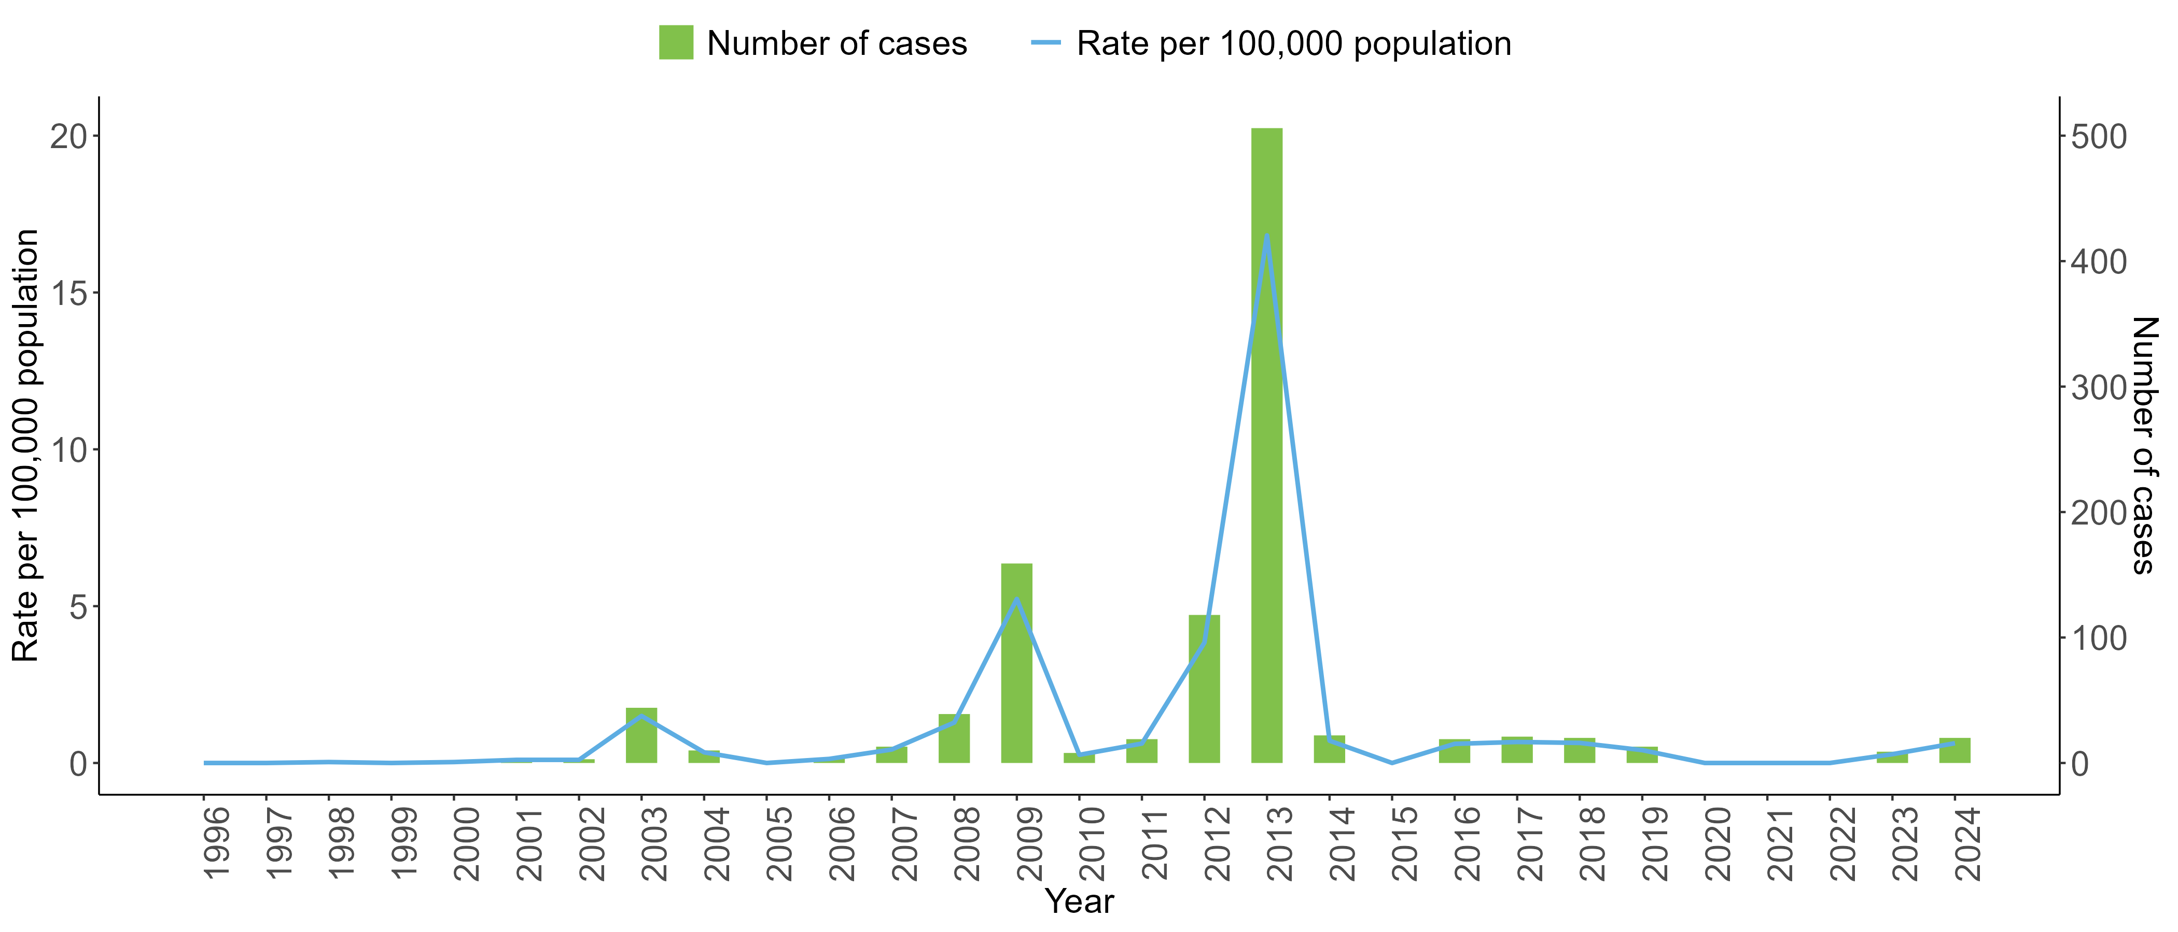
Siart yn dangos y gyfradd fesul 100,000 o'r boblogaeth a nifer yr achosion a gadarnhawyd o’r frech goch yng Nghymru rhwng 1996 a 2024
Goruchwyliaeth ac epidemioleg y frech goch | Iechyd Cyhoeddus Cymru
Notes:
For more information about measles, mumps, rubella and the MMR vaccine, visit: www.phw.nhs.wales/MMRvaccine

Slide 36
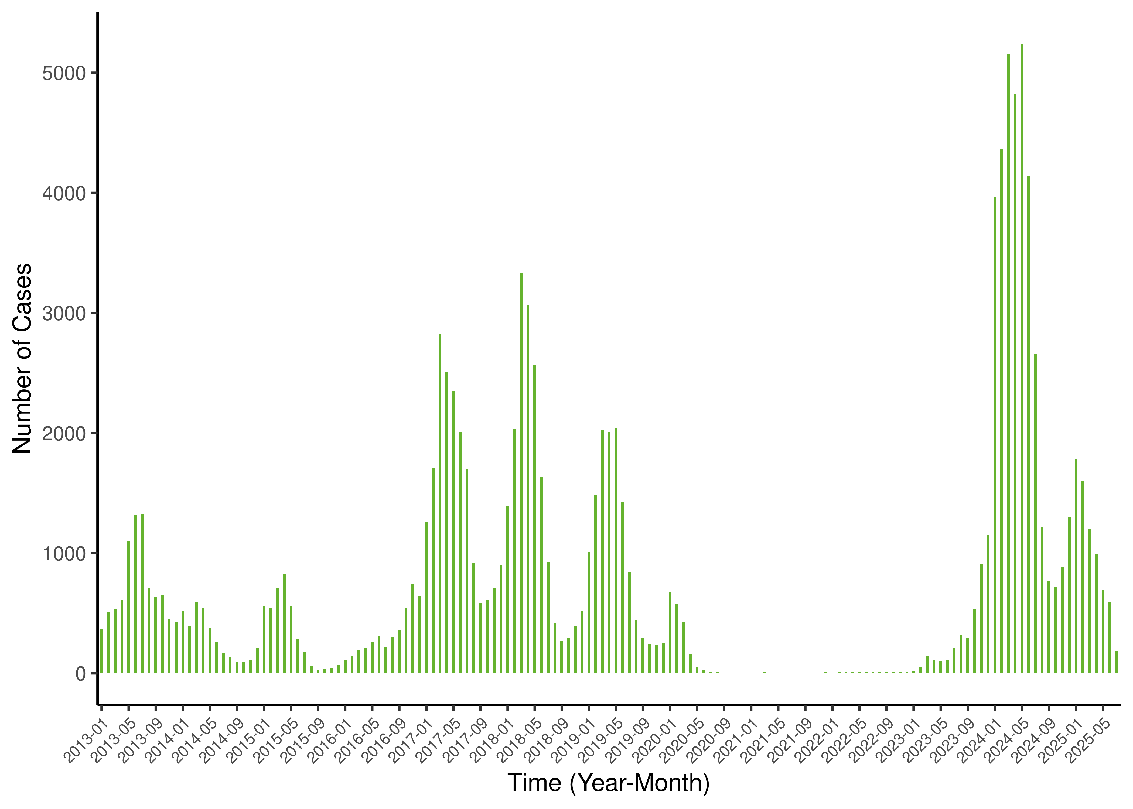
Y Frech Goch yn Ewrop
Mae cynnydd wedi bod yn nifer yr achosion o'r frech goch ledled Ewrop ers 2023.
O 1 Awst 2024 hyd at 31 Gorffennaf 2025, adroddodd 30 o Aelod-wladwriaethau'r UE/AEE fod cyfanswm o 11,943 o achosion o'r frech goch.
Bu farw 107,500 o bobl o'r frech goch ledled y byd yn 2023, ac roedd y rhan fwyaf ohonynt yn blant dan bum oed.
Bydd sicrhau eich bod wedi cael dau ddos ​​o'r brechlyn MMR yn eich diogelu chi a'r rhai o'ch cwmpas.
Nifer yr achosion o'r frech goch fesul mis a blwyddyn, UE/Ardal Economaidd Ewrop (AEE), 1 Ionawr 2013 hyd at 31 Gorffennaf 2025
https://measles-rubella-monthly.ecdc.europa.eu/
Notes:
https://www.ecdc.europa.eu/en/measles/surveillance-and-disease-data

Slide 37
Beth sydd angen i chi ei wneud?
Cyn y diwrnod dylech wneud y canlynol:
- Ymgyfarwyddo â'r wybodaeth am y brechlyn.
- Trafod yr wybodaeth gyda'ch rhiant neu warcheidwad.
- Dychwelyd y ffurflen gydsynio wedi'i chwblhau cyn gynted â phosibl. Gall hon fod yn ffurflen gydsynio bapur neu'n ffurflen e-gydsyniad ddigidol.
Ar y diwrnod dylech wneud y canlynol:
- Gwisgo dillad addas (crys polo ysgol/crys llawes fer).
- Cael brecwast neu fyrbryd cyn y sesiwn.
- Gwybod pryd/ble i fynd.
- Peidio ag ofni gofyn cwestiynau.
Os ydych chi'n nerfus, siaradwch â'r nyrs ymlaen llaw a bydd yn gallu eich cefnogi!
Notes:
May wish to discuss self consent with this slide
Gillick competence/ age of consent dependent on health board policy-further information on additional slides
Alongside the bullet point about wearing suitable clothing- depending on school uniform policy nurses can discuss wearing school tops with loose sleeves that can be rolled up or short sleeved shirts.

Slide 38
Cydsyniad
Mae cydsyniad yn golygu rhoi caniatâd i rywbeth ddigwydd.
Bydd y person sy'n rhoi'r brechlyn i chi bob amser yn gwirio a oes ganddyn nhw'r cydsyniad angenrheidiol gennych chi neu eich rhiant/gwarcheidwad cyn rhoi'r brechlyn.
Gall pobl ifanc 16 oed a hŷn gydsynio drostynt eu hunain.
Mewn rhai achosion, efallai y bydd pobl ifanc dan 16 oed yn gallu rhoi eu cydsyniad eu hunain. Bydd hyn yn digwydd os byddant wedi cael eu hasesu fel rhai sy'n ddigon aeddfed i ddeall yn llawn yr hyn sy'n cael ei gynnig.
Pan fydd pobl ifanc yn rhoi eu cydsyniad eu hunain, mae'n dal yn well bod rhieni/gwarcheidwaid yn rhan o'r broses o wneud y penderfyniad. Os yw'r person ifanc yn cytuno, bydd y rhiant/gwarcheidwad yn cael gwybod bod y brechiad wedi'i roi.

Slide 39
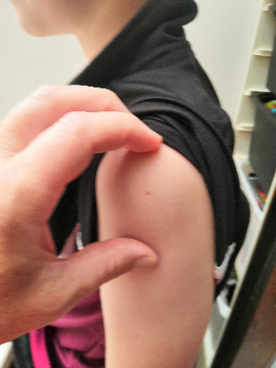
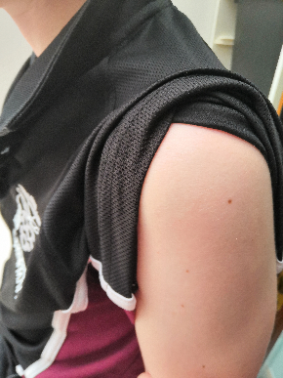
Sut a phryd mae'r brechlynnau'n cael eu rhoi?
Bydd y brechlynnau'n cael eu cynnig i chi ar yr adegau canlynol:
  blwyddyn 8 ar gyfer HPV;
  blwyddyn 9 ar gyfer y pigiad atgyfnerthu 3 mewn 1 i bobl ifanc yn eu harddegau a brechlyn MenACWY, (mewn rhai ardaloedd, mae’r rhain yn cael eu rhoi yn eich practis meddygon teulu).
Mae’r brechlynnau hyn yn cael eu rhoi fel pigiad i'r cyhyr yn rhan uchaf y fraich.

Slide 40
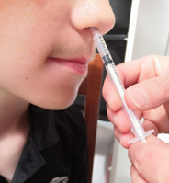
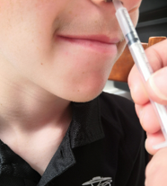
Sut a phryd mae'r brechlynnau'n cael eu rhoi?
Mae angen y brechiad ffliw arnoch bob blwyddyn ac mae hwn yn cael ei gynnig fel arfer yn ystod tymor yr hydref yn yr ysgolion.
  Chwistrell trwyn yw'r brechlyn ffliw i'r rhan fwyaf o bobl ifanc.
  Gellir rhoi’r brechiad ffliw fel pigiad yn rhan uchaf y fraich os nad yw'r chwistrell trwyn yn addas.

Slide 41
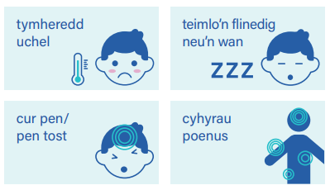
Oes sgil-effeithiau?
Fel yn achos pob meddyginiaeth, gall brechlynnau achosi sgil-effeithiau, ond ni fydd pawb yn eu profi.
Mae'r rhan fwyaf o sgil-effeithiau yn ysgafn a byddant fel arfer yn gwella ar ôl diwrnod neu ddau.
Bydd y nyrs yn eich cynghori ar yr hyn i'w ddisgwyl ar ôl i chi gael eich brechlyn.
Nid oes angen i chi golli'r ysgol ar ôl cael eich brechiad!
Notes:
All vaccines can cause side effects

Slide 42
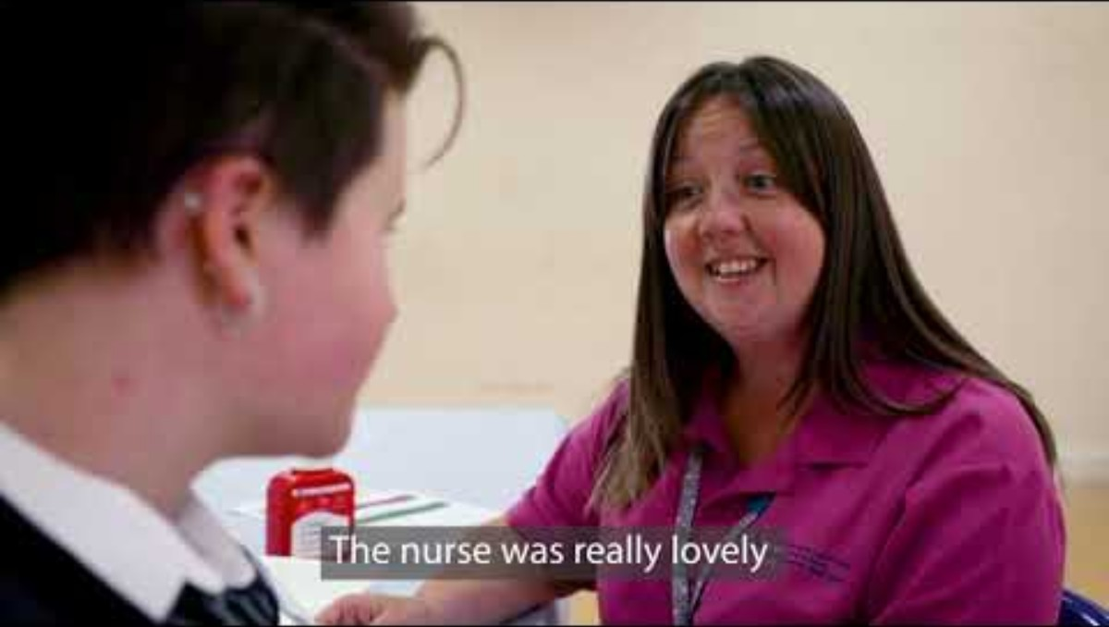
Fideo brechu mewn ysgolion a wnaed gan BIP Aneurin Bevan yw Cael eich Brechu

Slide 43
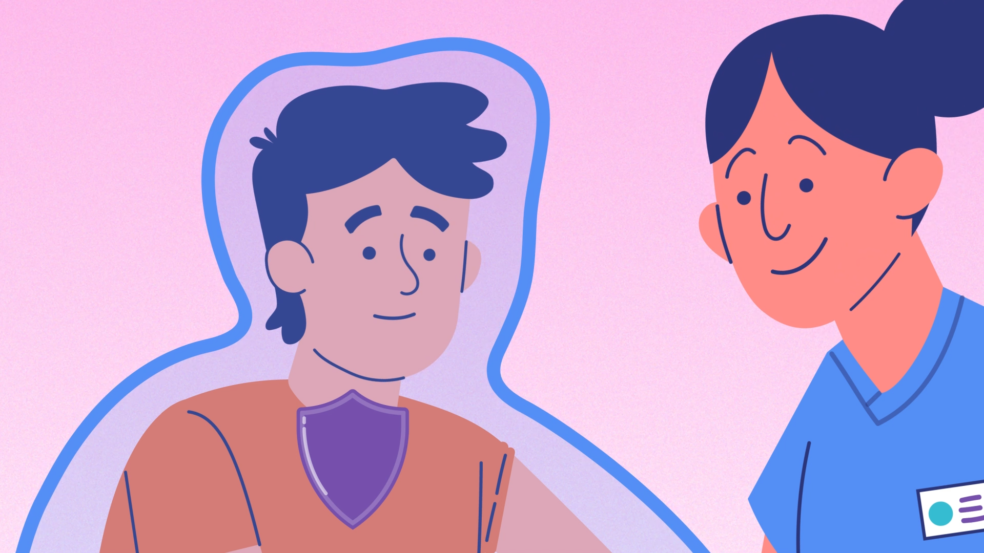
Pwyntiau allweddol
Mae brechu yn ffordd o helpu i'ch diogelu chi a phobl eraill nad ydynt yn gallu cael brechiadau rhag clefydau difrifol.
Efallai y bydd angen rhai brechlynnau cyn i chi ddechrau prifysgol neu goleg, ar gyfer eich gyrfa ddewisol, neu cyn i chi deithio i rai gwledydd yn y byd.
Mae brechlynnau'n achub bywydau!

Slide 44
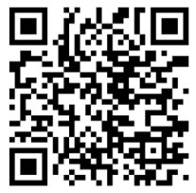
Rhagor o wybodaeth
Gallwch ddod o hyd i ragor o wybodaeth am frechiadau gan:
  Eich nyrs ysgol neu eich tîm imiwneiddio.
  Eich practis meddygon teulu.
Ewch ar-lein ac i:
  icc.gig.cymru/pynciau/imiwneiddio-a-brechlynnau/
  Neu sganiwch y cod QR i fynd â chi i'r dudalen brechlynnau

