Slide 1





The First 1000 Days
Y 1000 Diwrnod Cyntaf
Dull Iechyd y Cyhoedd o Gynorthwyo Rhieni
11/10/23
A Public Health Approach to Supporting Parents
11/10/23

Slide 2
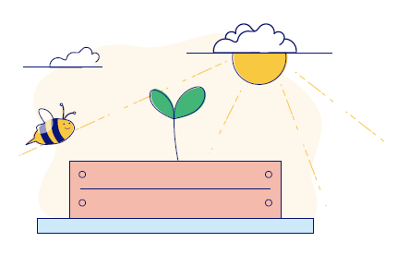
Trosolwg
1000 Diwrnod Cyntaf - sylfeini ar gyfer dyfodol iach, hapus
Dull iechyd y cyhoedd o gynorthwyo rhieni
Gwella canlyniadau yng Nghymru
Overview
The First 1000 Days - foundations for a healthy, happy future
A public health approach to supporting parents
Improving outcomes in Wales
Public Health Wales

Slide 3
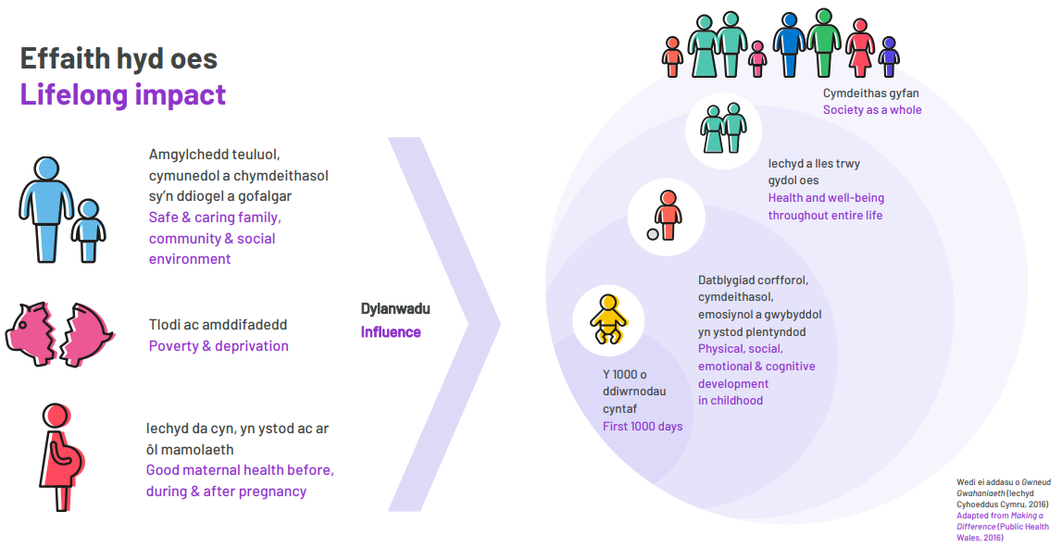
xxxxxxxxxxxxx

Slide 4
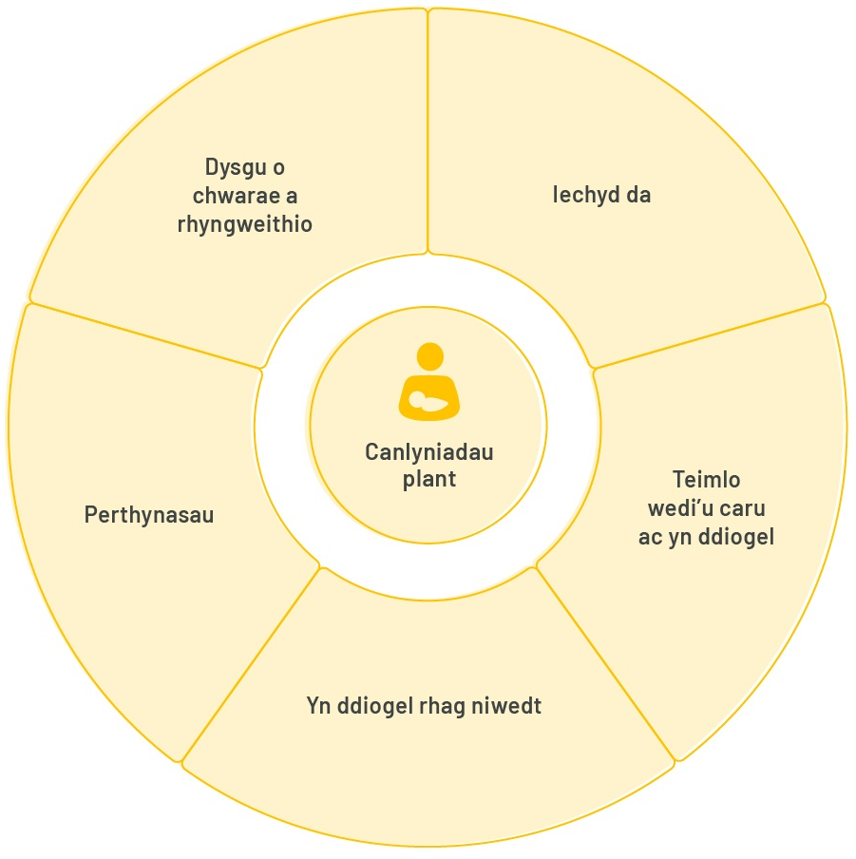
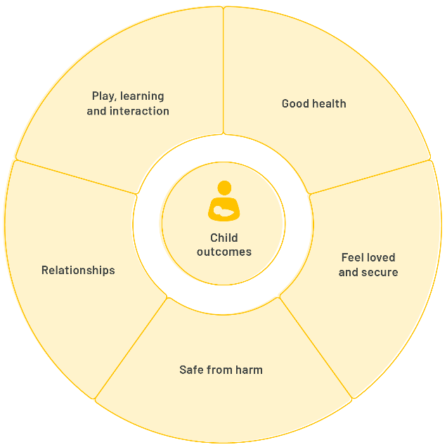
The best start in life
Y dechrau gorau mewn bywyd Beth sydd ei angen ar blant
What children need
Public Health Wales

Slide 5
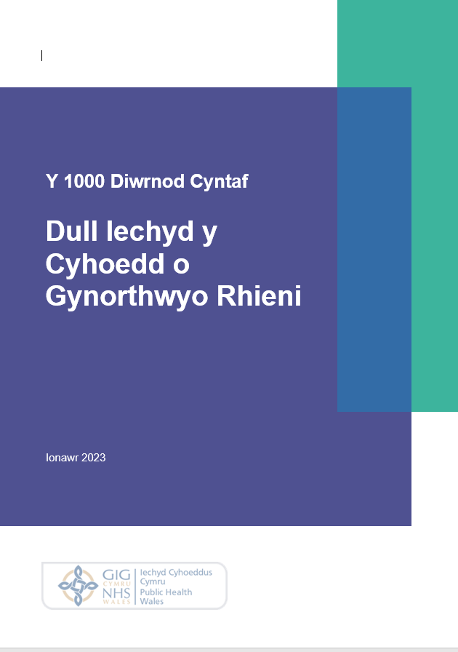
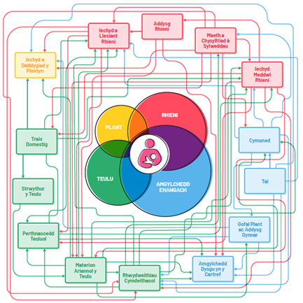

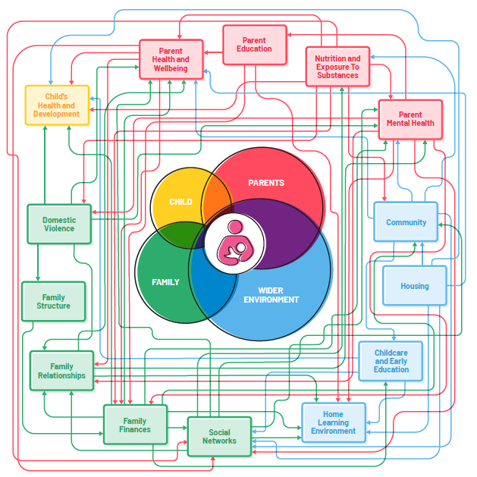
Developing the Approach
Datblygu'r dull
Theori, tystiolaeth a dirnadaeth
Adolygiad llenyddiaeth – theori gyfredol
Adolygiad o dystiolaeth – ffactorau risg ac amddiffynnol
Pedair o astudiaethau mewnwelediad, cyfweliadau a grwpiau ffocws gyda 169 o rieni a 105 o weithwyr proffesiynol
Theory, evidence and insight
Literature review – current theory
Evidence reviews – risk and protective factors
4 insight studies - interviews and focus groups with 169 parents and 105 professionals
Public Health Wales
Dull Iechyd Cyhoeddus y Cyhoedd 0 Gynorthwyo Rhieni
A Public Health Approach to Supporting Parents

Slide 6
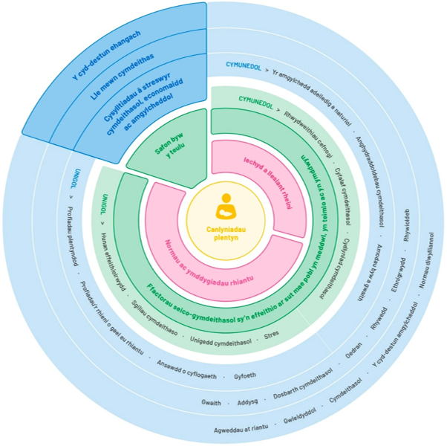
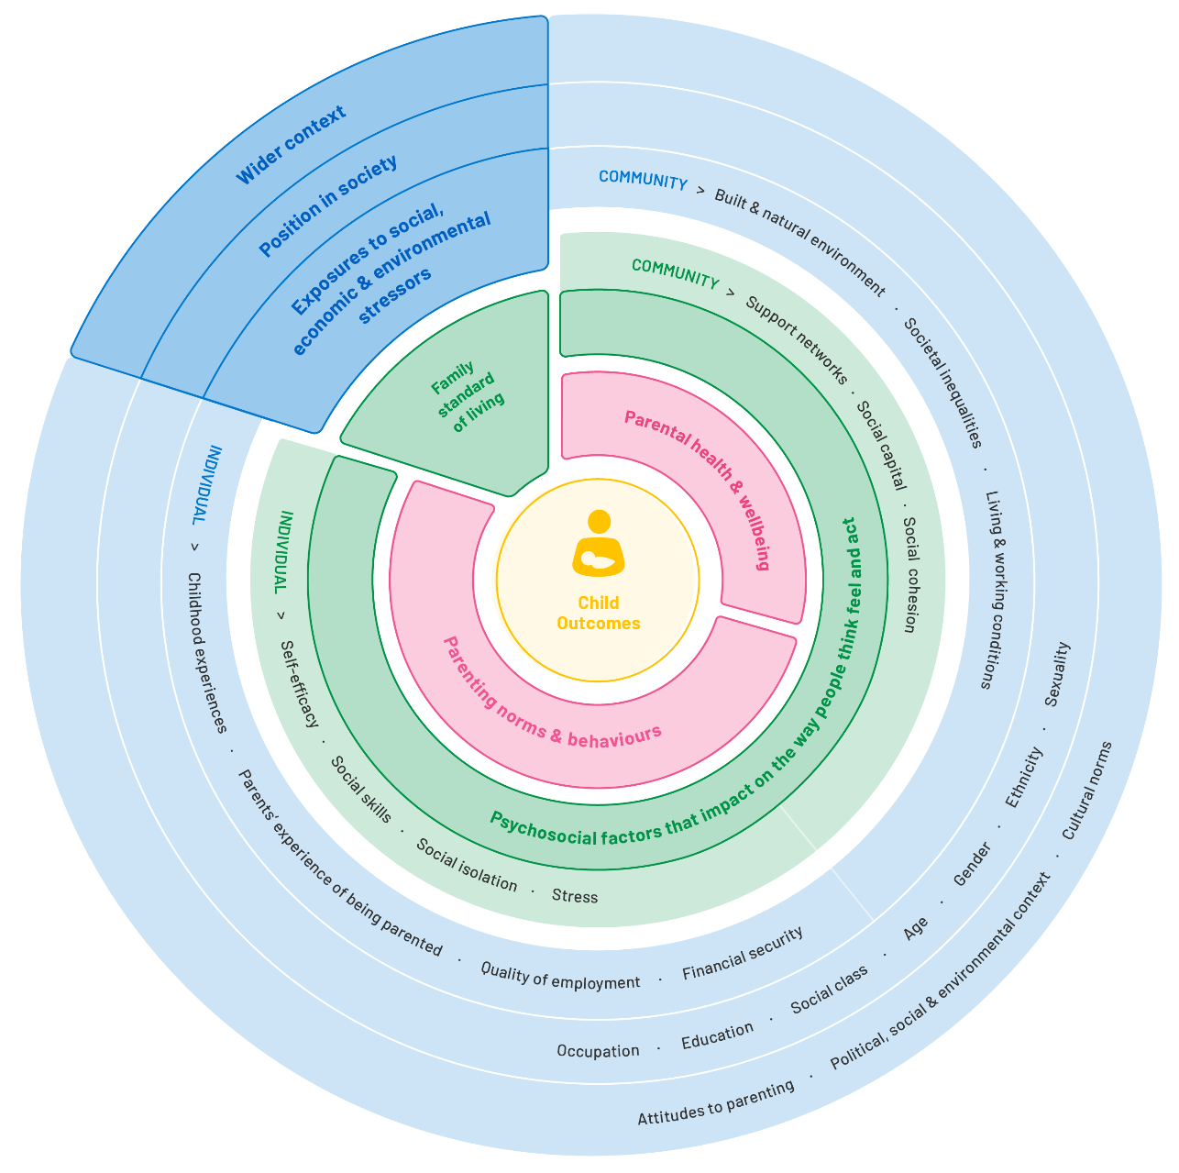
Routes of influence
Llwybrau dylanwad
xxxxxxxxxxxxx

Slide 7
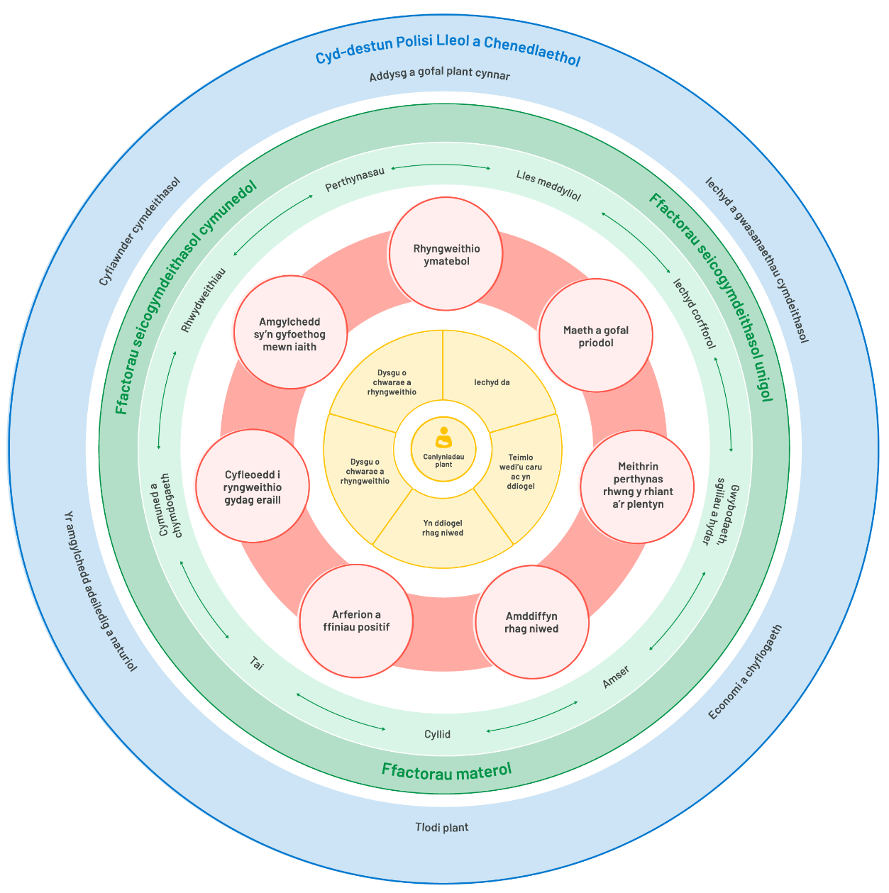
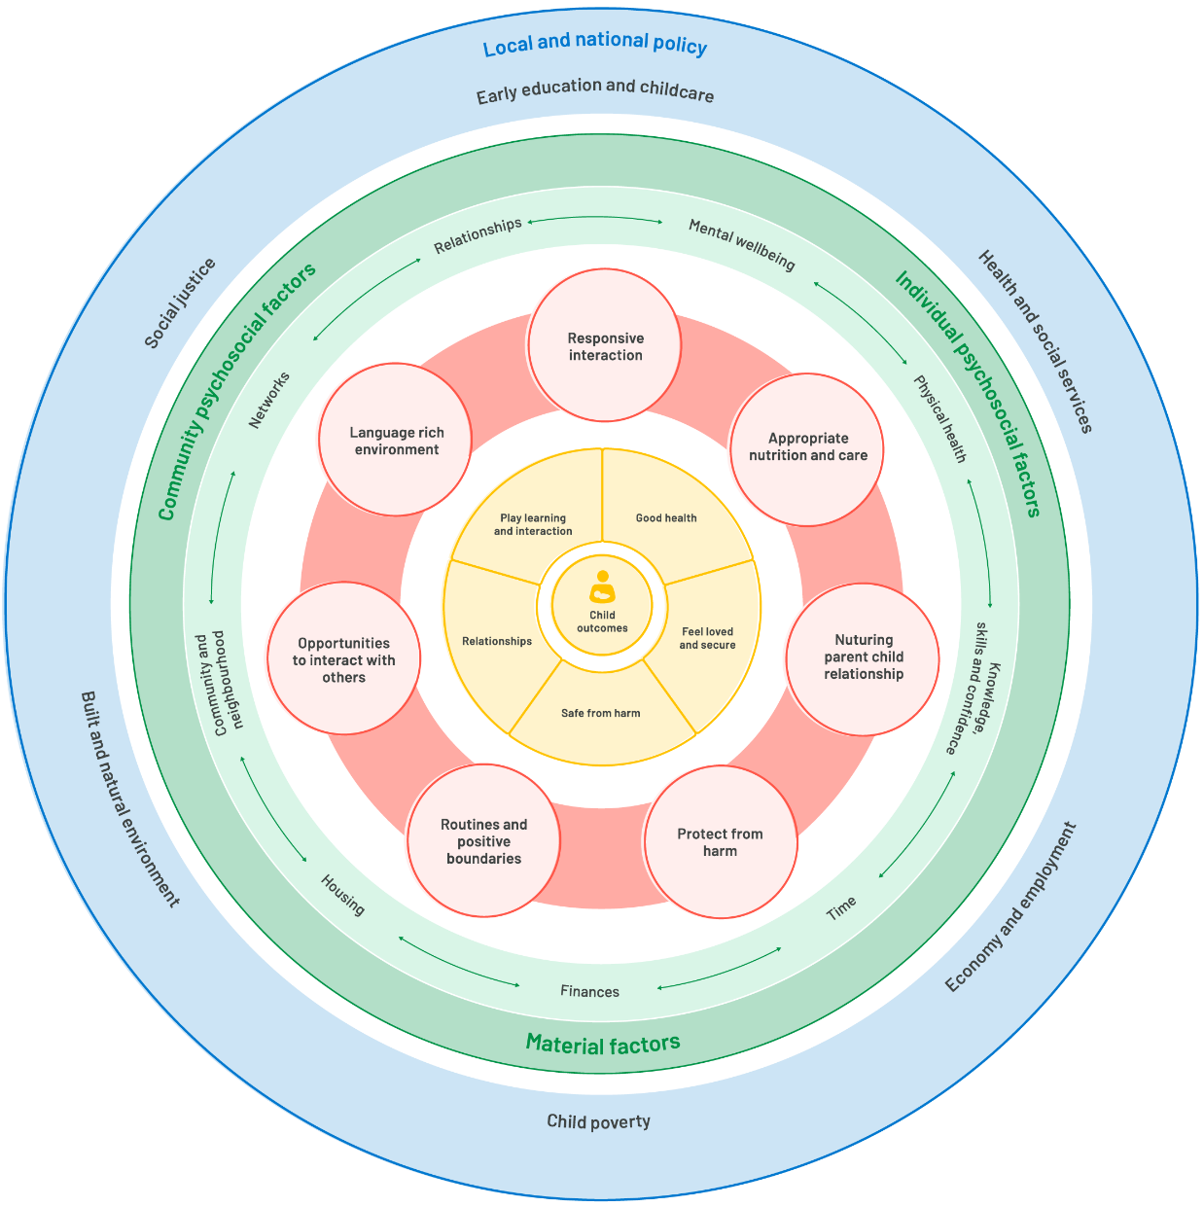
A public health approach to supporting parents
Dull Iechyd y Cyhoedd o Gynorthwyo Rhieni
Public Health Wales

Slide 8
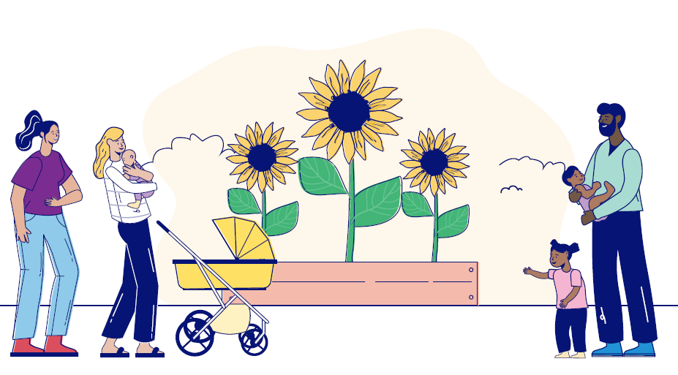
Key Themes
Themâu Allweddol
Mae rhianta yn bwysig i lesiant plant nawr ac yn y dyfodol.
Mae rhieni eisiau gwneud y gorau dros eu plant ond mae amgylchiadau yn golygu ei bod yn anoddach i rai rhieni nag eraill.
Mae modd gwneud rhagor i helpu i greu’r amodau a fydd yn arwain at ffyniant i deuluoedd yng Nghymru.
Mae cymorth iechyd meddwl a chymorth cymdeithasol da yn lleddfu problemau ac yn helpu rhieni i ddod i ben â heriau a lleihau’r effaith ar eu plant.
Parenting matters for children’s wellbeing now and into the future.
Parents want to do the very best for their children but circumstances mean that it is harder for some parents than others.
More can be done to help create the conditions for families in Wales to flourish.
Good mental health and social support act as buffers, helping parents manage challenges and minimise impact for their children.
Public Health Wales

Slide 9
Key messages
Negeseuon allweddol
Datblygu polisïau a strategaethau
Dylai gweithredu i wella canlyniadau yn y 1000 diwrnod cyntaf a lleihau tlodi plant fod yn flaenoriaeth strategol ar draws y system yng Nghymru.
Mabwysiadu dulliau cynhwysol sy'n canolbwyntio ar y teulu at ddatblygu polisïau lleol a chenedlaethol
Dylai gwybodaeth a chymorth rhianta cyson, o safon uchel, sy’n seiliedig ar dystiolaeth fod ar gael i bob teulu.
Mae gwasanaethau ymwelwyr iechyd a bydwreigiaeth mewn sefyllfa unigryw i asesu anghenion teuluoedd yn systematig a hwyluso mynediad cynnar at ystod eang o gymorth.
Nodi a mynd i'r afael â bylchau yn y cymorth a ddarperir i helpu teuluoedd i reoli straenachoswyr cyffredin mewn teuluoedd megis problemau perthynas, dyled a thai.
Mae angen set gyffredin o ddangosyddion system gyfan i ddangos tystiolaeth well a deall yr effaith
Policy and strategy development
Action to improve outcomes in the first 1000 days and reduce child poverty should be a strategic priority across the system in Wales.
Adopt inclusive, family centred approaches to local and national policy development
Consistent, high quality, evidence based parenting information and guidance should be available to all families.
Health visiting and midwifery services are uniquely placed to systematically assess families’ needs and facilitate early access to a broad range of support.
Identify and address gaps in the provision of support to help families manage common family stressors such as relationship problems, debt and housing.
A common set of system wide indicators are required to better evidence and understand the impact.
Public Health Wales

Slide 10
Key messages
Negeseuon allweddol
Datblygu a darparu gwasanaethau
Deall a gweithredu ar y ffactorau seicogymdeithasol a strwythurol.
Gweithio mewn partneriaeth â theuluoedd i ddatblygu a gwerthuso gwasanaethau.
Sicrhau bod hyder a llesiant rhieni yn cael eu cynnwys fel mesurau canlyniad.
Datblygu a chryfhau rhwydweithiau rhwng ymarferwyr.
Datblygu perthnasoedd o ymddiriedaeth rhwng rhieni a gweithwyr proffesiynol.
Rhoi cyngor a gwybodaeth gyson a chefnogol o safon uchel i deuluoedd am y ffactorau cyffredin sy'n achosi straen i'r teulu.
Adeiladu a chryfhau rhwydweithiau cymorth anffurfiol.
Service development and delivery
Understand and act on psychosocial and structural factors.
Work in partnership with families to develop and evaluate services.
Ensure parental confidence and wellbeing are included as outcome measures.
Build and strengthen networks between practitioners.
Enable the development of trusting relationships between parents and professionals.
High quality, consistent and supportive advice and information about common family stressors.
Build and strengthen informal support networks.
Public Health Wales

Slide 11
Gweithio gyda'n gilydd i greu Cymru iachach Working together for a healthier Wales

