Slide 1
Respiratory Syncytial Virus (RSV) Q&A webinar
Vaccine Preventable Disease Programme
Public Health Wales
8th August 2024
Notes:
Material contained in this document may be reproduced without prior permission provided it is done so accurately and is not used in a misleading context.
Acknowledgement to Public Health Wales NHS Trust to be stated.
© 2024 Public Health Wales NHS Trust.

Slide 2
Acknowledgements
UK Health Security Agency (UKHSA)
Vaccine Programme Wales (VPW)
Vaccine Preventable Disease Programme (VPDP)
Dr Catherine Moore - Consultant Clinical Scientist, Director Wales National Influenza Centre, Wales Specialist Virology Centre, Public Health Wales
Katie Rees - Principal Support & Business Analyst (DHCW - PCMH Digital)
Joshua Hunt (DHCW - PCMH)

Slide 3
Background
Since 2023, the Joint Committee on Vaccination and Immunisation (JCVI) has been actively reviewing evidence and considering a range of issues including disease epidemiology, vaccine efficacy, vaccine safety and the cost-effectiveness of introducing a routine RSV vaccination programme in the UK.
They subsequently recommended that a programme that is cost effective should be developed for both infants and older adults: www.gov.uk/government/publications/rsv-immunisation-programme-jcvi-advice-7-june-2023/respiratory-syncytial-virus-rsv-immunisation-programme-for-infants-and-older-adults-jcvi-full-statement-11-september-2023
From 1 September 2024, the RSV vaccine should be offered to:
  all pregnant women from 28 weeks' gestation
  adults turning 75 years old on or after 1st September 2024
  adults already aged 75 to 79 years on 1st September 2024
  RSV vaccine should be offered to eligible individuals throughout the year as this is a year-round programme
Green Book RSV Chapter 27a
Respiratory syncytial virus (RSV) programme: information for healthcare professionals - GOV.UK (www.gov.uk)

Slide 4
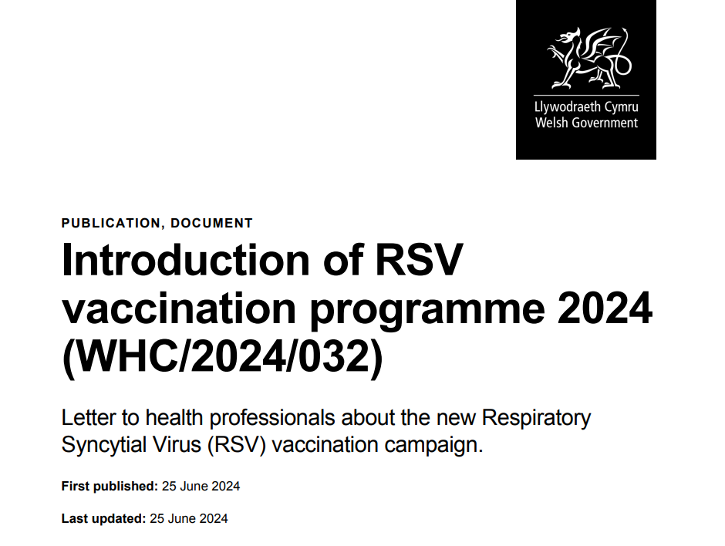
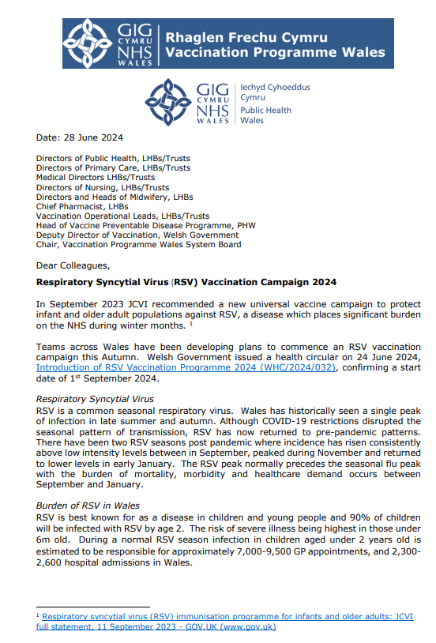
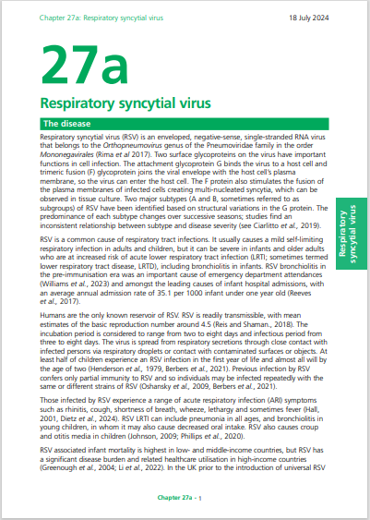
Key publications
Welsh Government issued a health circular on 24 June 2024, Introduction of RSV Vaccination Programme 2024 (WHC/2024/032), confirming a start date of 1st September 2024
Vaccine Programme Wales also issued a letter on the 28 June 2024, Respiratory Syncytial Virus (RSV) Vaccination Campaign 2024, summarising the maternal and adult RSV vaccination programmes, highlighting the vaccine to be used and the resources available from Public Health Wales to support the implementation of the campaign
The Green Book RSV chapter 27a is currently being updated. This provides the national clinical guidance and will be available to view here: Respiratory syncytial virus: the green book, chapter 27a - GOV.UK (www.gov.uk)

Slide 5
Prerequisites to administering RSV vaccines
Before administering the RSV vaccine, you should:
undertake training in the management of anaphylaxis and Basic Life Support (BLS) (adult) as specified by the policy for your local area and are familiar with Resuscitation Council UK (RCUK) guidance on Management of Anaphylaxis in the Vaccination Setting.
undertake any additional statutory and mandatory training as required by your employer
undertake theoretical and practical vaccination training and been assessed as competent
be able to describe the process of consent and how this applies when giving vaccines
undertake specific training on the RSV vaccination programme and familiarised yourself with the process for preparation of Abrysvo®
access and familiarised yourself with the following key documents: Green Book RSV Chapter 27a, RSV vaccination programme for older adults information for healthcare practitioners and the vaccine product information in the Summary of Product Characteristics (Electronic Medicines Compendium website)
Have an appropriate legal framework to supply and administer RSV vaccine in place for example patient specific prescription, Patient Specific Direction (PSD), Patient Group Direction (PGD) Further information will be available here: Patient Group Directions (PGD) - Welsh Medicines Advice Service (wales.nhs.uk)
Practitioners should always ensure they are accessing the most up to date information and guidance

Slide 6
Training resources
RSV recorded slides
1. An Introduction to Respiratory Syncytial Virus (RSV) – Published May 2024
2. Respiratory Syncytial Virus (RSV) - Vaccination Campaign 2024 – Published July 2024
The slides and recordings are available here: Training (sharepoint.com)
RSV training slide sets
Respiratory syncytial virus (RSV) vaccination programme for older adults
Respiratory syncytial virus (RSV) vaccination of pregnant women for infant protection
These training slides are available to view here: Immunisation training resources and events - Public Health Wales (nhs.wales)

Slide 7
PGDs
The following PGD templates have been published:
Respiratory Syncytial Virus (RSV) vaccine (Abrysvo▼®) for prevention of lower respiratory tract disease caused by RSV, Patient Group Directive for Older Adults (CYM-24010).
PGD version 1.0 is valid from 01 September 2024 to 31 August 2025
Respiratory Syncytial Virus (RSV) vaccine (Abrysvo▼®) for prevention of lower respiratory tract disease caused by RSV, Patient Group Directive for Pregnancy (CYM-24011)
PGD version 1.0 is valid from 01 September 2024 to 31 August 2025
The PGD templates are available for local adoption and can be accessed via the WMAS website –the RSV vaccine PGDs are in the adult immunisation section. Please note that these national PGD templates are not legal for use until adapted and authorised by the relevant Local Health Board.

Slide 8
RSV disease
Dr Catherine Moore - Consultant Clinical Scientist, Director Wales National Influenza Centre, Wales Specialist Virology Centre, Public Health Wales

Slide 9
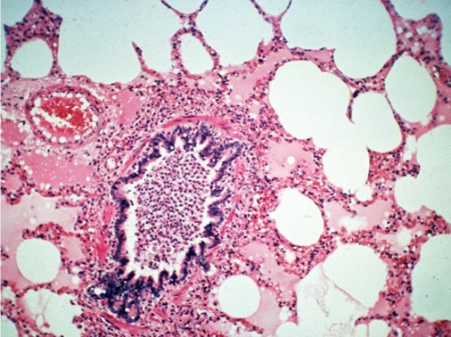
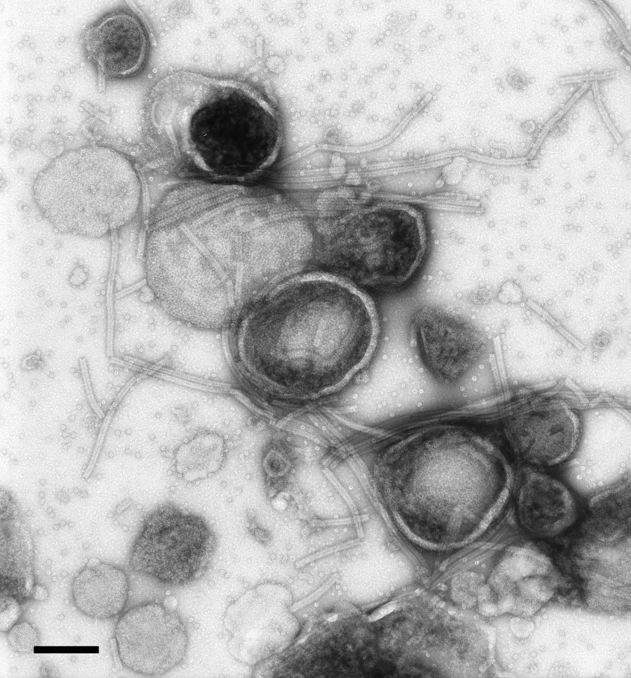
Respiratory Syncytial Virus (RSV)
Belongs to a large family of viruses Paramyxoviridae that includes a large number of significant human viruses including parainfluenza, human metapneumovirus, measles and mumps.
All have common features including a single stranded, negative sense, RNA genome of around 15000 nucleotides
Hans R. Gelderblom (2002)/RKI

Slide 10
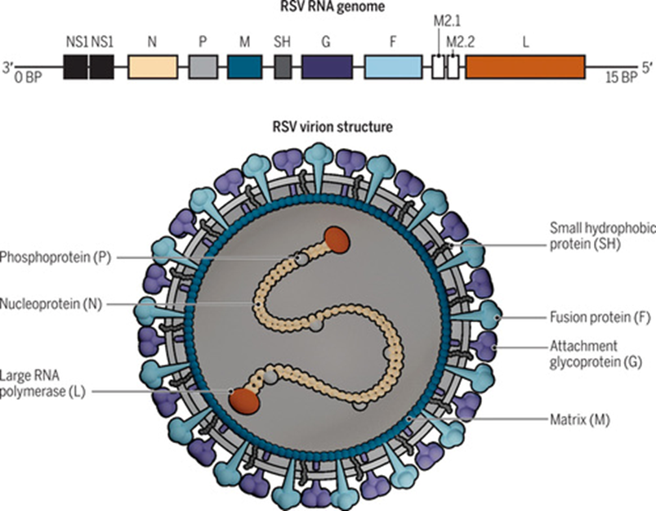
RSV the virus, immunity and vaccine targets
RSV exists as two types RSV A and RSV B, with further subtyping (clades) based on the genetically diverse surface glycoprotein
The virus enters the host cell by attachment via the G protein and then fuses itself via the F protein to the host cell, releasing it’s genome for replication
First infection occurs in infanthood, however immunity is not lifelong, with infection and reinfection occurring throughout life - this is due to a combination of immunity waning and antigenic changes in the virus particularly in the surface glycoproteins
Past attempts at developing vaccines have been challenging with early whole inactivated virus versions leading to increased severity of disease at first infection – was it actually possible?
Whole genome sequencing has demonstrated that whilst the RNA genome does continue to mutate, antigenically the fusion protein is fairly stable – particularly in the pre fusion form, making it a good target for vaccines and monoclonal therapies
Priorities for developing respiratory syncytial virus vaccines in different target populations, Volume: 12, Issue: 535, DOI: (10.1126/scitranslmed.aax2466)

Slide 11
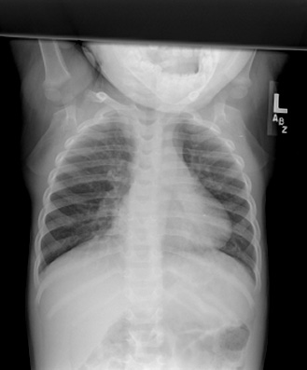
RSV – The Disease in Infants
RSV is most commonly associated with the clinical syndrome bronchiolitis
Every RSV season the proportion of babies under the age of 12 months admitted to paediatric units with bronchiolitis increases. Whilst other respiratory viruses can cause bronchiolitis, around 70% of cases are attributed to RSV.
  Bronchiolitis is caused by increased mucus secretion and inflammation in the small airways of the lung, this is then combined with virally damaged cells sloughing into the same airway causing blockage.
  To breath, the infant is able to pass air into the lung but the blockage prevents air leaving easily – this leads to hyperinflation of the lung alveoli and the chest then physically appears inflated with poor inspiration and expiration of air.
  There is no treatment, antivirals like ribavirin have little to no effect, with infants admitted to hospital managed supportively – a proportion will require ITU admission
Highly vulnerable infants are currently offered the prophylactic monoclonal palivizumab at monthly intervals throughout the RSV season to prevent severe disease
RSV infection in early life has long been attributed to increased risk of asthma and childhood wheeze
Diagnosis and Management of Respiratory Syncytial… | Relias Media

Slide 12
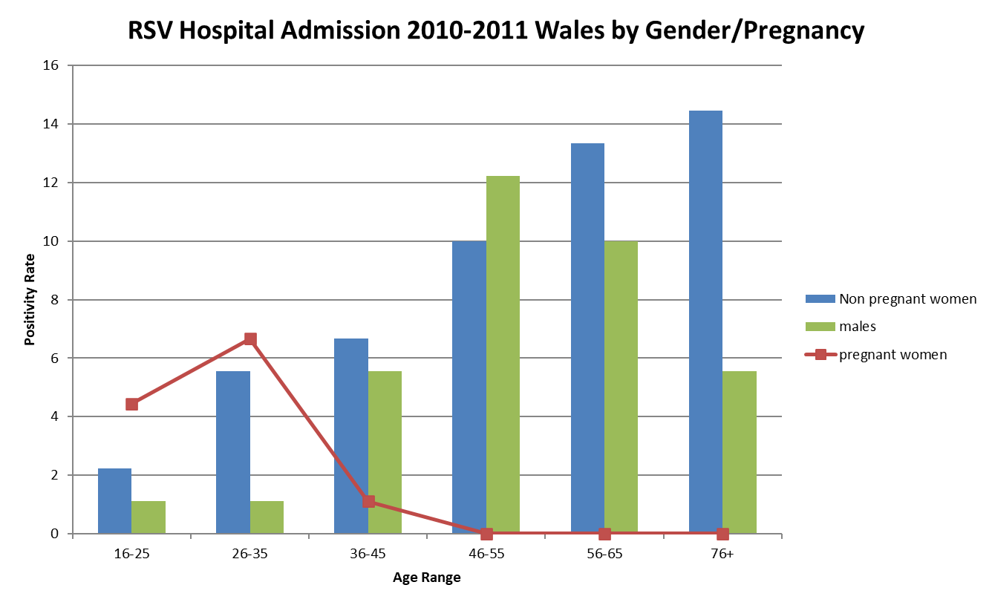
RSV – The Disease in Adults
RSV in older children and adults becomes part of the ‘common cold’ causing viruses
  Anecdotally adults with RSV describe the cold has being heavy and long lasting with prolonged post infection cough
Diseases like Bronchiolitis and bronchitis are can occur in adults, particularly in those who smoke or have chronic lung conditions
In the immunosuppressed, RSV is a significant cause of increased morbidity and mortality
  Treatment options are limited to ribavirin and immunoglobulins with little evidence of effectiveness
Increased awareness of adult RSV, has shown that in the elderly RSV is a significant cause of severe disease, often with insidious onset.
Generally, severe RSV disease is most common at the extremes of the age spectrum and in people with underlying conditions.

Slide 13
RSV epidemiology
Simon Cottrell-Scientific Lead/ Senior Principal Epidemiologist
Public Health Wales – CDSC Health Protection

Slide 14
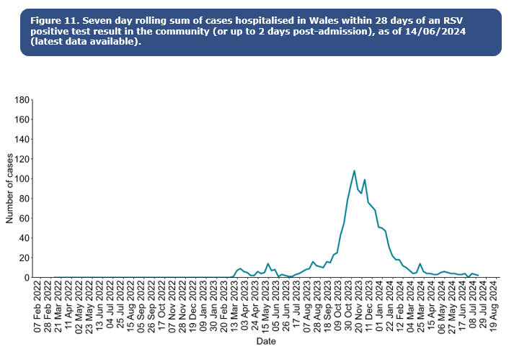
RSV epidemiology
Activity is higher in winter, with RSV season in the UK usually starting from October, peaking in December and declining by March
Whilst the occurrence of the mid-winter peak is often predictable, its size varies from year to year
Confirmed case burden is highest in children aged up to 5y. In Wales, there are more than 1,000 babies (<1y) in hospital with RSV annually
It is a leading cause of infant mortality globally, and results in 20 to 30 deaths per year in the UK
For further information on RSV in Wales please go to Public Health Wales Weekly Influenza & Acute Respiratory Infection Surveillance Report 10 (wales.nhs.uk)
Notes:
In recent years, the RSV season has been interrupted by control measures against the COVID-19 pandemic which has resulted in unseasonal RSV activity; this included significant rebound activity in summer 2021 and summer 2022 and a very prolonged period of virus activity in 2022.
RSV is a leading cause of infant mortality globally, resulting in 20 to 30 deaths per year in the UK. RSV-related mortality in low-income countries is considerably higher, and in some analyses is the second commonest cause of death (after malaria) in infancy.

Slide 15
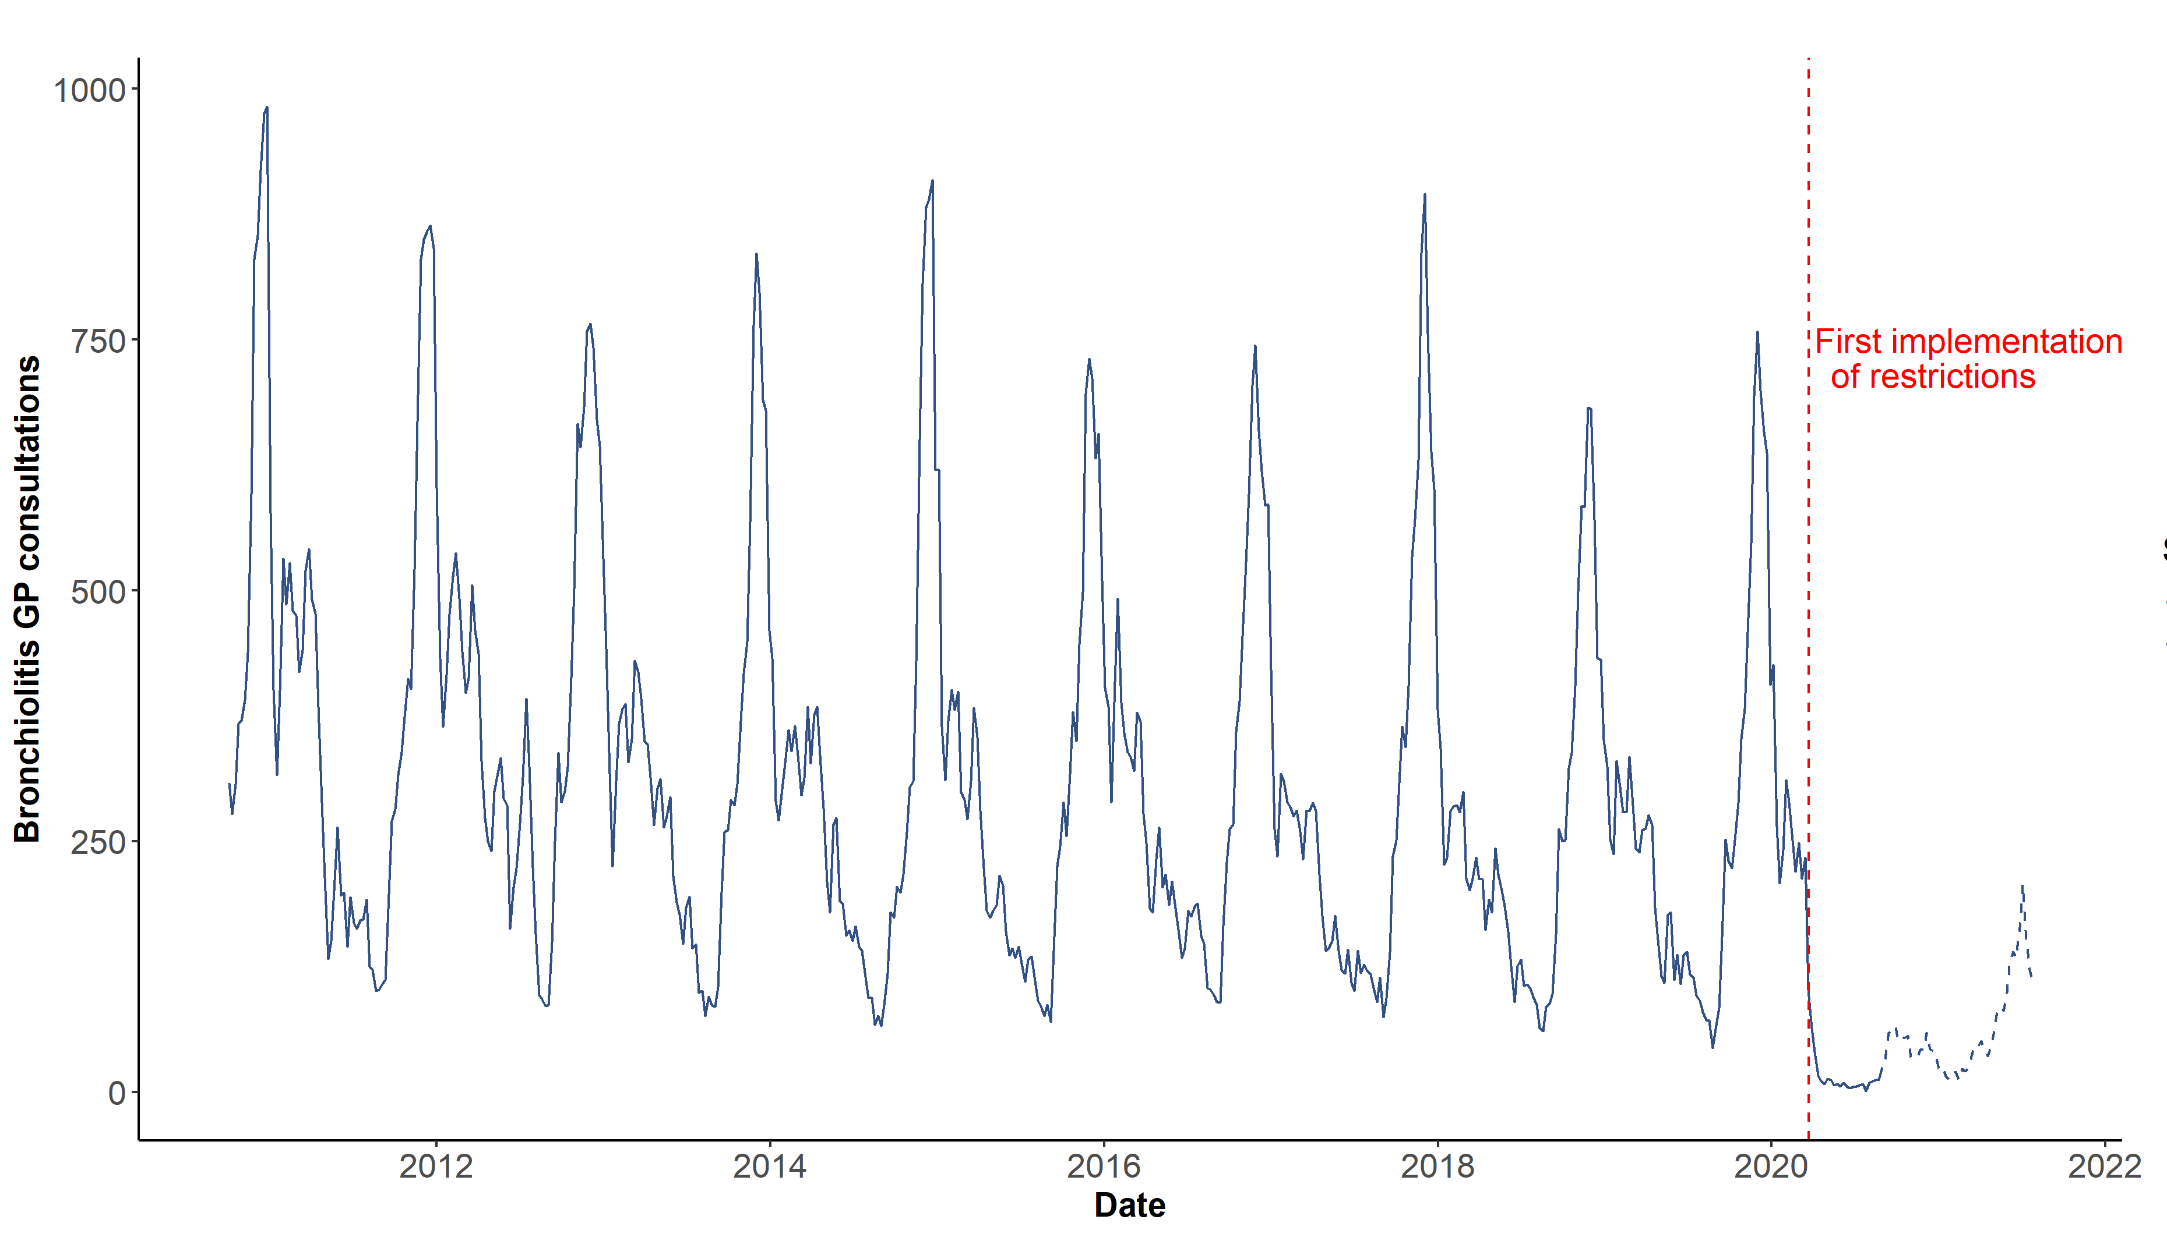
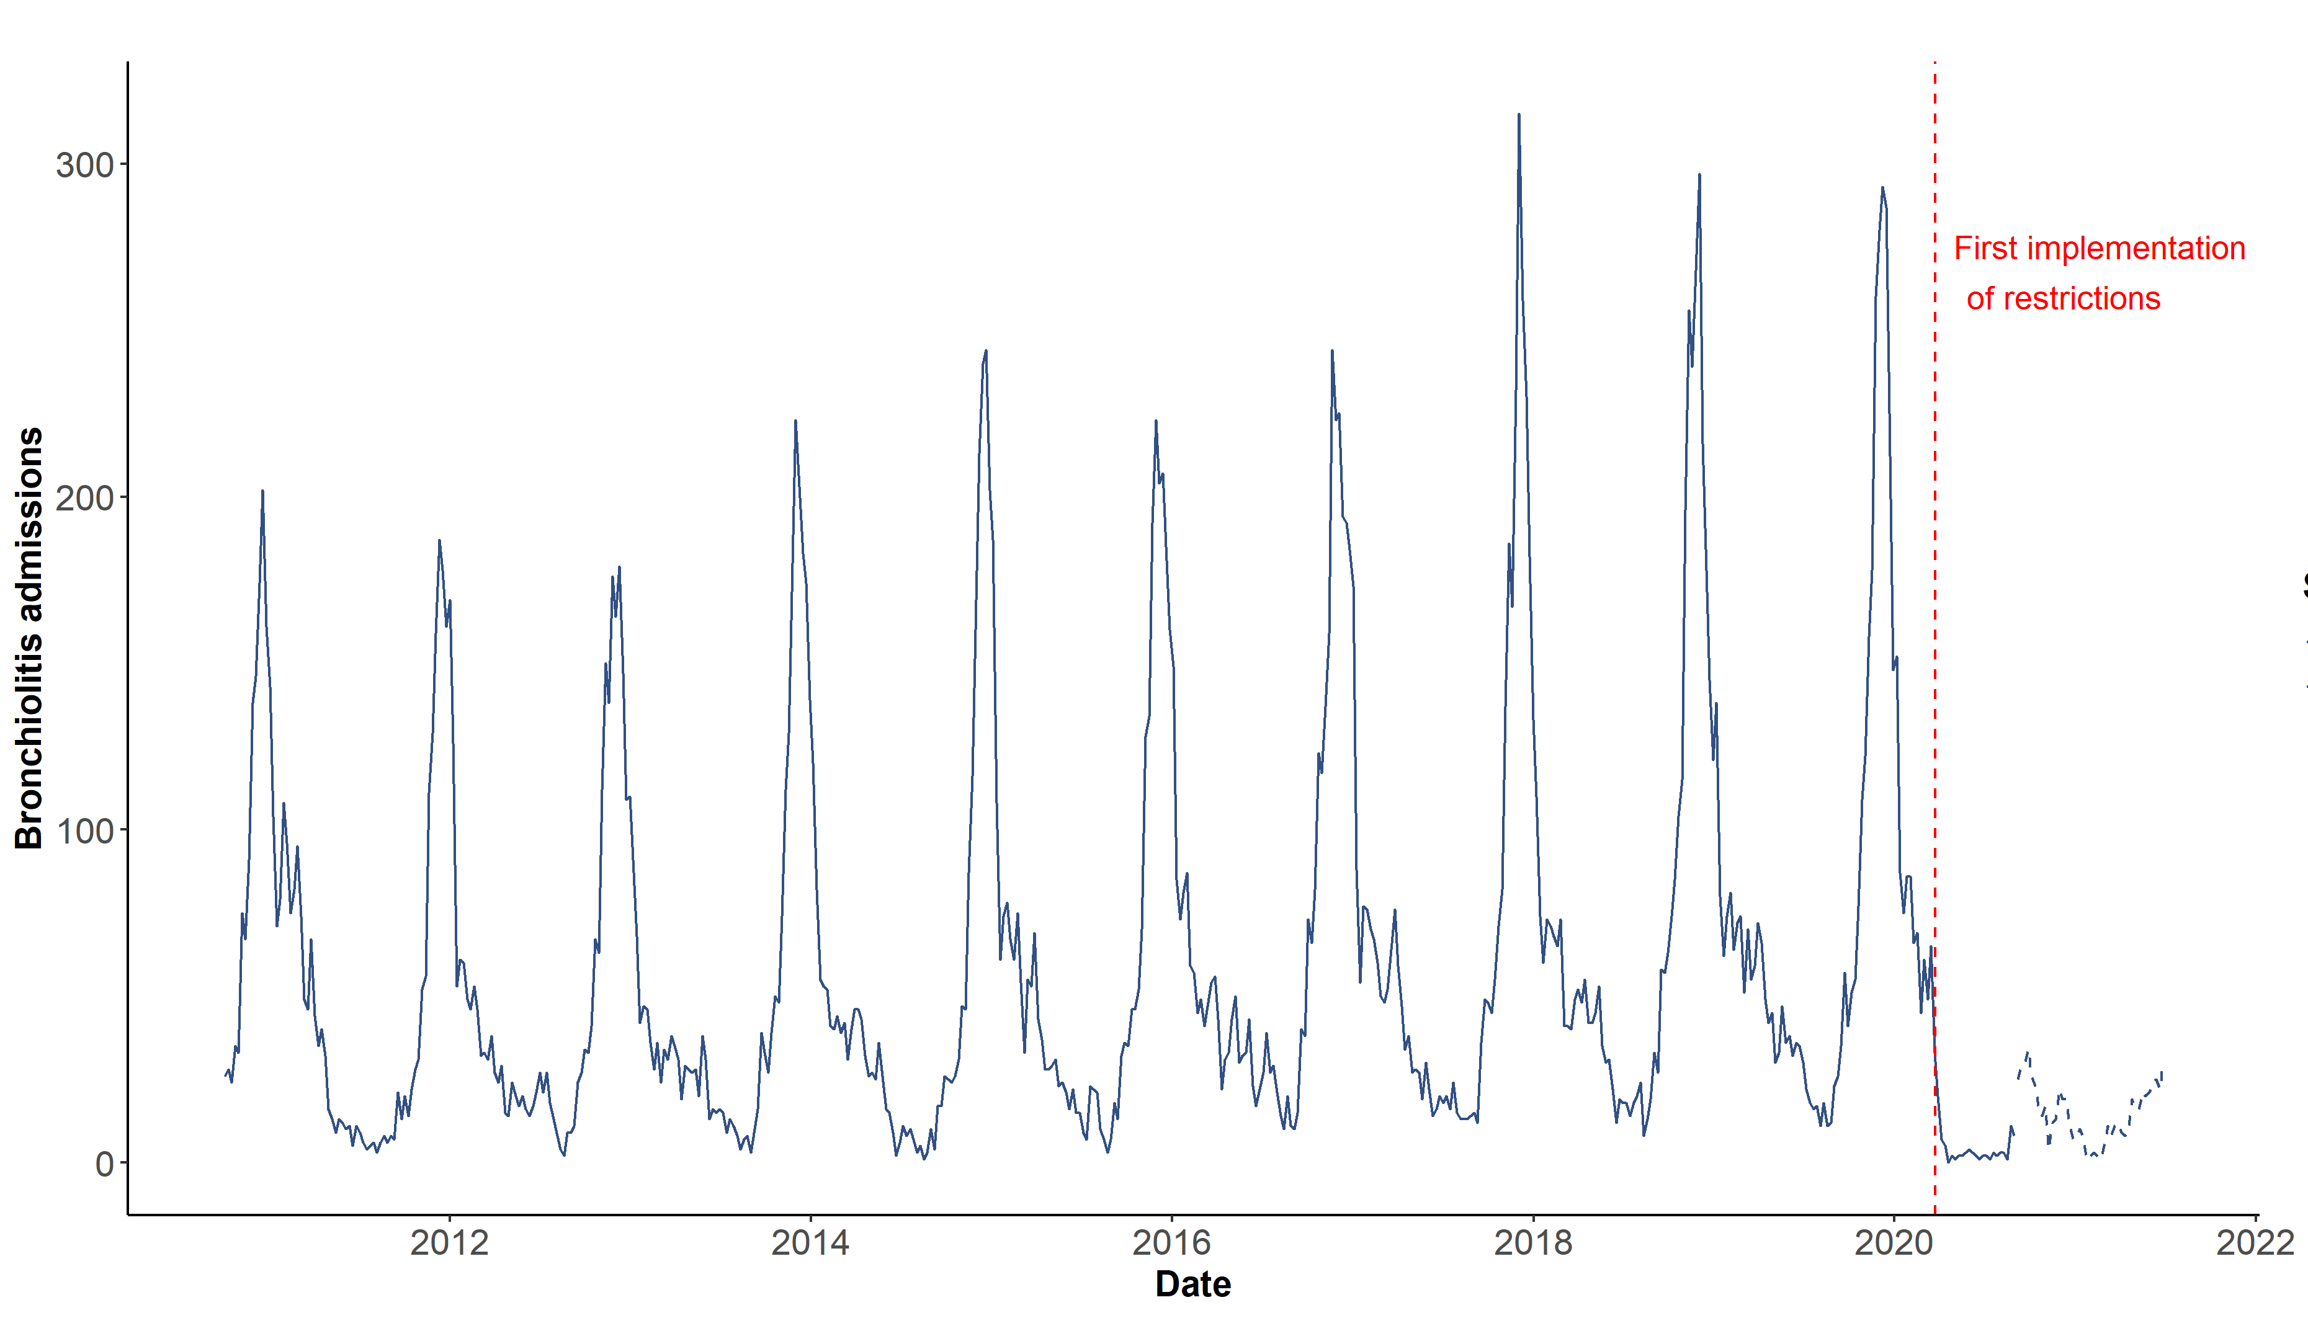
RSV burden in Wales (<5ys)
And the impact of COVID-19 restrictions on RSV seasonality
Bronchiolitis GP consultation trends in children aged under 5 years, October 2010- July 2021, Wales.
Bronchiolitis admission trends in children aged under 5 years, October 2010- June 2021, Wales
Data source: GP coded consultations accessed through Swansea University SAIL Databank
Data source: In-patient admissions from the national Patient Episode Database for Wales (PEDW), provided by DHCW
Reference: Harris (C). 2021. The impact of COVID-19 restrictions on Respiratory Syncytial Virus circulation in Wales, and the potential impact of the absence of RSV circulation in Wales during 2020. MPH Dissertation, Cardiff University
Public Health Wales
15
15
Notes:
This slide highlights the burden of RSV cases in milder community cases, and more severe cases being admitted in hospitals.
Both charts show the burden in children aged younger than 5 years from 2011 to 2020
The chart on the left shows weekly numbers of consultations with GPs in Wales for bronchiolitis, one of the characteristic presentations of RSV in children.
You can see that during RSV seasons, there are hundreds of children each week presenting to GPs with bronchiolitis
The chart on the right shows the weekly numbers of children who are admitted to hospital where RSV is recorded as reason for admission. Again, you can see that during the peak of the season, there are hundreds of children admitted to hospital with RSV each week.
In both charts, you can see that the regular pattern of seasonal epidemics was interrupted in 2020. This was likely because of the social and travel restrictions that were set in place during the first year of the COVID-19 pandemic, which reduced transmission of RSV in the community and resulted in some atypical RSV epidemics in the years that followed.

Slide 16
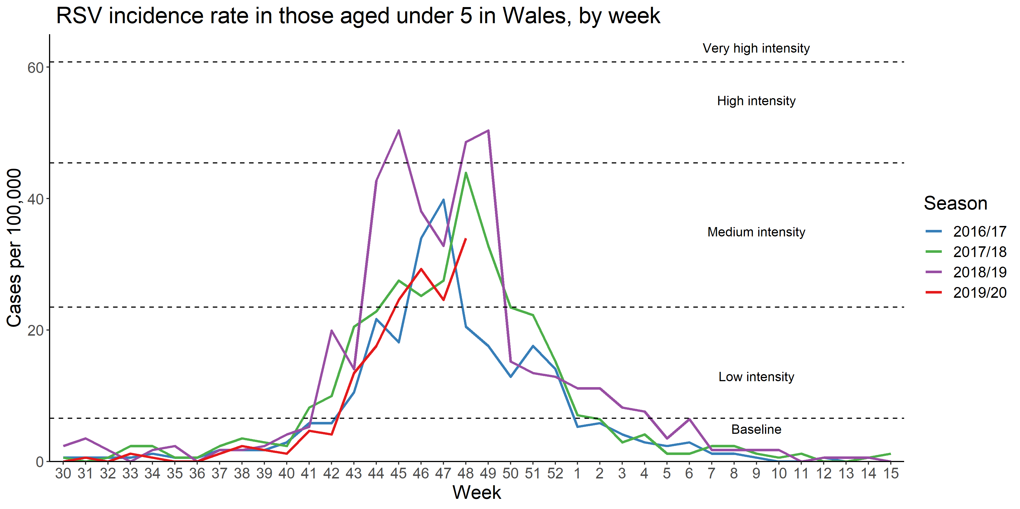
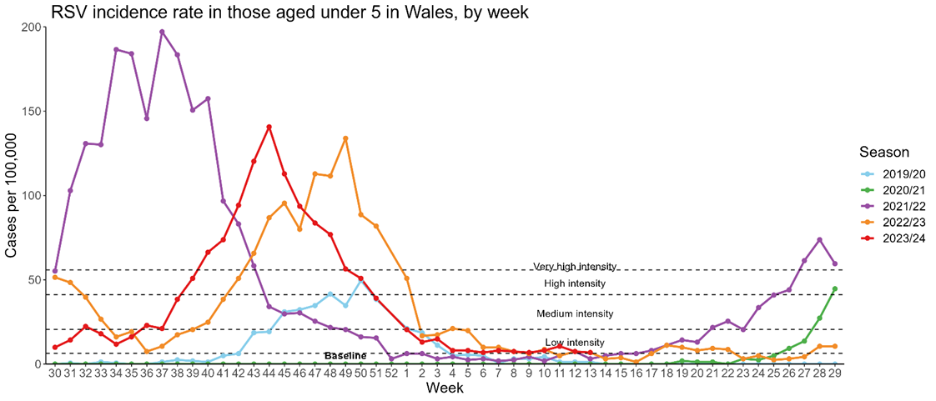
RSV seasonality pre and post 2020
2016 to 2020
2020 to 2024
Data source: All Wales routine virological testing data accessed through Public Health Wales Datastore database, RSV laboratory confirmation data for patients aged <5y
Public Health Wales
16
16
Notes:
This slide really highlights how atypical the RSV epidemics from 2020 to 2022 were in terms of timing and intensity.
The chart on the left shows the weekly incidence of confirmed RSV cases in the under 5’s from July to April and we have overlay the RSV epidemics from 2016 to 2019
You can see how consistent the start of each season was, usually beginning in early October, peaking before Christmas and back to baseline levels by the end of February
Epidemics in these years reached medium to high levels of intensity
The chart on the right shows similar information, but here we have overlayed the epidemics from 2019 to 2024.
The pale blue line is the 2019/20 epidemic, which was the last typical season before the COVID-19 pandemic.
The green line shows RSV incidence from July 2020 to June 2021, you can see that there were very low levels throughout 2020 and it was not until the spring of the following year that incidence began to increase.
The purple line shows incidence from July 2021 to June 2022, you can see the continuing increase in incidence from July to a peak in September and back to baseline levels by January. This epidemic was the longer than previous RSV epidemic.
Later in 2022, we saw activity again begin to increase from around April to a smaller peak in June 2022. This can be seen in the orange line in the chart.
This epidemic was followed almost immediately by another which began in June 2022, peaked around Christmas and was back to baseline levels by March 2023.
The red line on the chart is the 2023/24 RSV season, this is the most recent. It began earlier than historical RSV seasons and peaked slightly earlier too.
Although RSV seasons between 2020 and 2024 have moved around in terms of timing, there are signs that the seasonal pattern is moving back to the one we were familiar with before 2020.
The charts also show the significantly increased incidence of RSV since 2020. This may be explained by increased testing and changed testing patterns, but may also be in part due to the additional numbers of susceptible children who never experienced the virus during 2020.

Slide 17
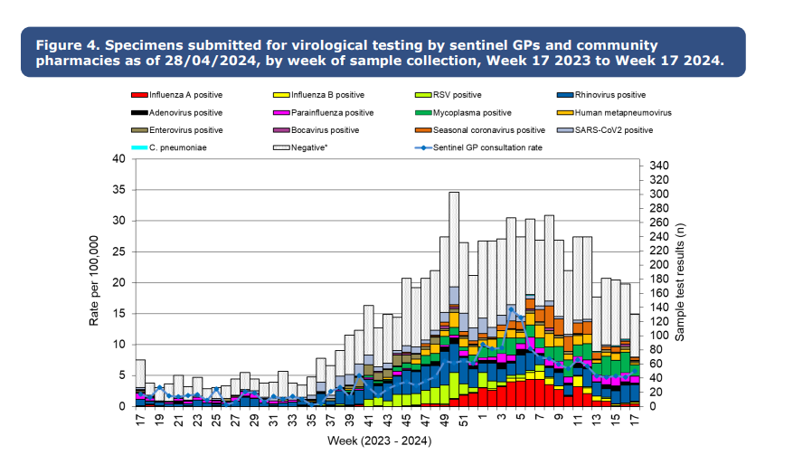
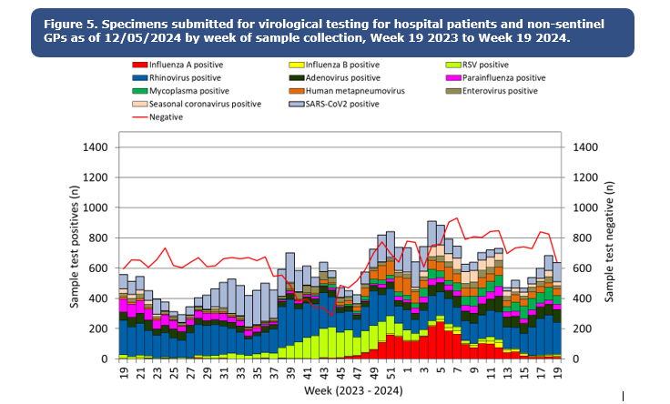
Respiratory Syncytial Virus (RSV)
RSV infection is a clearly identified seasonal virus usually occurring in the UK within the period October to March, often peaking by mid-December. During this time a number of other causes of seasonal respiratory infection also circulate (including influenza).
Source: Public Health Wales CDSC Weekly Influenza & Acute Respiratory Infection Surveillance Report
Weekly Influenza and Acute Respiratory Infection Report - Public Health Wales (nhs.wales)
Notes:
This slide summarises the causes of acute respiratory infections which we see during the winter months in the community and also in hospitals.
The chart on the left shows the test results from patients swabbed by sentinel GPs across Wales who presented with acute respiratory symptoms.
The chart on the right summarises similar information, but mainly for test results from patients attending or admitted to hospitals with respiratory symptoms.
RSV positive test results are shown in lime green. You can see that as RSV case numbers begin to increase, from week 40 (which is the start of October), other causes of respiratory infection also increase.
You can also see that the RSV season overlaps with the annual flu season. During December and January both of these viruses may be circulating and adding to pressures for primary care and hospitals.

Slide 18
RSV Burden of disease in Wales
Confirmed cases of RSV in Wales are highest in children. From 2015-2020 more than 50% of confirmed cases in children aged <5y each season were in infants aged 6 months or less
Testing patterns for RSV have changed in recent years, leading to increased ascertainment of cases and a higher median case age in children aged <5y
Data source: All Wales routine virological testing data accessed through Public Health Wales Datastore database, RSV laboratory confirmation data for patients aged <5y
Reference: Harris (C). 2021. The impact of COVID-19 restrictions on Respiratory Syncytial Virus circulation in Wales, and the potential impact of the absence of RSV circulation in Wales during 2020. MPH Dissertation, Cardiff University
Notes:
This information is from an analysis carried out by Caroline Harris in 2021, and describes the age distribution of RSV cases in children aged up to 5y.
The median age of cases in children from 2015-2019was around 5 to 6 months.
In 2021 this increased to 18 months of age, this may be related to changed testing patterns, but also the immune debt of children who did not experience RSV during 2020

Slide 19
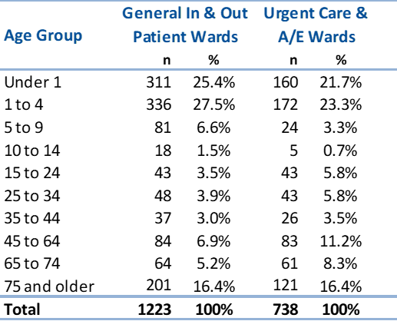
RSV Burden of disease in Wales
Patients testing positive for RSV in Wales, between 2021 week 40 and 2022 week 15, by hospital location and age group
After children aged <5y, adults aged 75y and older in Wales account for the highest number of confirmed RSV cases admitted to hospital¹
The risk of severe outcomes increases significantly in those aged 75y and older²
Data source: All Wales routine virological testing data accessed through Public Health Wales Datastore database
Notes:
There is also a notable burden of disease in older adults for RSV, although surveillance data are not as comprehensive and without testing it can be difficult to distinguish RSV symptoms from other causes of acute respiratory infection.
The table in this slide shows the proportion of RSV cases in hospital by age-group for the 2021/22 winter, and around 16% of cases were accounted for by patients aged 75y and older.
The burden and risk of severe outcomes of RSV in older adults is thought to be substantial. A 2022 meta-analyses of studies from developed countries estimated that 4.7% of all respiratory infection cases in adults aged 60y and older was due to RSV, of whom 24.5% were admitted to hospital, and the case-fatality proportion was 8.2%
1 Seasonal influenza in Wales 2021/22, Annual Report, 2021/22
2 Nguyen-Van-Tam JS, O'Leary M, Martin ET, Heijnen E, Callendret B, Fleischhackl R, Comeaux C, Tran TMP, Weber K. Burden of respiratory syncytial virus infection in older and high-risk adults: a systematic review and meta-analysis of the evidence from developed countries. Eur Respir Rev. 2022 Nov 15;31(166):220105. doi: 10.1183/16000617.0105-2022. PMID: 36384703; PMCID: PMC9724807. https://www.ncbi.nlm.nih.gov/pmc/articles/PMC9724807/

Slide 20
RSV vaccination of older adults programme
Ceriann Howard
Specialist Nurse Immunisation
VPDP, PHW

Slide 21
Routine vaccination programme for older adults and eligibility
The aim of the programme is to reduce the incidence and severity of RSV disease, and hospitalisation because of RSV disease, in eligible older adults.
From 1 September there will be a routine (year-round) programme
Older adult eligibility:
  individuals will become eligible on their 75th birthday and remain eligible until aged 79 years and 364 days (that is, up until and including the day before their 80th birthday)
  individuals will have been born on or after 1 September 1949
  individuals should be invited within 12 weeks of their 75th birthday
Notes:
The GB Respiratory syncytial virus: the green book, chapter 27a - GOV.UK (www.gov.uk) guidance says:
Clinically it is preferable to vaccinate as soon as possible after individuals become eligible, so they are protected at the earliest opportunity:
for those turning 75 years of age between March and October each year, the vaccine should ideally be given by the end of October before RSV activity increases and
soon after turning 75 if their birthday falls during the RSV season (November to February)

Slide 22
Catch-up campaign
There will be a catch-up campaign for those already aged 75 to 79 (but not yet 80) on 1 September 2024:
    individuals who are aged 79 years on 1 September will have their 80th birthday within the first year after the catch-up campaign commences (date of birth range 2 September 1944 to 31 August 1945 inclusive) but they remain eligible up until and including 31 August 2025 to ensure that they have sufficient opportunity to be vaccinated
    other eligible individuals (date of birth range 1 September 1945 to 31 August 1949) are eligible until and including the day before their 80th birthday
    The formal launch of the one-off campaign for those aged 75 to 79 begins in February 2025. There is operational flexibility to start from 1 September 2024, if there is capacity or vaccination is requested by eligible persons and can be accommodated. The one-off campaign will run for 12 months from the start of the programme, therefore starting from 1 September 2024 and concluding by 31 August 2025.
    https://www.gov.wales/sites/default/files/pdf-versions/2024/6/3/1719394081/introduction-rsv-vaccination-programme-2024-whc2024032.pdf
Notes:
Operational flexibility is provided for the start date of the one-off campaign for older adults in recognition of the pace
at which we are standing up the RSV programme this autumn and that there will be other pressures on services at this time. The RSV programme must not disrupt the delivery of the winter respiratory vaccination programme 2024 to
2025.

Slide 23
Eligibility table
Individuals age on 1 September 2024 | When should individuals have the RSV vaccine | How long are they eligible for?
74 | On or after their 75th birthday | Until their 80th birthday
75 - 78 | Between 1 September 2024 and 31 August 2025ˆˆ | Until their 80th birthday
79ˆ | Between 1 September 2024 and 31 August 2025ˆˆ | Until the 31 August 2025
ˆ Those turning 80 years of age between 2 September 2024 and 31 August 2025 will remain eligible up to and including 31 August 2025 (for the first year of the programme).
ˆˆ There is operational flexibility to start from 1 September 2024, if there is capacity or vaccination is requested by eligible persons and can be accommodated.

Slide 24
Administering Abrysvo® at the same time as seasonal influenza vaccine
There is some data which shows that in older adults administering Abrysvo® at the same time as seasonal influenza vaccine may reduce the immune response to the RSV vaccine
There is also data that suggests that the response to the influenza A(H3N2) component of seasonal influenza vaccine (the influenza subtype which most severely affects older adults) may be diminished when RSV and seasonal influenza vaccine are co-administered to older adults
The clinical significance of any reduced response is unknown, but influenza immune response is known to correlate with protection against infection, and there is emerging data that RSV immune response also correlates with clinical protection
It is therefore recommended that these vaccines are not routinely scheduled to be given at the same appointment or on the same day
No specific interval is required between administering the vaccines
However, if it is thought that the individual is unlikely to return for a second appointment or immediate protection is necessary, Abrysvo® can be administered at the same time as the influenza vaccine
Notes:
It is therefore recommended that these vaccines should not routinely be scheduled to be given at the same appointment or on the same day. No specific interval is required between administering the vaccines.
If it is thought that the individual is unlikely to return for a second appointment or immediate protection is necessary, Abrysvo® can be administered at the same time as the influenza vaccine.

Slide 25
Administering Abrysvo® at the same time as COVID-19 vaccine
There is also data in older adults which shows co-administration with of COVID 19 vaccination and RSV vaccination may reduce the immune response to the RSV vaccine
The clinical significance of any reduced response is unknown,
It is therefore recommended that these vaccines should not routinely be scheduled to be given at the same appointment or on the same day
No specific interval is required between administering the vaccines
However, if it is thought that the individual is unlikely to return for a second appointment or immediate protection is necessary, Abrysvo® can be administered at the same time as the COVID 19 vaccine
As we get older, we all experience age related reduction in immune response to vaccination, this is a natural part of ageing and is called immunosenescence
Notes:
It is therefore recommended that these vaccines should not routinely be scheduled to be given at the same appointment or on the same day. No specific interval is required between administering the vaccines.
If it is thought that the individual is unlikely to return for a second appointment or immediate protection is necessary, Abrysvo® can be administered at the same time as the influenza vaccine.

Slide 26
Administering Abrysvo® at the same time as other vaccines
Co-administration with pneumococcal, Shingrix® (shingles) and other inactivated or non-live vaccines
  in line with general advice about co-administration of inactivated and non-live vaccines, Abrysvo® can be safely given concomitantly with pneumococcal and/or the Shingrix shingles vaccines
  Abrysvo® can be given at any interval before or after these vaccines or other inactivated or non-live vaccines
Co-administration with a live vaccine
  although live vaccines are not commonly indicated in older adults, Abrysvo® is an inactivated or non-live vaccine so can be given at the same time as any live vaccines

Slide 27
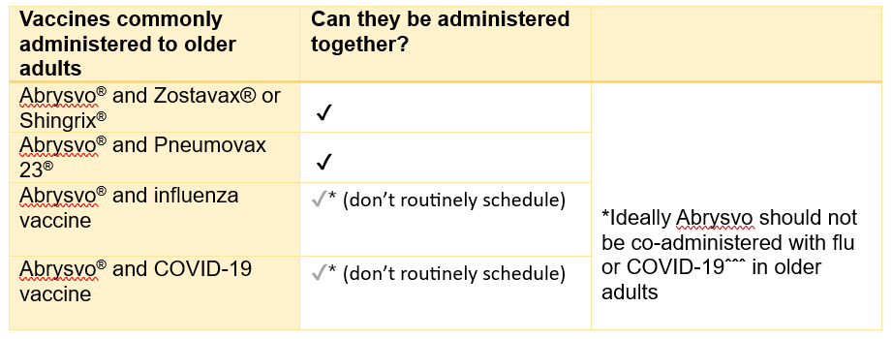
Co-administration:
®
ˆˆˆ Giving Abrysvo® with the seasonal influenza vaccine may reduce the immune response to both the RSV and influenza (H3N2) components, which may increase the risk of severe respiratory disease in older adults. Additionally, co-administering the COVID-19 vaccine may diminish the immune response to the RSV vaccine. However, if it is thought that the individual is unlikely to return for their influenza or COVID-19 vaccine, they can be given at the same time.

Slide 28
RSV vaccination of pregnant women for infant protection
Kate Lloyd
Specialist Nurse Immunisation
VPDP, PHW

Slide 29
Routine vaccination programme for pregnant women and eligibility
The purpose of the RSV vaccination of pregnant women programme is to boost immunity in women during pregnancy so RSV antibodies are passed from mother to baby to passively protect infants in the first months of life
Most women will have had RSV, but infection does not give them good immunity to pass on to their baby in the womb
If the woman is given an RSV vaccine from week 28 of pregnancy, the vaccine will temporarily boost their antibody to high levels
This enables the mother to transfer a high level of RSV antibodies across the placenta to their unborn child which should passively protect the infant against RSV disease until at least 6 months of age
This will be a year-round programme and all women should be offered an RSV vaccine in every pregnancy
Vaccination should be offered from 28 weeks' gestation (ideally in week 28 or soon after), however women may be offered vaccination up until delivery
It is clinically reasonable for women who present in labour and have not received the RSV vaccine during pregnancy to be offered the vaccine up until discharge from maternity services. This will not offer passive protection to the baby through transplacental antibody transfer but may protect the mother from contracting RSV, thus reducing the chance of transmission to the infant, and may help increase levels of antibodies in breast milk. Though neither of these is expected to be as protective a transplacental antibody transfer from vaccination earlier in pregnancy

Slide 30
How the vaccine works to protect the infant
When a pregnant woman is given RSV vaccine, her immune system recognises the proteins in the vaccine as being foreign and makes antibodies against them
These antibodies pass across the placenta and provide the baby with protection against RSV during their first few months of life
In the trial, Abrysvo® was shown to be effective at preventing lower respiratory tract disease caused by RSV in infants born to vaccinated mothers for at least the first 6 months of life and beyond
For the best protection, Abrysvo® is recommended for pregnant women in week 28 or soon after. This gives enough time for the mother to make antibodies and for these to cross the placenta, to help protect the baby, even if born early
RSV vaccine can be offered to pregnant women up until delivery, but this may not offer as high a level of passive protection to the baby

Slide 31
When Abrysvo® should be given
From 1st September 2024:
The routine programme will offer vaccination to all pregnant women at 28 weeks gestation, to protect infants.
A catch-up programme must be undertaken for women past 28 weeks gestation up to discharge from midwifery services. The vaccine should be offered at or near their next antenatal appointment.
Abrysvo® is licensed between week 28 and week 36 gestation but can be given ‘off-label’ up until delivery
Pregnant women will remain eligible until discharge from maternity services and should be actively offered vaccination at each opportunity – This recommendation has been agreed in Wales via the Vaccine Clinical Advisory Group (VCAG) – VPW
Women who have not yet received it should still be vaccinated later in pregnancy:
  vaccination late in pregnancy may not provide optimal protection to the infant as there may be insufficient time for the mother to make a good response and have antibodies to pass across the placenta
  however, data show that most women who gave birth within two weeks of vaccination still passed on protective antibodies to their babies
  late vaccination may also protect the mother from RSV infection and reduce the risk of her becoming a source of infection to their infant, and may help pass on some antibodies through breast milk
31
Notes:
Please note: Abrysvo® is licensed to be given up to 36 weeks gestation (this was based on the gestational ages included in the clinical trials). Pregnant women who have not received the RSV vaccine before 36 weeks remain eligible until delivery, and under the PGD the vaccine can be given off label in these circumstances.

Slide 32
Abrysvo® vaccine given before 28 weeks gestation
Before week 28
The vaccine should not routinely be given before week 28 of pregnancy. Where a consultant obstetrician or similar specialist considers that there is a compelling clinical reason for early immunisation the vaccine could be prescribed off-label and the rationale documented
Vaccine inadvertently given before 28 weeks’ gestation
If the dose was inadvertently given prior to 16 weeks of pregnancy, the dose should be repeated to maximise the volume of antibodies generated by the mother transferring across the placenta to the unborn baby. If a repeat dose is required, it should be given from 28 weeks of pregnancy
If the woman is more than 16 weeks pregnant when she receives the vaccine, this will be counted as a valid dose and does not need to be repeated as vaccination from this stage would be expected to generate an antibody response that will transfer across the placenta to protect the infant
RSV vaccination of pregnant women for infant protection: information for healthcare practitioners - GOV.UK (www.gov.uk)

Slide 33
Women with current or previous history of RSV
Although it might be expected that a woman diagnosed with RSV infection during pregnancy would transfer some antibodies to her unborn baby, there is no assurance that the levels would be high enough to sufficiently protect the infant
As high levels of antibodies are made following vaccination, offering vaccine in week 28 of pregnancy or as soon as possible after that should ensure that optimal antibody levels can be passed to the baby
Vaccination of women who may be infected or asymptomatic or incubating RSV infection is unlikely to have a detrimental effect on the illness but women currently experiencing symptoms of RSV disease should not attend for vaccination if they are acutely unwell with a fever

Slide 34
Co-administration of Abrysvo® in pregnancy
Vaccine/ medication given in pregnancy | Can they be administered together?
Abrysvo® and anti-D immunoglobulin | Yes
Abrysvo® and pertussis containing vaccine | Yes* (pertussis is offered from 16 weeks)
Abrysvo® and seasonal influenza vaccine | Yes (Influenza can be given at any stage of pregnancy)
Abrysvo® and seasonal COVID-19 vaccine | Yes (COVID-19 can be given at any stage of pregnancy)
*Pertussis-containing vaccine
Some evidence suggests that coadministration of RSV and pertussis containing vaccines may reduce the response made to pertussis components. The clinical significance of this is unclear and any impact on protection is likely to be small; the key pertussis toxoid component is least affected
Giving the vaccines separately at the usual scheduled times ( from 16 weeks gestation for pertussis and from 28 weeks' gestation for RSV) will avoid any potential attenuation (weakening) of antibody response to the pertussis containing vaccine
If a woman has not received a pertussis containing vaccine by the time she presents for an RSV vaccine, they can and should both be given at the same appointment to provide timely protection against both infections to the infant and to avoid the risk of the woman not returning for a later appointment

Slide 35
RSV monoclonal antibody for high-risk infants - Selective programme
It is not possible to vaccinate newborn babies to protect them against RSV during the early months of life – the immature immune system is not able to make a good response. Instead, passive immunisation can be used
An RSV monoclonal antibody passive immunisation programme for eligible high-risk infants has been delivered in secondary care by paediatric services since the JCVI recommended it in 2010
This selective immunisation programme will continue, and high-risk infants will remain eligible for monoclonal antibody immunisation in addition to all pregnant women being eligible for RSV vaccination during every pregnancy
High-risk infants and children who meet the eligibility criteria in the high-risk section of the Green Book RSV chapter should be offered a monoclonal antibody immunisation regardless of whether or not their mothers received RSV vaccine in pregnancy
Monoclonal antibody for high-risk infants is a different product to the vaccine offered to pregnant women and older adults
Further information on monoclonal antibodies and the high-risk infant programme can be found in the Green Book RSV chapter

Slide 36
Ordering Considerations
Abrysvo® vaccine
Rhys Oats
Vaccine Supply and Logistics Lead
Vaccine Programme Wales

Slide 37
Storage Considerations
Abrysvo® vaccine
Store vaccines in a validated fridge specifically designed for pharmaceutical products. Do not use a domestic fridge
Maintain the temperature between +2 and + 8⁰C. Keep the vaccine fridge secure. It should only be accessible to authorised practice staff. Therefore, keep it locked or in a locked room.
Good practice is to have a data logger in the fridge to monitor internal temperatures.
Reduce the possibility of accidentally interrupting the electricity supply. For example, install a switchless socket or clearly label the plug with a cautionary notice: ’Do not unplug/switch off’.
Use a large enough fridge to allow enough space around the vaccine packages for air to circulate.
Vaccines should be ordered, stored and monitored as described in the Green Book Chapter 3 (Storage, distribution and disposal of vaccines).
The advisory document for the ordering, storage and handling of vaccines has been updated, the updated edition will be available to view here

Slide 38
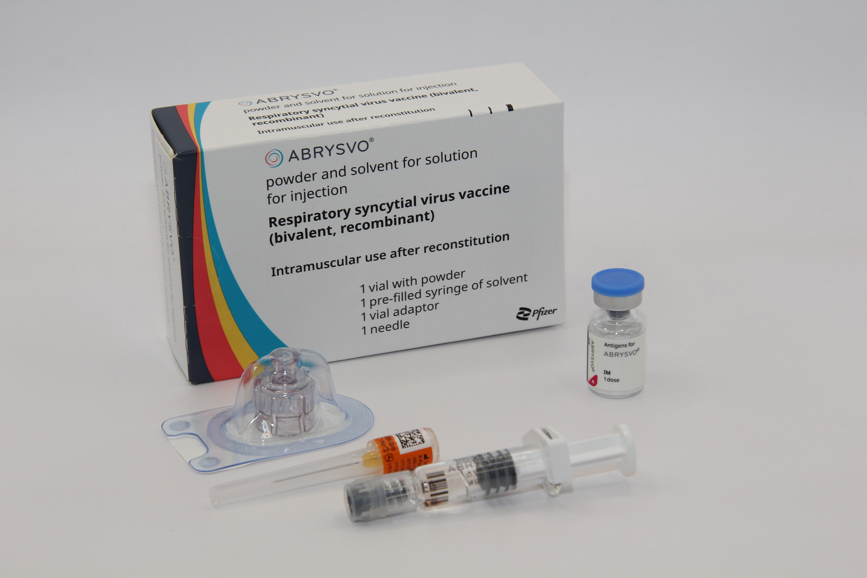
Ordering Considerations
Abrysvo® vaccine
Considerations when ordering Abrysvo®
Abrysvo® stocks should be monitored by the named staff members to avoid over-ordering or stockpiling.
Current expiry and quantity of Abrysvo® should be checked before ordering.
Only order stock sufficient for two weeks worth of clinics.
One pack contains one vial of vaccine, diluent for reconstitution and patient information leaflet (PIL). Each pack will also contain one 25 G x 25 mm (1") needle.
Ensure the correct Abrysvo® is ordered for the required cohort (Eg maternal vaccine for infant or for older adult protection).
The pack of Abrysvo® vaccine is physically larger than most other vaccines supplied via ImmForm. Each single dose pack measures 73mm x 35mm x 116mm (H x W x D). Please ensure you have enough fridge capacity before placing large orders.

Slide 39
Abrysvo® RSV vaccine
Clare Powell
Specialist Nurse Immunisation
Training lead
VPDP, PHW

Slide 40
Abrysvo® vaccine: pharmaceutical information
Abrysvo® was licensed in the UK in November 2023 by the Medicines and Healthcare products Regulatory Agency (MHRA) on the basis of quality, safety and efficacy following clinical trials in over 17,000 adults over the age of 60 and over 4,000 pregnant women
Abrysvo® is the recommended vaccine for RSV vaccination of older adults and pregnant women for infant protection and is the only vaccine currently available for use within the national programme in the UK
It is a non-live, bivalent recombinant vaccine
As it does not contain any live organisms, it cannot cause the disease against which it protects and can be given to immunosuppressed individuals
Abrysvo® requires reconstitution prior to administration
The full volume (0.5 mL) of the reconstituted vaccine should be administered
  Abrysvo® is licensed for active immunisation of individuals 60 years of age and older for the prevention of lower respiratory tract disease caused by RSV and passive protection against lower respiratory tract disease caused RSV in infants from birth through 6 months of age following maternal immunisation during pregnancy
  Infants born to women who have received Abrysvo® can be safely breastfed
Abrysvo powder and solvent for solution for injection - Summary of Product Characteristics (SmPC) - (emc) (medicines.org.uk)

Slide 41
Abrysvo® vaccine: effectiveness in older adults
Abrysvo® was licensed in the UK by the MHRA in November 2023 on the basis of safety and efficacy following a clinical trial of over 17,000 immunocompetent adults aged 60 years and above, 52% of whom had at least one stable chronic underlying condition
At the end of the first RSV season, analysis demonstrated statistically significant vaccine efficacy (VE) for Abrysvo® for reduction of RSV-associated lower respiratory tract illness with 2 or more symptoms of 65.1% and 3 or more symptoms of 88.9%
In the second season, the efficacy against 2 or more symptoms was 55.7% and against 3 or more symptoms was 77.8%.
Abrysvo® is licensed for use in Europe, the USA and in many other parts of the world. Over 3 million doses were administered to adults in the USA during winter 2023 to 2024
Healthcare professionals are asked to report all suspected adverse reactions via the Yellow Card Scheme at: www.mhra.gov.uk/yellowcard
There is currently no data to support second doses in older adults
Notes:
Source: Abrysvo powder and solvent for solution for injection - Summary of Product Characteristics (SmPC) - (emc) (medicines.org.uk)
The Green Book, Chapter 27A (https://www.gov.uk/government/publications/respiratory-syncytial-virus-the-green-book-chapter-27a) contains the following information regarding vaccine effectiveness in older adults:
For older adults, the pivotal phase 3, multi-country, randomised, double-blind, placebo-controlled trial recruited from the age of 60 years to assess Abrysvo’s efficacy against RSV lower respiratory tract infection (LRTI) with 2+ or 3+ symptoms (Walsh et al., 2023). Participants were randomised to receive vaccine (n=18,488) or placebo (n=18,479), stratified by ages 60-69 years (63%), 70-79 years (32%) and ≥80 years (5%). Stable chronic underlying conditions were present in 52% of participants; immunocompromised individuals were excluded. At the end of the first RSV season VE against RSV LRTI with ≥2 symptoms was 65.1% (95%CI: 35.9 to 82.0%) and with ≥3 symptoms 88.9%, (95%CI: 53.6 to 98.7%) (Pfizer 2024). VE estimates by RSV subtype have overlapping confidence intervals (Walsh et al., 2023). In the second season, VE was 77.8% against lower respiratory tract infection (LRTI )with 3+ symptoms (95%CI: 51.4 to 91.1%) and 55.7% (95%CI: 34.7 to 70.4%) against 2+ symptoms (Pfizer 2024).

Slide 42
Abrysvo® vaccine: effectiveness in pregnant women for infant protection
Abrysvo® was licensed in the UK in November 2023 following clinical trials which showed it to be safe and effective. It is currently the only RSV vaccine licensed for use in pregnancy
Abrysvo® has been licensed for use as a maternal vaccination in the United States since August 2023
It has also been licensed for use in several European countries, Canada, Australia, Argentina and Japan
In trials, Abrysvo® was shown to be 70% effective at preventing severe lower respiratory tract disease caused by RSV in infants born to vaccinated mothers for at least the first 6 months of life (which is the period of time when infants are most vulnerable to severe RSV infection)
Healthcare professionals are asked to report all suspected adverse reactions via the Yellow Card Scheme at: www.mhra.gov.uk/yellowcard​
Notes:
Source: Abrysvo powder and solvent for solution for injection - Summary of Product Characteristics (SmPC) - (emc) (medicines.org.uk)
Source: Bivalent Prefusion F Vaccine in Pregnancy to Prevent RSV Illness in Infants | New England Journal of Medicine (nejm.org)
The Green Book, Chapter 27A (https://www.gov.uk/government/publications/respiratory-syncytial-virus-the-green-book-chapter-27a) contains the following information regarding vaccine effectiveness following maternal vaccination:
Maternal (antenatal) vaccination has been demonstrated to be efficacious against RSV LRTI in infants from birth through 6 months of age (Kampmann et al., 2023). The pivotal phase 3, multi-country, randomised, double-blind, placebo-controlled trial assessed the prevention of RSV LRTI and severe RSV LRTI (co-primary efficacy endpoints) in infants born to pregnant women vaccinated between weeks 24 and 36 of gestation. Vaccine was administered to 3,695 pregnant women with uncomplicated, singleton pregnancies; 3,697 received placebo. In the final analysis, VE against severe RSV LRTI was 82.4% (95%CI: 57.5 to 93.9%) at 90 days and 70.0% (95%CI: 50.6 to 82.5%) at 180 days. VE against RSV LRTI was 57.6% (95%CI: 31.1 to 74.6%) at 90 days and 49.2% (95%CI: 31.4 to 62.8%) at 180 days (Munjal et al., 2024). VE estimates by RSV subtype have overlapping confidence intervals. There is some data showing high levels of antibody transfer to the infant even in infants born within two weeks of immunisation.

Slide 43
Abrysvo® vaccine safety in pregnant women
There were slightly more premature births in the vaccine group compared to the unvaccinated group (2.1% in the vaccine group and 1.9% in the placebo group in the month following vaccination), but this was not statistically significant and there was no temporal relationship between vaccination and premature birth. Average birth weight and average gestational age at birth was the same in infants of vaccinated and unvaccinated mothers
There was no mortality signals associated with prematurity, and the overall number of deaths by 24 months of age was 5 in the vaccination arm and 12 in the placebo arm. There are no safety concerns around congenital anomalies, which were less common in the vaccine arm than the placebo group. JCVI has advised that it is reassured that the safety data for Abrysvo ® vaccine does not raise significant concerns, and the vaccine is approved by the MHRA on the basis of safety, quality and effectiveness
The RSV vaccine is a non-live vaccine (may be referred to as inactivated). It does not contain any live organisms, cannot replicate and therefore cannot cause infection in either the mother or the fetus
As of July 2024, Abrysvo® has been given to more than 100,000 pregnant women in the USA where monitoring has shown a good safety record
RSV Green Book Chapter (27a)

Slide 44
Abrysvo® Vaccine safety in older adults
A small number of cases of Guillain-Barré syndrome (GBS) have been reported in older adults following vaccination with Abrysvo® in the trials and in post-marketing surveillance in the USA. GBS is a rare and serious condition that affects the nerves. It mainly affects the feet, hands and limbs, causing problems such as numbness, weakness and pain. In severe cases, GBS can cause difficulty moving, walking, breathing and/ or swallowing. GBS is most common following infection, including campylobacter and influenza
Around 5 cases of GBS were reported for every million doses of Abrysvo® given to recipients in the USA (against a background rate of 0.5 per million people vaccinated with vaccines considered not to have association with GBS)

Slide 45
Abrysvo® Vaccine safety
Overall, the benefits of RSV protection in the eligible groups are highly favorable relative to the risks of serious adverse reactions
Healthcare professionals should be alert to the signs and symptoms of GBS, to ensure correct diagnosis in order to initiate adequate supportive care and treatment and to rule out other causes
Individuals with a history of GBS should be vaccinated if they are in an eligible group. There is evidence from other vaccines to suggest that having had a prior diagnosis of GBS does not predispose an individual to further episodes of GBS following immunisation
Cases of GBS that occur following vaccination may occur by chance (the background rate of GBS is 20 per million per year in the population)
45

Slide 46
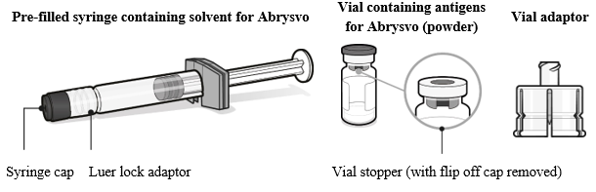
Preparing the Abrysvo® vaccine
Abrysvo® vaccine must be reconstituted prior to administration by adding the entire contents of the pre-filled syringe of solvent to the vial containing the powder using the vial adaptor
the vaccine must be reconstituted only with the solvent provided
Clear instructions on how to prepare the vaccine for administration can be found in the SmPC and the manufacturer's video. Immunisers are strongly encouraged to watch the video in its entirety before preparing the vaccine for the first time
Image from Abrysvo® vaccine SPC
More detailed information about the preparation, reconstitution and administration of Abrysvo® vaccine can be found in the RSV training slides which are available to view here: Immunisation training resources and events - Public Health Wales (nhs.wales)
Abrysvo powder and solvent for solution for injection - Summary of Product Characteristics (SmPC) - (emc) (medicines.org.uk)

Slide 47
Adverse reactions following vaccination in older adults
Some people can feel unwell following an injection and some people may experience an adverse reaction.
Vaccinees should be informed of the potential expected reactions to Abrysvo®
Adverse reactions reported by Abrysvo® clinical trial participants were the expected side-effects commonly reported after any vaccination, reflecting the initiation of the inflammatory and immune responses that lead to vaccine-induced protection against disease
For individuals aged 60 years and above, only vaccination site pain was very commonly reported (reported by 11% of those who received the vaccine in clinical trials)
Commonly reported reactions (affecting more than 1 in 100 but not as many as 1 in 10 of those receiving the vaccine) were vaccination site redness and swelling
Although headache and myalgia were commonly reported adverse reactions from the clinical trial of younger adults (aged 49 years or below), these were not reported by the 60 years and above age group

Slide 48
Adverse reactions following vaccination in pregnant women
Pregnant women should be informed of the most frequently reported potential reactions to Abrysvo® which are:
injection site pain (41%)
headache (31%)
myalgia (27%)
(figure in brackets is percentage of recipients who reported reaction in clinical trials)
For pregnant women, the majority of local and systemic reactions are mild in severity and resolve within a few days of onset

Slide 49
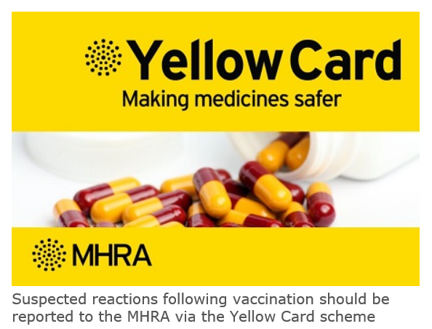
Reporting adverse reactions
Abrysvo® is a newly licensed vaccine in the UK and is subject to additional monitoring under the black triangle labelling scheme by the MHRA. This means that all suspected adverse reactions following administration should be reported to the MHRA using their Yellow CARD reporting scheme at Yellow Card | Making medicines and medical devices safer (mhra.gov.uk).
Vaccines are carefully monitored to ensure they are safe, not causing untoward side effects and are suitable for the immunisation programme
MHRA promotes the collection and investigation of adverse reactions through the Yellow Card scheme which is a voluntary reporting system for suspected adverse reactions
Anyone (vaccine recipients and healthcare practitioners) can make a Yellow Card report, even if they are uncertain as to whether a vaccine caused the condition

Slide 50
The process of recording
Abrysvo® vaccines given
Katie Rees - Principal Support & Business Analyst (DHCW - PCMH Digital)

Slide 51
DHCW RSV Update
Overview: we are adding in functionality to allow the recording, payment and reporting of the new RSV vaccination for 1st September.
WIS Software Changes: updating the consultation form in the current WIS-web application to allow input of an RSV vaccination. This is basic functionality that doesn’t use the new design work.
Payments: we have done work with NHS Wales Shared Services Partnership Primary Care Payments team to introduce an improved payment process from October, so should GPs use the system the payments will be managed in the same way as COVID.
Data Warehouse: the new data view has been created; this will be made available within the Data Warehouse alongside other WIS Data. The aim is to have this in place for 1st September to allow immediate reporting.
Release: The date is to be confirmed, but we are confident of the software changes needed for 1st September being in place before 1st September. Payment changes will be released later in September. A very short user guide detailing the changes to consultation form will be issued alongside the release.
GP Writeback: whilst this won't be available from the 1st September, we have submitted requests to GP Systems suppliers to explore extending the COVID writeback mechanism for RSV on an expedited time frame.

Slide 52
Engagement and insights work
Jasmin Chowdhury
Service Development and User Engagement
Senior Practitioner
VPDP, PHW

Slide 53
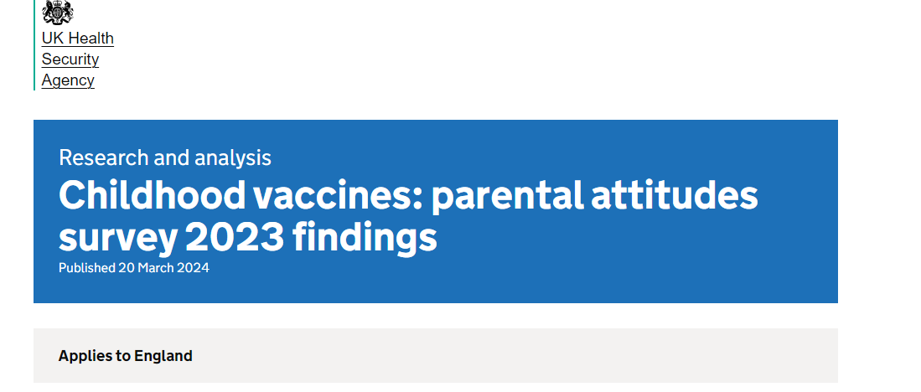
RSV was the most frequently recalled health issue that parents had seen or heard about in the past 12 moths (39%)
RSV was rated as very serious by 58% of parents of babies and younger children, higher than in parents of children aged 3 years 4 months to under 5 years of age
Notes:
Online survey to find out what parents of children aged 2 months to less than 5 years thought about vaccination.
1000 respondents with a child aged 2 months to less than 3 years 4 months
1000 respondents who had a child 3 years 4 months to less than 5 years old.
The diseases rated most often as ‘very serious’ for their child to catch by parents of babies and younger children were septicaemia (86%) and meningitis (81%)
RSV was the most frequently recalled health issue that parents had seen or heard about in the past 12 moths (39%)
RSV was rated as very serious by 58% of parents of babies and younger children, higher than in parents of children aged 3 years 4 months to under 5 years of age
Childhood vaccines: parental attitudes survey 2023 findings - GOV.UK (www.gov.uk)

Slide 54
Proposed work – Pregnancy/ Pre school
2 attitudinal surveys
1) to gather insights from pregnant people
2) to gather insights from parents of pre-school aged children
Using the COM-B model to gather behavioural insights across all vaccinations
Gather insights into perception of risk to RSV and attitudes towards new vaccinations
Qualitative phase – to understand barriers & facilitators identify groups (TIP approach) affected by inequity & to explore opportunities for improvements
Notes:
Broad survey and questions specific to new vaccines and RSV.
Additionally, we have recently undertaken some insights from out Time to talk survey where we have aimed to gather insights from people in Wales in relation to RSV. These results will be available later in the month.

Slide 55
Proposed work – adults
Attitudinal survey with adults 55+
Assess knowledge and awareness of RSV disease within the context of respiratory infections and the adult vaccination programme
Perceived risk and severity of RSV
Benefits, demand and acceptance of RSV vaccination
Preferred formats and communication channels

Slide 56
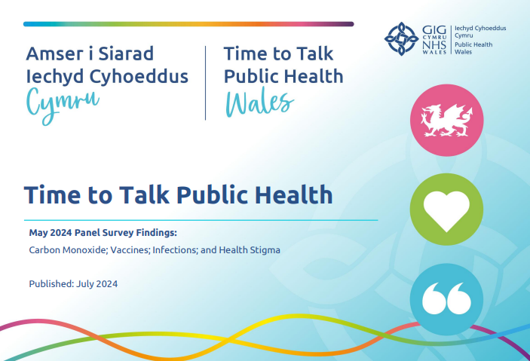
Time to talk survey
TTPH results with RSV Questions. The snap shot is:
43.2% overall are aware of RSV
51.3% awareness in 30 -49 year olds
31.3% in 70 plus
When asked is they would have a vaccine if one was available
44.3% said yes
14.3 % said no
30.6% would like more information first
51.1% of 70 plus said yes they would have it
More men than women said they would have it.
Time to Talk Public Health Panel - Public Health Wales (nhs.wales)
Main Presentation Title (nhs.wales)

Slide 57
Communication and engagement
Sheona Roberts
Communications officer
PHW

Slide 58
RSV – Communications so far
Four nations programme announcement went live 17 July 24.
Wales Ministerial Statement published 18 July 24
Wales coverage included BBC Wales, Daily Post
Published on PHW, Health board and WG news pages and newsletter
News social posts posted and shared
RSV landing page live (981 views on announcement day)
Letter to NHS leads cascaded through system
Training slides/podcast x2 for NHS on Sharepoint
Brandwatch social listening set up

Slide 59
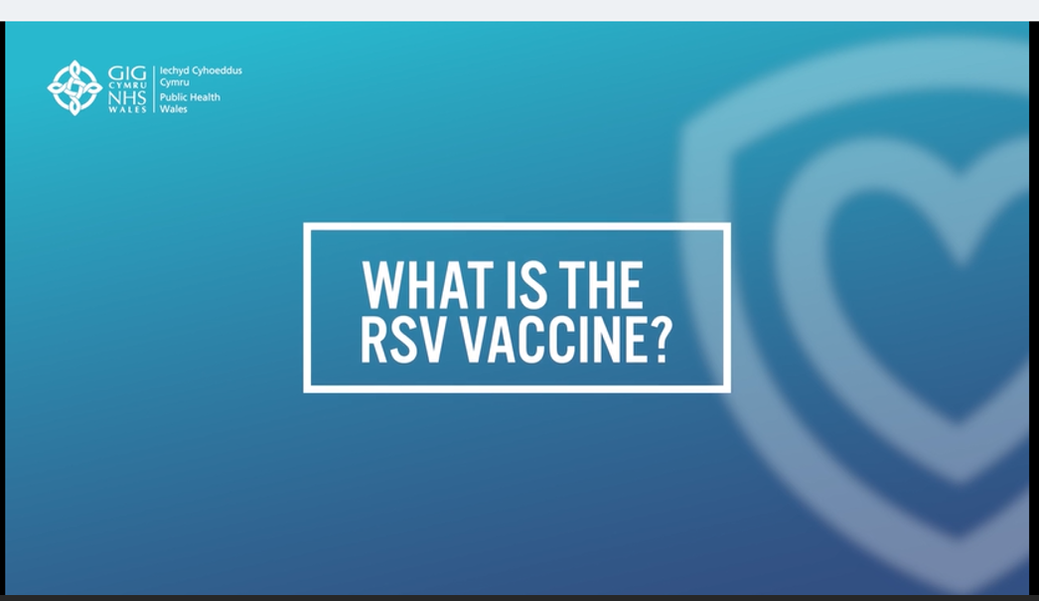
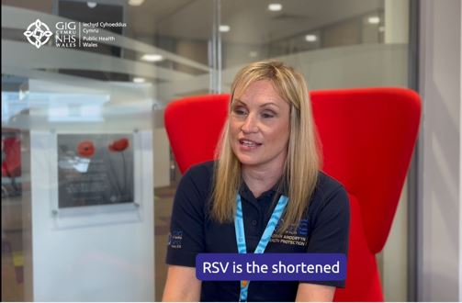
August 2024 – Knowledge building
  Fact file video - published on landing page
  Short version of above posted organically on social media channels of all.
  PHW channels reporting positive/neutral response
  Ask the Expert social posts with Dr Mair gone out this week.

Slide 60
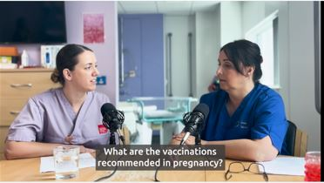
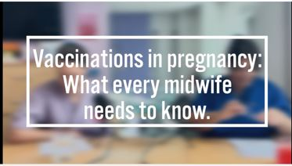
August cont.
  Toolkits for healthcare professionals to be shared and delivered. To include:
    Fact file video
    Peer to Peer midwife video
    Midwife to pregnant families video
    GP Screens, leaflets and posters for both audiences
    Appointment stickers for pregnancy notes
    Pregnancy postcard

Slide 61
RSV - partnership approach
  August – September 2024, Alert, educate, call to action
  Stakeholder engagement and toolkits for both audiences
  Stakeholders to include: Health Board pregnancy groups, Local authorities, NCT, North and South Wales Mums, First time mums UK, Caerphilly Early years, Happy bump and baby, Older People's Commissioner, Age Cymru, Befriending Networks, Older People's Alliance
  Influencer generated content - pregnancy.
  Canva Assets - for Health Boards

Slide 62
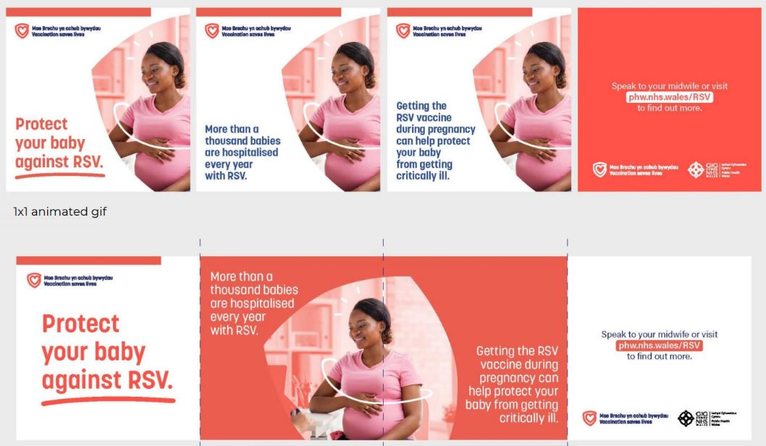
RSV - Paid for activity
  12 August 2024 – 31 March 2025 - Call to action

Slide 63
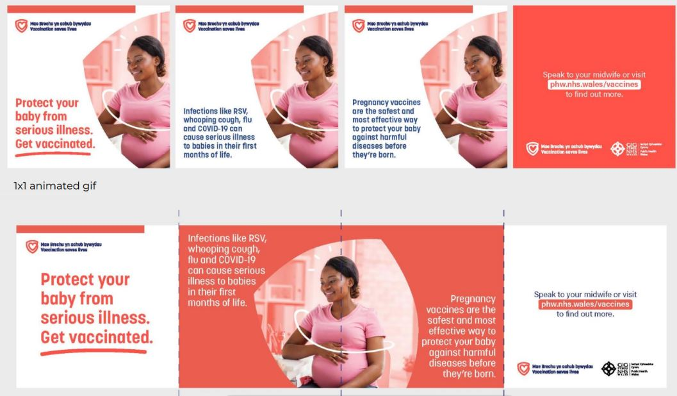
RSV - Paid for activity
  12 August – 30 September - Call to action

Slide 64
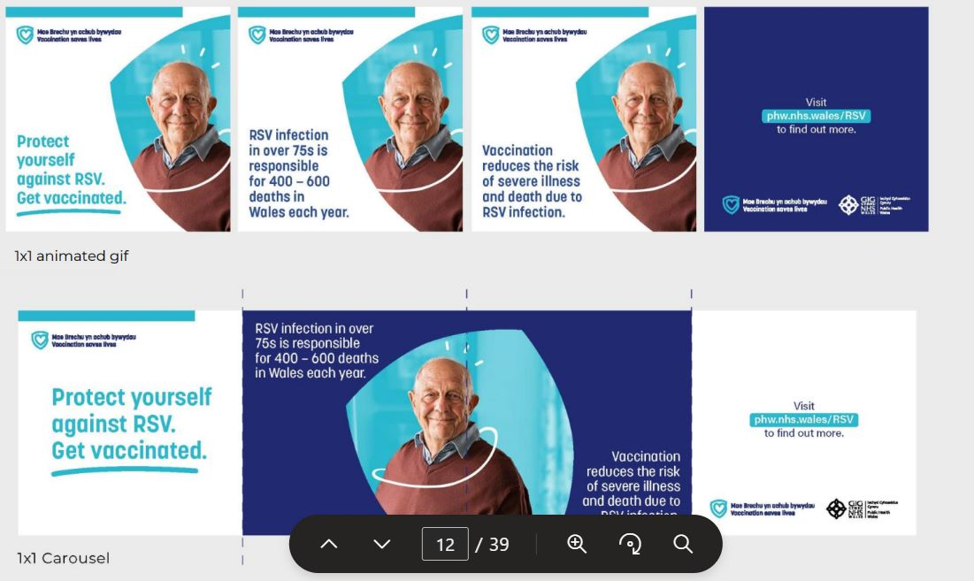
RSV - Paid for activity
  12 August – 30 September - Call to action

Slide 65
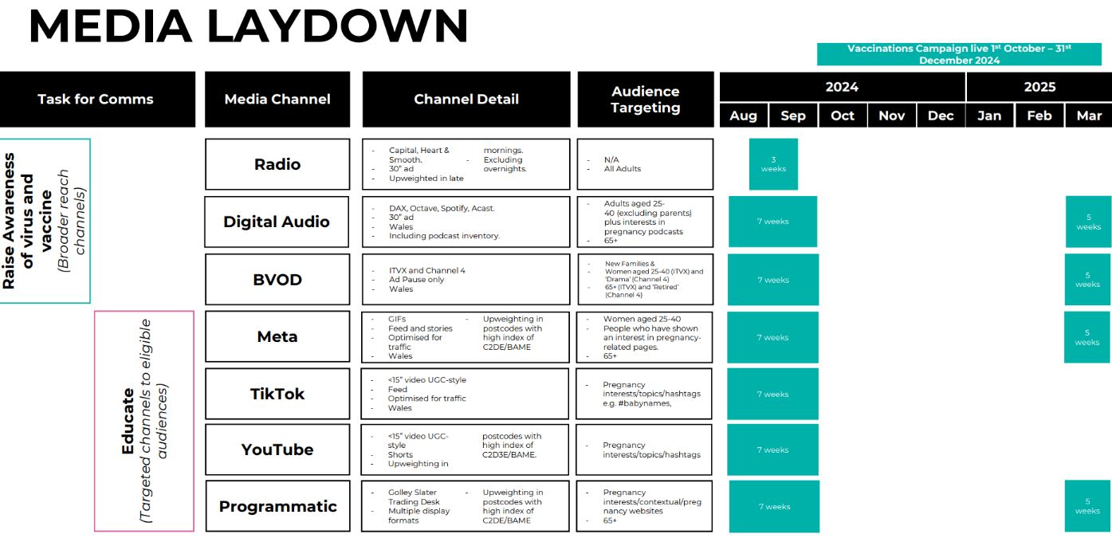
RSV - Paid for activity

Slide 66
RSV - Media relations
August 2024- sell in filming and interview opportunities to key media, to include:
  Clinical PHW spokespeople
  Paediatric consultant spokesperson
  Case study of baby hospitalised by RSV (Cardiff and Vale)
  First pregnancy vaccine to be delivered case study (Cwm Taf)
  Time to Talk survey results.
  1 September 2025 - Vaccines in arms media launch
  September
  Sell in for S4C's Prynhawn Da with Cardiff GP Dr Sherif Khalifa
    Advertorial – addition of RSV to Winter Respiratory
  October - Western Mail - editorial column in Health pages
  January/February 2025 – Media sell in of older person case study for catch up.

Slide 67
RSV resources
Juliet Norwood
Specialist Nurse Immunisation
VPDP, PHW

Slide 68
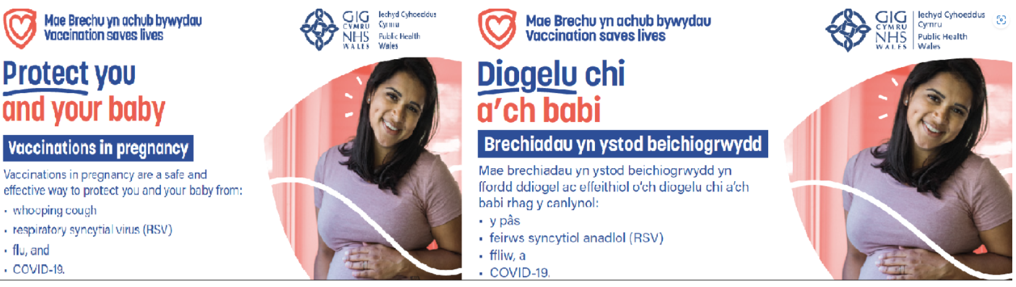
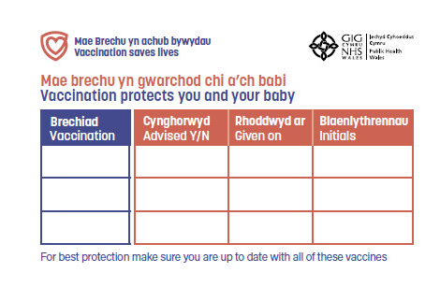
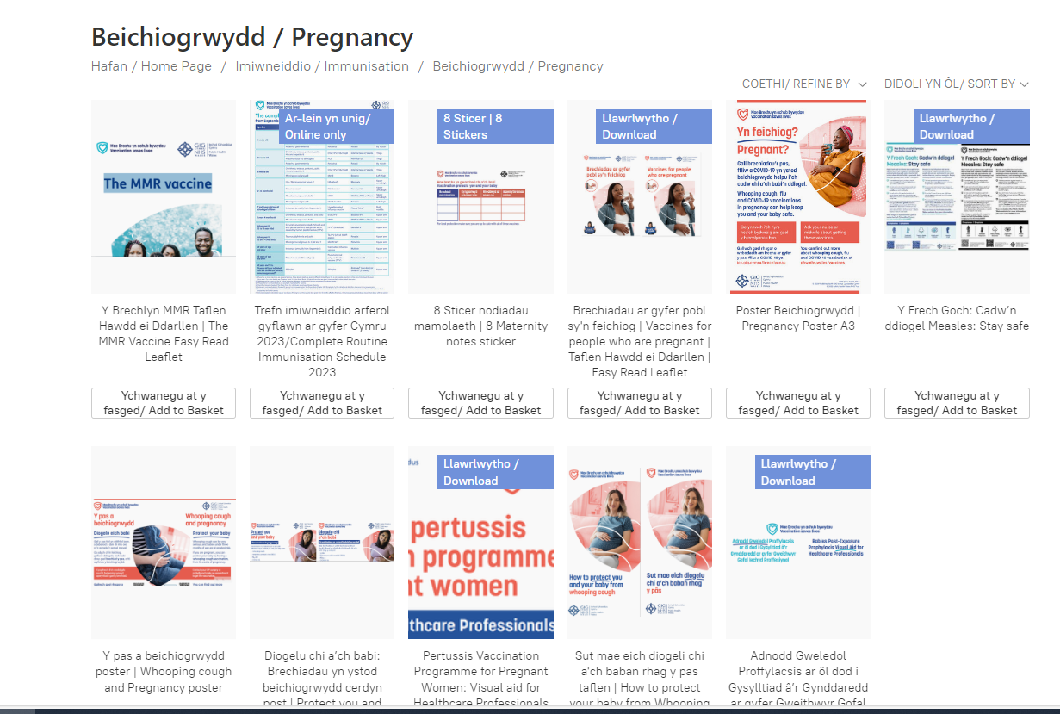
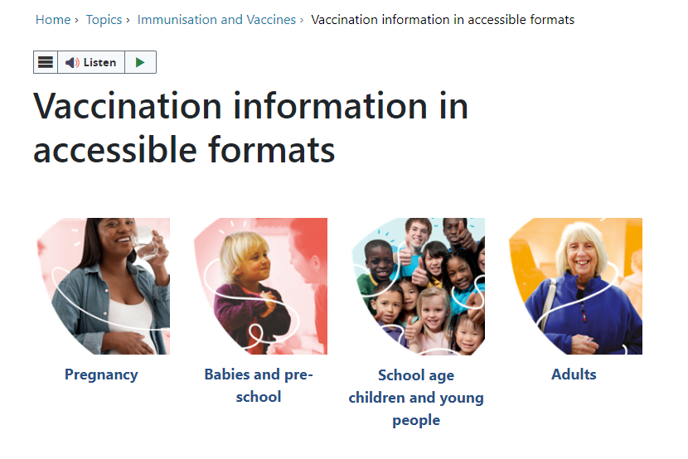
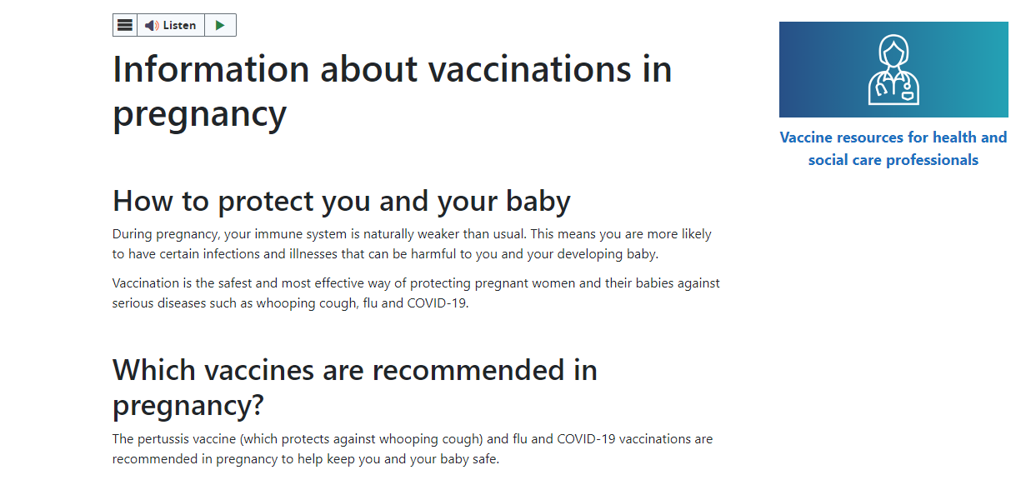
Maternal vaccination resources
All resources are FREE to order with FREE delivery
Pregnancy stickers and postcards are available to order from here:
Beichiogrwydd / Pregnancy (nhs.wales)
A pregnancy poster and booklet with information about all vaccines in pregnancy will be available to order here: Beichiogrwydd / Pregnancy (nhs.wales) [Available August 2024]
Accessible resources will be available from here:
Vaccination information in accessible formats - Public Health Wales (nhs.wales) [Available Sept/ Oct 2024]
Further information on maternal vaccines including RSV is available on our web page here:
Information about vaccinations in pregnancy - Public Health Wales (nhs.wales)

Slide 69
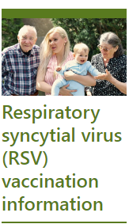
Older adult patient resources
All resources are FREE to order with FREE delivery
Leaflets and posters for older adults are available
This includes:
your guide to the RSV vaccine for older adults
accessible versions will available soon
Please visit the Health Information Resources page to order
Please visit the Vaccination information in accessible formats page for resources available in a variety of accessible formats

Slide 70
Optimising Vaccine Uptake: Using motivational interviewing for better conversations eLearning
The approach and style of a vaccine conversation can make a real difference in understanding individual hesitancy, addressing barriers, and influencing vaccine uptake
There is an eLearning module available called Optimising Vaccine Uptake: Using motivational interviewing for better conversations which aims to support staff with having positive conversations about immunisations
The module aims to provide health professionals the skills and knowledge required to implement motivational interviewing techniques when having vaccine-related conversations
Further information about the module and how to access it is available here: Immunisation eLearning - Public Health Wales (nhs.wales)
Healthcare professional are trusted voices, it is important to ensure we make every contact count to raise awareness of the RSV vaccination programme

Slide 71
Further information
The Green Book: Immunisation against infectious disease: RSV Green Book Chapter (27a)
Welsh Health Circular: Introduction of RSV vaccination programme 2024 (WHC/2024/032)
Marketing authorisation holder’s Summary of product characteristics
Medicines and Healthcare products Regulatory Agency (MHRA): reporting adverse reactions
National Patient Group Direction (PGD): RSV vaccine
PHW RSV recorded side sets
PHW RSV training slide sets
The information for healthcare practitioners' guidance Respiratory syncytial virus (RSV) programme: information for healthcare professionals - GOV.UK (www.gov.uk) is recommended reading for anyone involved in RSV immunisation
Pfizer Abrysvo® vaccine preparation instructional video
NHS website: Bronchiolitis
UKHSA RSV overview: RSV: symptoms, transmission, prevention, treatment
Public Health Wales public webpage: Respiratory syncytial virus (RSV) vaccination information - Public Health Wales (nhs.wales)

