Slide 1
Human papillomavirus (HPV) vaccination
Universal HPV adolescent immunisation programme
Vaccine Preventable Disease Programme
Public Health Wales
July 2023 Version 1
Notes:
Material contained in this document may be reproduced without prior permission provided it is done so accurately and is not used in a misleading context.
Acknowledgement to Public Health Wales NHS Trust to be stated.
© 2023 Public Health Wales NHS Trust.
Rationale for resource
This resource is designed to support practitioners and registered healthcare practitioners (including vaccinators) involved in the delivery of the HPV MSM vaccination programme in Wales.
This resource does not cover the actual administration techniques involved in vaccination against HPV. If staff are required to deliver vaccinations, they should refer to their line manager for alternative training.
Please note: These educational resources continue to be updated as required to support this programme but do not replace the clinical judgement of practitioners. Practitioners should refer to the Green Book (maintained and updated by UK Health Security Agency, formerly Public Health England) when administering the vaccine. Immunisation against infectious diseases: Human papillomavirus (HPV) 18a: Human papillomavirus (HPV): the green book, chapter 18a - GOV.UK (www.gov.uk)

Slide 2
Vaccination against Human Papillomavirus (HPV)
Clinical content of this training slide set
The information contained within this slide set is up to date as of July 2023. It is important that all immunisers delivering the HPV vaccination programme and or those who are providing immunisation advice familiarise themselves with the most up to date clinical evidence and guidance, this can be found in the following key documents.
HPV: the green book, chapter 28a: https://www.gov.uk/government/publications/human-papillomavirus-hpv-the-green-book-chapter-18a
UKHSA HPV vaccination: guidance for healthcare professionals: https://www.gov.uk/government/publications/hpv-universal-vaccination-guidance-for-health-professionals
HPV vaccination programme microsite page is available here: https://phw.nhs.wales/topics/immunisation-and-vaccines/vaccine-resources-for-health-and-social-care-professionals/hpv/
The content of this training slide set is subject to review, this resource will be version controlled. This is version 1, July 2023.

Slide 3
Acknowledgements
Acknowledgement to Public Health Wales NHS Trust to be stated
UK Health Security Agency www.gov.uk/government/topics/public-health
Public Health Scotland www.publichealthscotland.scot/
VPDP team members
Other references included in slides

Slide 4
Aims of Resource
To provide information for healthcare practitioners involved in advising on and delivering the HPV vaccination programme.
To raise awareness of the current epidemiology of HPV.
To describe the programme details including administration of the vaccine, eligibility, recommended dosage and schedule, contraindications, precautions and potential adverse reactions.
To raise awareness of the impact of the HPV vaccination programme.

Slide 5
Pre-requisites to administering HPV vaccine
Before administering HPV vaccine, it is recommended you have:
Undertaken training in the management of anaphylaxis and Basic Life Support as specified by policy for your local area and are familiar with Resuscitation Council UK (RCUK) guidance on Management of Anaphylaxis in the Vaccination Setting
Undertaken any additional statutory and mandatory training as required by your employer
Received HPV vaccine training through attending a taught session if you are a new immuniser a competency assessment is recommended - competency assessment tool: Publications | Royal College of Nursing (rcn.org.uk)
An appropriate legal framework to supply and administer HPV vaccine in place e.g. patient specific prescription, Patient Specific Direction (PSD), Patient Group Direction (PGD)
Described the process of consent and how this applies when giving vaccines
Accessed and familiarised yourself with the following key documents: Human papillomavirus (HPV): the green book, chapter 18a - GOV.UK (www.gov.uk) , the UK Health Security Agency UKHSA HPV vaccination: guidance for healthcare practitioners
Human papillomavirus (HPV) vaccination
Universal HPV adolescent immunisation programme
Notes:
Practitioners should always ensure they are accessing the most up to date information and guidance

Slide 6
Learning Outcomes
After completing this resource immunisers will be able to:
describe the aetiology and epidemiology of HPV
understand the rationale and evidence base for the HPV vaccination programme
discuss the benefits of vaccination against HPV
safely administer the vaccine
identify sources of additional information

Slide 7
Key messages
Human papillomavirus (HPV) is detectable in over 99% of cervical cancers. There is also evidence of an association between HPV infection and anogenital and oropharyngeal cancers.
Since the HPV vaccine programme for girls was introduced in September 2008, the number of diagnoses of genital warts has fallen sharply in both girls and boys, indicative of herd protection, and substantial declines in HPV16 and HPV18 in 16 to 21 year old females.
The HPV vaccination programme was extended to include adolescent boys from September 2019 in Wales.
In 2022 Gardasil 9 vaccine became available and now replaces Gardasil as the HPV vaccine for the routine programme.
Since April 2022 there has been a change from a 3-dose to a 2-dose schedule for eligible individuals aged over 15 years and MSM (a 3-dose schedule continues for those who are immunosuppressed or HIV-positive).
In August 2022 the Joint Committee on Vaccination and Immunisation (JCVI) advised moving to a one-dose schedule for the routine programme and MSM programme for under 25s. The change to a one-dose schedule will come into effect from 1 September 2023 in Wales.
  Changes to the vaccine for the HPV immunisation programme (WHC/2022/023) | GOV.WALES
  HPV immunisation programme update (WHC/2023/016) | GOV.WALES
Notes:
The National HPV Immunisation Programme for girls in school Year 8 began in September 2008 (throughout the UK)
Cervarix vaccine (HPV types 16, 18) was used between 2008 and 2012
Gardasil vaccine (HPV types 6, 11, 16, 18) was introduced in September 2012
In April 2018, a national HPV vaccination programme for MSM began for MSM aged up to and including 45 years old are offered HPV vaccine through Specialist Sexual Health Services (SHSs)
In September 2019 the HPV vaccine programme was extended to include boys as well as girls.
In 2022 Gardasil 9 vaccine became available at the HPV vaccine for the routine programme (HPV types 6, 11, 16, 18, 31, 33, 45, 52, 58)
From April 2022 eligible individuals aged over 15 years and MSM change from a 3 dose to a 2 dose schedule (2 doses at least 6 months apart). Those who are immunosuppressed or HIV positive at any age should receive 3 doses.
The change to one dose HPV for the routine adolescent programme and MSM under 25 years of age will come into effect from 1 September 2023 in Wales. Welsh Health Circular: https://www.gov.wales/changes-vaccine-hpv-immunisation-programme-whc2022023

Slide 8
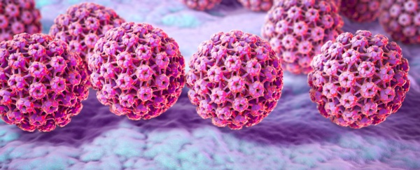
Human Papillomavirus (HPV)
HPV is a DNA virus.
Infects skin and mucosal sites (squamous epithelium) through skin-to-skin contact.
HPVs are a large group of related viruses. Each virus in the group is given a number, which is called an HPV type.
HPV infections are often asymptomatic.
Infection can resolve spontaneously:
  70% new high-risk infections will clear within a year
  90% new infections clear within 2 years
Persistent infection with high risk HPV types such as types 16 and 18 can lead to cancer – most notably cervical cancer in women as well as cancer of the anus, oropharyngeal and the penis.
Other types of HPV such as 6 and 11 cause genital warts.
Image source: PHW 2022

Slide 9
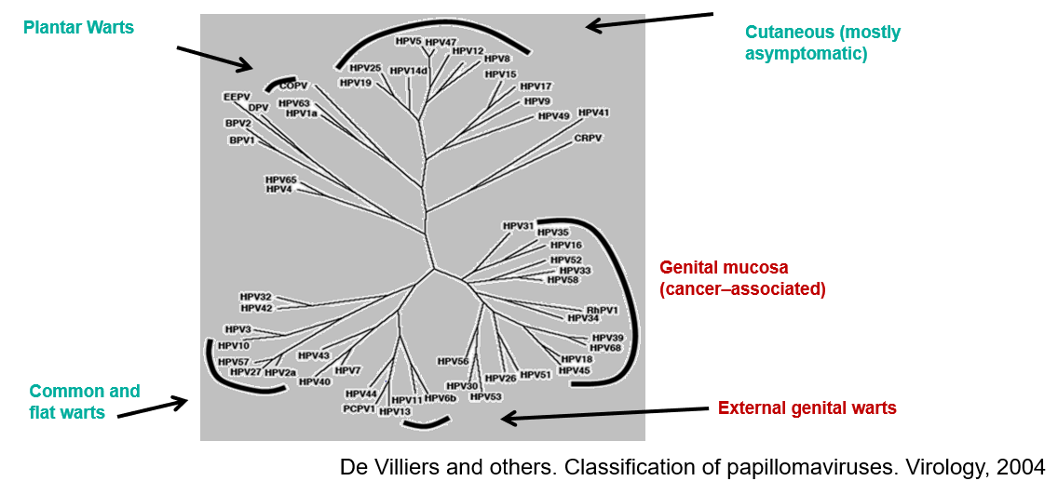
HPV Genotypes

Slide 10
Human Papillomavirus (HPV)
Of the 100+ different types of HPVs
over 40 types affect genital area
High-risk types (include HPV 16,18,31,33,45,52,58) cause cancer
Low-risk types (HPV 6,11) cause genital warts
HPV16:
HPV18:
HPV6:
HPV11:
HPV 16 accounts for almost 60% and HPV18 is responsible for more than 15% of all cervical cancers in Europe. They are also associated with most cases of cancer of the anus, penis, oropharyngeal, vagina & vulva
}
}
90% of cases of genital warts are due to HPV 6 and 11
Human papillomavirus (HPV): the green book, chapter 18a - GOV.UK (www.gov.uk)
Notes:
There are over 100 different types of HPV of which around 40 infect the genital area.
Genital HPVs are categorised as either High risk types - known to be associated with cancer or Low risk types- known to lead to the development of genital warts.
HPV16 and HPV18 responsible for between 70%-80% of all cervical cancers.
Types 16 and 18 are also associated with the majority of HPV related cancers of the anus, penis, oropharyngeal, vagina and vulva.
HPV infection is associated with 80-90% of all anal squamous cell cancers and HPV types 16 and 18 are found in the majority of HPV-related anal cancers.
Around 90% of cases of genital warts are thought to be due to HPV type 6 and 11. Although they do not cause cancer, genital warts can be difficult to treat. Some individuals may also experience frequent recurrent episodes which may cause significant distress to the individual and substantial costs to healthcare.
https://www.gov.uk/government/publications/human-papillomavirus-hpv-the-green-book-chapter-18a

Slide 11
Transmission
HPV is spread by skin to skin contact including sexual activity
HPV is a very common virus and is also one of the most common sexually transmitted infections in the UK.
Around 80% of people will come into contact with the virus at some point in their lives
HPV can resolve spontaneously:
  70% new high-risk infections clear within a year
  90% new infections clear within 2 years
The transmission of genital HPV’s are primarily by sexual contact with an infected partner, particularly through sexual intercourse but also by non-penetrative genital contact, including oral sex. Infection usually occurs after sexual debut and almost 40% of women are infected within two years. (Reference: Green Book Chapter 18a HPV)
Notes:
It is estimated that around 8 out of 10 people will be infected with HPV at some point in their lives. Most people never know they are infected – HPV infections are typically asymptomatic and most of the time the body clears the infection without it causing any problems.. The average length of an infection is around 8 months but for 10% women, infection can last longer than 2 years. It is this group of women who are at increased risk of developing cervical cancer. Cervical cancer often doesn’t occur until 20 years after the initial infection.
Persistent infection with high risk HPV types can damage DNA. This can cause cells to divide and grow out of control which can lead to cancer.

Slide 12
Transmission (continued)
Anyone who has ever had a sexual encounter, even without penetration, can contract HPV
Transmitted by intimate skin-skin contact, penetrative sex, digital, shared sex toys etc.
The risk of acquiring infection increases with the:
  number of previous sexual partners
  introduction of a new sexual partner
  sexual history of partners
HPV can still be present many years after an individual has been sexually active.
Notes:
The transmission of genital HPVs are primarily by sexual contact with an infected partner, particularly through sexual intercourse but also by non-penetrative genital contact, including oral sex.

Slide 13
Vertical transmission
Non sexual routes of HPV transmission include vertical transmission from mother to newborn baby
HPV 6 and HPV 11 also cause laryngeal papillomas
The disease occurs in two forms: juvenile or adult papillomatosis, based on whether it develops before or after 20 years of age
The juvenile form is generally transmitted through contract with a mother’s infected vaginal canal during childbirth.
Human papillomavirus (HPV): the green book, chapter 18a - GOV.UK (www.gov.uk)
Notes:
The transmission of genital HPVs are primarily by sexual contact with an infected partner, particularly through sexual intercourse but also by non-penetrative genital contact, including oral sex.

Slide 14
UK HPV vaccination history
The UK National HPV Immunisation Programme for girls in school Year 8 began in September 2008.
Cervarix vaccine (HPV types 16,18) was used between 2008 and 2012.
Gardasil vaccine (HPV types 6,11,16,18) was introduced in September 2012.
On 1 April 2017, a national HPV vaccination programme for men who have sex with men (MSM) began in Wales where MSM aged up to and including 45 years old are offered HPV vaccine through Specialist Sexual Health Services (SSHS) and/or HIV clinics.
In September 2019 the HPV vaccine programme was extended to include boys as well as girls.
In 2022 Gardasil 9 vaccine (HPV types 6,11,16,18,31,33,45,52,58) became available. From March 2023 Gardasil 9 is the only HPV vaccine available for the routine programme.
From 1 April 2022 there was a change from a 3-dose to a 2-dose schedule (2 doses at least 6 months apart) for eligible individuals aged over 15 years and MSM.
From 1 September 2023 there will be a change from a 2-dose HPV course to 1-dose HPV course for the routine, catch up and GBMSM* programme for individuals under 25 HPV immunisation programme update (WHC/2023/016) | GOV.WALES
Notes:
Individuals known to be HIV positive, including those on antiviral therapy, or known to be immunocompromised should continue to be offered the 3-dose schedule. This is because there is limited data on the effectiveness of fewer than 3 doses in these populations.
*Note: For the purpose of this resource Human Papillomavirus will be referred to as HPV and both men who have sex with men (MSM) and gay, bisexual and other men who have sex with men (GBMSM) will be used interchangeably as required in line with reference to related policy.

Slide 15
JCVI: One-dose HPV routine programme
In August 2022, JCVI published a statement on a one-dose schedule for the routine HPV immunisation programme.
This followed an interim statement published in February 2022 and a 6 week stakeholder consultation.
JCVI has made a detailed review of the evidence available and considers the evidence that one dose provides similar protection to that induced by two doses is very strong:
  Trial and non-trial evidence shows that initial vaccine efficacy from one dose is very high and likely comparable to that from 2 doses.
  Long duration of protection already seen is associated with a level of antibody that is steady – it is not biologically likely that the antibody level would suddenly fall in the next few years after being sustained for more than 10 years.
  The one-dose antibody level is associated with high efficacy against persistent infection of HPV vaccine types.
  JCVI statement on one-dose HPV routine programme, August 2022: https://www.gov.uk/government/publications/single-dose-of-hpv-vaccine-jcvi-concluding-advice/jcvi-statement-on-a-one-dose-schedule-for-the-routine-hpv-immunisation-programme
Notes:
JCVI statement on one-dose HPV routine programme, August 2022: https://www.gov.uk/government/publications/single-dose-of-hpv-vaccine-jcvi-concluding-advice/jcvi-statement-on-a-one-dose-schedule-for-the-routine-hpv-immunisation-programme
JCVI interim statement HPV one dose February 2022: https://www.gov.uk/government/publications/single-dose-of-hpv-vaccine-jcvi-interim-advice

Slide 16
WHO SAGE 2022 review: 1-dose HPV
This advice is supported by the World Health Organization (WHO) Strategic Advisory Group of Experts on Immunization (SAGE)
Their 2022 review concluded that a single dose HPV vaccine delivers solid protection against HPV to immunocompetent individuals under 25 years of age, that is comparable to a 2-dose schedule
Meeting of the Strategic Advisory Group of Experts on Immunization, April 2022: conclusions and recommendations (who.int)

Slide 17
JCVI: One-dose HPV evidence
Studies by the Costa Rica Vaccine trial (CVT) and Indian International Agency for Research on Cancer (IARC) have shown:
  Durability of one dose of the bivalent or quadrivalent vaccine with stable antibody levels up to 10/11 years with comparable efficacy to that of 3 doses
Preliminary data from trials investigating immunogenicity and efficacy of one dose of the 9-valent vaccine or a delayed second dose (the delayed booster study (DEBS)) are showing that:
  The 9-valent vaccine has the same qualities as the bivalent vaccine and quadrivalent vaccine in terms of high rates of efficacy against HPV vaccine types
  There is a trajectory of a stable antibody response similar to that seen for the bivalent and quadrivalent vaccines
  JCVI statement August 2022: JCVI statement on a one-dose schedule for the routine HPV immunisation programme - GOV.UK (www.gov.uk)
Notes:
JCVI statement on one-dose HPV routine programme, August 2022: https://www.gov.uk/government/publications/single-dose-of-hpv-vaccine-jcvi-concluding-advice/jcvi-statement-on-a-one-dose-schedule-for-the-routine-hpv-immunisation-programme
JCVI interim statement HPV one dose February 2022: https://www.gov.uk/government/publications/single-dose-of-hpv-vaccine-jcvi-interim-advice

Slide 18
JCVI: One-dose HPV evidence (continued)
The Kenya single dose HPV vaccine efficacy (KEN SHE) trial investigated single dose HPV with the 9-valent vaccine in young African women and showed:
  Adolescent girls and young women were protected effectively from HPV infection over the first 18 months post vaccination
  HPV 16/18 vaccine efficacy was over 97% - the same as results in licensure trials for 3 doses
  JCVI statement August 2022: JCVI statement on a one-dose schedule for the routine HPV immunisation programme - GOV.UK (www.gov.uk)
Notes:
JCVI statement on one-dose HPV routine programme, August 2022: https://www.gov.uk/government/publications/single-dose-of-hpv-vaccine-jcvi-concluding-advice/jcvi-statement-on-a-one-dose-schedule-for-the-routine-hpv-immunisation-programme
JCVI interim statement HPV one dose February 2022: https://www.gov.uk/government/publications/single-dose-of-hpv-vaccine-jcvi-interim-advice

Slide 19
Move to one dose HPV in Wales
In September 2022 Welsh Government issued a Welsh Health Circular to advise of the anticipated change to the HPV vaccination programme in Wales based on the JCVI’s advice on a 1-dose programme for eligible individuals under 25 Changes to the vaccine for the HPV immunisation programme (WHC/2022/023) | GOV.WALES
In May 2023 Welsh Government issued a Welsh Health Circular which provides guidance on implementing the move to one dose of the HPV vaccine in Wales. The WHC/2023/016 states that from 1 September 2023 doses required by individuals eligible for HPV vaccination will be as follows:
  1-dose schedule for the routine adolescent programme*, those eligible for catch up and GBMSM programme before 25th birthday
  2-dose schedule from the age of 25 in the GBMSM programme
  3-dose schedule for individuals who are immunosuppressed and those known to be HIV-positive
Notes:
*Catch up for the routine adolescent programme is up to the age of 25 for: girls born after 1 September 1991; and boys born after 1 September 2006. Therefore, those eligible for catch up in the routine programme will also only require one dose.
JCVI statement on one-dose HPV routine programme, August 2022: https://www.gov.uk/government/publications/single-dose-of-hpv-vaccine-jcvi-concluding-advice/jcvi-statement-on-a-one-dose-schedule-for-the-routine-hpv-immunisation-programme
JCVI interim statement HPV one dose February 2022: https://www.gov.uk/government/publications/single-dose-of-hpv-vaccine-jcvi-interim-advice

Slide 20
Move to one dose HPV in Wales (cont)
From 1st September 2023, immunocompetent adolescents and eligible adults under 25 years of age (including GBMSM) who have received 1 dose of HPV vaccine will be considered fully vaccinated and will not need any additional doses. The move to 1-dose will be implemented under a ‘hard stop’ approach from 1st September.
Eligible immunocompetent individuals under 25:
  Who have not received any HPV vaccinations will be eligible to receive 1 dose of the HPV vaccine
  Who have started their HPV vaccination schedule and have already received one dose of the vaccine will be considered fully vaccinated
Until the one dose schedule commences, the current 2 dose schedule will remain in place
Some parents, young people and GBMSM under 25 years of age may already have consented to a 2-dose HPV schedule and may expect the offer of two doses to be honoured.
There needs to be clear communication that the JCVI have advised that the evidence now shows that only 1 dose of HPV vaccine is needed for these groups to give a high level of protection.

Slide 21
WHO cancer elimination strategy
The WHC from May 2023 includes an uptake target for the adolescent HPV vaccination programme HPV immunisation programme update (WHC/2023/016) | GOV.WALES
In the WHC the Chief Medical Officer advises that health boards should focus on strengthening programme delivery, striving to achieve 90% uptake by the time individuals reach 15 years of age.
This uptake target is based on the WHO targets published in their global strategy to eliminate cervical cancer. The WHO uptake target is for girls but the welsh target is for both boys and girls.
The WHO global strategy proposes that the following 90-70-90 targets must be met by 2030 for countries to be on track towards the elimination of cervical cancer in the next century:
  90% of girls fully vaccinated with HPV vaccine by age 15 years
  70% of women are screened with a high-performance test by 35 years of age and 45 years of age
  90% of women identified with cervical disease receive treatment - (90% of women with precancer treated, and 90% of women with invasive cancer managed)
  Global strategy to accelerate the elimination of cervical cancer as a public health problem (who.int)
Notes:
Although the global strategy 90% target for vaccine uptake at 15 years is for girls only, the 90% target for Wales also includes boys.

Slide 22
HPV and cervical cancer
  Persistent infection by high risk HPV types is detectable in more than 99% of all cervical cancers.
  Cervical cancer is still one of the commonest cancers amongst women worldwide, with 604, 000 new cases and 342, 000 deaths estimated in 2020
  Cervical cancer is the most common cancer among women under the age of 35 (peak incidence 30-34 years)
  Approximately one third of women die within 5 years of the diagnosis of invasive cervical cancer in the UK
In the UK before the impact of the HPV vaccination programme started to take effect:
  over 3,000 women were diagnosed with cervical cancer every year
  around 900 women died from cervical cancer every year
The lifetime risk of cervical cancer in unvaccinated cohorts is 1 in 142
Notes:
Munoz N, Castellsague X, de Gonzalez AB et al. (2006) Chapter 1: HPV in the etiology of human cancer. Vaccine 24S3 S1-S10. https://pubmed.ncbi.nlm.nih.gov/16949995/

Slide 23
Other HPV associated cancers
HPV is also associated with:
  anal and cervical cancers (more than 90%)
  vaginal and vulvar cancers (about 70%)
  oropharyngeal cancers (70%)
  penile cancers (more than 60%)
Cancer Research UK (CRUK) suggests that the proportion of cancer cases linked to HPV is rising and that in Europe:
  73% of oropharyngeal cancer cases are HPV positive
  12% of oral cavity, hypopharynx and larynx cancer cases are HPV positive
  laryngeal squamous cell carcinoma (SCC) risk is 5.4 times higher in people with HPV infection
  the cancer risk for oropharyngeal, tonsil, and base of tongue is higher in people with more past sexual partners, people who started having sex at a younger age, and men who have ever had sexual contact with men
Notes:
In recent years there has been an increase of HPV positive oropharyngeal cancer and it is being seen in younger people aged between 40 and 50 years, who do not smoke. 1 in 55 men and 1 in 108 women will be diagnosed with oral cancer at some point in their life.
www.ncbi.nlm.nih.gov/pmc/articles/PMC4830161/
www.cancerresearchuk.org/about-cancer/causes-of-cancer/infections-eg-hpv-and-cancer/does-hpv-cause-cancer?_ga=2.107067074.1715641418.1562227587-1516946824.1550596213
www.cancerresearchuk.org/health-professional/cancer-statistics/statistics-by-cancer-type/head-and-neck-cancers/risk-factors#ref-10

Slide 24
Eligibility for vaccine
Routine programme for adolescents aged 12 to 13 years (school Years 8 and 9).
MSM up to and including 45 years of age attending Specialist Sexual Health Services and/or HIV clinics regardless of risk, sexual behaviour or disease status.
Other individuals with a similar risk profile to that seen in the MSM population who may benefit from vaccination. This includes – MSM over 45 years of age, HIV+ men and women, transgender individuals – where HPV vaccine may be considered on a case-by-case basis and can be offered following a clinical assessment of the patient. Vaccines should be purchased from the manufacturer or pharmaceutical wholesaler in this instance.
Eligible girls and boys (eligible boys born after 01/09/2006) can continue to be caught up until their 25th birthday.
Notes:
The vaccine is recommended for:
all adolescents aged 12 – 13 years / in school Year 8
MSM up to and including 45 years of age, attending Specialist Sexual Health Services and/or HIV clinics, regardless of risk, sexual behaviour or disease status.
Non–eligible individuals requesting vaccine should be assessed on case-by-case basis. Clinicians are able to offer vaccinations outside of the national programme using individual clinical judgement, however in these instances, vaccine should be purchased directly from the manufacturer.
Other individuals with a similar risk profile to that seen in the 16 – 45 year old MSM population may also benefit from vaccination.
Clinical FAQs are available here: https://nhswales365.sharepoint.com/sites/PHW_VPDPComms/SitePages/Frequently-asked-questions.aspx (NHS intranet only)

Slide 25
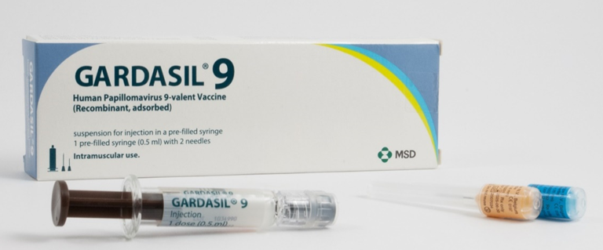
Gardasil 9
Brand name: Gardasil 9
Generic Name: Human Papillomavirus Vaccine
[Types 6, 11, 16, 18, 31, 33, 45, 52, 58]
Type of vaccine: Recombinant, adsorbed
Marketed by: MSD
Licensed from: 9 years of age
Image courtesy of UKHSA
Notes:
Gardasil®9 is the recommended vaccine for the HPV vaccination programme and is the only market authorised 9 valent HPV vaccine in the UK.
Gardasil 9 provides protection against 9 HPV strains: HPV-16 and HPV-18, the two high risk types that can lead to cancer, and HPV-6 and HPV-11, the two types that cause approximately 90 per cent of all anogenital warts in males and females, and HPV 31, 33, 45, 52, 58.
The additional Types 31, 33, 45, 52, 58 although less common than types 16 and 18, are also considered high-risk HPV types.
Gardasil 9 is expected to prevent the majority of cervical, vaginal and vulvar cancers and premalignant lesions, as well as genital warts associated with HPV
The vaccine is approved for use in females and males aged from 9 years of age.
Gardasil 9 SmPC: https://www.medicines.org.uk/emc/product/7330/smpc

Slide 26
HPV vaccine interchangeability
In 2022 Gardasil 9 Vaccine was introduced into the programme and supplied for those eligible for the HPV vaccine.
Whilst the programme transitioned from Gardasil to Gardasil 9 some individuals received a mixed schedule.
Gardasil and Gardasil 9 vaccines were considered as interchangeable so there are no concerns about individuals receiving a mixed schedule.
Like Gardasil 9, Gardasil gave protection against:
  HPV 16 and 18 which are responsible for 70% of all cervical cancers and most cases of cancer of the anus, penis, oropharyngeal, vagina & vulva. Persistence and disease is more common for infections by HPV types 16 and 18 than other high-risk types.
  HPV 6 and 11 which are responsible for 90% of cases of genital warts
Notes:
HPV Green Book chapter 18a: https://www.gov.uk/government/publications/human-papillomavirus-hpv-the-green-book-chapter-18a

Slide 27
HPV Vaccine
Made from the proteins of the outer coat of the virus types.
These proteins assemble into small spheres that are called virus-like particles (VLPs)
VLPs are not infectious and cannot cause HPV-associated cancers or genital warts as they do not contain the virus’s DNA
VLPs are very immunogenic, which means that they induce high levels of antibody production by the body
Upon subsequent exposure to the live virus, the immune system reacts quickly to prevent infection
An adjuvant (aluminium hydroxyphosphate sulfate) is added to increase the immune response made
Clinical trials show very high efficacy and well tolerated:
  over 99% effective at preventing pre-cancerous lesions associated with HPV types 16 and 18. Gardasil 9 offers protection against 5 additional types of HPV (31, 33, 45, 52, 58) which although less common than types 16 and 18, are also considered high-risk
  99% effective at preventing genital warts associated with vaccine types in young women
  (Green Book Chapter 18a HPV)
Notes:
Gardasil vaccine is made from the proteins that make up the outer coat of the virus types. These proteins assemble into small spheres that are called virus-like particles (VLPs). VLPs are not infectious and cannot cause HPV-associated cancers or genital warts as they do not contain the virus’s DNA. VLPs are however very immunogenic, which means that they induce high levels of antibody production by the body.
As with many other immunisations, when a person is vaccinated, their immune system mounts a response against these VLPs. When a person is then exposed to the live virus, the body’s immune system reacts quickly to stop the infection.
In clinical trials in young women with no previous history of HPV infection, vaccine was 99% effective at preventing pre-cancerous lesions associated with HPV types 16 and 18.
Gardasil is also 99% effective at preventing genital warts associated with vaccine types in young women.
A clinical trial of Gardasil in men indicated that it can prevent anal cell changes caused by persistent infection, and genital warts.
HPV vaccines have not been shown to have an impact on an existing infection or any of the outcomes of an existing HPV infection, such as anogenital warts but may boost immunity and prevent re-infection or reduce reoccurrences in people with previously treated high-grade anal intraepithelial neoplasia.
Swedish KA, Factor SH, Goldstone SE. Prevention of recurrent high-grade analneoplasia with quadrivalent human papillomavirus vaccination of men who have sexwith men: a nonconcurrent cohort study. Clin Infect Dis. 2012;54:891-8.Available at www.ncbi.nlm.nih.gov/pubmed/22291111

Slide 28
HPV Vaccine
A clinical trial of Gardasil in men indicated that it can prevent anal cell changes caused by persistent infection and genital warts (Swedish et al 2021).
May boost immunity and prevent re-infection or reduce reoccurrences in people with previously treated high-grade anal intraepithelial neoplasia established diseases.
Prior infection with one HPV type does not diminish the efficacy of the vaccine against other HPV types included in the vaccine
Current studies show that protection is maintained for at least ten years although based on immune responses seen, protection is expected to last longer than this and may be lifelong

Slide 29
The HPV vaccine
The HPV vaccine is used in over 113 countries around the world including the USA, Australia, Canada and most of Western Europe. More than 100 million people have been vaccinated worldwide.
In the UK since the start of the programme in 2008, more than 10.5 million doses of HPV vaccine have been given. HPV vaccination: guidance for healthcare practitioners - GOV.UK (www.gov.uk)
Vaccine coverage has been around 80% in women aged 15 to 24 years in Wales, meaning most have been given the vaccine. COVER - National childhood immunisation uptake data - Public Health Wales (nhs.wales)
In time it is expected that the vaccine will save hundreds of lives every year in the UK.

Slide 30
Safety of HPV vaccine
The safety of HPV vaccine has been established through rigorous testing in clinical trials, followed by use of many millions of doses across the world.
Some people may experience a mild side effect, but these are generally of short duration and are far outweighed by the expected benefits of the vaccine.
The Centers for Disease Control and Prevention (CDC) in the USA have posted clear advice on its website supporting the safety of HPV vaccine.
Notes:
www.who.int/news/item/31-10-2019-major-milestone-reached-as-100-countries-have-introduced-hpv-vaccine-into-national-schedule
www.gavi.org/types-support/vaccine-support/human-papillomavirus
Centers for Disease Control and Prevention (USA), HPV vaccine safety information: https://www.cdc.gov/vaccinesafety/vaccines/hpv-vaccine.html

Slide 31
HPV vaccine dosage and schedule: 2-dose, 3-dose
From 1 April 2022, all individuals eligible for the adolescent (including catch up to 25) or MSM HPV vaccination programme have been offered a 2 dose schedule.
From 1 September 2023 only MSM 25-45 years will require a 2 dose schedule:
  2 dose schedule of 0.5ml at 0, and 6 to 24 months
  2nd dose should be administered at least 6 months after the first dose
  any interval between doses of 6 and 24 months is clinically acceptable
Immunocompromised individuals and individuals known to be HIV-positive should continue to follow a 3 dose schedule:
  3 dose schedule of 0.5ml at 0, 1, and 4-6 months
  2nd dose at least 1 month after 1st, and 3rd dose at least 3 months after 2nd
  all 3 doses should ideally be given within a 12 month period
If either course is interrupted, it should be resumed but not repeated, ideally allowing the appropriate interval between the remaining doses
Notes:
In May 2020 the JCVI reviewed the latest evidence and concluded that there was no compelling reason to continue with a three dose schedule in those starting the schedule over the age of fifteen and that the programme should move to a two dose schedule for all children and adults, including MSM, at a suitable time.
However, there is no data on fewer than 3 doses among HIV positive or immunocompromised populations. Therefore a 3-dose schedule should still be offered to individuals who are known to be HIV positive, including those on antiretroviral therapy, or are known to be immunocompromised at the time of immunisation.
Green Book Chapter 18a for details
www.gov.uk/government/publications/human-papillomavirus-hpv-the-green-book-chapter-18a
From 1 September 2023 immunocompetent adolescents and eligible adults under 25 (including MSM) will only require 1-dose of HPV vaccine to be considered fully

Slide 32
HPV Programme dosage and schedule
From 15 to 24 years of age | From 25 to 45 years of age | From 15 to 45 years of age if HIV+ or have a weakened immune system
1st dose only required | 1st dose: Initial dose | 1st dose: Initial dose
 | 2nd dose: At least 6 months after initial dose | 2nd dose: 1 month after the first dose
 |  | 3rd dose: 4 to 6 months following second dose
Notes:
WHC/2023/016 https://www.gov.wales/hpv-immunisation-programme-update-whc2023016
With regard to any variations, please always consult the latest version of the Green Book chapter online at https://www.gov.uk/government/publications/human-papillomavirus-hpv-the-green-book-chapter-18a Human papillomavirus (HPV): the green book, chapter 18a - GOV.UK (www.gov.uk)

Slide 33
Minimal interval for second dose
Whenever possible, immunisations for individuals eligible for the two dose schedule should follow the recommended 0, 6-24 months schedule
For Gardasil 9 the minimum interval between the two doses can be 5 months
For further information see: Human papillomavirus (HPV): the green book, chapter 18a - GOV.UK (www.gov.uk) and Gardasil 9 SmPC
Notes:
Please refer to Chapter 18a Green Book for further detail. Human papillomavirus (HPV): the green book, chapter 18a - GOV.UK (www.gov.uk)
This advice applies to all the currently licensed HPV vaccines

Slide 34
Minimal interval for third dose
There is no clinical data on whether the interval between doses two and three can be reduced below three months
Where the second dose is given late and there is a high likelihood that the individual will not return after three months or if, for practical reasons it is not possible to schedule a third dose within this timeframe, then a third dose can be given at least one month after the second dose
For further information see: Human papillomavirus (HPV): the green book, chapter 18a - GOV.UK (www.gov.uk)
Notes:
Please refer to Chapter 18a Green Book for further detail. Human papillomavirus (HPV): the green book, chapter 18a - GOV.UK (www.gov.uk)
This advice applies to all the currently licensed HPV vaccines

Slide 35
Immunosuppression and HIV infection
Evidence suggests individuals living with HIV are at increased risk of acquiring HPV and persistent infection, as well as frequent carriage of multiple types of HPV and increased risk of HPV related rapidly progressive malignancies
Individuals in the eligible cohort who are positive for Human Immunodeficiency Virus (HIV) should be given a 3-dose schedule of HPV vaccine regardless of CD4 count, antiretroviral therapy use or viral load.
HPV vaccines are known to be safe and immunogenic for individuals infected with HIV although the immune response and its effectiveness may be less than that observed among those who are not HIV infected.
Individuals known to be immunocompromised at the time of vaccination should be offered a 3-dose course of vaccine.
Notes:
There is no data on fewer than 3 doses among HIV positive or immunocompromised populations. Therefore a 3-dose schedule should still be offered to individuals who are known to be HIV positive, including those on antiretroviral therapy, or are known to be immunocompromised at the time of immunisation.
Green Book Chapter 18a for details
www.gov.uk/government/publications/human-papillomavirus-hpv-the-green-book-chapter-18a

Slide 36
HPV vaccine dosage and schedule
Prior infection with one HPV type does not diminish the efficacy of the vaccine against other HPV types included in the vaccine
To get the best protection, it is important the full course of vaccination is received
Booster doses are not currently indicated
Current studies show protection is maintained for at least 10 years although protection is expected to last longer
Long-term follow-up studies are in place to evaluate length of protection and will determine the need for any subsequent boosters
Notes:
No evidence around boosters mentioned in - World Health Organisation: Weekly epidemiological record 16 December 2022 http://apps.who.int/iris/bitstream/handle/10665/365350/WER9750-eng-fre.pdf

Slide 37
Legal frameworks for administration of HPV vaccine
Gardasil 9 is a prescription only medicines and should only be administered using one of the following:
Prescription written manually or electronically by a registered medical practitioner or other authorised prescriber
Patient Specific Direction (PSD)
Patient Group Direction (PGD)
UK Health Security Agency (UKHSA) provide updated PGDs (Patient Group Directions) which are available at the Vaccine resources for health and social care professionals - Public Health Wales page. These are template PGD’s that can be amended locally by health boards.
Providers may choose to use this to source their own PGDs locally or prescribe the vaccination on an individual patient basis using a PSD.
The currently approved schedule for HPV vaccine is a 2-dose course. Use of a single dose is therefore off-label.
In line with advice from the MHRA, where authoritative advice and current practices supports the use of a medicine outside the terms of it’s license, it is not always necessary to draw attention to this when seeking consent
Notes:
PGD templates: https://phw.nhs.wales/topics/immunisation-and-vaccines/vaccine-resources-for-health-and-social-care-professionals/patient-group-directions-pgds-and-protocols-landing-page/

Slide 38
Preparation of HPV vaccine
Gardasil 9 is available for injection in a pre-filled syringe.
Shake syringe well before use to form a cloudy white suspension.
Discard the vaccine if particulates are present and/or it appears discoloured.
Select the appropriate needle length to ensure an intramuscular (IM) administration depending on the patient's size and weight.
Attach the needle by twisting in a clockwise direction until the needle fits securely onto the syringe.
Administer the entire 0.5ml dose as per standard protocol, preferably into the deltoid muscle of the arm.
The vaccine can be given at the same time as other national schedule vaccines. Human papillomavirus (HPV): the green book, chapter 18a - GOV.UK (www.gov.uk)
Gardasil 9 suspension for injection - Summary of Product Characteristics (SmPC) - (emc) (medicines.org.uk)
Notes:
Healthcare professionals are encouraged to read the Summary of Product Characteristics (SmPC) to ensure accurate reconstitution and delivery of the product.
A small air bubble may be visible in the prefilled syringe. This is not harmful and should not be removed prior to administration. This small bolus of air injected following administration of medication clears the needle and prevents a localised reaction from the vaccination. To try to expel it risks accidently expelling some of the vaccine and therefore not giving the patient the full dose.
HPV vaccine can be given at same time as other vaccines. The vaccines should be given at a separate site, preferably in a different limb. The sites at which each vaccine was given should be noted in the individual’s health records.
Individuals with bleeding disorders may be vaccinated intramuscularly if a doctor familiar with the individual's bleeding risk advises vaccines or similar small volume intramuscular injections can be administered with reasonable safety by this route. If the individual receives medication/treatment to reduce bleeding, for example treatment for haemophilia, intramuscular vaccination can be scheduled shortly after such medication/treatment is administered.
Individuals on stable anticoagulation therapy, including individuals on warfarin who are up to date with their scheduled INR testing and whose latest INR was below the upper threshold of their therapeutic range, can receive intramuscular vaccination. A fine needle (equal to 23 gauge or finer calibre such as 25 gauge) should be used for the vaccination, followed by firm pressure applied to the site (without rubbing) for at least 2 minutes.
If in any doubt, consult with the clinician responsible for prescribing or monitoring the individual’s anticoagulant therapy. See details specific vaccine PGD.

Slide 39
Administration of Gardasil 9 with other vaccines
HPV vaccines can be given at the same time as other vaccines such as Td/ IPV, MMR, Influenza, MenACWY and hepatitis A and B
The combined hepatitis A and B vaccine (Twinrix®) should be offered to MSMs in conjunction with the HPV vaccine if they have not had this vaccine(s) already due to the higher likelihood of infection from these viruses and the ongoing outbreak of hepatitis A in MSMs in the UK, as per JCVI recommendations
The vaccines should be given at a separate site, preferably in a different limb. If given in the same limb, they should be given at least 2.5cm apart (Green Book, Chapter 4: Immunisation procedures)
Notes:
The combined hepatitis A and B vaccine (Twinrix®) should be offered to MSMs in conjunction with the HPV vaccine if they have not had this vaccine(s) already due to the higher likelihood of infection from these viruses and the ongoing outbreak of hepatitis A in MSMs in the UK, as per JCVI recommendations
Outbreak of hepatitis A associated with men who have sex with men (MSM), England, July 2016 to January 2017 www.eurosurveillance.org/images/dynamic/EE/V22N05/art22706.pdf
*Where two or more injections need to be administered at the same time, they should be given at separate sites, preferably in a different limb. If more than one injection is to be given in the same limb, they should be administered at least 2.5cm apart. The site at which each injection is given should be noted in the individual’s records Green-Book-Chapter-4.pdf (publishing.service.gov.uk)

Slide 40
Contraindications
Gardasil 9 should not be administered to those who have had:
  A confirmed anaphylaxis to a previous dose of the vaccine
  A confirmed anaphylaxis to any constituent or excipient of the vaccine
Please note: Yeast allergy is not a contraindication to the HPV vaccine. Even though Gardasil 9 is grown in yeast cells, the final vaccine product does not contain any yeast.
For further information refer to Human papillomavirus (HPV): the green book, chapter 18a - GOV.UK (www.gov.uk) or SmPC
Notes:
There are very few individuals who cannot receive HPV vaccines. Where there is doubt, instead of withholding immunisation, appropriate advice should be sought from the local Immunisation Coordinator.
A mild fever or upper respiratory infection (for example cold) itself is not a reason to delay vaccination.
If acutely unwell, the immunisation may be deferred until the individual has recovered – this is to avoid confusing the differential diagnosis of acute illness by wrongly attributing signs or symptoms as adverse effects of the vaccine.
For the composition and full list of excipients of the vaccine, please refer to the manufacturer’s Summary of Product Characteristics (SmPC). Home - electronic medicines compendium (emc)
Please note: These educational resources continue to be updated as required to support this programme but do not replace the clinical judgement of practitioners. Practitioners should refer to the Green Book Chapter when administering the vaccine. Public Health England. Immunisation against infectious diseases: Human papillomavirus (HPV) 18a. https://www.gov.uk/government/publications/human-papillomavirus-hpv-the-green-book-chapter-18a Human papillomavirus (HPV): the green book, chapter 18a - GOV.UK (www.gov.uk)

Slide 41
Bleeding disorders
Individuals with bleeding disorders may be vaccinated intramuscularly if, in the opinion of a doctor familiar with the individual’s bleeding risk, vaccines or similar small volume intramuscular injections can be administered with reasonable safety by this route.
If the individual receives medication/treatment to reduce bleeding, for example treatment for haemophilia, intramuscular vaccination can be scheduled shortly after such medication/treatment is administered. Individuals on stable anticoagulation therapy, including individuals on warfarin who are up to date with their scheduled INR testing and whose latest INR was below the upper threshold of their therapeutic range, can receive intramuscular vaccination.
A fine needle (equal to 23 gauge or finer calibre such as 25 gauge) should be used for the vaccination, followed by firm pressure applied to the site (without rubbing) for at least 2 minutes.
If in any doubt, consult with the clinician responsible for prescribing or monitoring the individual’s anticoagulant therapy.
Notes:
https://www.gov.uk/government/publications/human-papillomavirus-hpv-the-green-book-chapter-18a

Slide 42
HPV vaccination and pregnancy
Pregnancy is not a contraindication or precaution for receiving HPV vaccination.
There is no known risk of giving inactivated, recombinant viral or bacterial vaccines or toxoids during pregnancy or whilst breast feeding.
The available data is very reassuring and does not indicate any safety concerns or harm to pregnancy.
Routine questioning about last menstrual period and/or pregnancy testing is not required before offering HPV vaccine.
Schoolgirls who are known to be sexually active including those who are or have been pregnant may still be susceptible to high risk HPV infection and could therefore benefit from vaccination.
Notes:
Green Book chapter 18a: https://www.gov.uk/government/publications/human-papillomavirus-hpv-the-green-book-chapter-18a

Slide 43
Possible adverse reactions
Possible adverse reactions for Gardasil 9 are the same as those for Gardasil.
Most common reactions include:
  pain, redness and swelling at the injection site
  headache, low grade fever, nausea, dizziness
These adverse reactions are usually mild or moderate in intensity and short lasting.
Full details available from the manufacturer’s SmPC:
Gardasil 9
** Manufacture of Gardasil has been discontinued. The last batch expired end of February 2023. Gardasil 9 is now the sole vaccine in use for the HPV vaccination programme.**
Notes:
Gardasil 9 SmPC: https://www.medicines.org.uk/emc/product/7330/smpc

Slide 44
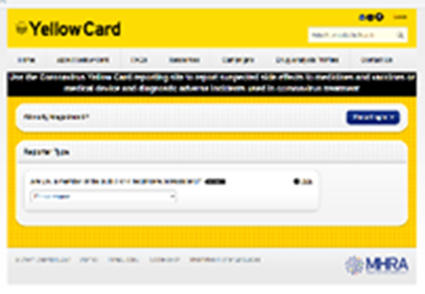
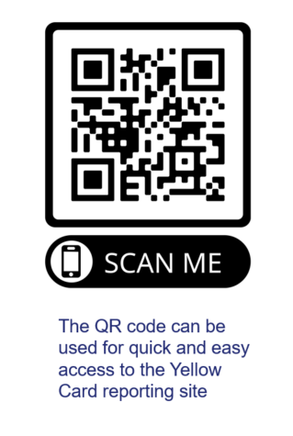
Reporting suspected adverse reactions
Vaccinees should be advised that they can report any adverse reactions or suspected side effects to the MHRA through the online yellow card scheme website or the Yellow Card app
Any suspected side effects following vaccine administration should be reported to the MHRA Yellow Card Scheme.
Anyone can report even if uncertain about whether vaccine caused condition:
www.mhra.gov.uk/yellowcard or call 0800 731 6789 (9am to 5pm Monday to Friday
see Green Book Chapter 9 for detailed guidance on reporting vaccine reactions
Notes:
Healthcare professionals and patients are encouraged to report suspected adverse reactions to the Medicines and Healthcare Products Regulatory Agency (MHRA) using the yellow card reporting scheme
Green Book chapter 9: https://www.gov.uk/government/publications/surveillance-and-monitoring-for-vaccine-safety-the-green-book-chapter-9

Slide 45
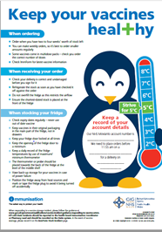
Ordering & Storage of Gardasil 9
Gardasil 9 should continue to be ordered using current processes.
There are separate order lines for the adolescent and GBMSM HPV programmes on ImmForm.
store between +2 and +8ºC
keep in original packaging
protect from light
use as soon as possible after removing from fridge
Effectiveness cannot be guaranteed for vaccines unless the cold chain has been maintained and vaccine has been monitored as per national recommendations.
Refer to local policy on vaccine storage and handling
NOTE: Temperature excursion data differs between Gardasil an Gardasil 9
Notes:
Vaccine is centrally procured for the adolescent and GBMSM HPV vaccination programme. Gardasil9 should be ordered using current processes.
It is recommended that registered healthcare practitioners place small and regular orders rather than over-ordering or stockpiling vaccines.
Gardasil® 9 should be administered as soon as possible after being removed from the refrigerator
Data from stability studies indicate that the Gardasil®9 vaccine components are stable for 96 hours when stored at temperatures from 8°C to 40°C or for 72 hours when stored at temperatures from 0°C to 2°C. At the end of this period Gardasil®9 should be used or discarded. These data are intended to guide healthcare professionals in case of temporary temperature excursion only.
The vaccine should be stored in the original packaging. This makes it easy to identify in the vaccine fridge, provides some protection against fluctuation of temperature and will protect from light.
Vaccines are expensive and it is important to minimise wastage through inappropriate storage.
Further information on the storage and handling of vaccines is included in chapter 3 of the green book.
www.gov.uk/government/publications/storage-distribution-and-disposal-of-vaccines-the-green-book-chapter-3

Slide 46
Vaccine stock management
All providers should:
review available fridge space to ensure adequate storage capacity before ordering new vaccine
ensure that there is enough stock for 2 to 4 weeks of use and not over order
have local protocols in place to reduce vaccine wastage to a minimum and protect vaccines in the event of a cold chain incident
report any cold chain failures or vaccine wastage in line with local policy and through the ImmForm website on the stock incident page
Small percentage reductions in vaccine wastage have a major impact on the financing of vaccine supplies.
Notes:
Effective management of vaccines throughout the supply chain is essential to reduce vaccine wastage and it is recommended that healthcare professionals order only what they need for a 2-4 week period rather than over-ordering or stockpiling vaccines.
Providers should review available fridge space to ensure adequate storage capacity before ordering and the delivery of vaccine.
All providers should have emergency vaccine storage and handling plans which clearly outline the actions to take in the event of out of range temperature excursions or refrigerator break down.
Cold chain failures must be documented and reported through the ImmForm website on the stock incident page.
Green Book Chapter 3: https://www.gov.uk/government/publications/storage-distribution-and-disposal-of-vaccines-the-green-book-chapter-3
ImmForm website: https://portal.immform.phe.gov.uk/Logon.aspx?returnurl=%2f

Slide 47
Impact of vaccination on HPV infection
Evidence from surveillance consistent with:
  very high vaccine effectiveness among those vaccinated
  a substantial herd protection effect with lower HPV 16 and 18 prevalence over time in unvaccinated women.
  studies in the USA and Australia found evidence of indirect protection of unvaccinated females through herd effects (WHO 2022).
  cross-protection – decline in HPV types 31, 33 and 45 in the post-vaccination period
No evidence of non-vaccine type replacement
Similar findings in Scotland, Denmark, Australia and systematic reviews
Notes:
World Health Organisation: Weekly epidemiological record 16 December 2022 http://apps.who.int/iris/bitstream/handle/10665/365350/WER9750-eng-fre.pdf

Slide 48
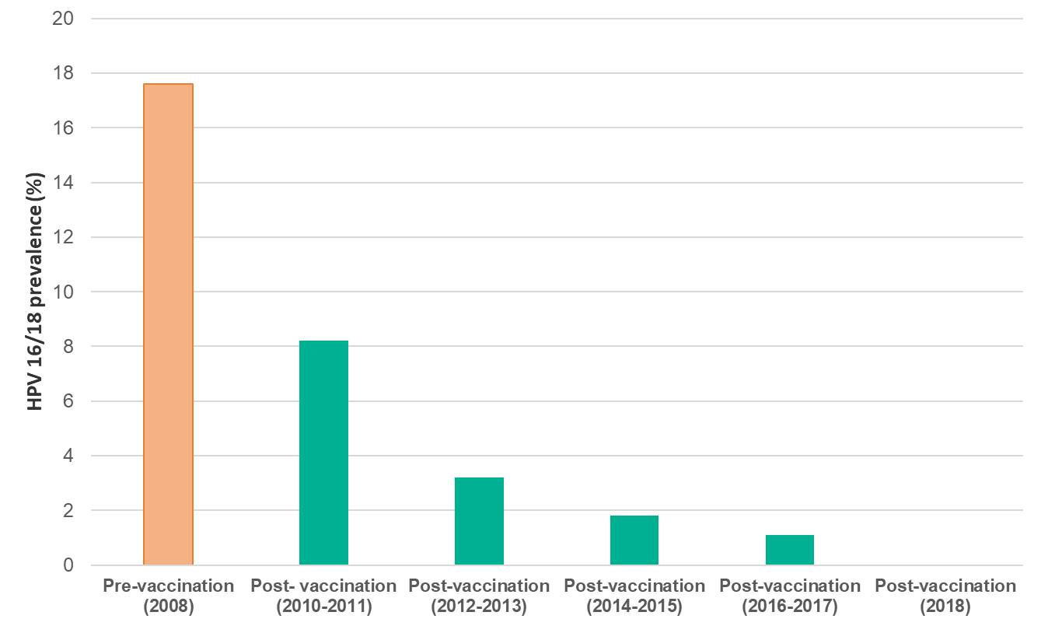
Changes in post-vaccination HPV prevalence in England:
16 to 18 year old females
In studies comparing pre vaccination and post vaccination periods involving more that 60 million individuals, prevalence of HPV16 and HPV18 decreased significantly by 83% among girls aged 13-19 years and by 66% among women aged 20-24 years after 5-8 years of vaccination (WHO 2022).
The prevalence of HPV 16 and/or 18 has decreased within the post-vaccination period from 8.2% in 2010/11 to 1.6% in 2016 (Mesher et al 2018).
In 2018, 10 years after vaccination was introduced, no HPV16/18 infections were detected in 16 to 18 year olds.
Notes:
This figure shows data on HPV 16 AND/OR 18 prevalence in 16-18 year old females, in the post-vaccination period over time, to 2016.
The prevalence of HPV 16 and/or 18 has decreased within the post-vaccination period over time, from 8.2% in 2010 to 1.6% in 2016. These decreases were strongly associated with the increasing estimated vaccination coverage.
World Health Organisation: Weekly epidemiological record 16 December 2022 http://apps.who.int/iris/bitstream/handle/10665/365350/WER9750-eng-fre.pdf
Mesher et al (2018) The Impact of the National HPV Vaccination Programme in England Using the Bivalent HPV Vaccine: Surveillance of Type-Specific HPV in Young Females, 2010-2016. Journal of Infectious Disease. 218 (6), 911-921. https://pubmed.ncbi.nlm.nih.gov/29917082/

Slide 49
Impact on anogenital warts (AGW)
Studies report a number of countries find significant reduction in cases of genital warts following introduction of national HPV vaccination programmes with reductions observed in unvaccinated young men in settings with female- only programmes indicating herd protection (WHO 2022)
Approximately 50,000 new cases of genital warts were diagnosed in sexual health services across England in 2019 (Ratna et al 2021)
  Diagnosis rates were highest in young adults under 24
However, the incidence of first episode AGW diagnoses in 15 to 17 year old girls was 84.9% lower in 2021 compared to 2017
  Most of whom would have been offered the quadrivalent vaccine (types 6, 11, 16 and 18)
there is also strong evidence of herd protection from the high coverage female programme
in young heterosexual males up to age 24 years there were:
  declines in incidence of AGW similar to same aged females
  the incidence of AGW diagnoses in 15 to 17 year old males was 80% lower in 2021 compared to 2017 (UKHSA 2022)
Notes:
One of the key successes of the programme is that we are seeing strong evidence of herd protection from the high coverage female vaccination programme.
For example, in young heterosexual males up to age 24, we are seeing declines in genital warts incidence that are similar to those seen in same aged females.
World Health Organisation: Weekly epidemiological record 16 December 2022 http://apps.who.int/iris/bitstream/handle/10665/365350/WER9750-eng-fre.pdf
Ratna et al (2021) Sexually transmitted infections and screening for chlamydia in England, 2020. September 2021. Public Health England: London (Referenced in the Green Book Chapter 18a: https://www.gov.uk/government/publications/human-papillomavirus-hpv-the-green-book-chapter-18a)
UK Health Security Agency (UKHSA) (2022). Sexually transmitted infections and screening for chlamydia in
England: 2021 report. Available from: https://www.gov.uk/government/statistics/sexually-transmitted-infections-stis-annual-data-tables/sexually-transmitted-infections-and-screening-for-chlamydia-in-England-2021-report

Slide 50
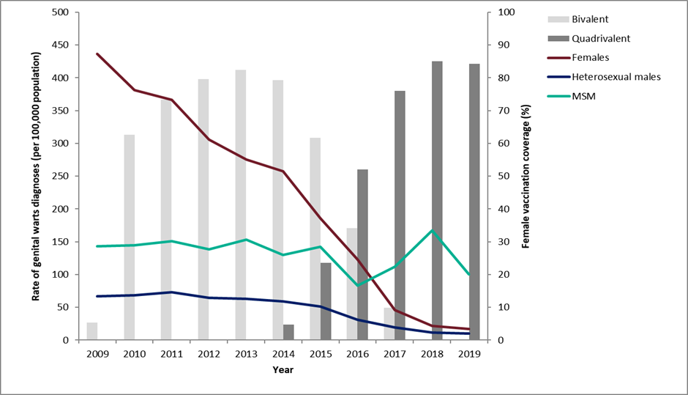
Declines in genital warts diagnoses in England for 15-17 year olds: 2009 to 2020
Notes:
Latest data on declines in GW diagnoses in England.
As reported in latest STI report (https://assets.publishing.service.gov.uk/government/uploads/system/uploads/attachment_data/file/914184/STI_NCSP_report_2019.pdf): In 2019, the rate of genital warts diagnoses among girls aged 15 to 17 years attending SHSs, most of whom would have been offered the quadrivalent HPV vaccine (protecting against HPV types 16,18, 6 and 11) when aged 12 to 13 years old, was 91% lower compared to 2015 (16.9 vs 193.5 per 100,000 population). A decline of 81% (10.0 vs 53.3 per 100,000 population) was seen in same aged heterosexual boys over the same period, suggesting substantial herd protection.

Slide 51


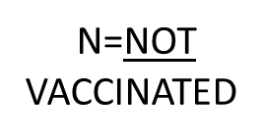







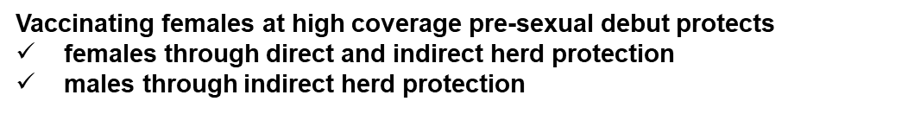
Indirect herd protection through reduced transmission
Notes:
In addition to direct protection to females, the girls only HPV programme induced herd protection, which provides substantial protection to heterosexual boys and men as long as there is high vaccine coverage in girls.

Slide 52
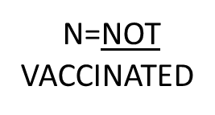

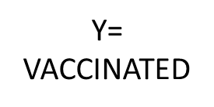




Indirect herd protection through reduced transmission
Notes:
Since the introduction of the adolescent girls programme evidence has emerged that HPV immunisation is likely to provide protection against a wider range of HPV-related diseases including anal, penile and oropharyngeal cancers.
However while the girls’ programme clearly confers indirect protection through reduced transmission to heterosexual males, MSM receive little benefit from it. The extension of the HPV vaccine to boys will confer direct protection to MSM before their sexual debut in future years.

Slide 53
Impact on cervical cancer
In a study published in the Lancet (Falcaro et al 2021), evidence showed that HPV vaccination in England dramatically reduced cervical cancer rates by almost 90% in women in their 20s who were offered vaccine at age 12 to 13.
The HPV immunisation programme has successfully almost eliminated cervical cancer in women born since 1 September 1995
estimates indicate that the HPV vaccination programme has prevented around 450 cervical cancers and 17,200 cases of precancerous conditions over an 11 year period.
Modelling suggests that vaccinated women mat only need 3 cervical screens in the their lifetime (Landy et al 2018)
Notes:
Falcaro et al (2021) The effects of the national HPV vaccination programme in England, UK, on cervical cancer and grade 3 cervical intraepithelial neoplasia incidence: a register-based observational study. The Lancet, 298; 10316 available at: https://www.thelancet.com/journals/lancet/article/PIIS0140-6736(21)02178-4/fulltext
Landy R, Windridge P, Gillman MS, Sasieni PD. What cervical screening is appropriate for women who have been vaccinated against high risk HPV? A simulation study. Int J Cancer. 2018 Feb 15;142(4):709-718. doi: 10.1002/ijc.31094. Epub 2017 Nov 10. PMID: 29023748; PMCID: PMC5765470. Available at: www.ncbi.nlm.nih.gov/pmc/articles/PMC5765470/

Slide 54
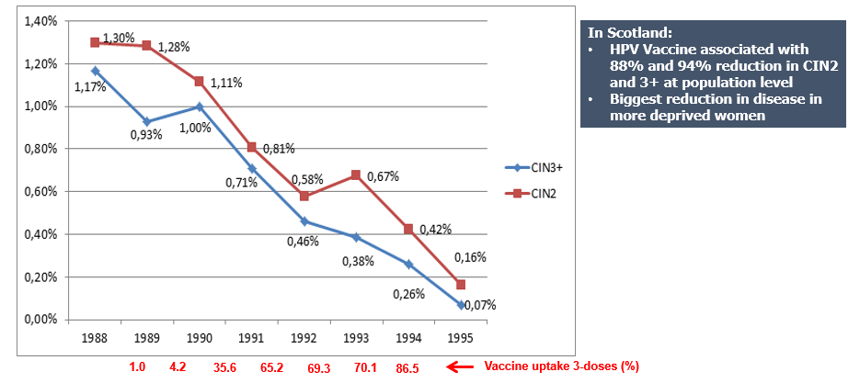
Percentage of 20 year old women diagnosed with
CIN 2/CIN 3+ by birth cohort year
Notes:
Pollock KG, Kavanagh K, Potts A et al. Reduction of low- and high-grade cervical abnormalities associated with high uptake of the HPV bivalent vaccine in Scotland. Br J Cancer 2014;111:1824–1830. doi: 10.1038/bjc.2014.479

Slide 55
Welsh National coverage and impact on coverage due to COVID-19
Due to the COVID-19 pandemic, all educational settings in Wales were closed from the 23 March 2020 and the delivery of the 2019/20 school immunisation programmes was paused. From 1 June 2020 some schools partially re-opened for some year groups for a mini summer term and all schools fully re-opened for the 2020 to 2021 academic year.
Despite the challenges posed by the COVID-19 pandemic the routine school-aged HPV immunisation programme was delivered throughout Wales in the 2020/21 academic year. This was delivered alongside an ongoing offer of catch-up for the cohorts who missed out on their vaccines in the 2019/20 academic year.
In 2020 to 2021, 39.8% of Year 9 females completed the 2-dose HPV vaccination course in 2020 to 2021, compared with 52.6% in 2019 to 2020.
HPV vaccine coverage for the priming dose in 2020 to 2021 was 74.9% in Year 8 females (compared with 59.4% in 2019 to 2020) and 69.0% in Year 8 males (compared with 53.4% in 2019 to 2020).

Slide 56
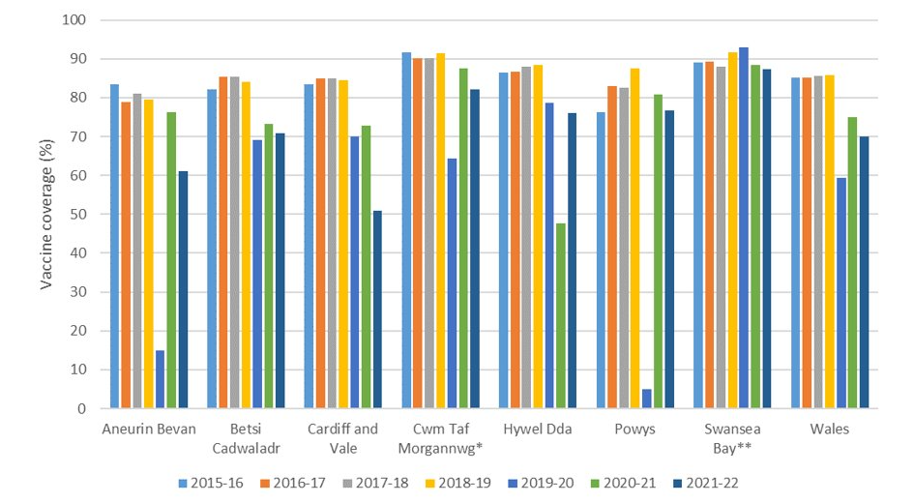
Dose 1 (priming) HPV vaccine coverage by NHS Wales Health Board for the routine female cohort (Year 8) in academic years 2015/16 to 2021/22: Wales
Coverage as reported at the end of the September to August academic year
*Prior to 2018/19, data is given for Cwm Taf University Health Board
**Prior to 2018/19, data is given for Abertawe Bro Morgannwg University Health Board
Notes:
The Coverage of Vaccination Evaluated Rapidly (COVER) reports are available here: https://phw.nhs.wales/topics/immunisation-and-vaccines/cover-national-childhood-immunisation-uptake-data/

Slide 57
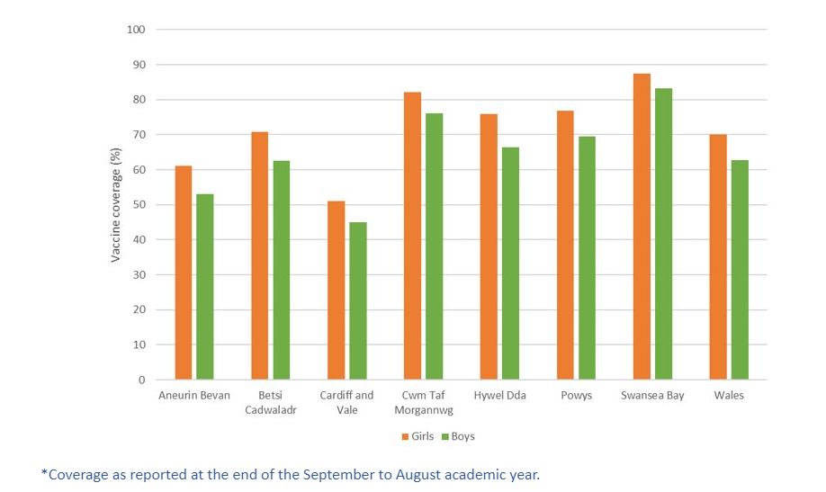
Dose 1 (priming) HPV vaccine coverage by NHS Wales Health Board for female and male cohorts (Year 8) in academic year 2021/22: Wales
Notes:
The Coverage of Vaccination Evaluated Rapidly (COVER) reports are available here: https://phw.nhs.wales/topics/immunisation-and-vaccines/cover-national-childhood-immunisation-uptake-data/

Slide 58
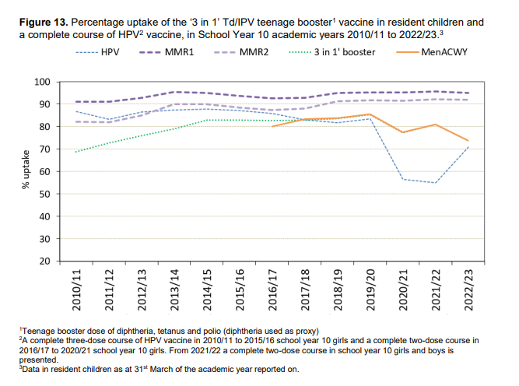
COVER annual report 2023
Coverage of immunisations in teenagers in Wales is lower compared to previous years.
School based vaccination sessions were disrupted during the 2020/21 academic year due to school closures – catch up activities were planned.
Of all the vaccinations given to teenagers, HPV uptake continues to be the most impacted by school closures during the COVID-19 pandemic period.
Uptake of 2 doses of HPV vaccine has improved between 31 March 2022 and 31 March 2023
Final uptake figures for the academic year at the end of July will be higher
Notes:
COVER annual report 2023: https://phw.nhs.wales/topics/immunisation-and-vaccines/cover-national-childhood-immunisation-uptake-data/cover-archive-folder/annual-reports/vaccine-uptake-in-children-in-wales-cover-annual-report-2023/

Slide 59
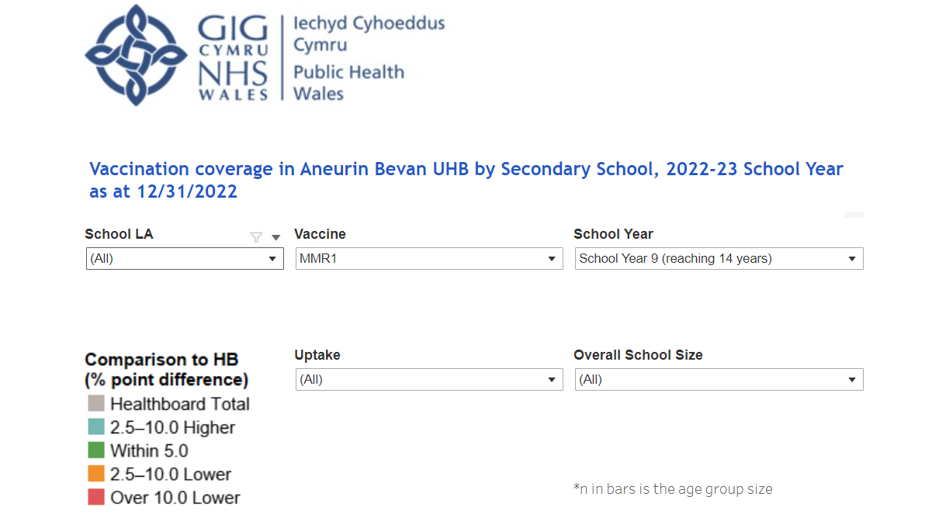
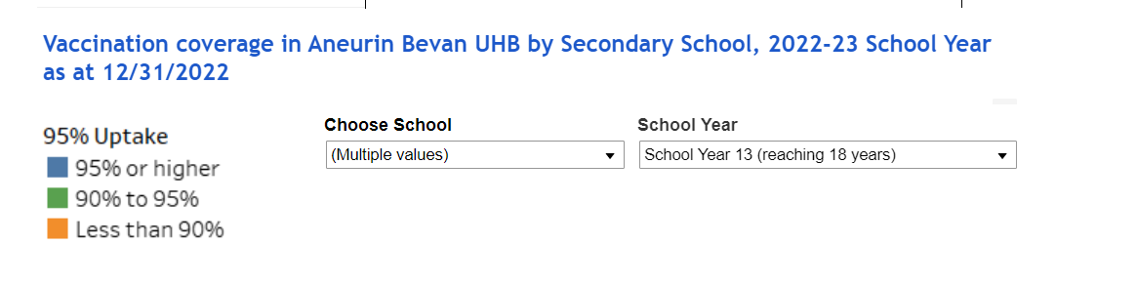
School level data dashboard
In February 2023, school level immunisation data dashboards were made available on SharePoint (NHS intranet only)
The dashboards are health board specific and primary school and secondary school dashboards are separate.
The data is based on the most recent quarterly COVER report
Its an interactive dashboard and can be refined to show:
  specific vaccination uptake by local authority, year group, by vaccine, school size and uptake ranges
  Individual school level uptake by year group
Notes:
See ‘Quarterly dashboards’ under each health board name here: https://nhswales365.sharepoint.com/sites/PHW_VPDPComms/SitePages/Childhood-Immunisation-(COVER).aspx

Slide 60
Why data flow matters
HPV vaccination status on the Children and Young Persons Integrated System (CYPriS) and GP records should be used to ensure eligible individuals who are not up to date are caught up before their 25th birthday.

Slide 61
Wales Attitudinal Survey
From the summer of 2021 the COVID-19 and flu vaccination programmes were extended to secondary school aged children and young people
In late 2021, PHW commissioned BMG to conduct a study to explore parent and young people’s attitudes towards the COVID-19 and flu vaccines
Although the study focussed on COVID-19 and flu vaccination, it also collected information relating to vaccinations in general and other school aged vaccinations
Findings were that:
  Parental and young people awareness was higher for flu and COVID-19 vaccination than other routine adolescent vaccinations
  Apart from healthcare sources, social media, family and television are important sources of information on vaccination for young people
  Health professionals and school are the most trusted sources of information. While social media came at the bottom in terms of trust, around 7 in 10 trust social media at least to come extent
  Trust in the safety of routine adolescent vaccinations is high for both parents and young people
  Around 2 in 5 parents and young people are not aware that young people aged 13 and above may be able to give consent for vaccines.
  Young people want to decide themselves or make a joint decision with parents about whether they receive a vaccine.
Notes:
From summer 2021 onwards, the vaccination programme in Wales was extended: NHS Wales began offering the COVID-19 vaccine to all children and young people aged 12 years and over, as well as extending the flu programme to secondary school ages 11-16.
Attitudes towards COVID-19 and Flu Immunisations among Young People and Parents: phw.nhs.wales/news/parents-and-young-people-urged-to-use-trusted-sources-for-vaccine-information/attitudes-towards-covid-19-and-flu-immunisations-among-young-people-and-parents/

Slide 62
Vaccine safety monitoring
The safety of the HPV vaccine has been established through rigorous testing in clinical trials, followed by extensive use with more than 500 million doses given across the world
Some people may experience a mild side effect, but these are generally short lived and are far outweighed by the expected benefits of the vaccine
The Medicines and Healthcare products Regulatory Agency (MHRA):
monitors safety of vaccination programmes
volume of suspected side effects reported via the Yellow Card Scheme for HPV is not unusual. Overwhelming majority relate to possible side-effects that might result from any adolescent vaccination programme – such as injection site reactions, rashes, mild allergic events, nausea, dizziness, fatigue, immediate faints due to needle phobia
a Yellow Card report is not proof of a side effect, but a suspicion by the reporter that the reaction may have been caused by the vaccine

Slide 63
Vaccine safety reviews
JCVI carried out a routine review of HPV vaccine safety in 2015 and concluded that it had no concerns about the safety of the HPV vaccine.
Extensive reviews of HPV vaccine safety have also been undertaken by various independent health bodies and authorities worldwide:
MHRA
World Health Organization’s Global Advisory Committee on Vaccine Safety
European Medicines Agency
US Centre for Disease Control and Prevention
Health Canada
All concluded that the evidence does not support a link between HPV vaccine and the development of a range of chronic illnesses.
Since licenced in 2006, over 500million doses of HPV vaccine have been distributed. Post licence surveillance has detected no serious safety issues, except rare reports of anaphylaxis¹.
Notes:
1. World Health Organisation: Weekly epidemiological record 16 December 2022 http://apps.who.int/iris/bitstream/handle/10665/365350/WER9750-eng-fre.pdf

Slide 64
Summary
HPV vaccine is not a new vaccine.
There has been a high uptake of the HPV vaccine in over 80 countries around the world to date and millions of doses have been given.
Evidence from the UK and around the world that high coverage of HPV vaccine in girls is providing substantial herd protection in unvaccinated girls and boys.
In 2018, no HPV16 and/or 18 infections detected in 16 to 18 year old girls indicating both direct and indirect protection.
The rate of genital warts among 15 to 17 year old girls in 2019 was 91% lower than the rate in 2015.
HPV vaccination in England dramatically reduced cervical cancer rates by almost 90% in women in their 20s who were offered vaccine at age 12 to 13.
HPV vaccine does not protect against all HPV types so cervical screening is still important and should be carried out according to the local screening programme.
The COVID-19 pandemic and subsequent school closures impacted delivery of the HPV vaccine programme in the 2019 to 2020 and 2020 to 2021 academic years and affected children should be caught up as soon as possible. School-based delivery of the HPV programme (including catch-up) is associated with higher vaccine uptake and lower inequalities.
From March 2023 Gardasil 9 is now the only vaccine used in the HPV vaccination programme
From 1 September 2023 adolescents and eligible adults under 25 (including MSM) will only require 1-dose of HPV vaccine to be fully vaccinated.

Slide 65
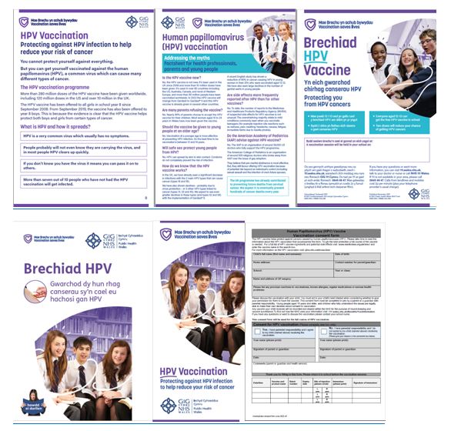
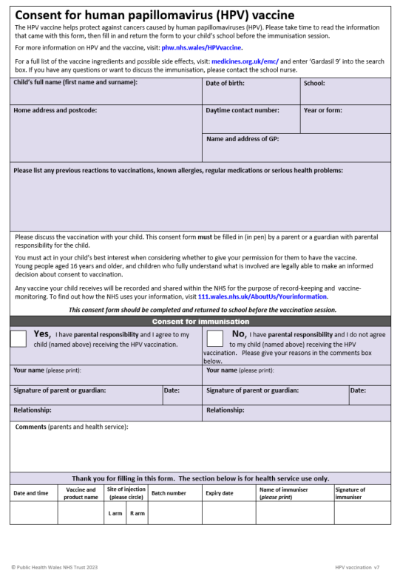
Information materials
A number of public facing resources are already available for the HPV vaccination programme
Resources can be downloaded from: HPV vaccine - Information for health professionals page on the Public Health Wales website
Hard copies of branded resources can be ordered from: phw.nhs.wales/services-and-teams/health-information-resources/
Note: Resources are being updated in readiness for the change to 1-dose in September and will be available at the links above in due course.

Slide 66
Resources and additional information (1)
UKHSA Immunisation against infectious diseases The Green Book: Human papillomavirus (HPV) Chapter18a: www.gov.uk/government/publications/human-papillomavirus-hpv-the-green-book-chapter-18a
HPV guidance for healthcare practitioners: www.gov.uk/government/publications/hpv-universal-vaccination-guidance-for-health-professionals
Summary of Product Characteristics for Gardasil 9: www.medicines.org.uk/emc/product/7330/smpc
JCVI statement on HPV vaccination of men who have sex with men November 2015: www.gov.uk/government/publications/jcvi-statement-on-hpv-vaccination-of-men-who-have-sex-with-men
CEM/CMO/2022/12 Changing to a two-dose NHS Human Papillomavirus (HPV) vaccination schedule for eligible adolescents and adults starting the course after they turn 15 years old, including men who have sex with men (MSM), March 2022: Vaccine Preventable Disease Programme (VPDP) - Changing to a two-dose NHS Human Papillomavirus (HPV) vaccination schedule (2022).pdf - All Documents (sharepoint.com)
WHC/2022/015 Changes to the vaccine for the HPV immunisation programme. June 2022: https://www.gov.wales/changes-vaccine-hpv-immunisation-programme-whc2022015
JCVI statement on a one-dose schedule for the routine HPV immunisation programme August 2022 https://www.gov.uk/government/publications/single-dose-of-hpv-vaccine-jcvi-concluding-advice/jcvi-statement-on-a-one-dose-schedule-for-the-routine-hpv-immunisation-programme
WHC/2022/023 Changes to the vaccine for the HPV immunisation programme, Sept 2022: https://www.gov.wales/changes-vaccine-hpv-immunisation-programme-whc2022023
WHC/2023/016 HPV immunisation programme update, May 2023: https://www.gov.wales/hpv-immunisation-programme-update-whc2023016

Slide 67
Resources and additional information (2)
NHS 111 Wales: NHS 111 Wales - Health A-Z : Human papillomavirus (HPV)
Resources can be ordered from Health Information Resources: phw.nhs.wales/services-and-teams/health-information-resources/
HPV vaccine – Information for the public: phw.nhs.wales/HPVvaccine
HPV vaccine - Information for health professionals: phw.nhs.wales/topics/immunisation-and-vaccines/vaccine-resources-for-health-and-social-care-professionals/hpv/
Cervical Screening Wales: phw.nhs.wales/services-and-teams/cervical-screening-wales/
Jo’s Cervical Cancer Trust: www.jostrust.org.uk
WHO Immunization Resource Centre: Vaccines and immunization (who.int)
Attitudes towards COVID-19 and Flu Immunisations among Young People and Parents: phw.nhs.wales/news/parents-and-young-people-urged-to-use-trusted-sources-for-vaccine-information/attitudes-towards-covid-19-and-flu-immunisations-among-young-people-and-parents/
Optimising Vaccine Uptake: Using motivational interviewing for better conversations eLearning available on ESR and here: https://phw.nhs.wales/topics/immunisation-and-vaccines/immunisation-elearning/

