Slide 1
Vaccination against Pneumococcal disease for older adults and people at risk
Vaccine Preventable Disease Programme
Public Health Wales
Version 1. 23 December 2025
Notes:
Material contained in this document may be reproduced without prior permission provided it is done so accurately and is not used in a misleading context.
Acknowledgement to Public Health Wales NHS Trust to be stated.
© 2025 Public Health Wales NHS Trust.

Slide 2
Vaccination against Pneumococcal disease
The information contained within this slide set is up to date as of 23.12.2025
It is important that all immunisers delivering the pneumococcal vaccination programme for older adults and people at risk and/ or those who are providing immunisation advice familiarise themselves with the most up to date clinical evidence and guidance, this can be found in the following key documents:
The Green Book: Pneumococcal: the green book, chapter - GOV.UK
Welsh Health Circular: A change of vaccine product for the routine adult pneumococcal vaccination programme, and those with certain clinical risk conditions (WHC/2025/054)
UKHSA Pneumococcal (Adult and individuals at increased clinical risk) Information for Healthcare Professionals: Anticipated in due course Pneumococcal vaccination programmes for infants, adults and individuals at increased clinical risk - GOV.UK
Joint Committee on Vaccination and Immunisation: JCVI Minutes from meeting held 07 June 2023
PHW VPDP webpage is available here: Pneumococcal vaccine for older adults and people at risk - Public Health Wales**Currently being updated**
The content of this training slide set is subject to review. This resource will be version controlled. This is version 1, (23.12.2025)
Notes:
Pneumococcal vaccination: product change (WHC/2025/054) | GOV.WALES

Slide 3
Acknowledgements
Vaccine Preventable Disease Programme (VPDP), Public Health Wales: Immunisation and Vaccines - Public Health Wales
Vaccine Programme Wales (VPW)
UK Health Security Agency: www.gov.uk/government/topics/public-health
Welsh Government

Slide 4
Notes to users
This slide set contains a collection of core slides for both individual use and for use or adaptation during the delivery of pneumococcal vaccination training
Trainers should select the slides required depending on the background and experience of the healthcare practitioners they are training and according to the role they will have in delivering the pneumococcal vaccine programme
The information in this slide set (version 1) was correct at time of publication
Updates to the slide set may be required in the future, for example in response to changing epidemiology or vaccination recommendations - please check online to ensure you are using the latest version of these slides

Slide 5
Contents
Section | Slide number
Aims | 6
Objectives | 7
Pneumococcal disease | 8
Pneumococcal vaccination programme | 12
Pneumococcal vaccines | 21
Vaccine administration | 27
Summary & resources | 46

Slide 6
Aims
To provide information for healthcare practitioners involved in advising on and delivering the pneumococcal vaccination programme for older adults and people at risk
To raise awareness of the current epidemiology of pneumococcal and the impact
To describe the vaccination programme details including administration of the vaccine, eligibility, recommended dosage and schedule, contraindications, precautions and potential adverse reactions
To raise awareness of the impact of the pneumococcal vaccination programme
To highlight resources that support the pneumococcal vaccination programme

Slide 7
Objectives
After completing this resource immunisers will be able to:
Describe the aetiology and epidemiology of pneumococcal disease
Understand the rationale and evidence base for the pneumococcal vaccination programme for older adults and people at risk
Discuss the benefits of vaccination against pneumococcal
Gain essential knowledge to administer the pneumococcal vaccine safely
Identify relevant resources and additional information in relation to the pneumococcal vaccination programme for older adults and people at risk

Slide 8
Pneumococcal disease

Slide 9
Pneumococcal disease
Pneumococcal disease is the term used to describe infections caused by the bacterium Streptococcus pneumoniae (also called pneumococcus)
Streptococcus pneumoniae is an encapsulated Gram-positive coccus
Over 100 capsular types
There is a seasonal variation in pneumococcal disease, with peak levels in the winter months
Invasive Pneumococcal Disease (IPD) is a major cause of morbidity and mortality
Green Book Chapter 25 - pneumococcal

Slide 10
Epidemiology of pneumococcal disease
IPD particularly affects the very young and elderly, and those with impaired immunity and other underlying medical conditions
Recurrent infections may occur in association with skull fractures, skull defects, cerebrospinal fluid (CSF) leaks and cochlear implants
Pneumococcal pneumonia is the most common clinical presentation of pneumococcal disease among adults*
Pneumococci is the most common bacterial cause of childhood pneumonia especially in children under 5year*
Pneumococcal disease is a leading cause of bacterial pneumonia, meningitis, and sepsis in children at present (2021)**
Notes:
References:
Pneumococcal: the green book, chapter 25 - GOV.UK
*Chapter 17: Pneumococcal Disease | Pink Book | CDC
**Review on Pneumococcal Infection in Children – PMC (2021)

Slide 11
Carriage, transmission, and infection
Some pneumococcal serotypes may be carried in the nasopharynx without symptoms, with disease occurring in a small proportion of infected individuals
Other serotypes are rarely identified in the nasopharynx but are associated with invasive disease
Transmission is by aerosol, droplets or direct contact with respiratory secretions of someone carrying the organism. Transmission usually requires either frequent or prolonged close contact
The incubation period for pneumococcal disease is not clearly defined but it may be as short as one to three days
May present as sinusitis, otitis media, pneumonia or systemic (invasive) infections including bacteraemic pneumonia, sepsis and meningitis
Notes:
Pneumococcal: the green book, chapter 25 - GOV.UK

Slide 12
Pneumococcal vaccination programme

Slide 13
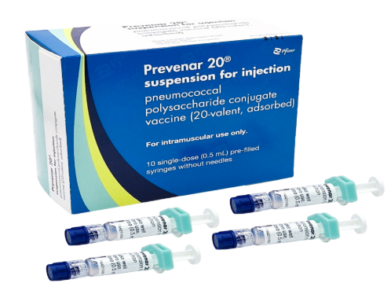

Pneumococcal product change expected
Prevenar 20® (PCV20) is expected to replace Pneumovax 23® (PPV23) in adults over 65 years and the at-risk programme in early 2026
In June 2023, the JCVI advised that either PPV23 or PCV20 could be used in the adult and at-risk programmes. [JCVI Minutes from meeting held 07 June 2023]
Vaccine supply
  PPV23 central supply will be run down (likely Jan/Feb 2026) and PCV20 will become available to order.
Image source: UKHSA (2025)
Image source: UKHSA (2025)
Notes:
JCVI interim statement on adult pneumococcal vaccination - GOV.UK
Pneumococcal vaccination: product change (WHC/2025/054) | GOV.WALES

Slide 14

Welsh Health Circular
Welsh Government. Welsh Health Circular: A change of vaccine product for the routine adult pneumococcal vaccination programme, and those with certain clinical risk conditions (WHC/2025/054) [17 December 2025]
The WHC/2025/054 contains information about the change to the vaccine used for the routine adult pneumococcal vaccination programme and for people with certain clinical risk conditions.
Active call and recall for pneumococcal vaccination must be in place for everyone eligible:
  For the infant program, call and recall is provided through the child health system (CYPrIS).
  For the older adult program, to align with other programmes, practices should offer vaccination within 12 weeks of a person becoming eligible
You can view the WHC/2025/054 here

Slide 15
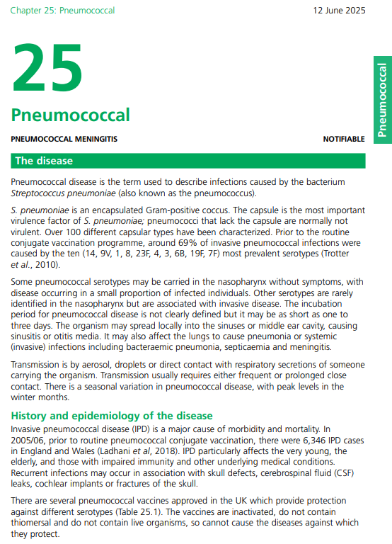
Green Book Pneumococcal chapter updated
Green Book has been updated with information on PCV 20 (Prevenar 20®)
PCV20 is licensed for use from 6 weeks of age*
PCV20 is expected to replace PPV23 in adults over 65 years and the at-risk programme in Jan/Feb 2026
Immform is the ordering platform for pneumococcal vaccines
Green Book Chapter - pneumococcal
Notes:
* Updated since JCVI minutes 2023. (SmPC: Prevenar 20 suspension for injection in pre-filled syringe - Summary of Product Characteristics (SmPC) - (emc) | 13461).
Pneumococcal vaccination: product change (WHC/2025/054) | GOV.WALES

Slide 16
Eligible groups
People aged 65 years and over
People aged 2 years of age and over in a clinical risk group (refer to Green Book: Pneumococcal Chapter Table 25.2)
Children under 2 years of age with asplenia, splenic dysfunction, complement disorder or severe immunocompromise (refer to Green Book: Pneumococcal Chapter Table 25.2 and Table 25.3)
Notes:
Refer to GBC Pneumococcal: the green book, chapter 25 - GOV.UK for details of when vaccine required in individuals with a clinical risk refer to table 25.2 and 25.3.
Refer to Welsh Government. Welsh Health Circular: A change of vaccine product for the routine adult pneumococcal vaccination programme, and those with certain clinical risk conditions (WHC/2025/054) for eligible groups

Slide 17
Dosage and schedule (1)
Adults aged 65 years and over, and clinical risk groups aged 2 years or over*:
  a single dose of 0.5ml of PPV23 or PCV20 (when available)
Individuals with asplenia, splenic dysfunction (including sickle cell disease) or chronic renal disease:
  re-immunisation with PPV23 or PCV20 (when available) is recommended every five years in these groups
Children under 2 years of age with asplenia, splenic dysfunction, complement disorder or severe immunocompromise should also receive PCV20 (when available)*
Revaccination with PPV23 or PCV20 is currently not recommended for any other clinical risk groups or age groups
Notes:
*Refer to GBC Pneumococcal: the green book, chapter 25 - GOV.UK for details of when vaccine required in individuals with a clinical risk refer to table 25.2 and 25.3.
Refer to Welsh Government. Welsh Health Circular: A change of vaccine product for the routine adult pneumococcal vaccination programme, and those with certain clinical risk conditions (WHC/2025/054) for eligible groups

Slide 18
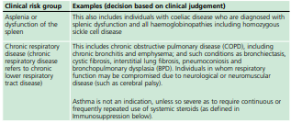
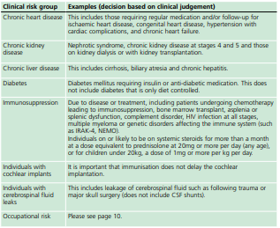
Dosage and schedule (2)
Clinical risk groups who should receive pneumococcal immunisation
Refer to: Green Book: Pneumococcal chapter:
Table 25.2 Clinical risk groups who should receive pneumococcal immunisation

Slide 19
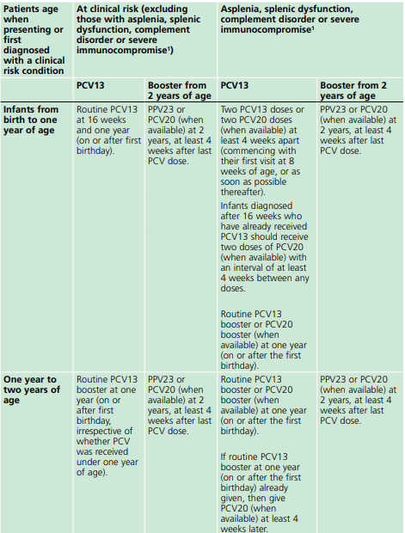
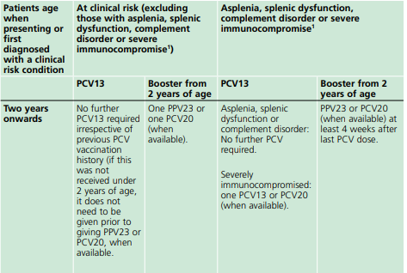
Dosage and schedule (3)
PPV23 and PCV20
Adults aged 65 years and over, and clinical risk groups* aged 2 years or over:
a single dose of 0.5ml of PPV23 or PCV20 (when available)
PCV20 is expected to replace PPV23 in adults over 65 years and the at-risk programme in Jan/Feb 2026
Children under 2 years of age with:
  asplenia*
  splenic dysfunction*
  complement disorder or
  severe immunocompromise
Should receive PCV20 (when available). See Table 25.3 for details.
Table 25.3 – Summary of vaccine doses for individuals in a clinical risk group
¹ Examples of severe immunocompromise include bone marrow transplant patients, patients with acute and chronic leukaemia, multiple myeloma or genetic disorders affecting the immune system (such as IRAK-4, NEMO).
Note that bone marrow transplant recipients will require two doses of PCV13 or PCV20 (when available) given at a minimum 4-week interval, followed by PPV23 or PCV20 (when available) at least 4 weeks later**.
Green Book Chapter - pneumococcal
Notes:
*Antibody levels are likely to decline rapidly in individuals with asplenia, splenic dysfunction (including sickle cell disease) or chronic renal disease (Giebink et al., 1981; Rytel et al., 1986) and, therefore, re-immunisation with PPV23 or PCV20 (when available) is recommended every five years in these groups. Testing of antibody levels prior to vaccination is not required for these or any other risk groups. Revaccination with PPV23 or PCV20 is currently not recommended for any other clinical risk groups or age groups.
**Please note the information in the Pneumococcal: the green book, chapter 25 - GOV.UK is expected to be updated to reflect a 4-week interval in due course.

Slide 20
Dosage and schedule: common scenarios
If an individual has already received PPV23 because they are in a clinical risk group, they do not require another dose at 65 years of age, irrespective of the interval since they received PPV23
Whilst PPV23 is being supplied for the routine programme for adults aged 65 years and over, if an individual not in a risk group becomes eligible for PPV23 at age 65 years but has already received PCV20, PPV23 can still be offered at any interval after this but it is recommended that a minimum 4-week interval is observed
Once PCV20 has replaced PPV23, if an individual has already received PCV20 because they are in a clinical risk group, they do not require another dose at 65 years of age, irrespective of the interval since they received PCV20
Notes:
Pneumococcal: the green book, chapter 25 - GOV.UK

Slide 21
Pneumococcal vaccines:
Prevenar 20® (PCV20)
Pneumovax 23® (PPV23)

Slide 22
Prevenar 20® vaccine
Full product name: Prevenar 20 suspension for injection in pre-filled syringe
Type of vaccine: Pneumococcal polysaccharide conjugate vaccine (20 valent, adsorbed)
Marketed by: Pfizer Limited
Black triangle medicine: Yes
Contains Polysorbate 80
The tip cap is synthetic isoprene/bromobutyl blend rubber
The plunger stopper is chlorobutyl rubber
Considered latex free
Prevenar 20® is licensed for IM injection only
Will be available to order on ImmForm for eligible patients when available (anticipated Jan/Feb 2026)
Image source:UKHSA (2025)
Refer to SmPC for vaccine contents and excipients
Notes:
Prevenar 20 suspension for injection in pre-filled syringe - Summary of Product Characteristics (SmPC) - (emc) | 13461

Slide 23
Prevenar 20® vaccine composition and excipients
Vaccine type | Licensed vaccine | Serotypes covered
Pneumococcal conjugate vaccine (PCV20) | Prevenar 20® | 1, 3, 4, 5, 6A, 6B, 7F, 8, 9V, 10A, 11A, 12F, 14, 15B, 18C, 19A, 19F, 22F, 23F, 33F
Prevenar 20® contains the following excipients:
Sodium chloride
Succinic acid
Polysorbate 80
Water for injections
Polysorbate 80
Rarely, people may be allergic to polysorbate 80. However, polysorbate 80 is widely used in medicines and foods, and is present in many medicines including monoclonal antibody preparations
Some vaccines (such as the main injected influenza vaccines for individuals aged 65 years and above) contain polysorbate 80. It is also commonly used in foods such as ice cream, and other frozen desserts. It is likely that people will know if they are allergic to it and individuals who have tolerated injections that contain polysorbate 80 are likely to tolerate the Prevenar 20® vaccine
Prevenar20® SmPC

Slide 24
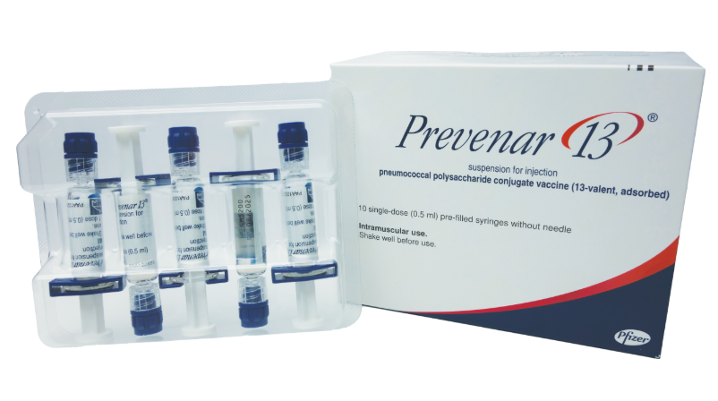
Prevenar 20® packaging
**PLEASE NOTE**
There are some similarities between the pre-filled syringes of Prevenar 20® and Prevenar 13®
Prevenar 20®
Prevenar 13®
Image source: UKHSA (2025)
Image source: UKHSA (2025)
Notes:
UKHSA (2025) A visual guide to vaccines - GOV.UK

Slide 25
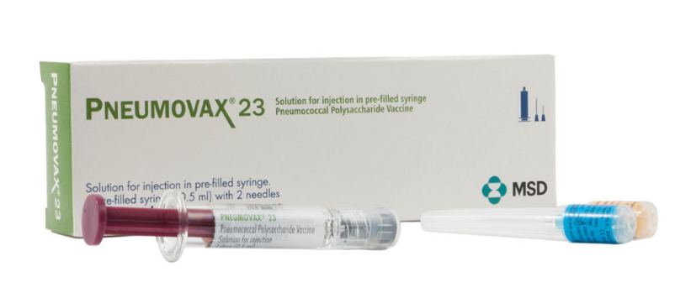
Pneumovax 23® vaccine
Full product name: Pneumovax 23® solution for injection in pre-filled syringe
Type of vaccine: Pneumococcal polysaccharide vaccine
Manufactured by: Pfizer Limited
Black triangle medicine: No
The tip cap is isoprene bromobutyl blend-polyisoprene or styrene-butadiene rubber
The plunger stopper is bromobutyl elastomer
Considered latex free
Pneumovax 23® is licensed for IM or subcutaneous injection
Available to order on ImmForm for eligible patients
Image source: UKHSA (2025)
Refer to SmPC for vaccine contents and excipients
Notes:
Pneumovax 23 solution for injection in pre-filled syringe - Summary of Product Characteristics (SmPC) - (emc) | 9692

Slide 26
Pneumovax 23® vaccine composition and excipients
Vaccine type | Licensed vaccine | Serotypes covered
Pneumococcal polysaccharide vaccine (PPV23) | Pneumococcal Polysaccharide Vaccine® | 1, 2, 3, 4, 5, 6B, 7F, 8, 9N, 9V, 10A, 11A, 12F, 14, 15B, 17F, 18C, 19F, 19A, 20, 22F, 23F, 33F
Pneumovax 23® contains the following excipients:
  Phenol
  Sodium chloride
  Water for injections
Excipient(s) with known effect:
Sodium less than 1 mmol (23 mg) per dosage unit.
Expiry date of latest PPV23 batch:
31 December 2026
Pneumococcal 23® SmPC

Slide 27
Vaccine administration

Slide 28
Pre-requisites to administering pneumococcal vaccine
Before administering a pneumococcal vaccine, it is recommended that:
*Those new to immunisation should receive comprehensive foundation immunisation training. Both knowledge and clinical competence should be assessed before new immunisers start to give and/or advise about the pneumococcal vaccine Immunisation training standards for healthcare practitioner UK Health Security Agency - UKHSA)
Immunisers have received pneumococcal vaccine training through attending a taught session and/or eLearning Immunisation eLearning - Public Health Wales (nhs.wales)​
Immunisers have received practical training in pneumococcal vaccine preparation and administration (if required)
​Training in the management of anaphylaxis and Basic Life Support is undertaken, as specified by policy for your local area and are familiar with Resuscitation Council UK (RCUK) guidance on Management of Anaphylaxis in the Vaccination Setting
Any additional statutory and mandatory training as required by your employer is completed
An appropriate legal framework to supply and administer Pneumococcal vaccine is in place e.g. Written prescription, Patient Specific Direction (PSD), or Patient Group Direction (PGD). Visit here for UKHSA PGD template
Those involved in immunisation and vaccination understand the process of consent and how this applies when giving vaccines. Information on consent can be viewed here: Consent: the green book, chapter 2 - GOV.UK
Immunisers and those giving immunisation advice access and familiarise themselves with the following key documents: Pneumococcal: the green book, chapter - GOV.UK, UKHSA Pneumococcal (Adult and individuals at increased clinical risk): Information for healthcare practitioners (when available): Pneumococcal vaccination programmes for infants, adults and individuals at increased clinical risk . The vaccine product information in the Summary of Product Characteristics (Electronic Medicines Compendium website)
Notes:
*This should be either through a face to face taught course or a blended approach of both e-learning and a face to face taught course. New immunisers should also have a period of supervised practice and support with a registered healthcare practitioner who is experienced, up to date and competent in immunisation.
Practitioners should always ensure they are accessing the most up to date information and guidance.

Slide 29
Prescription only medication (POM)
Pneumococcal vaccine should only be administered using a:
Prescription written manually or electronically by a registered medical practitioner or other authorised prescriber.
Patient specific direction (PSD).
Patient group direction (PGD).
UK Health Security Agency (UKHSA) provide updated PGD templates (Patient Group Directions) which are available here: Welsh Medicines Advice Service (WMAS). These are template PGD’s that can be amended locally by health boards
NB: Local authorisation is required before PGD templates can be used.

Slide 30
Contraindications
There are very few individuals who cannot receive pneumococcal vaccines
The vaccines should not be given to those who have had:
a confirmed anaphylactic reaction to a previous dose of a pneumococcal vaccine
a confirmed anaphylactic reaction to any component or residue from the manufacturing process (NB. including diphtheria toxoid for PCV20)
Notes:
Pneumococcal: the green book, chapter 25 - GOV.UK
Prevenar 20 suspension for injection in pre-filled syringe - Summary of Product Characteristics (SmPC) - (emc) | 13461
Pneumovax 23 solution for injection in pre-filled syringe - Summary of Product Characteristics (SmPC) - (emc) | 9692

Slide 31
Precautions (1)
Minor illness:
Minor illnesses, without fever or systemic upset, are not valid reasons to postpone immunisation. If an individual is acutely unwell, immunisation may be postponed until they have fully recovered. This is to avoid confusing the differential diagnosis of any acute illness by wrongly attributing any signs or symptoms to the adverse effects of the vaccine.
Thrombocytopenia and coagulation disorders:
The vaccine must be administered with caution to individuals with thrombocytopenia or a bleeding disorder since bleeding may occur following an intramuscular administration. The risk of bleeding in patients with coagulation disorders needs to be carefully evaluated before intramuscular administration of any vaccine, and subcutaneous administration should be considered if the potential benefit clearly outweighs the risks.
Immunosuppression and HIV infection:
Individuals with immunosuppression and HIV infection (regardless of CD4 count) should be given pneumococcal vaccines according to the recommendations above. The potential benefit of PPV23 (and PCV20 when available) in preventing pneumococcal disease outweighs any potential risks in HIV- infected adults.
However, these individuals may not mount as good an antibody response as immunocompetent individuals
Notes:
Pneumococcal: the green book, chapter 25 - GOV.UK
Prevenar 20 suspension for injection in pre-filled syringe - Summary of Product Characteristics (SmPC) - (emc) | 13461
Immunisation of individuals with underlying medical conditions: the green book, chapter 7 - GOV.UK

Slide 32
Precautions (2)
Pregnancy and breast-feeding
Pneumococcal vaccines may be given to pregnant women when the need for protection is required without delay. There is no evidence of risk from vaccinating pregnant women or those who are breast-feeding with inactivated viral or bacterial vaccines or toxoids.
Notes:
Pneumococcal: the green book, chapter 25 - GOV.UK

Slide 33
Before administering a vaccine
Before administering a vaccine, the individual should be assessed to ensure that:
there are no contraindications to the vaccine being given
they have not experienced any serious reactions to a previous dose or component of the vaccine
they or their carer is fully informed about the vaccine to be given and understand the vaccination procedure
they or their carer are aware of possible adverse reactions to the vaccine and how to treat them
appropriate consent is obtained
Immunisers should ensure that:
they have the appropriate knowledge and legal authority to administer the vaccine
the vaccine has been properly stored and prepared for use and that they know where and how to administer it

Slide 34
Consent
Before vaccinating, ‘informed’ consent must be obtained
Informed consent is a legal requirement, and the individual’s views must be respected
Sufficient evidence-based information must be provided to enable the person to make a balanced and informed decision about their care and treatment
Consent can be given verbally, in writing or it can be implied, but however it is given, the person must understand what they are consenting to
Consent is a process and can be withdrawn
Notes:
Before giving pneumococcal vaccine, immunisers must ensure that they have obtained informed consent from the individual or that a best interest decision has been made if the individual does not have mental capacity at the time of vaccination.
In order to be able to consent to vaccination, the vaccinee should receive an explanation of the treatment and its benefits and risks, either verbally from a clinician, or in the form of a leaflet and letter.
When assessing capacity to consent, the immuniser should be guided by the principles of the Mental Capacity Act (2005). This Act applies to those aged 16 years and over and is designed to protect and empower people who may lack the mental capacity to make their own decisions about their care and treatment.
Consent is a process, not a one-off discussion and must consider 3 factors:
the person giving consent must be appropriately informed: they must have the necessary information in order to make the decision
consent must be voluntary by the individual without undue pressure or coercion
the person consenting must have the capacity to make the decision

Slide 35
Informed consent
How much information should you give?
this will be personal to the individual at the time and will depend on their previous knowledge and discussions with others
give people as much information as they need and/or want to make an informed decision
some people will just ‘trust’ what you say while others want lots of information; either is fine
how much each individual needs is up to them, no one is obliged to seek full information
Information to be given includes:
which vaccine is being offered and the disease against which it protects
benefits/risks of immunisation versus risks of the disease​
any possible vaccine reactions and what to do if these occur
Consent is a process, not a one-off discussion and must consider 3 factors:
the person giving consent must be appropriately informed: they must have the necessary information in order to make the decision
consent must be voluntary by the individual without undue pressure or coercion
the person consenting must have the capacity to make the decision
Mental capacity Act 2005: https://www.legislation.gov.uk/ukpga/2005/9/contents
Consent: the green book, chapter 2 - GOV.UK (www.gov.uk)
Notes:
If there are any issues or uncertainties with seeking or gaining consent, ask for advice from an experienced colleague rather than abandon the offer of immunisation

Slide 36
Vaccination intramuscular administration
Giving vaccine into the muscle:
leads to a better immune response to the vaccine (as the muscle contains the appropriate cells necessary to initiate the immune response)
is less likely to cause local reactions than if the vaccine is given under the skin (subcutaneously)
The needle needs to be long enough to ensure vaccine is injected into the muscle. For this reason, a 25mm needle is generally recommended.

Slide 37
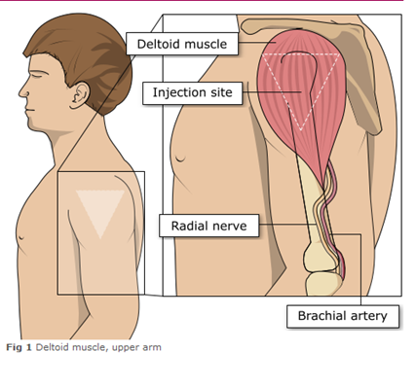
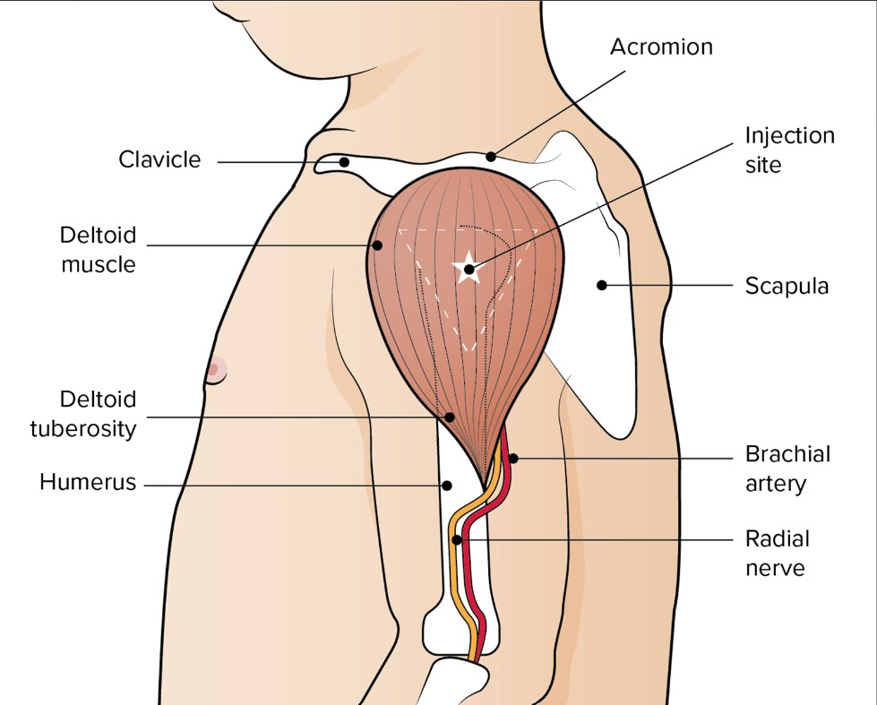
Administering vaccine into the deltoid muscle
Pneumococcal vaccine in individuals over 1 year of age should be injected into the deltoid muscle in the upper arm
It is essential that the correct site and injection technique is used to administer vaccines
Injecting too high into the upper arm might result in the vaccine being deposited in the shoulder capsule resulting in potential inflammation leading to a shoulder injury or a frozen shoulder. This leads to pain, weakness and a limited range of motion that can last for months
Injecting too low or too far to the side of the arm risks injecting into the axillary nerve or the radial nerve. This can cause a burning or shooting pain and can lead to nerve damage.
To avoid shoulder injury, always assess the limb before administering the vaccine to identify the correct site for injection
Images adapted from the Australian Immunisation Handbook

Slide 38
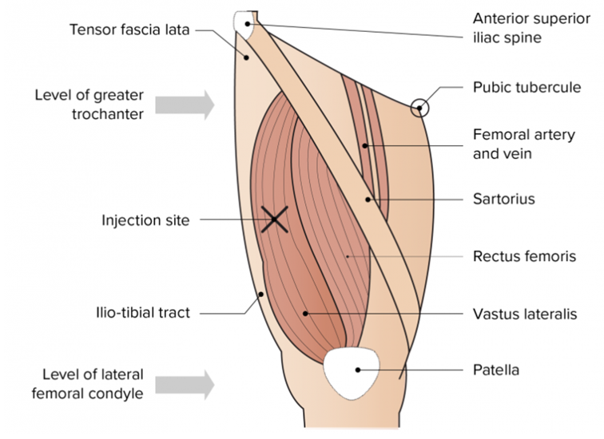
The vastus lateralis muscle (anterolateral aspect of the thigh)
The preferred site for intramuscular vaccine administration in infants under 1 year is generally the anterolateral aspect of the thigh​
Image from the Australian Immunisation Handbook

Slide 39
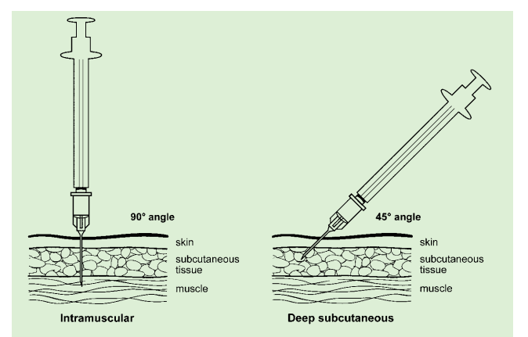
Vaccine administration
Skin does not need to be specially cleaned prior to vaccination. If it is visibly dirty, then water is sufficient to clean it.
Intramuscular process:
identify the correct site for IM injection
stretch the skin at the site
insert the needle at a 90 degrees angle far enough to ensure vaccine is delivered into muscle
depress the plunger
gently remove the needle
apply light pressure using gauze or cotton wool if bleeding occurs
Green-Book-Chapter-4.pdf (publishing.service.gov.uk)
Deep subcutaneous process:
Deep SC injections should be given with the needle at a 45º angle to the skin and the skin should be bunched, not stretched
Prevenar 20® is licensed for IM injection only
Notes:
https://assets.publishing.service.gov.uk/government/uploads/system/uploads/attachment_data/file/147915/Green-Book-Chapter-4.pdf

Slide 40
Co administration
Green Book: The UK immunisation schedule chapter states:
Doses of different inactivated vaccines can usually be administered at any time before, after, or at the same time as each other, unless stated otherwise. Doses of inactivated vaccines can also be given at any interval before, after, or at the same time as a live vaccine and vice versa.
Green Book: Immunisation procedures chapter states:
Where two or more injections need to be administered at the same time, they should be given at separate sites, preferably in a different limb. If more than one injection is to be given in the same limb, they should be administered at least 2.5cm apart
Green Book: Pneumococcal chapter states:
Where additional or booster doses of PCV13, PCV20 or PPV23* are required, they should be given at least 4 weeks after last PCV dose. Refer to Green Book: Pneumococcal table 25.3
Notes:
*Please note the information in the Pneumococcal: the green book, chapter 25 - GOV.UK is expected to be updated to reflect a 4-week interval in due course.

Slide 41
Adverse reactions: Prevenar 20® (1)
Adults
Very common (≥ 1/10): Decreased appetite¹, headache, muscle pain, joint pain, fatigue, pain/tenderness at vaccination site, pain/tenderness at vaccination site causing limitation of limb movement¹
Common (≥ 1/100 to < 1/10): Fever, vaccination site redness/swelling/induration²
Uncommon (≥ 1/1,000 to < 1/100): Hypersensitivity reaction including face oedema, dyspnoea and bronchospasm, diarrhoea², nausea, vomitting², rash², angioedema, vaccination site pruritus, lymphadenopathy, vaccination site urticaria, chills²
Driving and using machines:
Prevenar 20 has no or negligible influence on the ability to drive and use machines. However, some of the effects mentioned under section 4.8 may temporarily affect the ability to drive or use machines.
Notes:
¹ These frequencies are based on adverse reactions (ARs) reported in clinical trials with Prevenar 13 as these ARs were not reported in Prevenar 20 trials.
² Event reported with very common frequency (≥ 1/10) in clinical trials with Prevenar 13.
Prevenar 20 suspension for injection in pre-filled syringe - Summary of Product Characteristics (SmPC) - (emc) | 13461

Slide 42
Adverse reactions: Prevenar 20® (2)
Children/Adolescents (5 years to less than 18 years of age)
Very common (≥ 1/10): Decreased appetite¹, irritability¹, drowsiness/increased sleep¹, restless sleep/decreased sleep¹, headache, muscle pain, fatigue, vaccination site erythema/swelling/induration, vaccination site pain/tenderness
Common (≥ 1/100 to < 1/10): Diarrhoea¹, vomitting¹, rash¹, joint pain, vaccination site pain/tenderness causing limitation of limb movement
Uncommon (≥ 1/1,000 to < 1/100): Urticaria or urticaria-like rash, fever
Notes:
¹ These frequencies are based on adverse reactions (ARs) reported in clinical trials with Prevenar 13 as these ARs were not reported in Prevenar 20 trials.
² Event reported with very common frequency (≥ 1/10) in clinical trials with Prevenar 13.
Prevenar 20 suspension for injection in pre-filled syringe - Summary of Product Characteristics (SmPC) - (emc) | 13461

Slide 43
Adverse reactions: Prevenar 20® (3)
Infants/children aged 6 weeks to less than 5 years of age
Very common (≥ 1/10): Decreased appetite¹, irritability, drowsiness/increased sleep, restless sleep/decreased sleep¹, fever, vaccination site erythema/induration/swelling, vaccination site erythema/induration/swelling (> 2.0-7.0cm) after toddler dose and in older children [age 2 to >5 years]), pain/tenderness at vaccination site
Common (≥ 1/100 to < 1/10): Diarrhoea, vomiting, rash, fever greater than 38.9º, vaccination site erythema/induration/swelling (> 2.0-7.0cm), pain/tenderness at vaccination site causing limitation of limb movement
Uncommon (≥ 1/1,000 to < 1/100): Crying¹, seizures (including febrile seizures), urticaria or urticaria-like rash, vaccination-site erythema or induration/swelling (> 7.0 cm)
Rare (≥ 1/10,000 to < 1/1,000): Hypersensitivity reaction including face oedema, dyspnoea and bronchospasm¹, hypotonic-hyporesponsive episode¹, vaccination-site hypersensitivity²
Notes:
¹ These frequencies are based on adverse reactions (ARs) reported in clinical trials with Prevenar 13 as these ARs were not reported in Prevenar 20 trials.
² AR not reported for Prevenar 13, although injection-site urticaria, injection-site pruritus, and injection-site dermatitis were reported in Prevenar 13 postmarketing experience.
Prevenar 20 suspension for injection in pre-filled syringe - Summary of Product Characteristics (SmPC) - (emc) | 13461

Slide 44
Adverse reactions: Pneumovax 23®
Very common (≥1/10): Fever (≤38.8°C), Injection site reactions: erythema, induration, pain, soreness, swelling, warmth
Rare (≥1/10,000 to <1/1,000): Extensive swelling of the vaccinated limb†
Not known (cannot be estimated from available data): Haemolytic anaemia*, leukocytosis, lymphadenitis, lymphadenopathy, thrombocytopenia**, anaphylactoid reactions, angioneurotic oedema, serum sickness, febrile convulsions, Guillain-Barré Syndrome, headache, paraesthesia, radiculoneuropathy, nausea, vomiting, rash, urticaria, arthralgia, arthritis, myalgia, asthenia, chills, fever, injected limb mobility decreased, malaise, peripheral oedema††, C-reactive protein increased
Paediatric population:
A clinical study was conducted to evaluate the safety and immunogenicity of Pneumococcal polysaccharide vaccine in 102 individuals, including 25 subjects 2 to 17 years of age, 27 subjects 18 to 49 years of age, and 50 subjects 50 years of age and older. The type and severity of injection-site and systemic adverse reactions reported among children 2 to 17 years of age were comparable to those reported among adults 18 years of age and older. However, the proportions of subjects reporting injection-site and systemic adverse reactions were higher among subjects 2 to 17 years of age than those 18 years of age and older.
Notes:
† with short onset time from vaccine administration; defined by clinical review of cases reporting the preferred terms of extensive swelling of the vaccinated limb, injection site cellulitis and cellulitis, all of which described cellulitis-like reactions
* in patients who have had other haematologic disorders
** in patients with stabilised idiopathic thrombocytopenic purpura
†† in the injected extremity
Pneumovax 23 solution for injection in pre-filled syringe - Summary of Product Characteristics (SmPC) - (emc) | 9692
Pneumovax 23 solution for injection in pre-filled syringe - Summary of Product Characteristics (SmPC) - (emc) | 9692

Slide 45
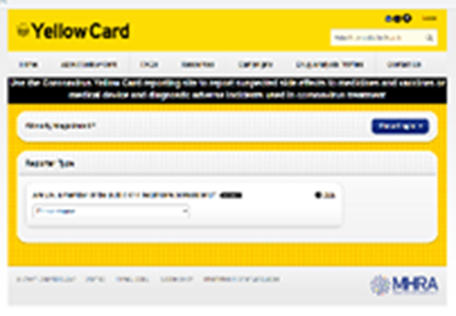
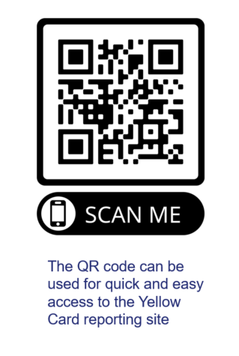
Reporting suspected adverse reactions
Vaccinees should be advised that they can report any adverse reactions or suspected side effects to the MHRA through the online yellow card scheme website or the Yellow Card app
Any suspected side effects following vaccine administration should be reported to the MHRA Yellow Card Scheme.
Anyone can report even if uncertain about whether vaccine caused condition:
  www.mhra.gov.uk/yellowcard or call 0800 731 6789 (9am to 5pm Monday to Friday)
  Green Book Chapter 9 for detailed guidance on reporting vaccine reactions
Notes:
Healthcare professionals and patients are encouraged to report suspected adverse reactions to the Medicines and Healthcare Products Regulatory Agency (MHRA) using the yellow card reporting scheme
Green Book chapter 9: https://www.gov.uk/government/publications/surveillance-and-monitoring-for-vaccine-safety-the-green-book-chapter-9

Slide 46
Summary & Resources
Influenza

Slide 47
Summary
Welsh Health Circular: A change of vaccine product for the routine adult pneumococcal vaccination programme, and those with certain clinical risk conditions (WHC/2025/054) is available here: Pneumococcal vaccination: product change (WHC/2025/054) | GOV.WALES
Prevenar 20® (PCV20) is expected to replace Pneumovax 23® (PPV23) in adults over 65 years and the at-risk programme in Jan/Feb 2026
Expiry date of latest PPV23 batch: 31 December 2026
Routine programme for adults aged 65 years and over and those aged 2 years and over in a clinical risk group
Active call and recall for pneumococcal vaccination must be in place for everyone eligible as per WHC/2025/054
Infants under 2 years of age with asplenia, splenic dysfunction, complement disorder or severe immunocompromise should also receive PCV20 (when available)*
Refer to Green Book: Pneumococcal Chapter for the vaccine doses for individuals in a clinical risk group
Individuals with asplenia, splenic dysfunction, chronic renal disease require re-immunisation with PPV23 or PCV20 (when available) is recommended every five years in these groups
Revaccination with PPV23 or PCV20 is currently not recommended for any other clinical risk groups or age groups
Vaccine packaging: there are some similarities between the pre-filled syringes of Prevenar 20® and Prevenar 13® so clinicians should be vigilant to ensure they select the correct vaccine
A UKHSA Pneumococcal (Adult and individuals at increased clinical risk): Information for HCP is anticipated in due course once available you can view here: Pneumococcal vaccination programmes for infants, adults and individuals at increased clinical risk - GOV.UK
Notes:
*Refer to GBC Pneumococcal: the green book, chapter 25 - GOV.UK for details of when vaccine required in individuals with a clinical risk refer to table 25.2 and 25.3.

Slide 48


Public facing and healthcare professional PHW Information materials
Bilingual patient information leaflet will be available here: Health Information Resources - Public Health Wales
Accessible resources will be available here: Vaccination information in accessible formats - Public Health Wales
Public facing webpage Pneumococcal vaccine for older adults and people at risk - Public Health Wales **Currently being updated**
Healthcare professional webpage * Pneumococcal vaccine - Information for health professionals - Public Health Wales **Currently being updated**
Healthcare professional FAQs: Frequently asked questions **Coming soon**
Generic older adult poster **Coming soon**

Slide 49
Resources and additional information
The Green Book: Pneumococcal: the green book, chapter - GOV.UK
Welsh Health Circular. A change of vaccine product for the routine adult pneumococcal vaccination programme, and those with certain clinical risk conditions (WHC/2025/054): Pneumococcal vaccination: product change (WHC/2025/054) | GOV.WALES
Joint Committee on Vaccination and Immunisation: JCVI Minutes from meeting held 07 June 2023
UKHSA Pneumococcal (Adult and individuals at increased clinical risk): Information for Healthcare Professionals: Anticipated in due course once available you can view here: Pneumococcal vaccination programmes for infants, adults and individuals at increased clinical risk - GOV.UK
Pneumococcal23® SmPC
Prevenar20® SmPC

