Slide 1

All Wales Maternity Record:
Vaccinations in Pregnancy
(Information in this slide set is accurate as of the 22 February 2024)
Vaccine Preventable Disease Programme
Public Health Wales

Slide 2
Current vaccinations in pregnancy
Whooping cough vaccine – from week 16 of pregnancy
Flu vaccine – at any stage in pregnancy during flu season (September to March)
Coronavirus (COVID-19) vaccine – at any stage in pregnancy currently during the winter respiratory vaccination campaign (September to March)

Slide 3
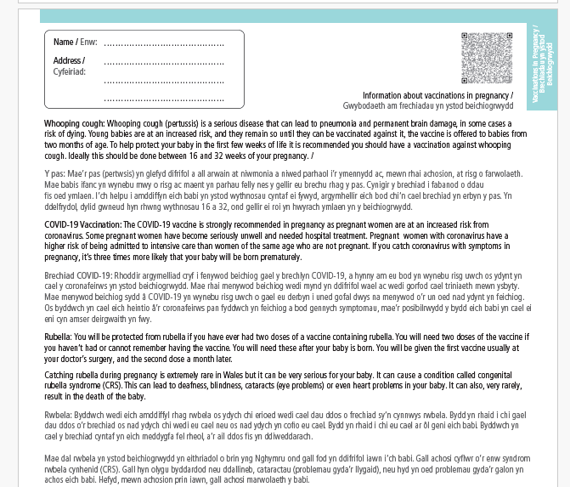
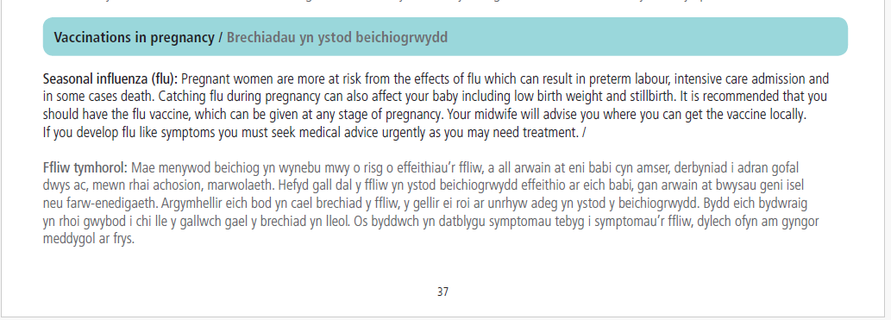
All Wales Maternity Record: Vaccinations in pregnancy found on pages 37 & 38

Slide 4
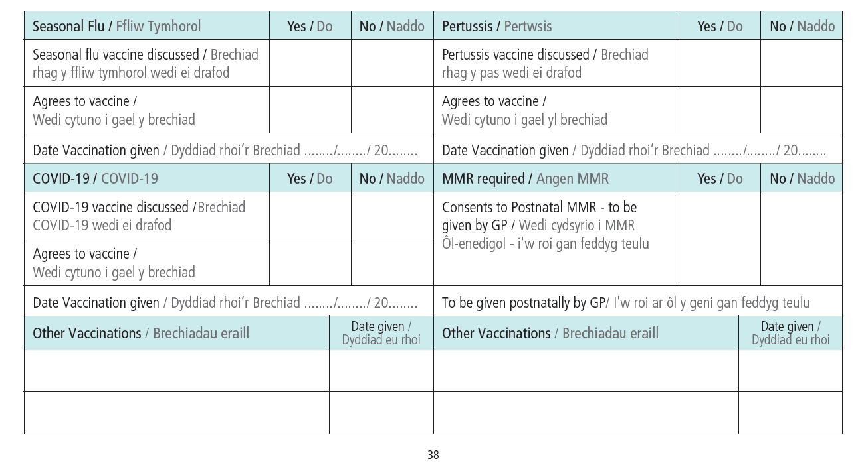
Recording vaccinations in the record

Slide 5
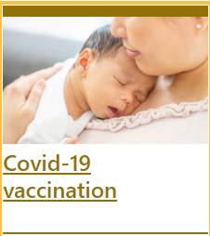
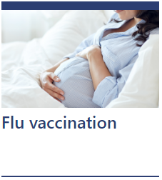
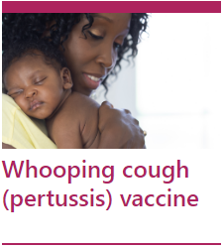
Pregnancy Vaccination: Sources of Information
Notes:
In summary:
HCWs are trusted voices. You all have a role to play in making every contact count and talking confidently to women and their partners about vaccinations in pregnancy. You can make a real difference in improving pregnancy vaccine uptake and reducing mortality and morbidity from vaccine preventable diseases. You can make a difference in ensuring that vaccine uptake is equitable and you as HCWs should be able to signpost pregnant women and their partners for further information.

Slide 6
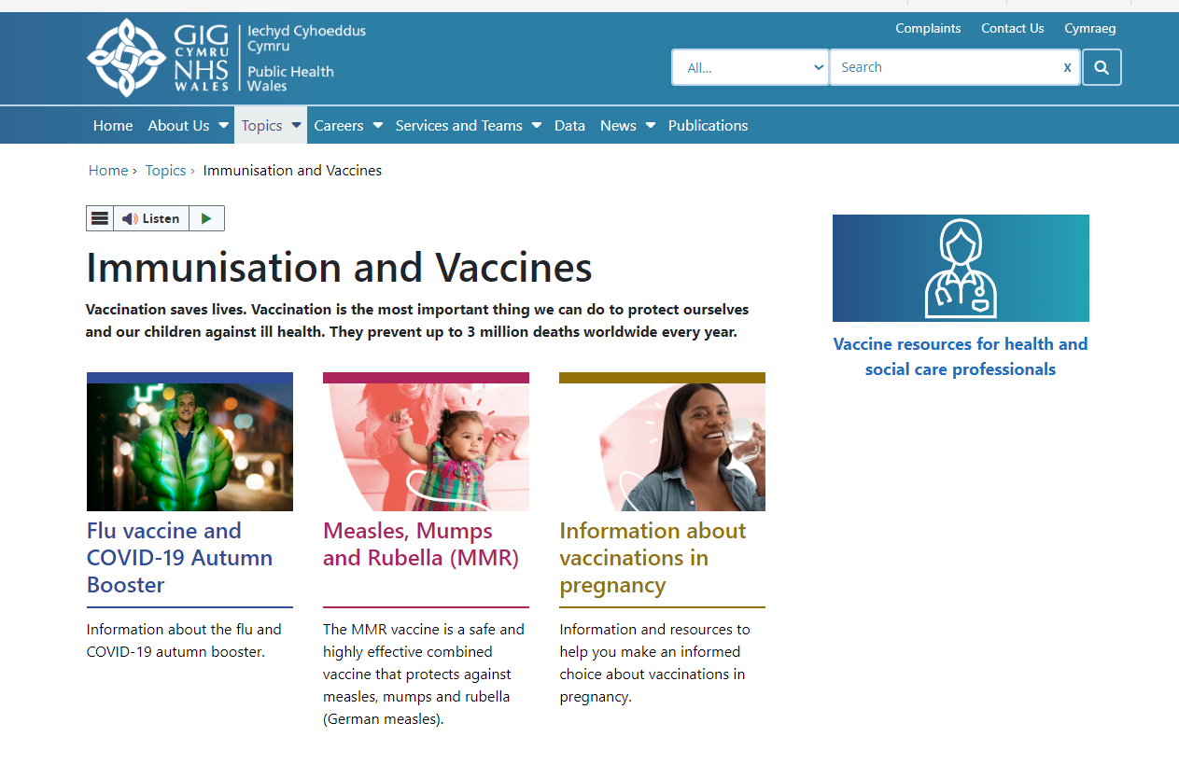
Public Health Wales Website: Immunisations and Vaccines
Information about vaccinations in pregnancy for pregnant women
Immunisation and vaccination information for all health and social care professionals
Immunisation and Vaccines - Public Health Wales (nhs.wales)

Slide 7
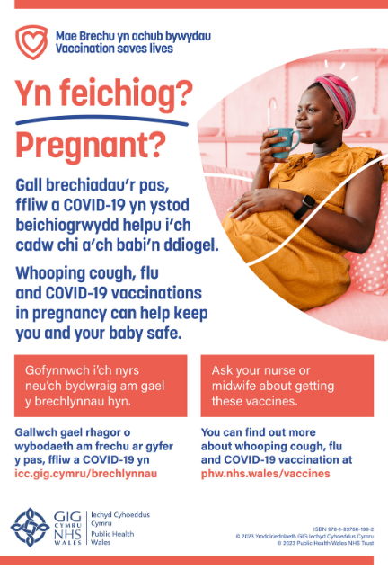

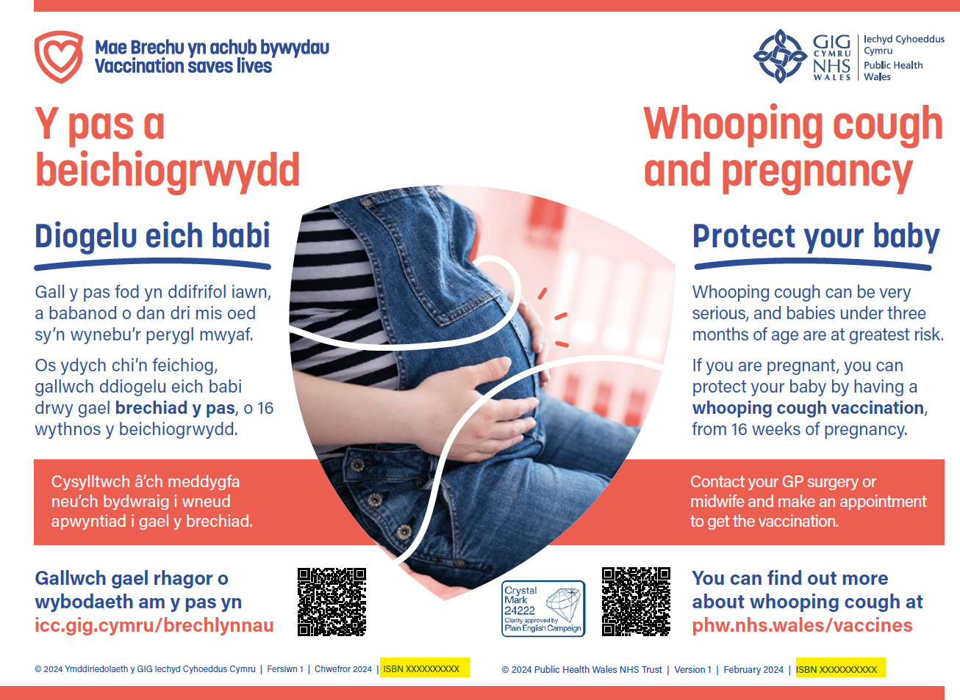
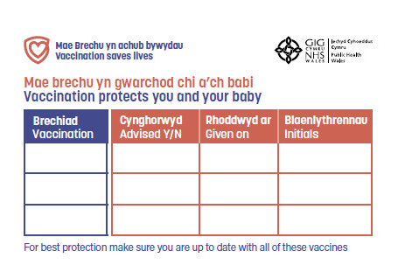
Free resources
Leaflets
Posters
Maternity record stickers
Order resources at: Health Information Resources - Public Health Wales (nhs.wales)
Accessible resources:
Easy read
Large print
Audio
Sign language video
All available at:
Information about vaccinations in pregnancy - Public Health Wales (nhs.wales)

Slide 8

Training for midwives and health care professionals
Training resources: Immunisation training resources and events - Public Health Wales (nhs.wales)
Webinar Q&A -Vaccinations in pregnancy - slide set [21 September 2023]
Webinar Q&A – Vaccinations in pregnancy - recording [21 September 2023] Training (sharepoint.com)

Slide 9
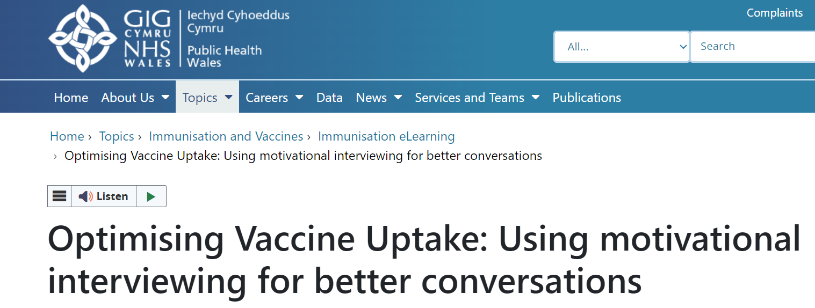
eLearning module: Optimising Vaccine Uptake: Using motivational interviewing for better conversations
The approach and style of a vaccine conversation can make a real difference in understanding individual hesitancy, addressing barriers, and influencing vaccine uptake.
There is an eLearning module available called Optimising Vaccine Uptake: Using motivational interviewing for better conversations which aims to support staff with having positive conversations about immunisations.
The module aims to provide health professionals the skills and knowledge required to implement motivational interviewing techniques when having vaccine-related conversations
Further information about the module and how to access it is available here: Immunisation eLearning - Public Health Wales (nhs.wales)

Slide 10
Health and social care workers
Vaccination of health and social care workers protects them and reduces risk of infecting patients, service users, colleagues and family members
Frontline health and social care workers have a duty of care to protect their patients and service users from infection
Vaccination of frontline workers also helps reduce sickness absences and contributes to keeping the NHS and care services running through winter pressures
NHS and social care bodies have a responsibility to ensure, as far as is reasonably practicable, that health and social care workers are free of, and are protected from exposure to infections that can be caught at work (Health and Social Care Act 2008, Code of Practice on the prevention and control of infections)

Slide 11
New vaccines:
Respiratory Syncytial Virus (RSV)
  Common virus which causes coughs and colds in winter (October-March).
  Transmitted by droplets and secretions from infected person
  Very young (<1y) and elderly at greatest risk. Infants < 6m develop the most severe disease.
  Bronchiolitis is common cause of hospitalisation in infants aged under one.
  Significant burden of RSV illness in UK and impact on NHS services Green Book Chapter 27a Respiratory syncytial virus (publishing.service.gov.uk)
Notes:
RSV - RSV is an enveloped RNA virus, in the same family as the human parainfluenza viruses and mumps and measles viruses. RSV is one of the common viruses that cause coughs and colds in winter. The incubation period - the delay between infection and the appearance of symptoms - is short at about 3 to 5 days.
RSV is the most common cause of bronchiolitis in infants. Over 60% of children have been infected by their first birthday, and over 80% by 2 years of age.
UK. @ 30,000 < 5 years hospitalised/ yr because of RSV. Numbers of hospital admissions due to RSV have increased in the last 20 years. RSV causes the deaths of around 30 babies a year in the UK.
All immunisation and vaccination changes are based on the expert advice of the Joint Committee on Vaccination and Immunisation (JCVI).
All the vaccination programmes we are talking about today are part of the routine immunisation programme in Wales and the UK based on recommendations by the JCVI.

Slide 12
JCVI advice on RSV Immunisation Programme
  Recognise there is a significant burden of RSV.
  Have been monitoring products in development and reviewing the latest evidence on products in late-stage development, or newly licensed to protect neonates and infants and older adults.
  In June 2023 JCVI advised that an RSV programme that is cost effective should be developed for both infants.
  Respiratory syncytial virus (RSV) immunisation programme: JCVI advice, 7 June 2023 - GOV.UK (www.gov.uk)
  JCVI statement September 2023: Respiratory syncytial virus (RSV) immunisation programme for infants and older adults: JCVI full statement, 11 September 2023 - GOV.UK (www.gov.uk)

Slide 13
RSV Programme to protect neonates and infants
Options being considered:
A universal maternal vaccination programme being seasonal (July to December) or year-round
or
A universal passive immunisation programme to protect infants from RSV being seasonal (July to February with catch up) or year-round
No decision at present regarding maternal or neonatal programme
Potential start date for new vaccination programme September 2024
Further information to follow

Slide 14
Vaccine change: Prenatal pertussis vaccination
At a JCVI meeting in October 2022 results from the IMaP studies were reviewed, the outcome was:
To use a non-IPV containing vaccine in the maternal programme, to address the potential immunity gap caused by the blunting effect observed in the IMaP study.
JCVI agreed that the overall priority remains to ensure that a maternal pertussis campaign is in place as the programme continues to save lives. If a non-IPV containing pertussis vaccine with a UK marketing authorisation could be secured at a cost-effective price, it would be preferable to switch at the next contract opportunity, otherwise to maintain the programme as is.
JCVI Minutes October 2022
iMAP2 - Health Research Authority (hra.nhs.uk) & iMAP3- Health Research Authority (hra.nhs.uk)

Slide 15
Prenatal pertussis vaccine change
Changing from Boostrix-IPV (dTaP/IPV) to Adacel (Tdap), a non-IPV containing vaccine in the prenatal pertussis vaccination programme
Introduction of Adacel expected July 2024
The Adacel (Tdap) vaccine is manufactured by Sanofi.
The vaccine contains tetanus, diphtheria and pertussis (acellular) antigens and was licensed for UK use in April 2016.
The prenatal pertussis vaccine change project board also aims to raise awareness and increase uptake generally for this programme.
Further information to follow

Slide 16
Horizon scanning: Vaccinations in Pregnancy
Future maternal vaccine against group B streptococcus (GBS)

Slide 17
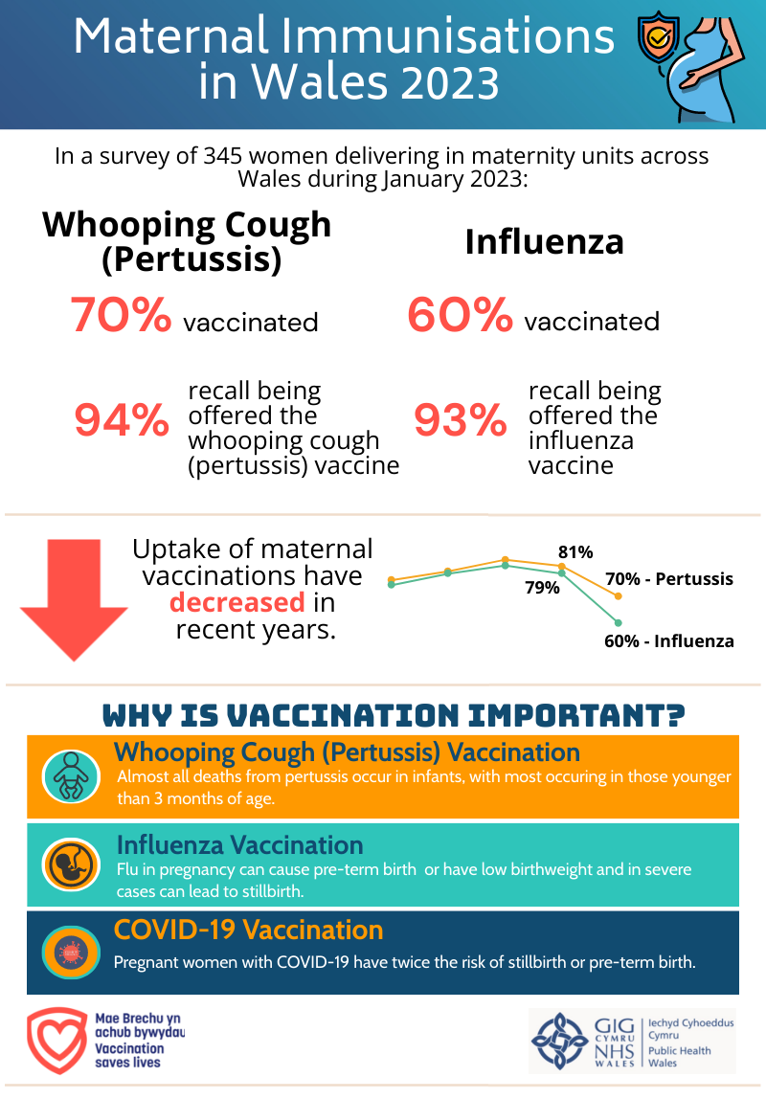
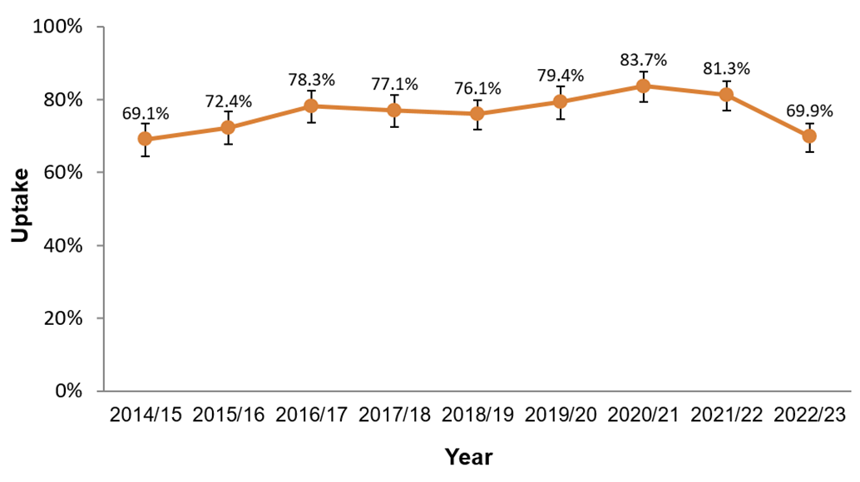
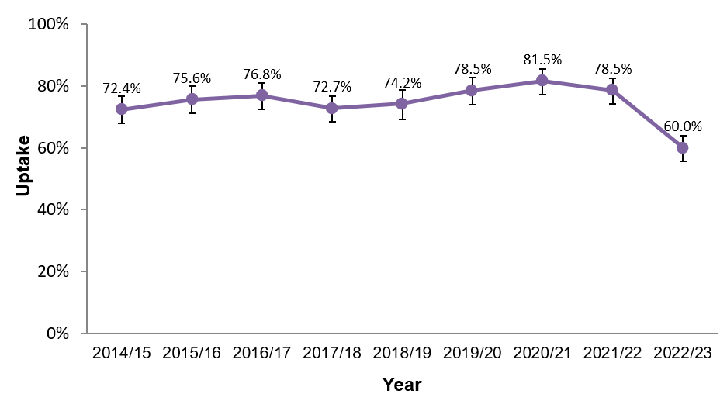
Point of Delivery Survey
A snapshot of maternal immunisation uptake
Carried out in January each year
Denominator is all those women delivering during a 5 day period
All seven health boards in Wales participate
Standard questionnaire asks about offer of vaccinations and receipt of vaccinations
Timeliness of pertussis vaccination is also gathered
Approximately 350-400 women take part in the survey each year
Uptake of pertussis vaccination in pregnant women participating in the 2014/15 to 2022/23 surveys¹
Uptake of influenza vaccination in pregnant women participating in the 2014/15 to 2022/23 surveys¹
¹Bars indicate 95% confidence intervals.
https://nhswales365.sharepoint.com/sites/PHW_VPDPComms/SitePages/Immunisation-uptake-in-pregnancy.aspx
Public Health Wales
Notes:
Surveillance: Issues with ascertaining immunisation uptake. Difficulties with ascertaining the denominator - inconsistent recording of pregnancies in GP systems
Pertussis vaccination provided through and recorded in GP systems, however flu vaccinations are provided through a wider range of settings and recording in different systems. No single system consistently records all influenza vaccinations.

Slide 18
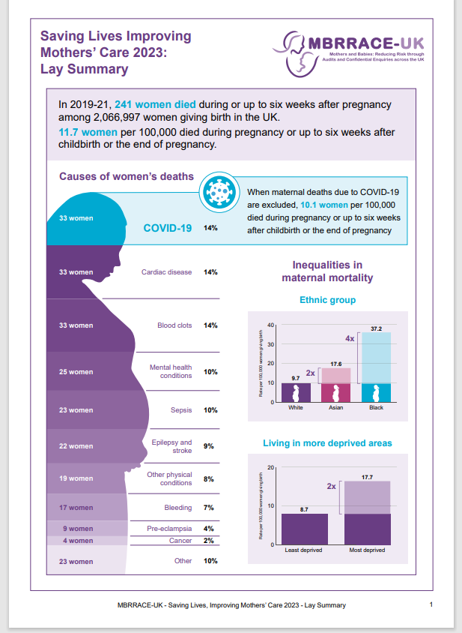
Saving Lives, Improving Mothers’ Care 2023: Lay Summary MBRRACE- UK
33 women died as a result of COVID-19 and this was the leading cause of maternal death in the UK between 2019 and 2021 during or up to 6 weeks after the end of pregnancy.
Make sure women take up vaccinations during pregnancy.
https://www.npeu.ox.ac.uk/assets/downloads/mbrrace-uk/reports/maternal-report-2023/MBRRACE-UK_Maternal_Report_2023_-_Lay_Summary.pdf

Slide 19
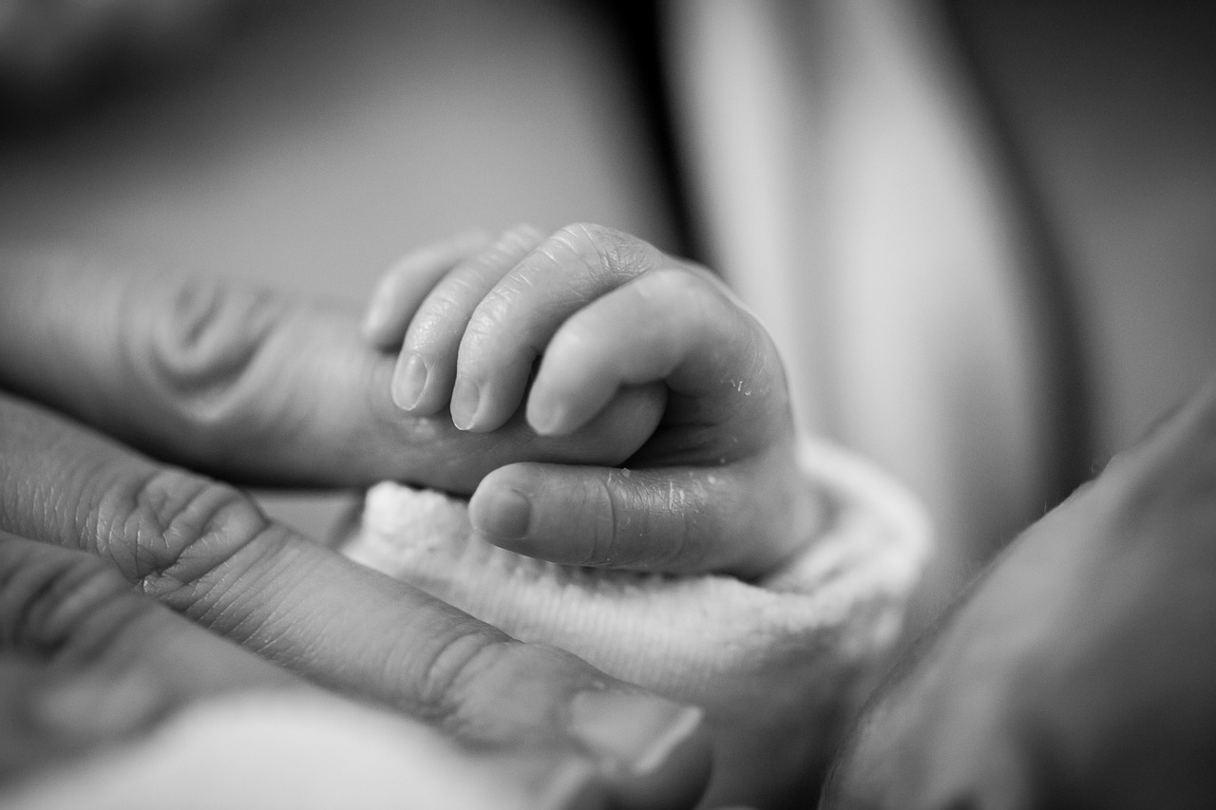
Key messages:
Vaccination is the safest and most effective way of protecting pregnant women and their babies against serious illnesses such as whooping cough, flu and COVID-19.
Risks to the mother and the unborn child include:
  Increased risks of complications for the mother
  Perinatal mortality, prematurity, low birth weight and increased risk of death in neonates too young to have their own vaccines.
  Congenital rubella syndrome for the unborn baby
  Future risk of cirrhosis and liver cancer for the infant (Hep B)
Healthcare professionals are a trusted voice and an important source of information about vaccination in pregnancy. Make every contact count.

Slide 20
Contact:
Public Health Wales Vaccines
Vaccine Preventable Disease Programme:
Email: phw.vaccines@wales.nhs.uk
Notes:
In summary:
HCWs are trusted voices. You all have a role to play in making every contact count and talking confidently to women and their partners about vaccinations in pregnancy. You can make a real difference in improving pregnancy vaccine uptake and reducing mortality and morbidity from vaccine preventable diseases. You can make a difference in ensuring that vaccine uptake is equitable and you as HCWs should be able to signpost pregnant women and their partners for further information.

