Slide 1

Surveillance for effects of Zika virus in pregnancy
15th November 2016
Dr Robert Smith
Clinical Scientist, CDSC
Public Health Wales

Slide 2
Outline
Zika and pregnancy
UKOSS surveillance
BPSU
PH Wales surveillance
Pregnancy
Testing
Question

Slide 3
Zika
Flavivirus isolated 1947, Uganda
Mosquito-borne (like Dengue/Chikungunya)
2007 Pacific → 2015 Americas
Incubation 3-12 days
Rash, fever, headache, myalgia, arthralgia
80% asymptomatic

Slide 4
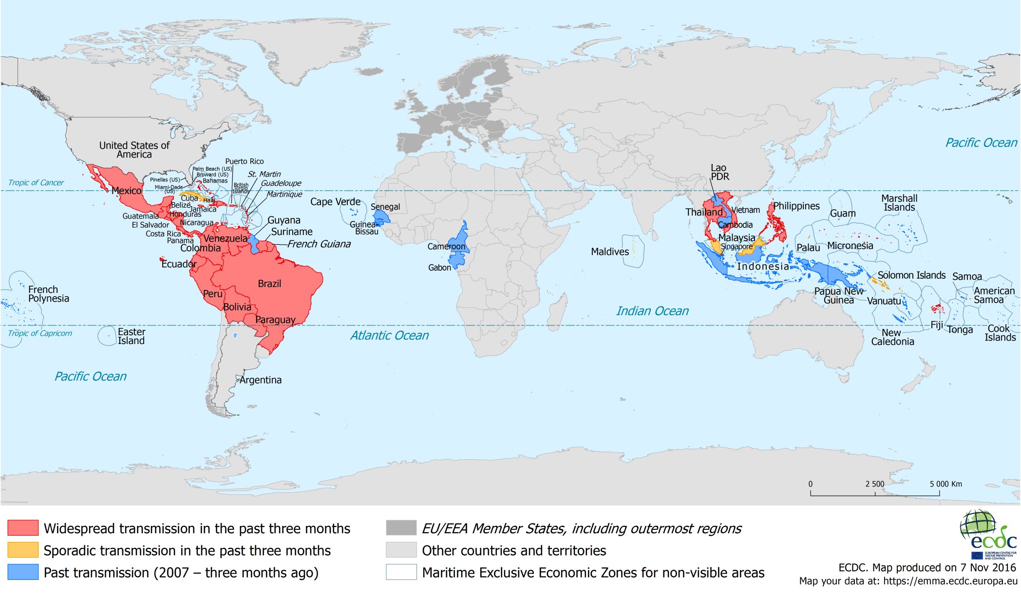
Zika virus:affected areas
Notes:
ECDC map as of 7 Nov 2016

Slide 5
Zika and pregnancy
Risk of acquiring Zika
Visit to affected country
Sexual contact with infected case
Advise safe sex (male partner) post-travel
6 months (sympto.) 8 weeks (asympto.)
May change to 6 months for both
Female- 8 weeks

Slide 6
Zika in pregnancy- effects
Brazil: microcephaly increase (0.5 to 20 /10,000 LB)
“Fetal brain disruption sequence” [Brazil, 48 presumed]
Craniofacial disproportion, biparetal depression, prominent occiput, excess nuchal skin
Zika PCR + women
12/42 fetal USS abnormal; 7/42 microcephaly, cerebral atrophy or brain calcifications
French Polynesia: CNS malformations (n=17)
Viral neurotropism in mice
“Most data… remain unpublished”- WHO
http://wwwnc.cdc.gov/eid/article/22/7/15-1990_article
http://wwwnc.cdc.gov/eid/article/22/11/16-0956_article
http://dx.doi.org/10.2471/BLT.16.176990
https://www.ncbi.nlm.nih.gov/pubmed/26943629?dopt=Abstract
Notes:
Increase is apparent, no good baseline

Slide 7
How many travellers? (if no change in behaviour)
350K visits to affected countries
16-44 females , 2013
46% Caribbean
~8500 from Wales
Note conception rate ~7% in this age group, assuming no change in behaviour/travel
Office for National Statistics [Internet]. Travel Trends – Section 5 UK Residents Visits Abroad, 2013, 5.09– [cited 2016-Feb-01]. Available from: <http://www.ons.gov.uk/ons/rel/ott/travel-trends/2013/rft-travel-trends--section-5-uk-residents-abroad--2013.xls>

Slide 8
Imported UK cases to date
244 cases (to 26/10/2016)
Mainly from Caribbean travel
Surveillance: measure any impact to UK pregnancies

Slide 9
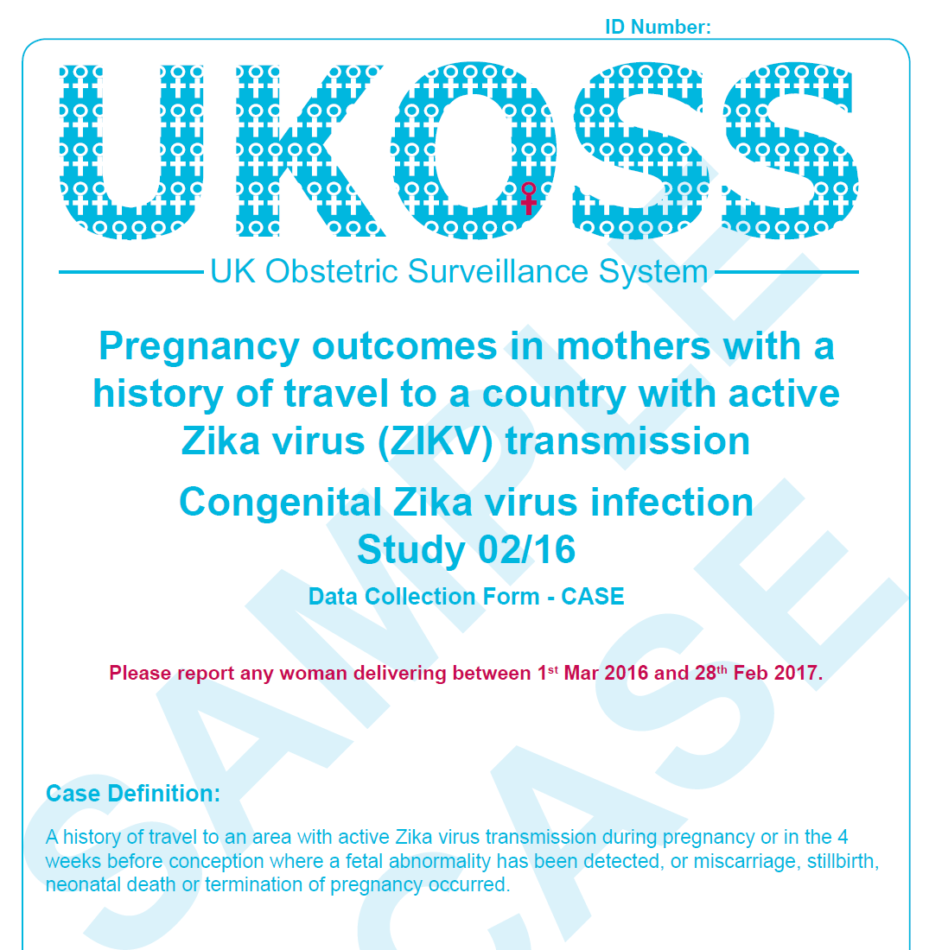

Slide 10
UKOSS Zika surveillance
Exposure: travel to affected country during pregnancy/ 4 weeks prior to conception
Aggregate data on exposed
Case form if any fetal USS abnormality or other adverse outcome [miscarriage/stillbirth/ neonatal death/ termination]
March-Oct 2016: [UK-wide, no breakdown]
~512 exposed
<10 adverse outcome

Slide 11
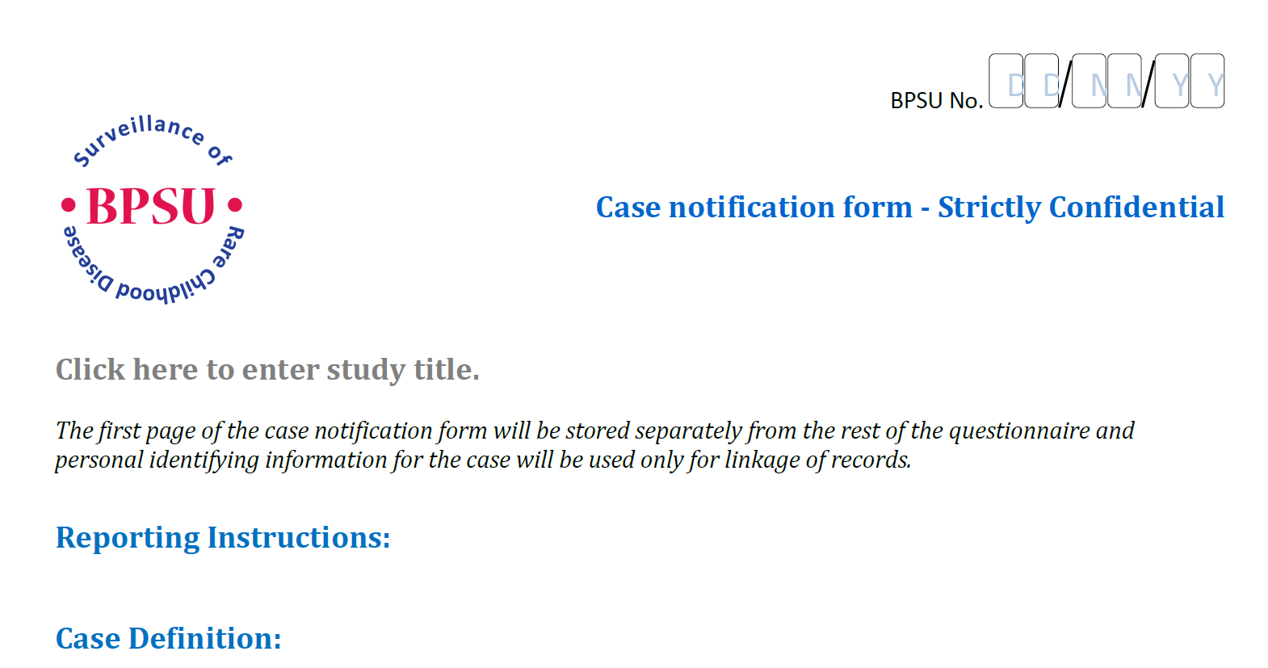
BPSU

Slide 12
BPSU Zika surveillance: Possible case definition
infant ≤ 6 months , HC> 2 standard deviations below the mean for gestational age and sex (i.e. below the 2nd centile)
or intracranial abnormalities including but not restricted to intracranial calcifications, ventricular dilation, lissencephaly, pachygyria or cortical/subcortical atrophy
whose mother has travelled to a country with active ZIKV transmission during pregnancy or in the three months prior to conception
(a list of ZIKV affected countries will be provided on the study flyer/questionnaire as well as a web link to a regularly updated list)
Notes:
3 months is longer than the 4 weeks in UKOSS

Slide 13
Public Health Wales surveillance
CDSC/ obstetric collaboration
Aim to capture all travel-exposed pregnant women
7 reports since March
All UHW, 6/7 Cardiff

Slide 14
Pregnancy forms (n=7)
March (2), July (1), Aug (1), Sep (3)
Aged 24-34
5-90 days LMP to return, mean 39
4/7 Caribbean; away 5-31 days
2 symptomatic (1 head/joint pain)
1 USS; 1 blood saved
Notes:
Other symptomatic- no symptoms ticked. No reporting outside Cardiff. USS was not in symptomatic case.

Slide 15
Zika testing in Welsh patients
Rare and imported pathogens lab
Jan-Sept 2016
119 tests, 59 persons
42 female, 17 male
No overlap with pregnancy forms

Slide 16
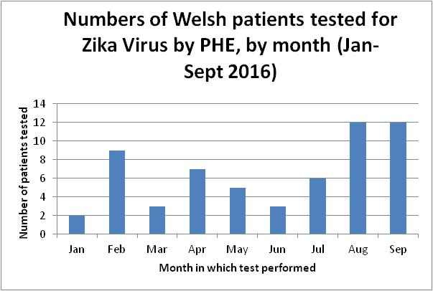
Notes:
N=116 tests, 59 persons. Positive tests , then earliest if negative/no result

Slide 17
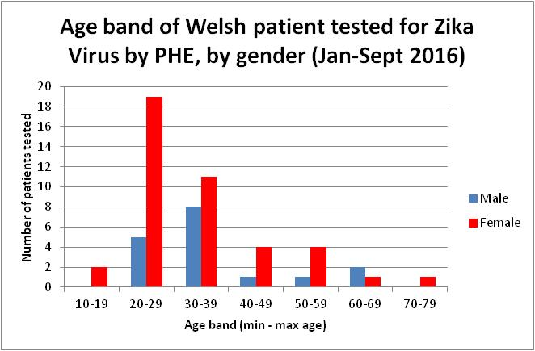
Notes:
42 female (mean age 34), 18 male (mean age 37)

Slide 18
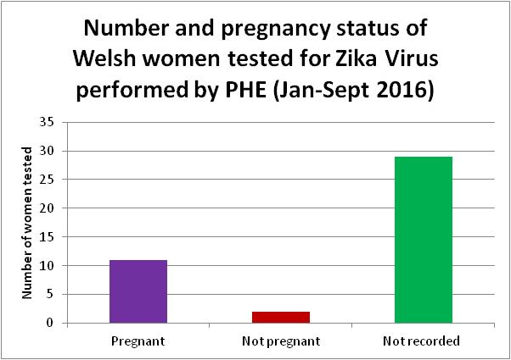
Notes:
N=42 women

Slide 19
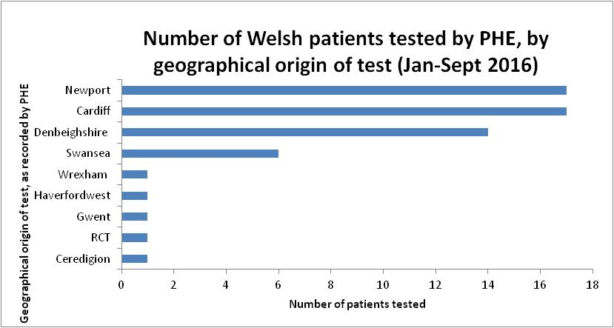

Slide 20
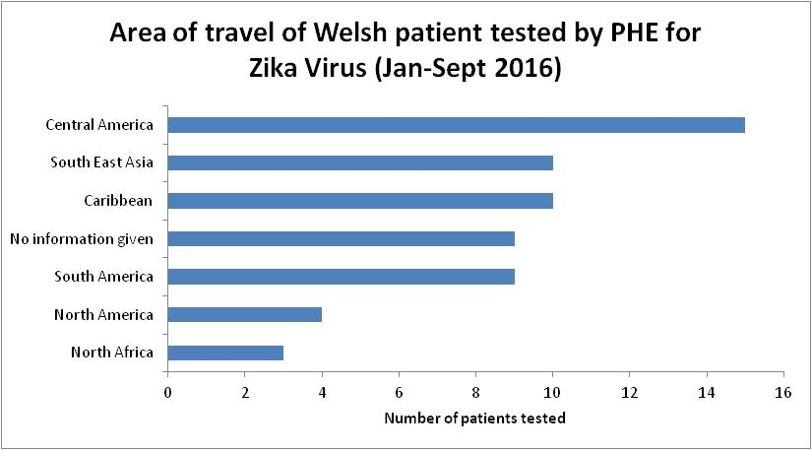

Slide 21
Main results
59 PHE tested, 71%F, 18% pregnant
7 pregnancy forms to PHW, 1 symp.
Mostly SE Wales (few W/N Wales)
No report of adverse outcomes
UKOSS>PHW reporting (but no breakdown)
Likely under-reporting to both

Slide 22
Questions
Have you seen/submitted UKOSS?
Seen/submitted BPSU?
Seen/submitted PHW form
PHW form- continue?

