Slide 1
CMV infection in pregnancy
Annual CARIS WALES meeting
Sandra Bakker
Neonatologist YGC
November 2016

Slide 2
CMV in pregnancy
Case presentation
Management of cCMV infection
Who do we screen, who should we screen
Research evidence
Future

Slide 3
Monday morning handover
Baby boy W
BBA
Maternal notes unavailable (booked YG, BBA brought to YGC)
‘Bony white structure’ in abdomen early scan, but this disappeared
Mother was CMV IgG positive, CMV IgM negative

Slide 4
Maternal details
Age: 36year old
PMHx; psoriasis (topical steroids/UV light Tx)
Non smoker
No alcohol since being pregnant
Iron + folic acid

Slide 5
Obstetric details
G4P1
2007 misc ? dates
2008 TOP 9 weeks
2011 term NVD F&W
This pregnancy – EDD 7/5/2016, booked at YG (West)
First scan; 9+ weeks dichorionic diamniotic twin pregnancy
Went on holiday to Egypt at around 10 weeks, episode of ?’food poisening

Slide 6
This pregnancy
11+ weeks scan; fetal demise of one twin
Anomaly USS @ 20/40; Echogenic bowel
Referral to fetal medicine in YWM (East), seen at 21+5 weeks
Prominent echogenic bowel + small fetal pleural effusion
DD chromosomal abnormality, CF, fetal infection
Amniocenthesis, maternal blood for viral infection screen, parents blood for CF carrier status

Slide 7
This pregnancy
Results:
46XY
CF carrier negative
Viral screen negative except:
Maternal blood 21+6 weeks: CMV IgG positive (avidity 32 low), IgM negative
Booking bloods at 9+ weeks; CMV IgG positive (avidity 77 high), IgM positive
IgG immunity acquired within the time frame of pregnancy

Slide 8
This pregnancy
Amniotic fluid 21+5 weeks CMV PCR positive, high viral load
Primary CMV infection in early pregnancy,
‘About 25% risk that the fetus will be affected in some way or other’.
Scanned in fetal medicine at 25 weeks in fetal medicine in YWM (East)
Normal fetal growth, bowel less echogenic
Bright lung field, not echogenic
FU one week: to discuss results (not all above results available)

Slide 9
This pregnancy
FU YG
29+1 weeks: has been seen in Wrexham with echogenic bowel, CMV +, discussed implications, neuro developmental impact unknown. Normal fetal growth
Paediatric alert completed, in maternal notes
33+5 weeks: cephalic, normal FH, normal growth
possible

Slide 10
This pregnancy
35+4 weeks:
Notes not available at first clinic,
notes from last clinic not filed
*concern that mother had not understood that significant
disability has not been ruled out, despite normal
growth
* fetal medicine ‘vague’ when they counselled her
* plan; joint paeds/obs review, logistically not possible
Uncertainty about outcome discussed
    *Referral to LWH (discussed they may or may not offer abortion)
    *Referral to paeds (to discuss sequelae)

Slide 11
This pregnancy
I am not sure what happened
37+5 weeks; normal FH, normal growth

Slide 12
Baby M.W.
Twin pregnancy, but other twin demised early pregnancy.
Echogenic bowel on anomaly USS @ 21/40 – resolved
CMV +ve
BBA, Term, good condition, Apgars 9+9
No RF for sepsis.
No maternal notes.
Was booked at YG.

Slide 13
CMV+
History from Mum:
Twin pregnancy at 9+ weeks. One twin demised at 11+ weeks.
Echogenic bowel on anomaly USS at 21/40 – Referred to FMU in Wrexham
CMV + on amniotic fluid, was told it was just a ‘cold-virus’
Fortnightly USS. Echogenic bowel resolved.
Counselling about Congenital CMV +/- Termination of pregnancy at 35/40
Maternal notes requested several times, but arrived after the baby had gone home

Slide 14
During admission…
Isolation measures.
EON completed (No jaundice or rashes. Resp & CVS N, Abd: tip of spleen felt 1-2cm, rest N. CNS N).
Growth: Wt 25th, HC < 2nd, L 9th
Bloods: Plt 114, rest of FBC, U&E’s, LFT’s N
Urine CMV PCR +ve
CrUSS: No IVH. Widespread calcifications, Periventricular ++
MRI head: Not conclusive. Rt post PV cyst. ? Calcifications
Hearing and ophthalmology N.

Slide 15
Impression:
Congenital CMV
Transient thrombocytopaenia, splenomegaly, brain calcifications
D/W AHH ID re: further management.
D/w parents re: treatment – PO Valgancyclovir 6/12
Improves hearing and neurological outcomes.
Side effects: bone marrow suppression, liver toxicity, ? Long term malignancy, fertility problems.
Close F/u with frequent bloods and assessments.

Slide 16
Conclusion…
After long discussions and fully informed, parents decided to start treatment.
F/u at YG as more convenient/closer to home.
So far, doing well.

Slide 17
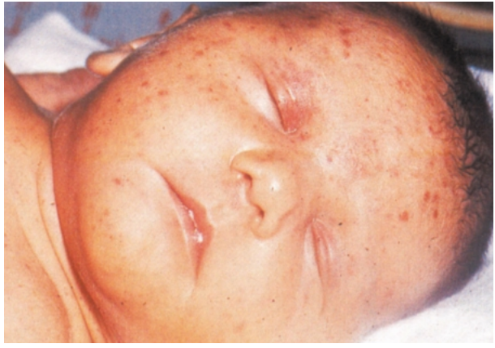
Congenital CMV
Consensus Guidelines from June/2015 (By ID team at AHH)

Slide 18
Epidemiology
Prevalence of cCMV 0.4-0.8% developing countries
UK: symptomatic cCMV 3/1000 in 1970-80’s
Now unknown
CMV is the most common infection passed from mother to baby
Mild – severe
Mortality 5%
cCMV leading causes of hearing loss (25%) and childhood disability.

Slide 19
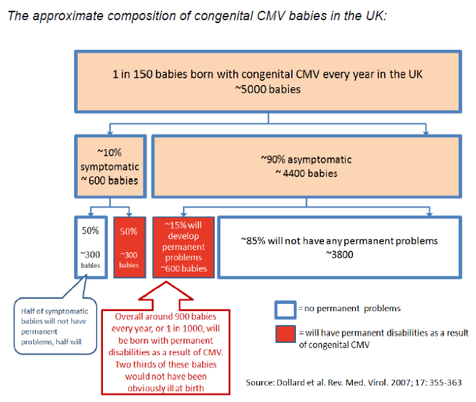

Slide 20
Clinical Features? Symptomatic disease
10% have symptomatic disease @ birth.
Typically reticuloendothelial, hepatobiliary or CNS involvement.
Mild – severe
Mortality 5%
Of the 10% - 2/3 long term CNS sequelae (hearing loss, psychomotor and gross motor delay, blindness)
15% asymptomatic – CNS sequelae.
cCMV – 10-20% hearing loss (1/3 symp, 1/10 assymp)

Slide 21
Who should be screened for cCMV?
Clinical features to trigger screening Neonates
Intracranial ventriculomegaly (without other explanation)
Calcification on cranial USS (often periventricular)
Congenital cataracts
Failed neonatal hearing screen
Petechiae or purpura in the newborn
Hepatosplenomegaly
Prolonged jaundice with transaminitis
Unexplained thrombocytopenia
Evidence of maternal primary CMV infection in pregnancy
Consider Screening
Prematurity
IUGR

Slide 22
Transmission
Pregnancy, delivery, postnatally through breast milk or close contact
Transmission is higher @ later stages of pregnancy, but if in early pregnancy – severe consequences
Rate of transmission pregnancy 30-40% in primary maternal CMV, but 1% on reactivation
UK 50% of women are CMV negative
Main way women get infected is from saliva and urine of small children

Slide 23
Confirmed cCMV, what next?
Urgent referral to ID to consider Tx
Determine if there’s evidence of disease :
clinical assessment,
Invx (FBC, U&E’s, LFT’s, viral load by PCR),
Imaging (CrUSS, MRI – look for PV calcifications, ventriculomegaly, white matter changes, cysts, neuronal migration defects, cerebellar hypoplasia)
Ophthalmology r/v: chorio-retinitis, optic atrophy, cataracts
Audiology: auditory brainstem response.

Slide 24
Kimberlin, D.W., et al., Effect of ganciclovir therapy on hearing in symptomatic congenital cytomegalovirus disease involving the central nervous system: a randomized, controlled trial. J Pediatr, 2003. 143(1): p. 16-25.
RCT, 1991-1999 USA, cCMV with CNS involvement
6/52 IV ganciclovir versus placebo
Prevents hearing deterioration at 6 months and probably > 1year

Slide 25
Oliver, S.E., et al., Neurodevelopmental outcomes following ganciclovir therapy in symptomatic congenital cytomegalovirus infections involving the central nervous system. J Clin Virol, 2009. 46 Suppl 4: p. S22-6

Slide 26
Kimberlin, D.W., et al., Valganciclovir for Symptomatic Congenital Cytomegalovirus Disease. New England Journal of Medicine, 2015. 372(10): p. 933-943
Randomised placebo-controlled trial comparing 6 weeks with 6 months oral valganciclovir treatment of symptomatic cCMV.
Multicentre, >32/40, >1800g, start Tx in first 30/7, 2008-2011 USA
With or without CNS involvement
Modest improvement in hearing and developmental outcomes in the longer term (12-24 months FU)
statistically significant improvement in language and receptive-communication scales The
benefit of 6 months versus 6 weeks treatment on hearing was more marked when there was baseline CNS disease compared to those infants with no CNS involvement

Slide 27
Williams, E.J., et al., Feasibility and acceptability of targeted screening for congenital CMV-related hearing loss. Arch Dis Child Fetal Neonatal Ed, 2014. 99(3): p. F230-6.
BEST study (Benefits of Extended Screening testing)
cCMV related Sensorineural hearing loss (SNHL)
Feasibility= get samples before 3 weeks of age + clinical assessment <30 days
Acceptability= maternal anxiety (At recruitement and 3/12)
UK, multicentre, 46242 screened, 1133 referred (2.5%)
411 recruited, 6 cCMV postive (0.7%)

Slide 28
Kadambari, S., et al., Evaluating the feasibility of integrating salivary testing for congenital CMV into the Newborn Hearing Screening Programme in the UK. Eur J Pediatr, 2015.
Newborn hearing screening programme UK (2006, 96.5%)
Saliva testing for CMV DNA PCR by hearing screeners
All babies referred for further testing after failing initial hearing screen, <22 days old, 7/12 study, UK, multicentre
Over 10.000 hearing screens, 3.4% referred, 20% >22/7 old excluded
80% of parents agreed to saliva swab, 2/203 swabs positive
1 symptomatic and treated
Training improved screeners confidence

Slide 29
Screening
Only half of babies with cCMV related hearing loss identifiable at birth

Slide 30
Conclusion
cCMV important cause of morbidity and mortality
Early diagnosis & investigations important for Tx
Long relationship between family+patient with health services (ID team/local team)
Advice and support for families: National CMV support group – cmvaction.org.uk

Slide 31
Mother’s (parent’s) perspective

Slide 32
room for improvement?
CMV PCR + in amniotic fluids=c CMV infection??
Improve communication between teams
Importance of accurate documentation and clear information passed on to all involved, most importantly parents.
Access to maternal notes
Early diagnosis – early counselling – early management/treatment.

Slide 33
What did the mother tell us

Slide 34
Thank you!
Any Questions?

