Slide 1

CARIS Update
November 2016
CARIS Update
Linda Bailey, Consultant in Public Health

Slide 2
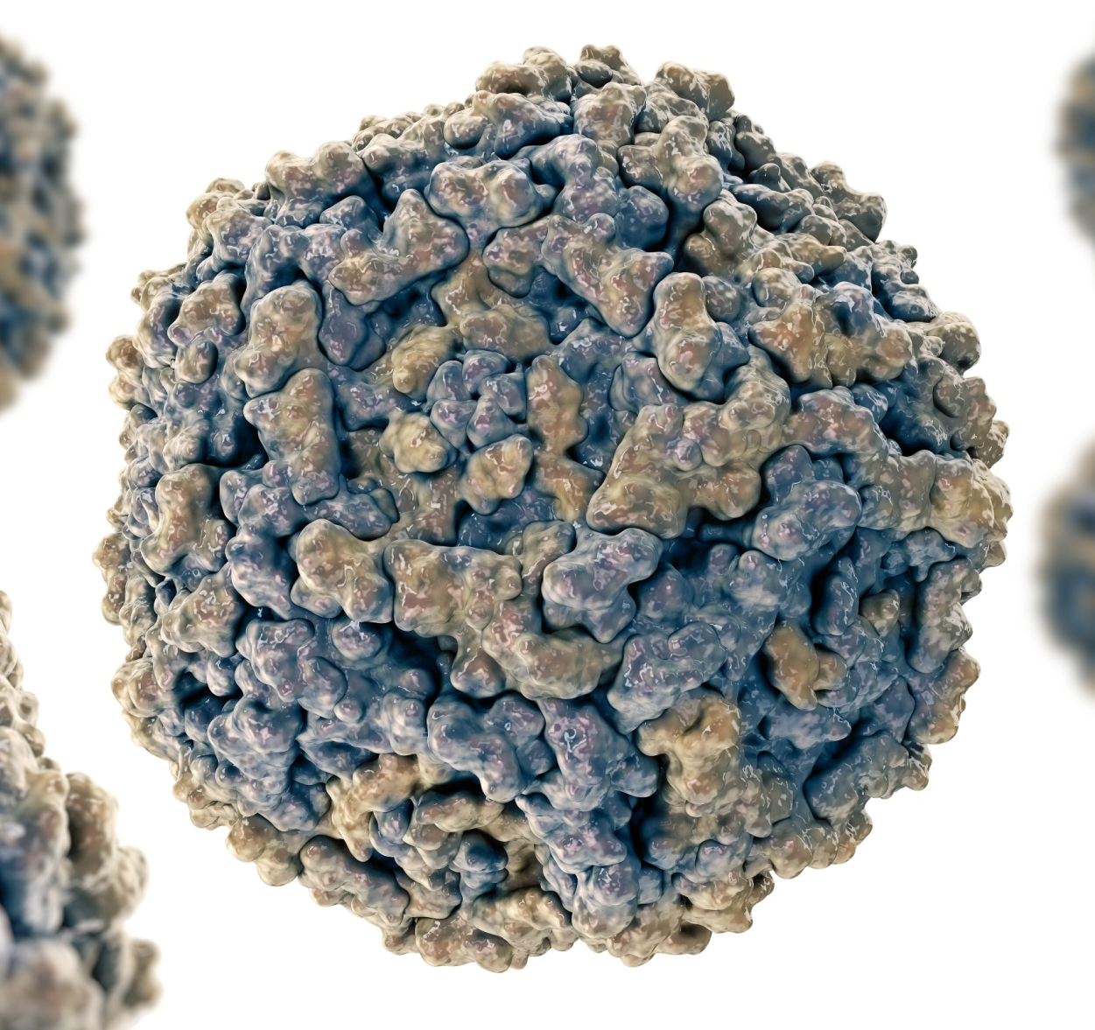
CARIS update
CARIS aim
CARIS activity since 2015
Update on CARIS data

Slide 3
Aims of CARIS
Public Health Wales established in 2009 with four statutory functions. The third of these includes the requirement for a congenital anomaly register.
CARIS aims to collect reliable data that can be used to:
Build up and monitor the picture of congenital anomalies in Wales
Assess possible clusters & their causes
Assess interventions to prevent or detect anomalies
Plan & co-ordinate provision of health care

Slide 4
Key publications since last meeting
BMJ: Long term trends in prevalence of neural tube defects in Europe: population based study
Arch.Dis.Child: Prevention of neural tube defects in the UK: a missed opportunity
BMJ: Prevalence of microcephaly in Europe

Slide 5
CARIS – headlines1998 to 2015
31,123 cases recorded in CARIS
Gross rate of 5.2%
86.2% live born of whom 96.9% survived to one year
More males than females – 58% to 40%
Most (59.9%) with a single anomaly

Slide 6
Neural Tube defect

Slide 7
Gastroschisis

Slide 8
Multicystic dysplastic kidneys

Slide 10
Congenital anomaly rates across Wales – 1998 to 2015

Slide 11
Survival to the age of one year

Slide 13
Other CARIS work
Rare diseases
Antenatal screening – rates of detection

Slide 14

Any questions?

