Slide 1
Teenage Pregnancies - Increased Risk of Congenital Anomalies?
F Hodge, D Tucker, C Humphries & M Morgan
Welsh Obs & Gynae Society Meeting October 2015

Slide 2
Background
Wales teenage conception rate 48/1000 (Stats Wales 2015)
UK teenage birth rate 2012 19.7/1000 (ONS 2012)
European teenage birth rate 15.4/1000 (ONS 2012)
Teenage pregnancies known to be associated with:
Pre-term delivery
Low birth weight
Neonatal mortality
(Paranjothy et al 2008)

Slide 3
Methods
Retrospective study
Selected conditions of congenital anomalies in Wales recorded by CARIS from 1st January 1998 until 31st December 2012
Primiparous and multiparous women
Singleton and multiple pregnancies included
All outcomes including spontaneous fetal losses and terminations of pregnancy
Denominator data used was total births over the given time period by maternal age which was 425,025 births
Cases were categorised by maternal age at delivery into two groups: those less than 20 years and those aged 20 to 34 years
Congenital anomalies are classified by ICD-10 coding system

Slide 4
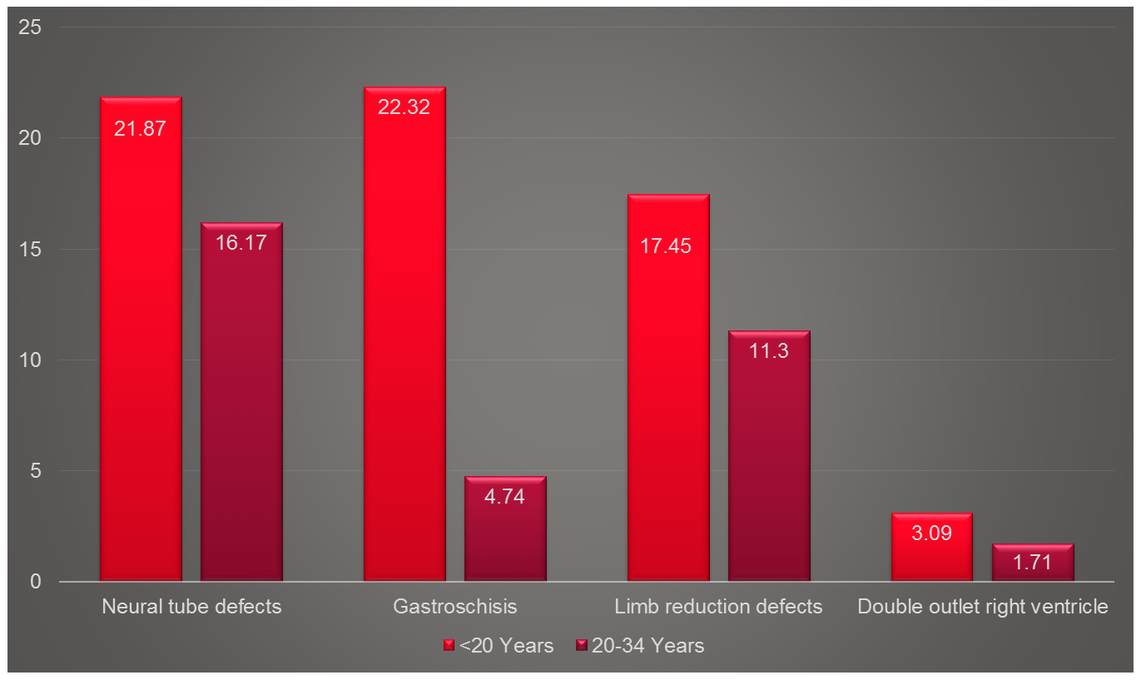
Rates of Anomalies per 10,000 Births by Maternal Age

Slide 5
Odds Ratios with 95% Confidence Intervals
95% confidence interval
Gastroschisis
Neural tube defects
Limb reduction
Double outlet right ventricle
1.81
95% confidence interval
Gastroschisis
Neural tube defects
Limb reduction
Double outlet right ventricle
1.81

Slide 6
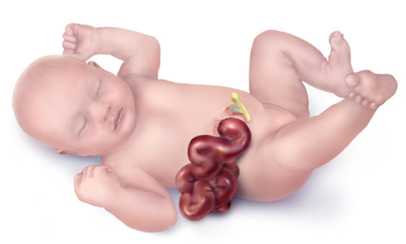
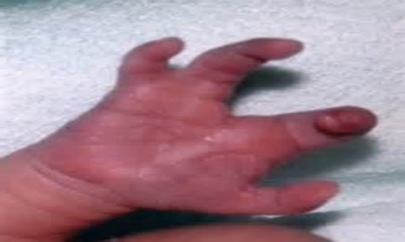
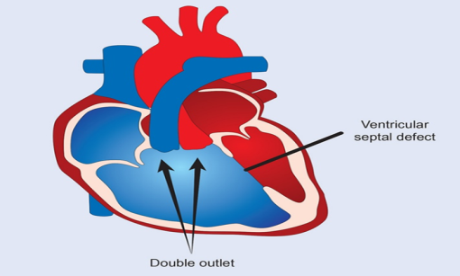
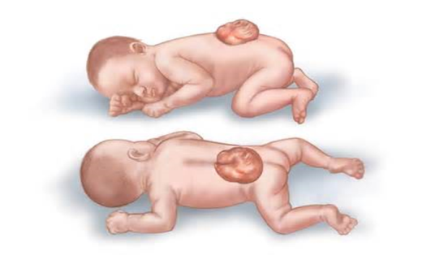
Results
Statistically different rates in teenage pregnancy of:
Neural tube defects
Gastroschisis
Limb reduction defects
Double outlet right ventricle
No statistical difference for:
Exomphalos
Cleft palate
Cleft lip and palate
Non neural tube central nervous system anomalies
Truncus arteriosus
Transposition of the great arteries
Fallot’s tetralogy
Hypoplastic left heart syndrome
Total anomalous pulmonary venous disease

Slide 7
Recent Literature – Increased Teenage Rates
North American Study (Chen et al 2007):
Non neural tube CNS anomalies
GI anomalies - Exomphalos/ Gastroschisis
MSK anomalies – cleft lip/palate, polydactyly/syndactyly/adactyly
European Study (Loane, Dolk & Morris 2009):
Gastroschisis
Maternal Infection Syndromes
Tricuspid atresia
Anencephalus
Nervous system anomalies
Digestive system anomalies

Slide 8
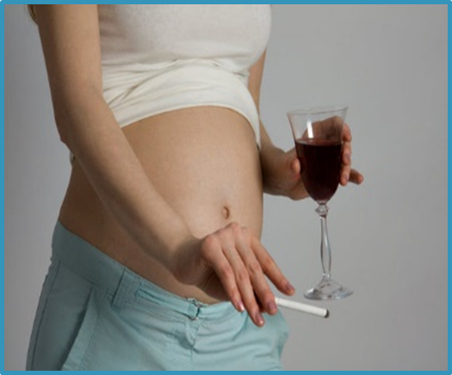
Conclusion
Some differences between our data and previous studies
May relate to differences within populations and exposures
This data highlights opportunities to reduce risk in teenage mothers
Pre-conceptual folic acid
Healthy diet

Slide 9
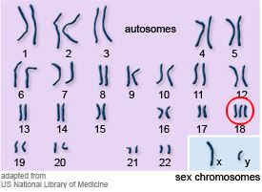
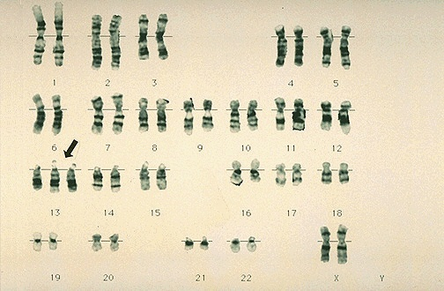
Trisomy 13 and Trisomy 18 International Mortality Review International Clearing House for Birth Defects, Surveillance and Research Wales Outcome Review

Slide 10
Disorders of Sex Development
CARIS 2015

Slide 11
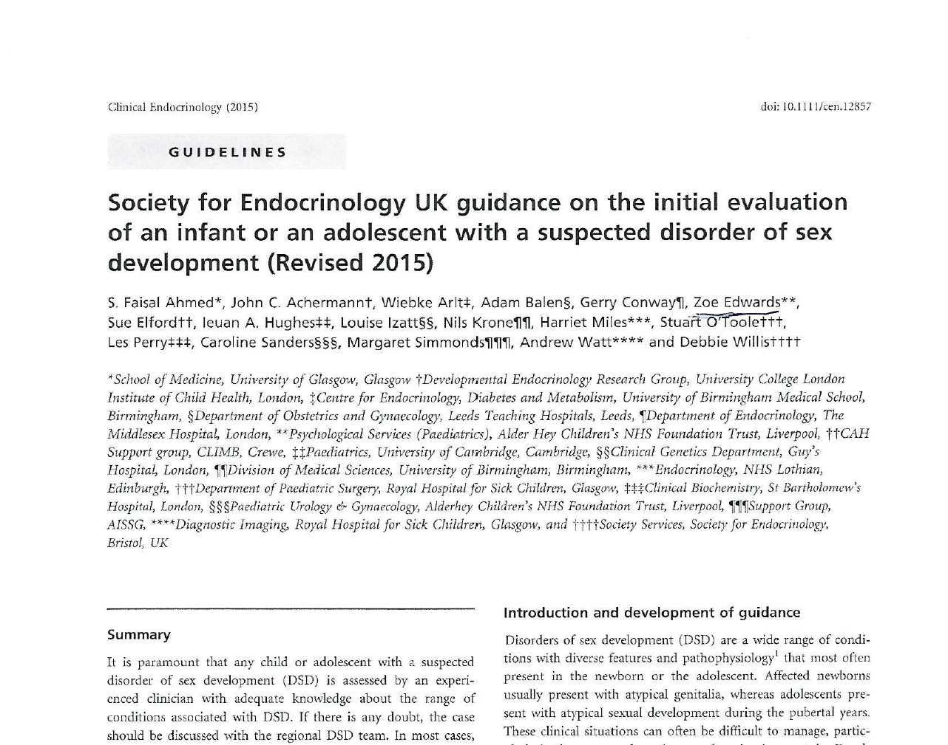

Slide 12
DSD Guidelines
Assessment by experienced clinician
Involve regional DSD team
Specialist psychological support
Parental discussion
Research and clinical collaboration

Slide 13
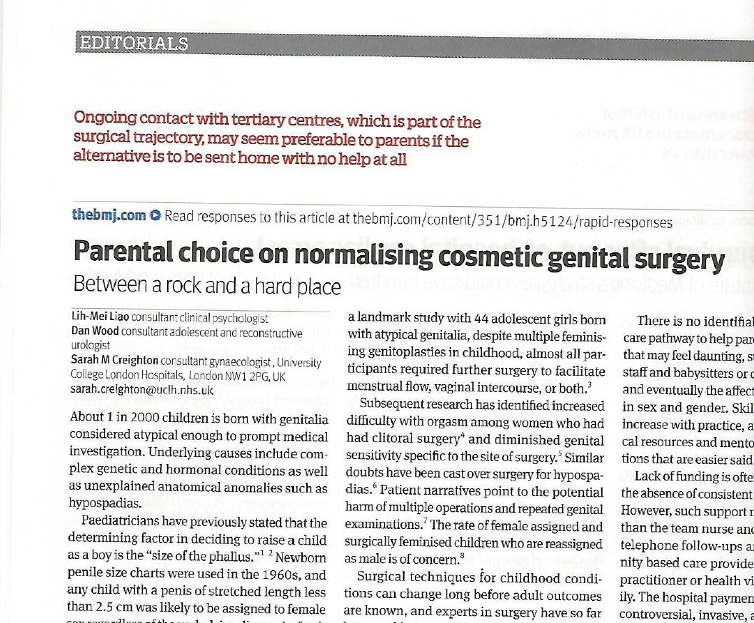
101111

Slide 14
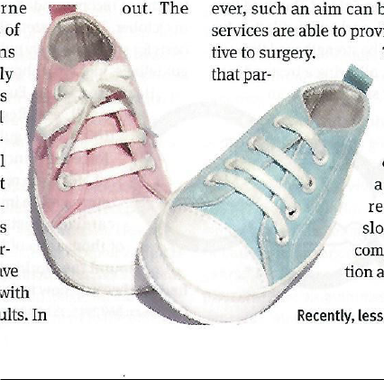
1 in 2000 born with atypical genitalia
Normalising surgery is common
Limited longitudinal research on outcomes
Parental pressure/regret
Non surgical protocol
Mandatory surgical audit

Slide 15
2012 – Germany, gender can be left blank on birth certificate
2015 – Malta has moratorium on non vital genital surgery
2015 – ‘avoid non-consensual sex normalising medical treatements on intersex people’
European Union Agency for Fundamental Rights

Slide 16
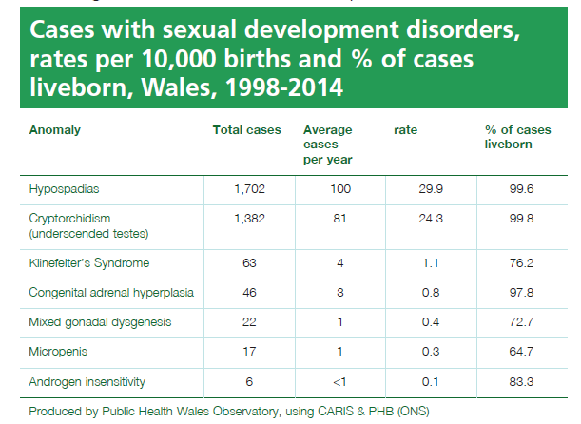

Slide 17
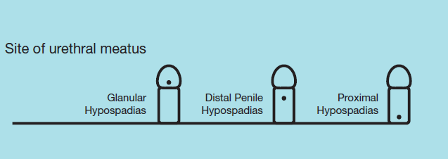
Hypospadias
Type of hypospadias | Number | % of total known cases
Glanular (Q54.0) | 938 | 78.1
Penile (Q54.1) | 179 | 14.9
Penoscrotal (Q54.2) | 67 | 5.6
Perineal (Q54.3) | 17 | 1.4
There are an additional 501 cases where the type of hypospadias hasn’t been specified.

Slide 18
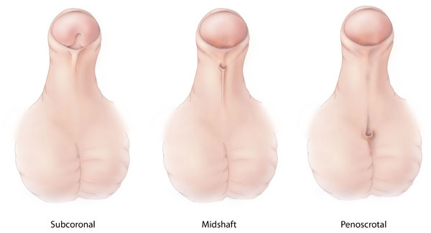
Surgery for hypospadias
Age at first surgical procedure | Number | % of cases
< 2 years old | 112 | 26.7
< 3 years old | 216 | 51.6
< 4 years old | 56 | 13.4
< 5 years old | 21 | 5.0
5+ years old | 14 | 3.2
In summary this data shows that 78.3% of cases notified to CARIS have surgery before their 3rd birthday.

Slide 19
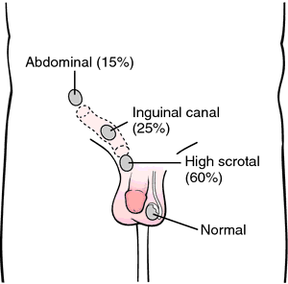

Slide 21
Thanks

