Slide 1

CARIS 1998 – 2014 annual report
November 2015
Presenter: Linda Bailey – Consultant in Public Health / Health Intelligence

Slide 2
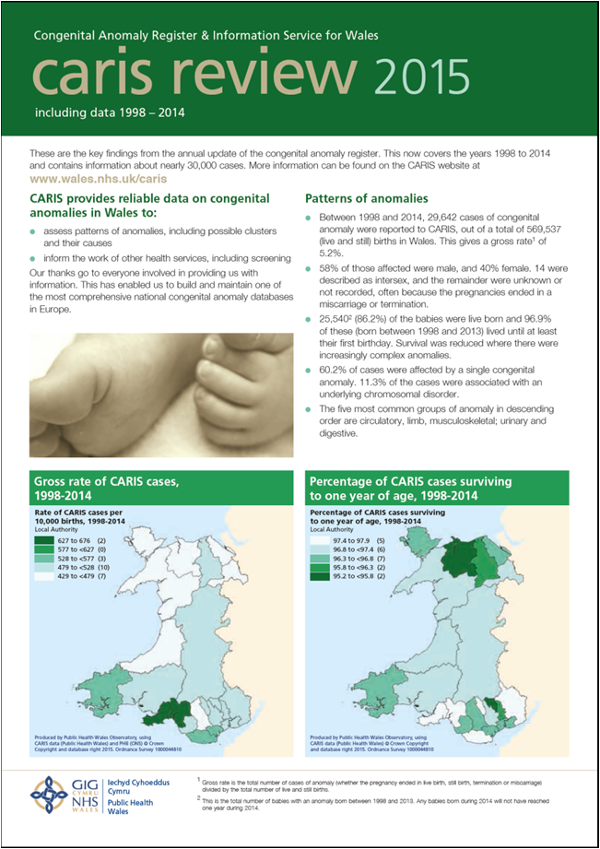
Overview of CARIS
Headline statistics
Focus – teenage pregnancy and disorders of sexual development

Slide 3
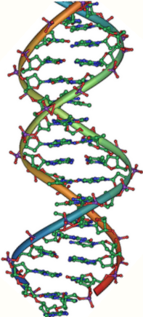
Aims of CARIS
Build up and monitor the picture of congenital anomalies in Wales
Assess interventions to prevent or detect anomalies
Plan & co-ordinate provision of health care
Assess possible clusters & their causes
Also – participation in UK and international work

Slide 4

CARIS criteria
Babies and fetuses:
  delivered from 1st January 1998 onwards
  mothers normally resident in Wales at time of birth
Anomaly should be:
  detected during pregnancy, at birth or within the first year of life
  present at the time of delivery, regardless of when detected

Slide 5
Official Statistics
Publication time table
November 2015 | Publication of prevalence tables for congenital anomalies in Wales (1998-2014)
February 2016 | Publication of prevalence rates of rare diseases in Wales (1998-2014)
March 2016 | Publication of latest antenatal detection rates of select (FASP) anomalies (2012-2014)

Slide 6
CARIS headline numbers and rates 1998 – 2014
29,642 cases reported since 1998
Gross rate – 5.2% - about 1 in 20
25,540 live born
Live born rate 4.5%
60% of our cases are affected by a single anomaly
96.9% of babies born alive survive to their first birthday

Slide 7

Cases by sex 1998 – 2014

Slide 8

CARIS headline numbers and rates 1998 – 2014
The largest groups, in order are :-
  Heart
  Limbs
  Musculoskeletal
  Urinary
  Digestive

Slide 10
Pattern of anomalies and survival

Slide 11
Isolated cleft palate (Q35), rate per 10,000 total births with 95% confidence intervals, local authorities, 1998-2014
Produced by Public Health Wales Observatory, using CARIS (Public Health Wales) & PHB (ONS)

Slide 12
Rates per 10,000 births
Vary across Wales, possibly because of variations in reporting
Rates of specific anomalies vary too, but small numbers don’t allow for too much investigation

Slide 13
CARIS data tables

Slide 14
EUROMEDICAT study – risk of congenital anomalies after exposure to asthma medication in the first trimester of pregnancy – a cohort linkage study
Data from 3 registries: Norway, Wales and Denmark
20% increased risk for major congenital anomalies, same finding as in other studies BUT very small difference after adjustment for maternal age and socio-economic status
Significant OR up to 3 at the 1% significance level for inhaled medications for some specific congenital anomalies
Higher risks with systemic steroids
Overall, the increased risk for a specific major congenital anomaly for the individual pregnant woman with asthma is low
It is very difficult to define the correct exposure period for asthma medications using data from prescription databases

Slide 15
Warning card / E-Alert
Cases can be reported at anytime using a warning card (see pack) or our E-alert
If you wonder if a case has been reported you can phone or send a confidential email to:
Caris.safehavenMailbox@wales.nhs.uk
Your assistance is very much appreciated as none of the work would be possible without you

Slide 16

Any questions?

