Slide 1
Spina bifida: paediatric challenges
Frances Gibbon
Consultant Paediatric Neurologist
University Hospital of Wales

Slide 2
Antenatal advice re spina bifida
Regular requests from fetal medicine to counsel parents when spina bifida has been found
Parents seen by paediatric neurosurgeon (PL) and neurologist (FG)
Advice given re general issues around SB and also details of the neurosurgical procedures
Recently the paediatric urological surgeon (AA) has also offered to counsel families if they so wish
Referral made to counselling service provided by SHINE charity

Slide 3
How does spina bifida affect people?
90% of babies with spina bifida now survive to adulthood
80% have normal intelligence
75% participate in sport

Slide 4
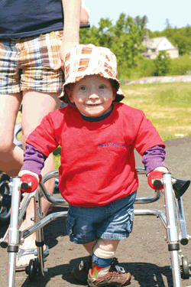
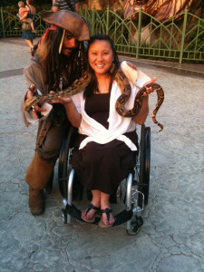
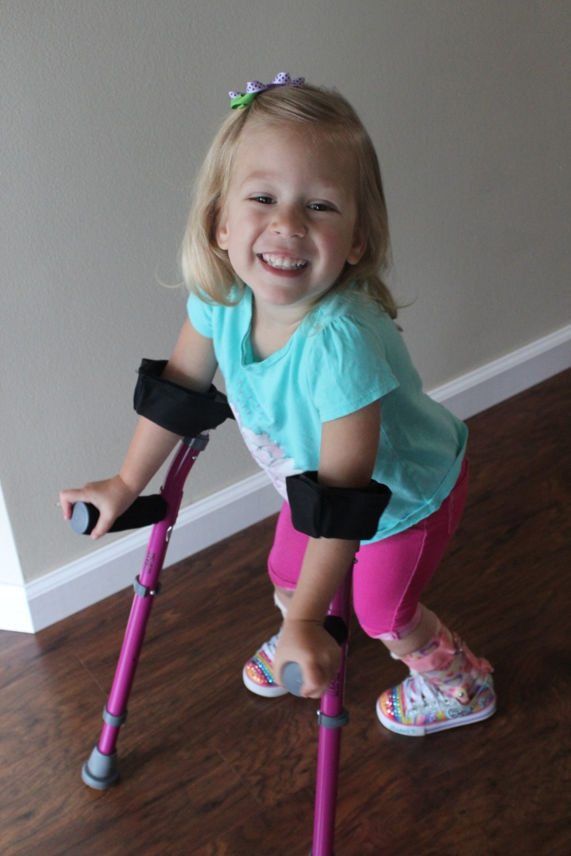
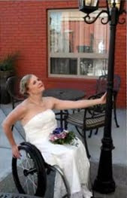
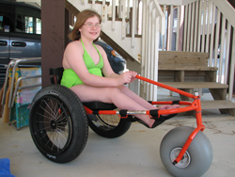
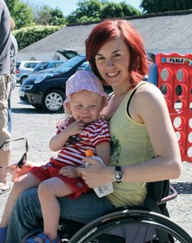
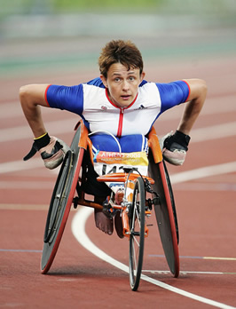
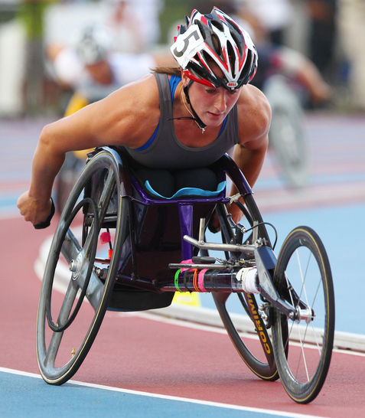
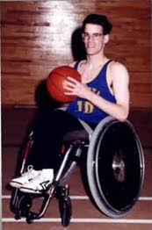

Slide 5
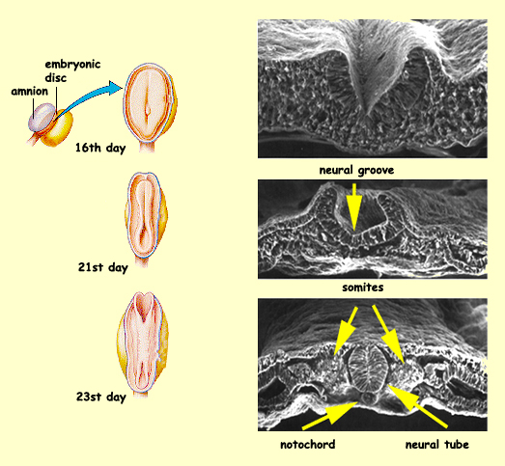
How does spina bifida happen?
Environmental and genetic factors affect development in weeks 0-3 after conception

Slide 6
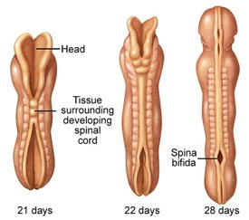
3-4 weeks: establishment of SB

Slide 7
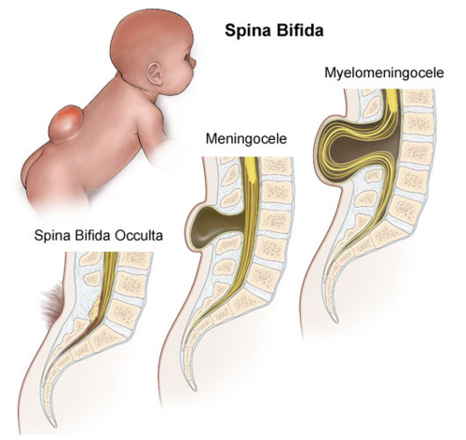
Types of spina bifida

Slide 8
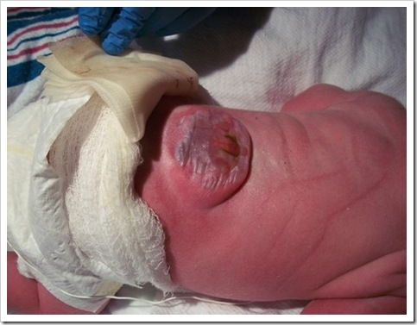
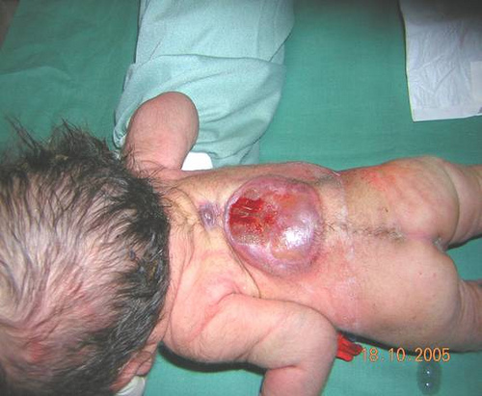
Myelomeningocoele

Slide 9
Main problems in SB
Hydrocephalus: affects 80% of people with spina bifida
Motor: weakness of lower limbs
Sensory: loss of sensation in lower limbs
90-95% have problems with bladder and bowel continence
Sexual function may be affected

Slide 10
Hydrocephalus
Distortion of the lower brainstem can cause blockage to flow of CSF (Chiari II malformation)
Hydrocephalus can develop
  in utero
  After surgery to close the lumbar defect
Treatable with VP shunt
Lifelong risk of shunt blockage and infection
May be associated with epilepsy/seizures

Slide 11
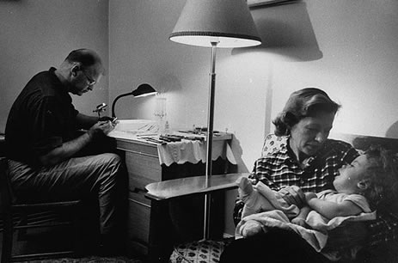
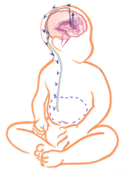
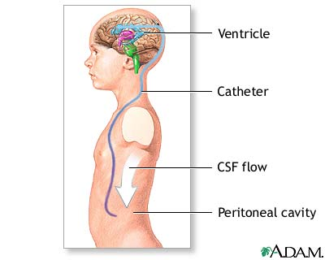
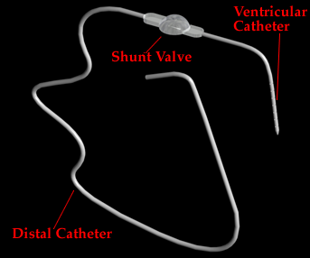

Slide 12
Neurological levels in Spina bifida
The level of weakness depends of the spinal level
  Hips L3/L4
  Knees L4/L5
  Ankles L5/S1
Motor levels can be patchy and sensory levels more accurate
Insensitivity to pain can cause pressure sores and burns

Slide 13
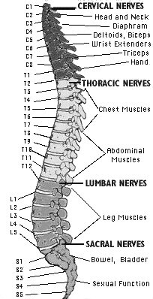
Spinal levels

Slide 14
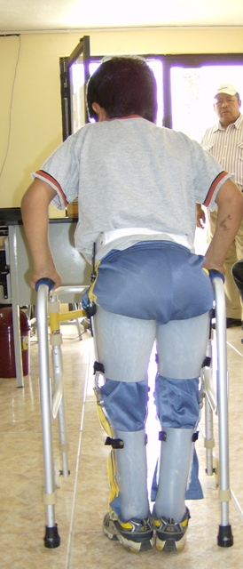
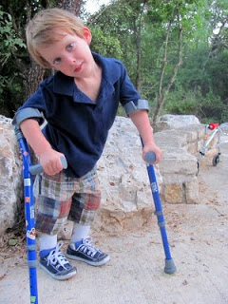
Motor levels

Slide 15
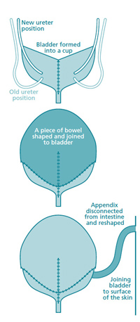
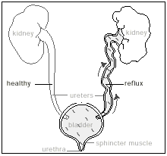
Neurogenic bladder
Urinary retention
Reflux and kidney damage
Risk of kidney failure
Urology clinic
Urodynamic studies
Various bladder surgeries

Slide 16
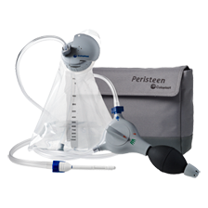
Neurogenic bowel
Constipation main problem
Treatment with enemas/washouts
Sexual function may be affected in males and females
but at least 50% of men with lesions below L5 can have children without medical help

Slide 17
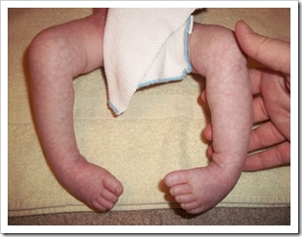
Orthopaedic issues
Talipes may need casting and/or surgery
Hips are often dislocated in high lesions
Aim of surgery is to allow weight bearing

Slide 18
Educational issues
Verbal skills may be in advance of performance skills
Hand-eye co-ordination may be a problem
Attention deficit is more common
Problem solving and sequencing difficulties may become more obvious in an older child
Lower scores associated with higher spinal deficits/antenatal hydrocephalus/epilepsy

Slide 19
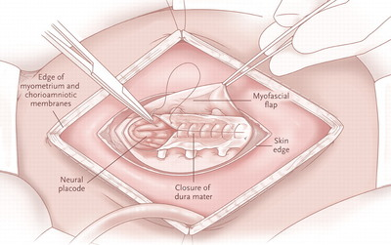
Surgery for spina bifida
All S. Wales children have neurosurgery at UHW with support from the plastic surgeon (NW-J)
Both paediatric neurosurgeons able to perform procedures
Babies kept in NICU for 7-10 days post op to monitor OFC

Slide 20
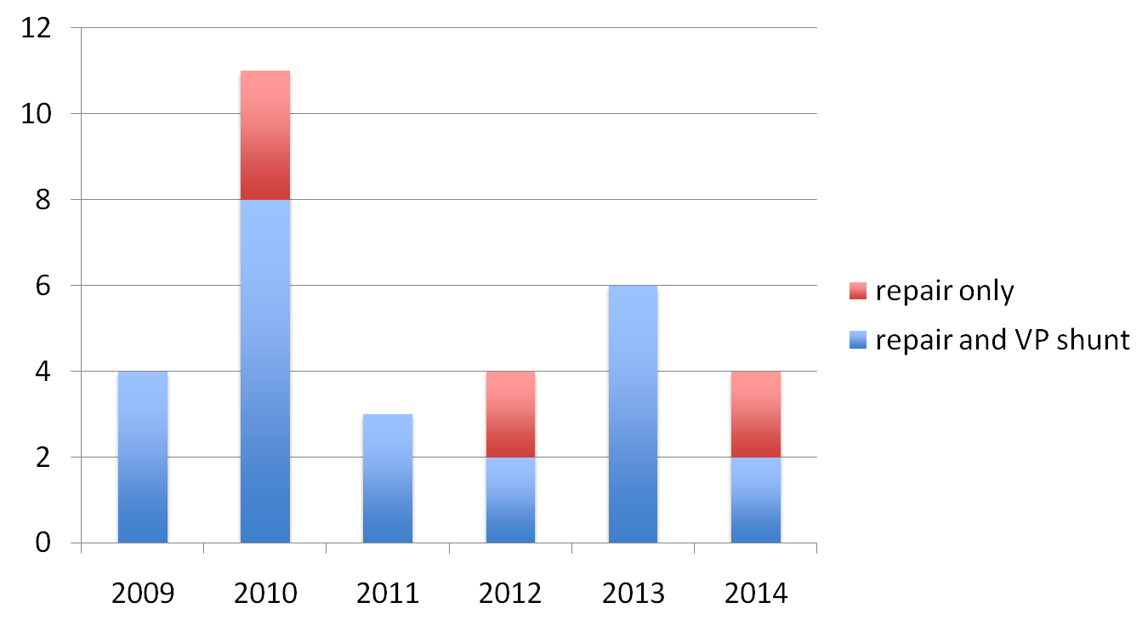
Surgical treatment of spina bifida UHW

Slide 21

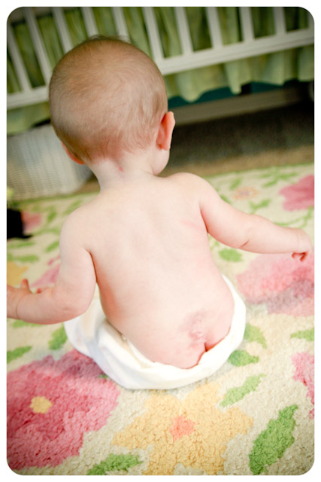
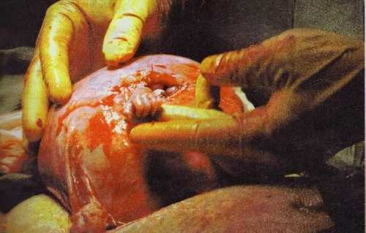
Fetal surgery

Slide 22
Issues for the future
Likely increase in numbers of children surviving with SB
Burden of disability on families
Pressure on paediatric services: especially urology
Difficulties with transition to adult services
Long term monitoring to prevent kidney failure and shunt malfunction

Slide 23
References
http://www.waisman.wisc.edu/~rowley/sb-kids/famous.html#mark
http://www.shinecharity.org.uk/
http://www.spinabifidaassociation.org/site/c.evKRI7OXIoJ8H/b.8028963/k.BE67/Home.htm

