Slide 1







Oral health of 5-year-old children in Wales in 2024/25
Iechyd y geg ymhlith plant 5 oed yng Nghymru 2024/25
Swyddogaeth Gwybodaeth Iechyd Geneuol, Tîm Iechyd Deintyddol y Cyhoedd, Iechyd Cyhoeddus Cymru
Oral Health Intelligence function, Dental Public Health Team, Public Health Wales
Ionawr 2026
January 2026

Slide 2
Ein cenhadaeth
Our Mission
Ni yw Iechyd Cyhoeddus Cymru. Ni yw sefydliad iechyd cyhoeddus cenedlaethol Cymru. Rydym yn bodoli i helpu pawb yng Nghymru i fyw bywydau hirach, iachach
Gyda'n partneriaid, ein nod yw cynyddu disgwyliad oes iach, gwella iechyd a llesiant, a lleihau anghydraddoldebau i bawb yng Nghymru, nawr ac ar gyfer cenedlaethau'r dyfodol
Gyda'i gilydd, mae ein timau'n gweithio i atal clefyd, diogelu iechyd, darparu arweinyddiaeth systemau, gwasanaethau arbenigol ac arbenigedd iechyd cyhoeddus
Ni yw'r brif ffynhonnell o wybodaeth, ymchwil ac arloesedd iechyd cyhoeddus, i helpu pawb yng Nghymru i fyw bywydau iachach
Gweithio gyda'n gilydd ar gyfer Cymru iachach
We are Public Health Wales. We are the national public health organisation for Wales. We exist to help all people in Wales live longer, healthier lives
With our partners, we aim to increase healthy life expectancy, improve health and wellbeing, and reduce inequalities for everyone in Wales, now and for future generations
Together, our teams work to prevent disease, protect health, provide system leadership, specialist services and public health expertise
We are the primary source of public health information, research and innovation, to help everyone in Wales live healthier lives
Working together for a healthier Wales
Public Health Wales

Slide 3
Ein gweledigaeth
Our Vision
Erbyn 2035, byddwn wedi cyflawni dyfodol iachach i Gymru. Rydym yn gweithio tuag at Gymru lle mae pobl yn byw bywydau hirach, iachach a lle mae gan bawb yng Nghymru fynediad teg a chyfartal at y pethau sy'n arwain at iechyd a llesiant da
By 2035, we will have achieved a healthier future for Wales. We are working towards a Wales where people live longer, healthier lives and where all people in Wales have fair and equal access to the things that lead to good health and well-being
Public Health Wales

Slide 4
Cyflwyniad
Introduction
Dyma grynodeb o arolygiad Rhaglen Epidemiolegol Deintyddol GIG Cymru o blant blwyddyn ysgol un (5 oed) a gynhaliwyd ledled Cymru yn 2024-25
Casglwyd data gan dimau Gwasanaeth Deintyddol Cymunedol y GIG ym mhob Bwrdd Iechyd Lleol a'u dadansoddi gan Uned Gwybodaeth Iechyd Geneuol Cymru ym Mhrifysgol Caerdydd ar y cyd â Gwybodaeth Iechyd y Geg yn Iechyd Cyhoeddus Cymru
Ceir rhagor o wybodaeth yn Adroddiad Technegol 'Darlun o Iechyd y Geg 2026', a gyhoeddwyd gan Uned Gwybodaeth Iechyd Geneuol Cymru, Prifysgol Caerdydd
Mae arolygon o blant 5 oed (blwyddyn ysgol un) yn darparu data manwl ar anghenion iechyd y geg ar gyfer gwyliadwriaeth, cynllunio gwasanaethau a gwerthuso.
This is a summary of the NHS Wales Dental Epidemiological Programme’s inspection of school year one (5-year-old) children undertaken across Wales in 2024-25
Data was collected by the NHS Community Dental Service teams within each Local Health Board and analysed by the Welsh Oral Health Information Unit at Cardiff University in conjunction with Oral Health Intelligence at Public Health Wales
Further information can be found in the Technical Report ‘Picture of Oral Health 2026’, published by the Welsh Oral Health Information Unit, Cardiff University
Surveys of 5-year-old (school year one) children provide detailed data on oral health need for surveillance, service planning and evaluation
Public Health Wales

Slide 5
Methodoleg
Methodology
Yn debyg i’r blynyddoedd blaenorol, dilynodd yr arolwg ganllawiau’r Gymdeithas Brydeinig ar gyfer Astudio Deintyddiaeth Gymunedol.
Amcanion arolygiad Rhaglen Epidemioleg Ddeintyddol GIG Cymru o blant blwyddyn ysgol un (5 oed):
1-Cofnodi data, o sampl o blant blwyddyn ysgol un yng Nghymru yn y tymhorau ysgol, Gaeaf 2024/2025 a Gwanwyn 2025;
2-Cael amcangyfrifon dilys o gyffredinrwydd a difrifoldeb pydredd dannedd plant blwyddyn ysgol un i’w cymharu â’r arolygon blaenorol
Cydnabyddiaethau: Hoffai Iechyd Cyhoeddus Cymru a Phrifysgol Caerdydd ddiolch i’r holl ysgolion a gytunodd i gymryd rhan a hwyluso’r arolwg. Yn yr un modd, hoffem ddiolch hefyd i’r timau Gwasanaethau Deintyddol Cymunedol ym mhob Bwrdd Iechyd am eu holl waith caled yn cysylltu â’r ysgolion a chasglu’r data
As in previous years, the survey followed the guidance from the British Association for the Study of Community Dentistry
The objectives of the NHS Dental Epidemiology Programme for Wales inspection of school year one (5-year-old) children:
1-Record data, from a sample of school year one children in Wales in the school terms, Winter 2024/2025 and Spring 2025;
2-Obtain valid estimates of caries prevalence and severity in school year one children to compare to previous surveys
Acknowledgements: Public Health Wales and Cardiff University would like to extend our gratitude to all the schools that agreed to participate and facilitate the survey. Equally, we would also like to thank the Community Dental Service teams in each Health Board for all their hard work in contacting the schools and collecting the data
Public Health Wales

Slide 6
Crynodeb
Summary
Archwiliwyd 8,526 o blant o 655 o ysgolion gwladol prif ffrwd, sy’n cynrychioli 27.4% o gyfanswm poblogaeth blwyddyn ysgol un mewn ysgolion gwladol prif ffrwd.
Mesurwyd dau fesur o brofiad pydredd dannedd: cyffredinrwydd a difrifoldeb
Mae cyffredinrwydd yn cofnodi faint o blant oedd â dannedd wedi’u pydru, ar goll neu wedi’u llenwi. Mae difrifoldeb yn disgrifio nifer cyfartalog y dannedd yr effeithiwyd arnynt gan bydredd dannedd fesul plentyn
Cwblhawyd cwestiynau Ansawdd Bywyd yn ymwneud ag Iechyd y Geg gan 7,988 o blant
Dylid trin data o Fae Abertawe a Chwm Taf Morgannwg yn ofalus oherwydd y newidiadau a wnaed i ffiniau’r byrddau iechyd hyn yn 2019.
8,526 children from 655 state-maintained mainstream schools were examined, which represents 27.4% of the total school year one population in mainstream state-maintained schools
Two measures of dental caries experience were measured: prevalence and severity
Prevalence records how many children had decayed, missing or filled teeth, whilst severity describes the average number of teeth affected by tooth decay per child
Oral Health related Quality of Life questions were completed by 7,988 children
Data from Swansea Bay and Cwm Taf Morgannwg should be treated with caution due to the repatriation of Bridgend County Council
Public Health Wales

Slide 7
Crynodeb
Summary
Yn 2007/8, roedd bron i un o bob dau blentyn wedi cael profiad o bydredd a byddai dau ddant wedi cael eu heffeithio. Yn 2024/25, mae hyn wedi gostwng i bron i un o bob pedwar plentyn gydag un dant wedi pydru.
At ei gilydd, roedd gostyngiad ystadegol arwyddocaol o ran cyffredinrwydd a difrifoldeb pydredd dannedd rhwng 2022/23 a 2024/25. Effeithiwyd ar dros dri dant plant â chlefyd
Effeithiwyd ar iechyd y geg bron i un o bob pum plentyn a samplwyd
Mae anghydraddoldebau iechyd y geg yn parhau (h.y. mae'r rhai o gefndiroedd tlotach yn profi mwy o afiechyd). Nid yw mynegai llethr o anghydraddoldeb wedi newid yn sylweddol (2007/8 i 2023/24)
In 2007/8, approaching one in two children had decay experience and two teeth would be affected. In 2024/25, this has reduced to approaching one in four children with one carious teeth
Overall, there was a statistically significant reduction in the prevalence and severity of dental caries across from 2022/23 to 2024/25. Children with disease had over three teeth affected
Oral health impacted approaching one in every five children sampled
Oral health inequalities remain (i.e. those from poorer backgrounds experience more disease). The slope index of inequality has not significantly changed (2007/8 to 2023/24)
Public Health Wales

Slide 8
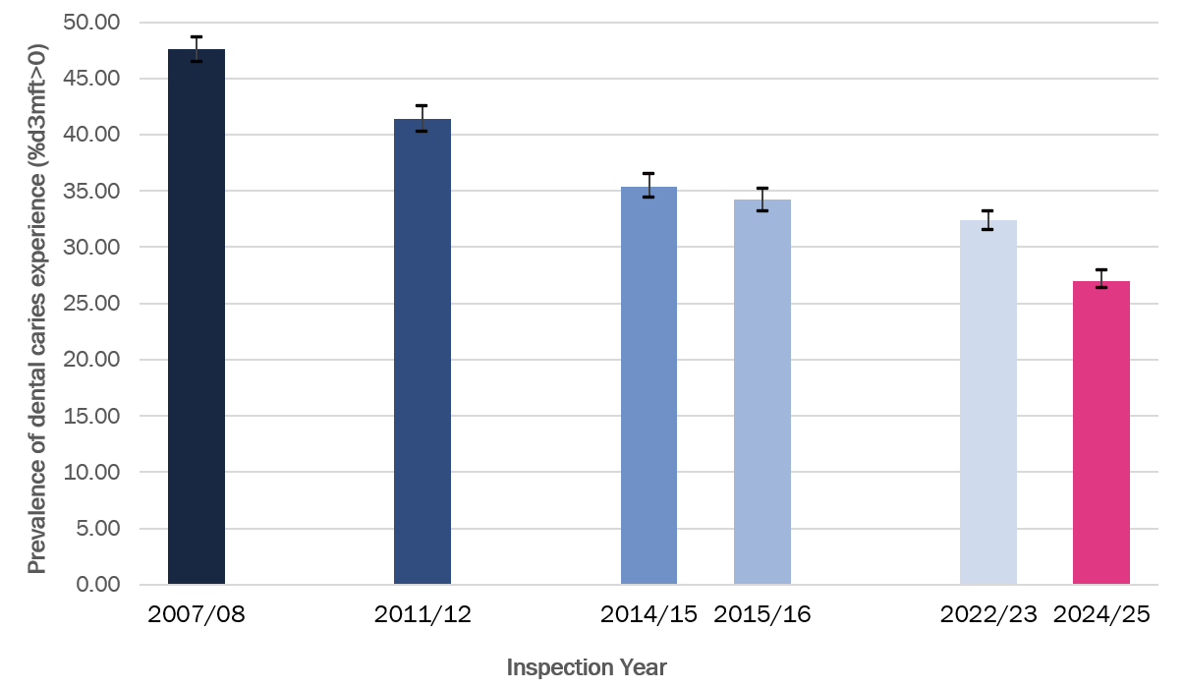
Cyffredinrwydd pydredd dannedd
Prevalence of dental caries
Mae cyffredinrwydd pydredd dannedd wedi gostwng ymhellach yn 2024/25
Roedd y gyfradd o ran profiad o bydredd dannedd yn 27.2% (95%CI 26.3-28.0) gostyngiad ystadegol arwyddocaol o'i gymharu â 2022/23 (32.4% (95%CI 31.5-33.2))
The prevalence of dental caries has reduced further in 2024/25
Dental caries experience was 27.2% (95%CI 26.3-28.0) a statistically significant decrease from 2022/23 (32.4% (95%CI 31.5-33.2))
Public Health Wales

Slide 9
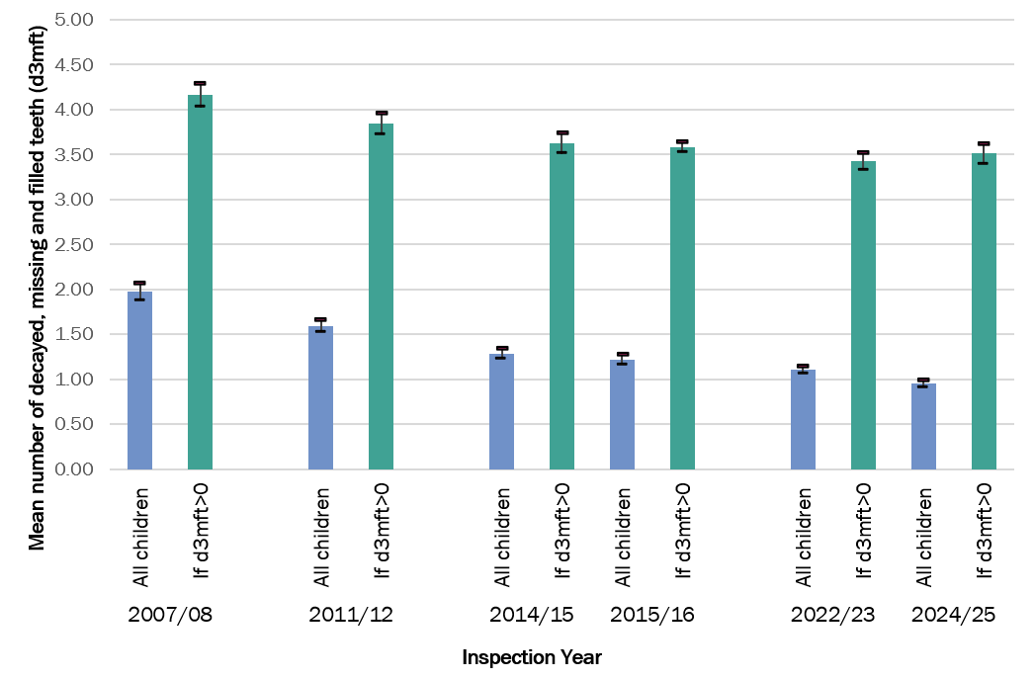
Difrifoldeb pydredd dannedd
Severity of dental caries
Mae difrifoldeb y clefyd (nifer y plant â d3mft) wedi gostwng ymhellach yn 2024/25
Roedd y gyfradd o ran difrifoldeb pydredd dannedd yn 0.95 ar gyfer pob plentyn (95%CI 0.91-0.99), sy’n ostyngiad ystadegol arwyddocaol o'i gymharu â 2022/23 (1.11 (95%CI 1.07-1.15))
Fodd bynnag, pan fo gan blant glefyd, maent yn profi nifer uchel o ddannedd wedi pydru, ar goll neu wedi'u llenwi 3.51 (95%CI 3.39-3.62
Disease severity (number of children with d3mft) has reduced further in 2024/25
Dental caries severity was 0.95 for all children (95%CI 0.91-0.99) a statistically significant decrease on from 2022/23 (1.11 (95%CI 1.07-1.15))
However, when children have disease, they experience a high number of decayed, missing or filled teeth 3.51 (95%CI 3.39-3.62)
Public Health Wales

Slide 10
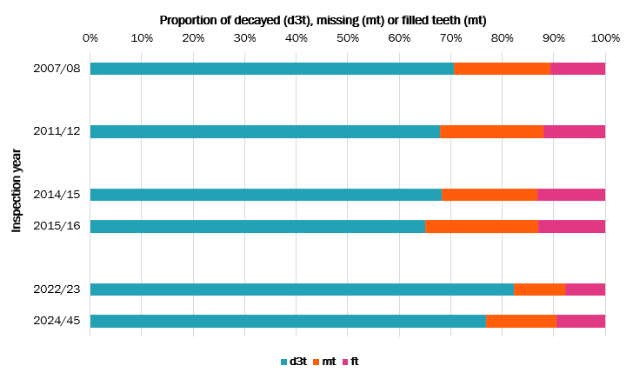
Cyfansoddiad d3mft
Composition of d3mft
Pydredd dannedd heb ei drin yw'r elfen fwyaf cyffredin o d3mft
Fel cyfran o gyfanswm y d3mft, mae'r elfen hon wedi cynyddu yn arolygon 2022/23 a 2024/25 (ar ôl COVID)
Untreated dental caries is the most common element of d3mft
As a proportion of total d3mft, this element has increased in the 2022/23 and 2024/25 surveys (post-COVID)
Public Health Wales

Slide 11
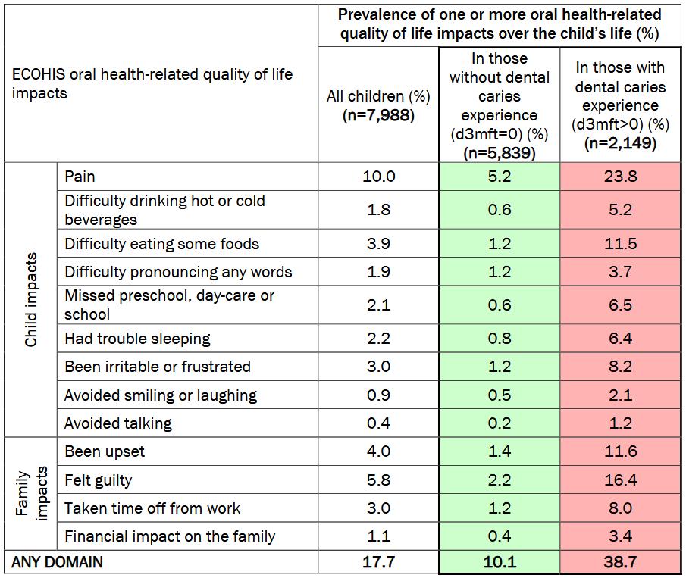
Ansawdd bywyd
Quality of Life
Ymhlith yr holl rieni a samplwyd, nododd 17.7% effaith ar ansawdd bywyd eu plentyn. Yn y grŵp hwn, poen oedd yr effaith fwyaf cyffredin (10.0%)
Ymhlith rhieni plant â d3mft, nododd 38.7% o rieni effaith ar ansawdd bywyd eu plentyn. Yn y grŵp hwn, poen oedd yr effaith fwyaf cyffredin (23.8%)
Across all parents sampled, 17.7% reported an impact on their child's quality of life. In this group, pain was the most common impact (10.0%)
Across parents of children with d3mft, 38.7% of parents reported an impact on their child's quality of life. In this group, pain was the most common impact (23.8%)
Public Health Wales

Slide 12
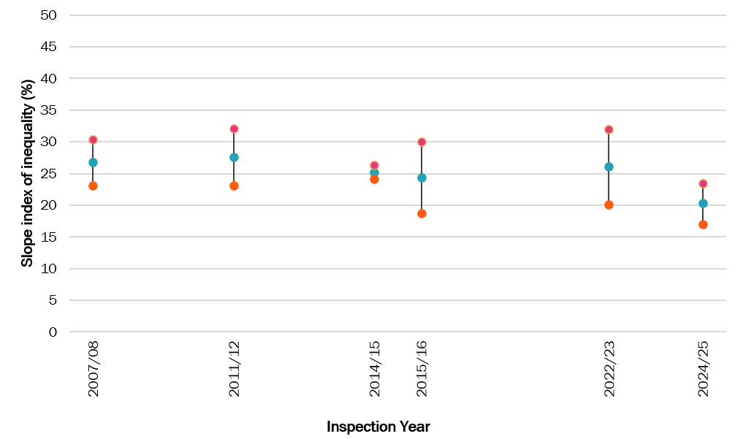
Anghydraddoldeb
Inequality
Roedd y plant o'r cymunedau mwyaf difreintiedig yn fwy tebygol o brofi pydredd dannedd a chael mwy o ddannedd sydd wedi cael eu heffeithio. Ers arolwg 2022/23 mae cyffredinrwydd pydredd dannedd wedi gostwng ym mhedwar cwintel mwyaf difreintiedig WIMD 2019
Nid yw’r mynegai llethr o anghydraddoldeb yn seiliedig ar gyffredinrwydd pydredd dannedd wedi newid yn sylweddol rhwng 2007/08 a 2024/25
Children from the most deprived communities were more likely to experience dental caries and have more teeth affected. Since the 2022/23 survey the prevalence of dental caries has fallen in the four most deprived WIMD 2019 quintiles
Slope index of inequality based on caries prevalence has not significantly changed between 2007/08 and 2024/25
Public Health Wales

Slide 13
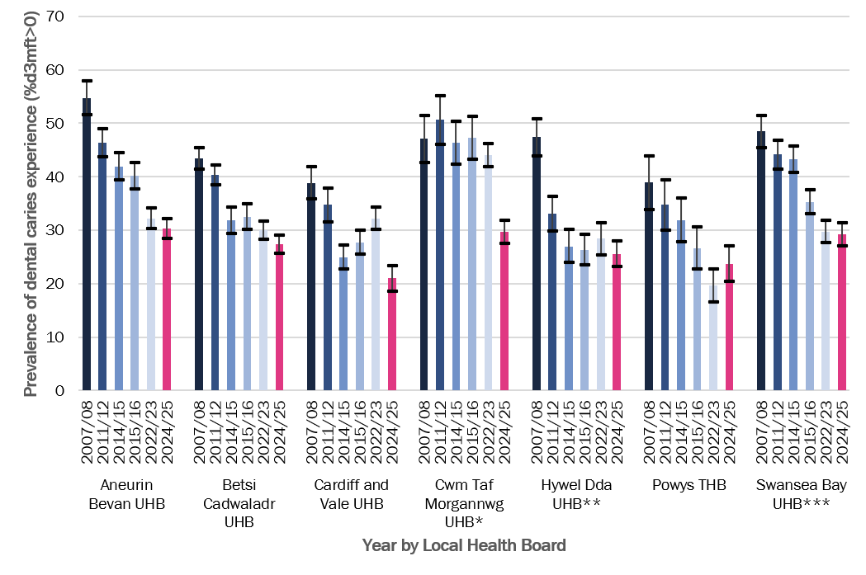
Byrddau Iechyd
Health Boards
Gostyngiad o ran cyffredinrwydd ers 2022/23:
1. Bwrdd Iechyd Prifysgol Caerdydd a’r Fro
2. Bwrdd Iechyd Prifysgol Cwm Taf Morgannwg
Dim newid o ran cyffredinrwydd ers 2022/23:
1. Bwrdd Iechyd Prifysgol Aneurin Bevan
2. Bwrdd Iechyd Prifysgol Betsi Cadwaladr
3. Bwrdd Iechyd Prifysgol Bae Abertawe
4. Bwrdd Iechyd Addysgu Powys
Nid yw’r data sydd ar goll o Geredigion yn galluogi cymhariaeth ym Mhrif Iechyd Prifysgol Hywel Dda ers 2022/23
Reduction in prevalence since 2022/23:
Cardiff & Vale UHB
Cwm Taf Morgannwg UHB
No change in prevalence since 2022/23:
Aneurin Bevan UHB
Betsi Cadwaladr UHB
Swansea Bay UHB
Powys THB
Missing Ceredigion data does not enable a comparison in Hywel Dda UHB since 2022/23
Public Health Wales

Slide 14
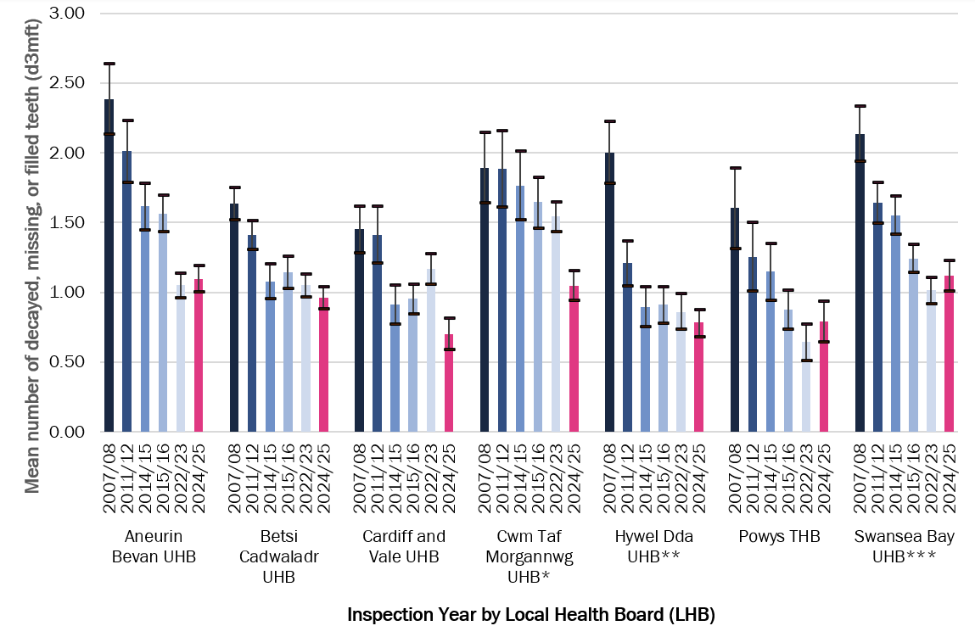
Byrddau Iechyd
Health Boards
Gostyngiad o ran difrifoldeb ers 2022/23:
1. Bwrdd Iechyd Prifysgol Caerdydd a’r Fro
2. Bwrdd Iechyd Prifysgol Cwm Taf Morgannwg
Dim newid o ran difrifoldeb ers 2022/23:
1. Bwrdd Iechyd Prifysgol Aneurin Bevan
2. Bwrdd Iechyd Prifysgol Betsi Cadwaladr
3. Bwrdd Iechyd Addysgu Powys
4. Bwrdd Iechyd Prifysgol Bae Abertawe
Nid yw’r data sydd ar goll o Geredigion yn galluogi cymhariaeth ym Mhrif Iechyd Prifysgol Hywel Dda ers 2022/23
Reduction in severity since 2022/23:
Cardiff & Vale UHB
Cwm Taf Morgannwg UHB
No change in severity since 2022/23:
Aneurin Bevan UHB
Betsi Cadwaladr UHB
Powys THB
Swansea Bay UHB
Missing Ceredigion data does not enable a comparison in Hywel Dda UHB since 2022/23
Public Health Wales

Slide 15
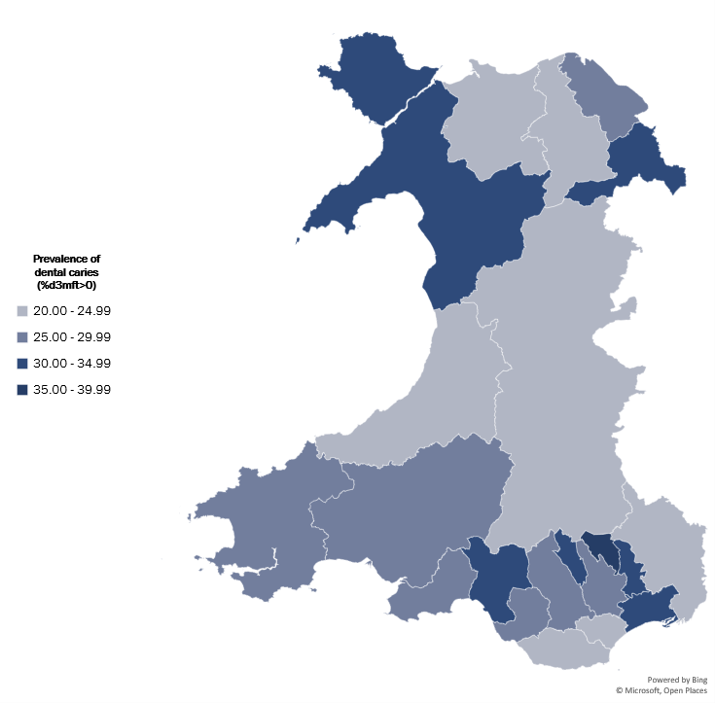
Awdurdodau Unedol
Unitary Authorities
Ar lefel Awdurdod Unedol, mae cyffredinrwydd pydredd dannedd yn amrywio o 20.2% (95%CI 16.8%-23.6%) yng Nghonwy i 36.0% (95%CI 30.8%-41.2%) ym Mlaenau Gwent.
At a Unitary Authority level, dental caries prevalence ranges from 20.2% (95%CI 16.8%-23.6%) in Conwy to 36.0% (95%CI 30.8%-41.2%) in Blaenau Gwent
Public Health Wales

Slide 16
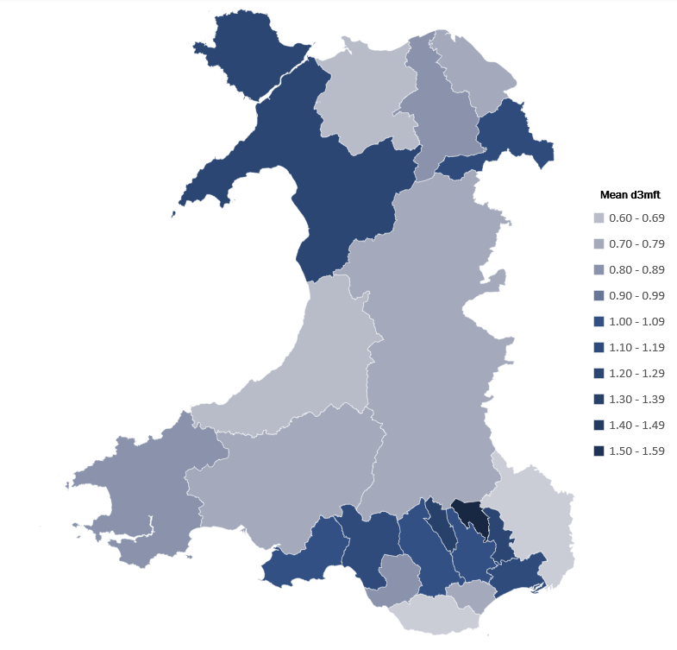
Awdurdodau Unedol
Unitary Authorities
Ar lefel Awdurdod Unedol, mae difrifoldeb yn amrywio o 0.55 (95%CI 0.40-0.70) ym Mro Morgannwg i 1.58 (95%CI 1.28-1.87) ym Mlaenau Gwent.
At a Unitary Authority level, severity ranges from 0.55 (95%CI 0.40-0.70) in the Vale of Glamorgan to 1.58 (95%CI 1.28-1.87) in Blaenau Gwent
Public Health Wales

Slide 17
Gweithio gyda'n gilydd i greu Cymru iachach
Working together for a healthier Wales

