Slide 1
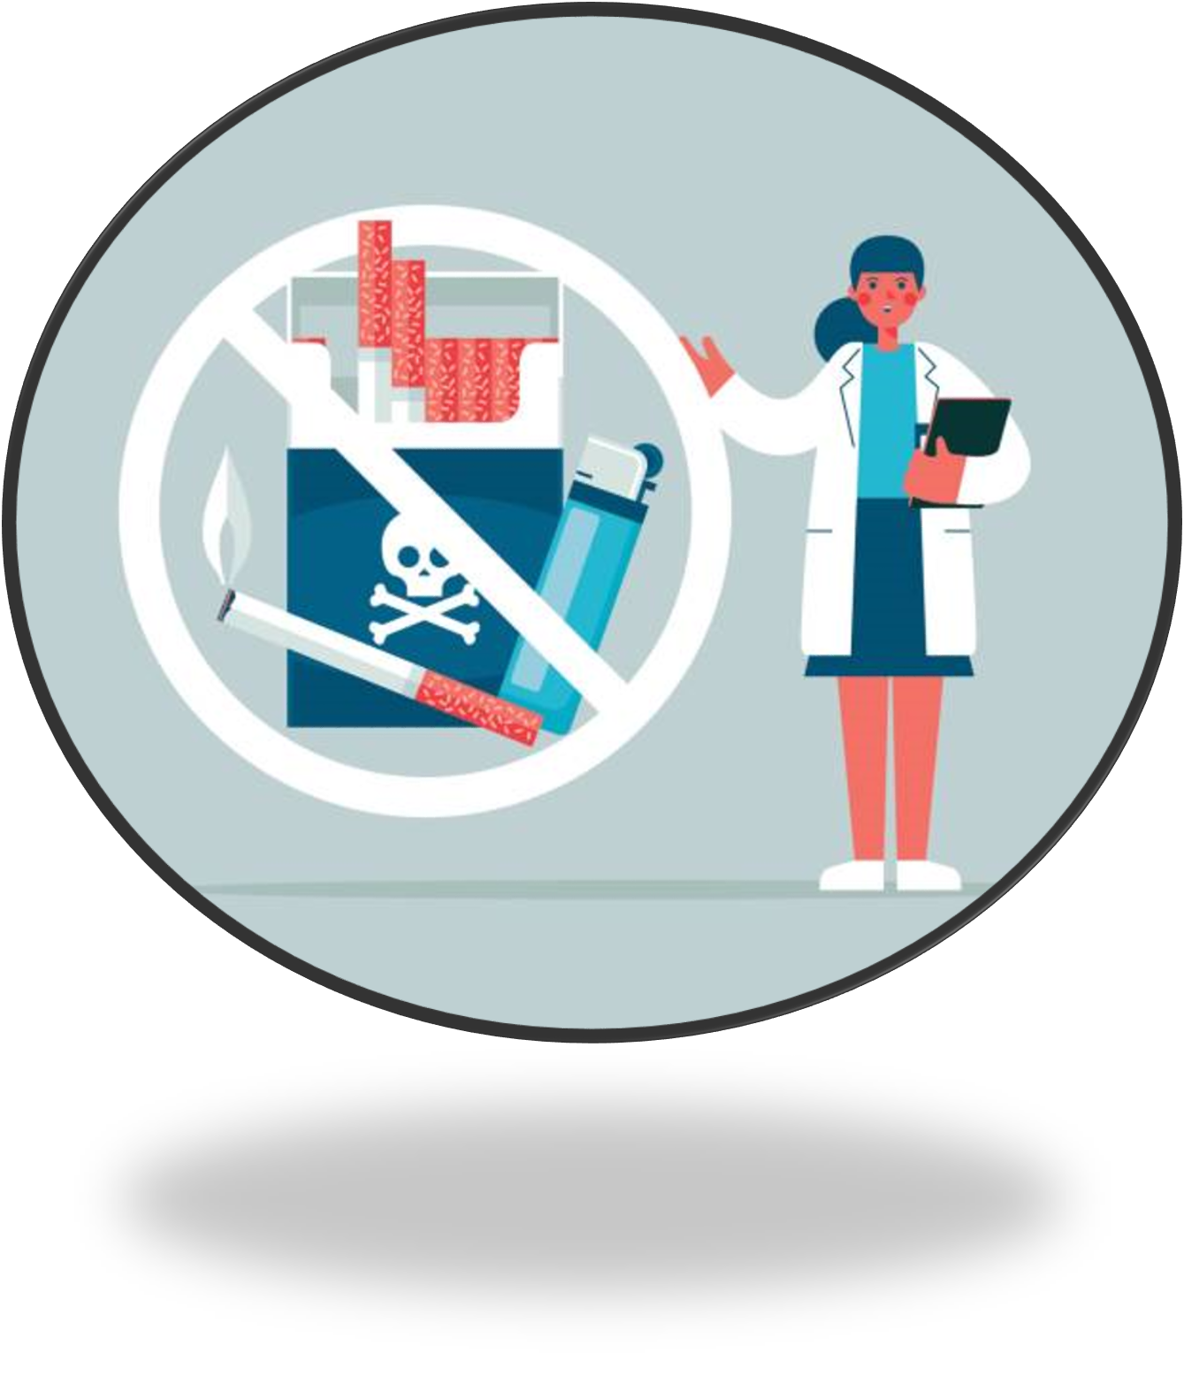
Smoking Data and Statistics

Slide 2
In this slide set, we’ll explore:
Smoking rates among adults in Wales
Trends over time
Smoking rates among children and teenagers
Trends over time
Health impacts and burden on Wales
Inequalities & socio-economic patterns
What the data suggests for the future

Slide 3
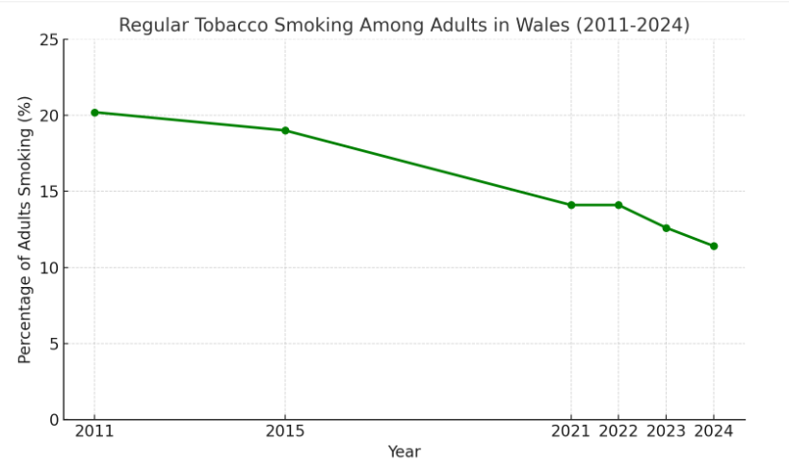
Adult Tobacco Smoking in Wales
According to the latest National Survey for Wales (2024-25), 10.4% of adults (aged 18+) in Wales reported that they currently smoke cigarettes. This is a reduction from 13% in 2022-23.
This is the lowest adult smoking rate recorded in Wales since records began.
Smoking prevalence is highest among adults aged 25–34 years.
Compared with 2011, adult smoking in Wales has fallen by more than 50%.
However, while the downward trend is continuing, 1 in 10 adults in Wales still smoke.
.
National Survey for Wales headline results: April 2024 to March 2025 [HTML] | GOV.WALES

Slide 4
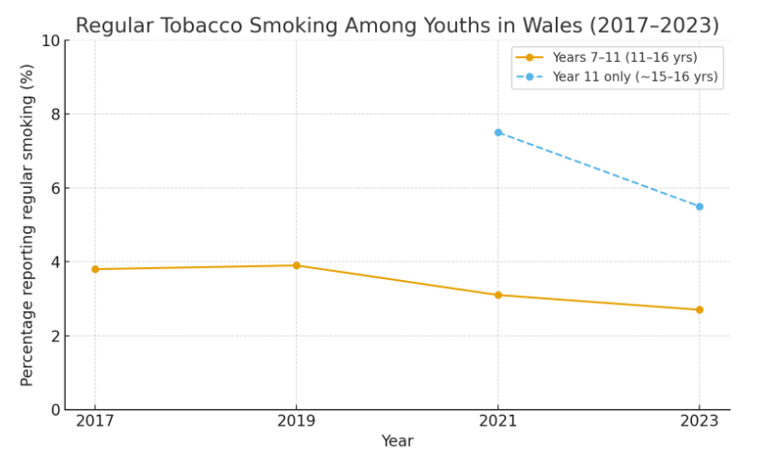
Youth Tobacco Smoking in Wales
Smoking among school-aged children is very low.
In years 7–11 (ages 11–16): ~3% currently smoke cigarettes.
In older pupils (years 12–13): ~7% report current smoking.
"Ever tried smoking” is slightly higher, but still under 10% for most secondary school students.
Regular smoking among teenagers in Wales has been steadily decreasing.
Source: Public Health Wales
Use your own SHRN data to establish how common smoking is among your learners and identify any patterns that may need attention.

Slide 5
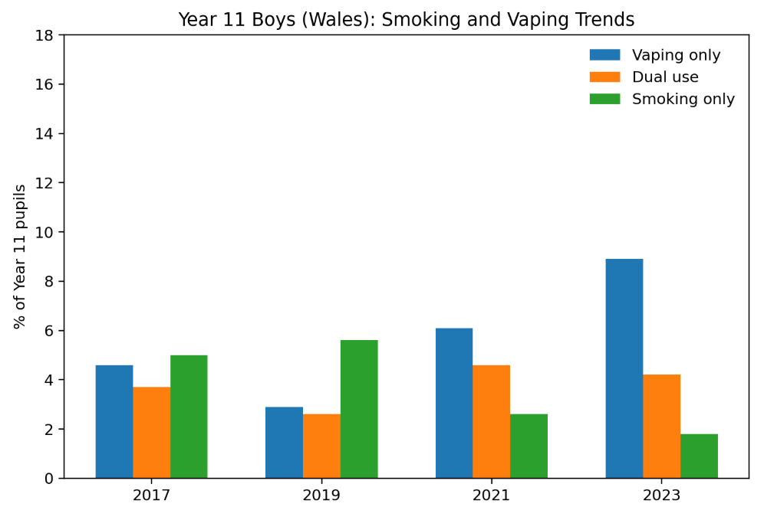
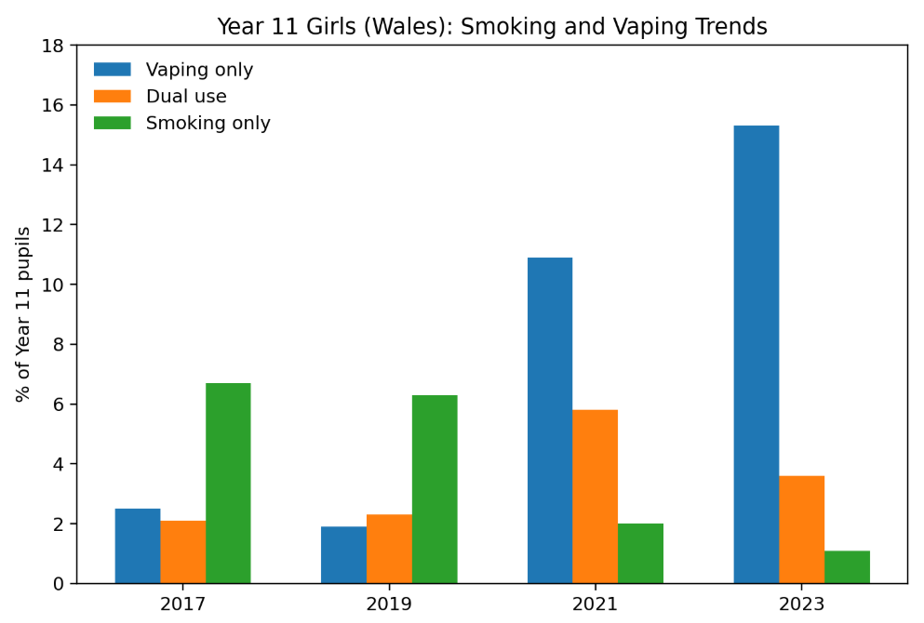
Understanding Current Smoking Trends
The SHRN data shows that regular smoking among Year 11 pupils in Wales has continued to decline between 2017 and 2023.

Slide 6
The Health Impact and Burden in Wales
An estimated 3,845 deaths per year in Wales (among people aged 35+) were attributable to smoking - over 10% of all deaths in that age group. (Calculated between 2020 and 2022)
Smoking also contributes to significant pressure on health services: around 17,000 hospital admissions each year in Wales are attributable to smoking.
The burden of death and illness is not evenly distributed: people in the most deprived communities suffer far more - smoking-related death and hospital admission rates are about three times higher in the most deprived areas than in the least deprived.

Slide 7
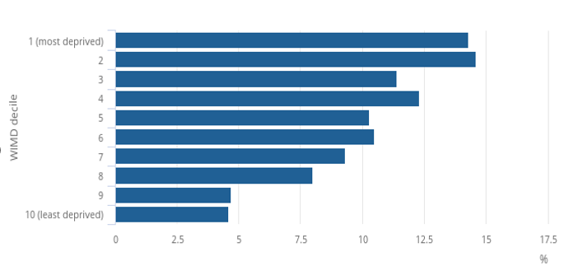
Inequalities & Socio-Economic Patterns
There is a strong link between area‑level deprivation and smoking prevalence. In Wales, around 22.4% of adults living in the most deprived neighbourhoods smoke, compared with just 6.6% of those in the least deprived areas (Office for National Statistics, 2023).
Distribution of smokers in Wales aged 18 and over by neighbourhood
In Wales socio‑economic status - including employment and occupational class - also matters. Smoking rates are higher among people in “routine and manual” jobs or those unemployed, compared with those in managerial or professional roles.
Source: Annual Population Survey from the Office of National Statistics
Deprivation and the impact on smoking prevalence, England and Wales: (2017 to 2021)

Slide 8

Summary
Smoking rates in Wales have reached historic lows, with low prevalence among children and young people, although just over 1 in 10 adults still smoke.
Long-term trends show a substantial and continuing decline in smoking across all age groups. However, smoking remains a major cause of preventable illness and death, contributing to over 10% of deaths and significant pressure on health services each year.
The burden of smoking is not evenly distributed, with rates and health impacts markedly higher in more deprived communities. While progress has been strong, reducing inequalities and supporting smokers in disadvantaged groups, as well as initiatives to prevent uptake of smoking, remains critical to achieving further reductions in harm.

Slide 9
References
The information provided in this slide set took references from the following:
National Survey for Wales headline results: April 2024 to March 2025 [HTML] | GOV.WALES
https://phw.nhs.wales/news/over-10-percent-of-deaths-in-wales-due-to-smoking/
https://publichealthnetwork.cymru/over-10-percent-of-deaths-in-wales-due-to-smoking/
Action on Smoking and Health
https://www.ons.gov.uk/peoplepopulationandcommunity/healthandsocialcare/drugusealcoholandsmoking/bulletins/deprivationandtheimpactonsmokingprevalenceenglandandwales/2017to2021

