Slide 1
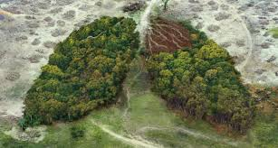
The Social and Environmental Impact of Tobacco Products
Wider consequences beyond individual health

Slide 2
In this slide set we’ll explore:
The Social and Environmental Impact of Tobacco Products
The Environmental Effects
  How tobacco waste is affecting our environment
  The Impact of Tobacco Smoking on Homes and Communities
  The effects of second-hand smoking
  Laws and policies in Wales
  Social Influence and Inequality
  Peer pressure, family habits and media portrayals
  The Welsh Government’s Tobacco Control Strategy
  The Tobacco Industry – What You Should Know
  A Shared Responsibility

Slide 3
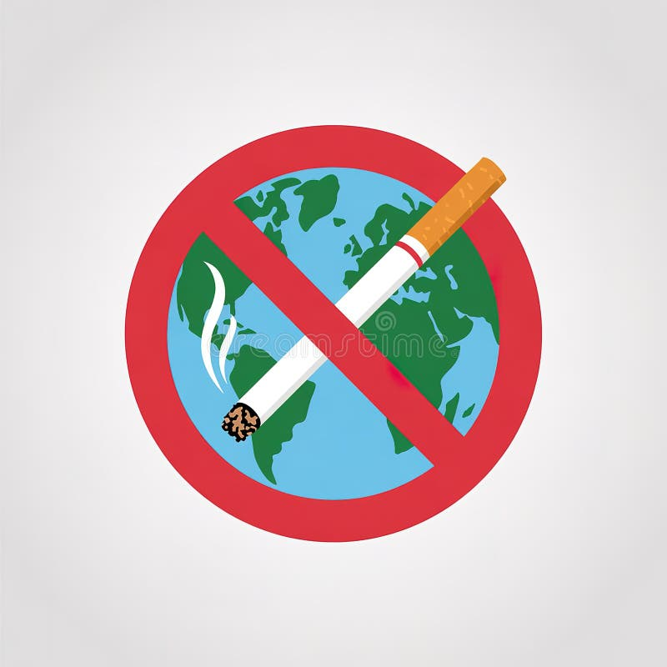
The Social and Environmental Impacts
Tobacco use doesn’t just harm individual smokers - it has wide-reaching effects on families, communities, the environment and the economy.
The impact begins with how tobacco is grown, often involving deforestation, pesticide use and poor labour conditions overseas, and continues with the waste left behind, including cigarette butts that pollute streets, rivers and coastal areas.
In Wales, reducing tobacco use contributes to cleaner air, healthier communities, reduced health inequalities and a more sustainable environment, supporting national goals under the Well-being of Future Generations (Wales) Act 2015.

Slide 4
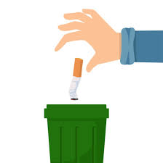
The Environmental Effects
Most of the tobacco used in UK products is grown overseas, often in regions where farming leads to:
deforestation
soil damage
pollution from pesticides
In Wales, cigarette butts are one of the most common types of litter, polluting beaches, streets and waterways. These filters are made from non-biodegradable plastic which can take years to break down and release toxins harmful to wildlife.
Reducing tobacco waste supports Wales’ Clean Air and Zero Waste strategies, helping to protect the land, natural habitats and coastal environments.
​
Source: towards-zero-waste-our-waste-strategy.pdf

Slide 5
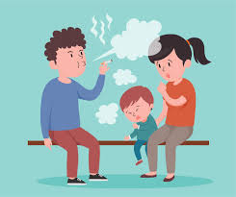
Impact on Homes and Communities
Smoking affects more than just the user. Second-hand smoke exposes non-smokers to harmful chemicals, increasing the risk of things like:
Heart disease
Asthma
Respiratory illnesses
Children are particularly vulnerable, with exposure linked to chest infections, ear problems, breathing difficulties and asthma attacks.
In Wales, it is illegal to smoke in cars carrying anyone under-18, or in hospital grounds, school and early years sites and playgrounds. Even after smoking, third-hand smoke clings to clothing, soft furnishings, carpets and walls, continuing to expose others to harmful chemicals.
Tobacco use can also strain household budgets due to its high cost and contribute to health inequalities in more deprived communities.

Slide 6

Social Influence and Inequality
Social factors play a strong role in tobacco use. Peer pressure, family habits and media exposure influence whether young people start smoking or using tobacco and other nicotine products.
In Wales, smoking rates remain highest in deprived areas and among people facing financial stress, mental health challenges or long-term illness.
The Welsh Government’s Tobacco Control Strategy (2022–2032) aims to create a smoke-free Wales by 2030, focusing on reducing inequalities and supporting people to quit.
Public health campaigns such as those run by Help Me Quit and ASH Wales have helped make smoking less socially acceptable and raise awareness of its wider impacts.

Slide 7
The Tobacco Industry:
What You Should Know
Tobacco companies have a long history of misleading the public about the dangers of smoking to protect their profits.
They continue to use marketing, promotions, lobbying and lawsuits to delay or weaken health laws around the world.
Young people and disadvantaged communities are often deliberately targeted, as the industry needs new customers to replace those who quit or become ill.
Tobacco products - including newer items like pouches or heated tobacco - are designed to be addictive, keeping people buying them.
The industry also causes significant environmental harm, from deforestation and pollution to billions of cigarette butts polluting land and water.
Understanding these tactics helps us see that tobacco harm is not just about individual choices - it’s also shaped by powerful industry influence.

Slide 8

A Shared Responsibility
Tobacco use affects:
Health
Society
The environment
Future generations
Reducing smoking and preventing uptake helps Wales move toward a cleaner, fairer and healthier future, supporting national well-being goals.
Everyone has a role to play - families, schools, communities and policymakers - in creating a smoke-free Wales, protecting both people and the planet.

Slide 9
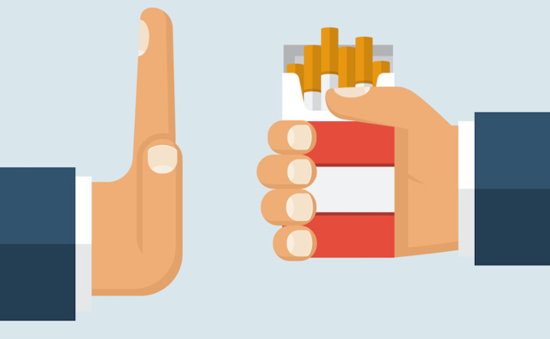
Summary
Tobacco use affects more than personal health - it impacts the environment, economy and society. From global farming practices to local litter and community well-being, the consequences are wide-reaching.
Wales’ smoke-free ambition reflects a growing movement to create a cleaner, fairer and healthier future for all.

Slide 10
References
The information provided in this slide set uses the following sources:
The Well-being of Future Generations | GOV.WALES
Well-being of Future Generations (Wales) Act 2015
The environmental and health impacts of tobacco agriculture, cigarette manufacture and consumption – PMC
towards-zero-waste-our-waste-strategy.pdf
Health Problems Caused by Secondhand Smoke | Smoking and Tobacco Use | CDC
A smoke-free Wales: Our long-term tobacco control strategy [HTML] | GOV.WALES
Ambition to make Wales smoke-free by 2030 - as smoking remains the leading cause of premature deaths - Public Health Network Cymru
Stopping Tobacco Organizations and Products (STOP)

