Slide 1

How Tobacco and Nicotine Use Affects your Emotional and Mental Well-being

Slide 2
In this slide set we’ll explore:
Understanding the Connection
How nicotine affects the brain and emotions.
What Nicotine Does in the Brain
The science behind nicotine’s impact on mood and dependence.
The Emotional Cycle of Nicotine Dependence
Why nicotine seems to relieve stress – and how it maintains it.
How Tobacco and Nicotine Affect Emotions
Common emotional and psychological effects of nicotine use.
Smoking and Mental Health
The relationship between tobacco use and mental health conditions.
The Myth of Stress Relief
Why smoking doesn’t truly reduce stress or anxiety.
Nicotine and Specific Mental Health Conditions
How nicotine interacts with anxiety, depression, ADHD and other conditions.
Benefits of Quitting for Emotional Well-Being
How mood, confidence and focus improve after stopping.
Quitting Support in Wales
Services and resources to help people quit safely.
Building Positive Emotional Health After Quitting
Practical ways to maintain mental well-being.
Communities and Mental Well-Being
How Wales promotes smoke-free, supportive environments.
.

Slide 3

Understanding the Connection
Tobacco and nicotine use do not only harm physical health - they also affect how we think, feel and manage emotions.
Nicotine changes brain chemistry, influencing mood, stress levels and concentration.
Over time, dependence develops, creating emotional highs and lows linked to nicotine use.
Recognising this connection helps explain why quitting can improve both mental and emotional well-being.

Slide 4
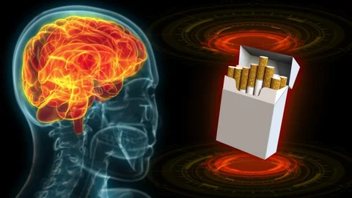
What Nicotine Does in the Brain
Nicotine enters the bloodstream within seconds and reaches the brain rapidly.
It binds to special receptors and triggers the release of dopamine and other “feel-good” chemicals. These chemicals create a temporary feeling of pleasure, calm or focus.
Over time, the brain reduces its own dopamine production - this leads to:
Tolerance levels rising – this means more nicotine is needed to gain the same effect as before.
Dependence - when nicotine levels fall, withdrawal symptoms appear, such as irritability, low mood and restlessness.

Slide 5
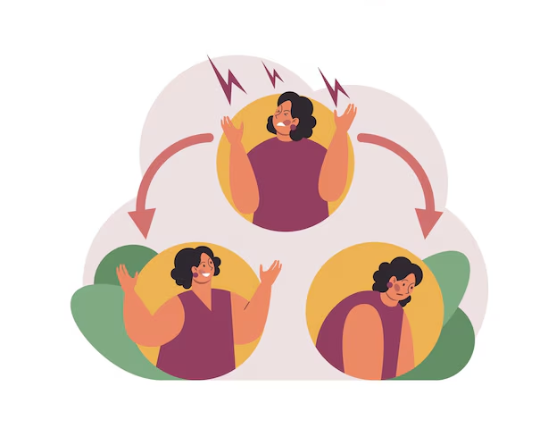
The Emotional Cycle of Nicotine Dependence
Nicotine creates a repeating emotional pattern:
Use nicotine → short burst of calm or focus.
Nicotine wears off → withdrawal begins (tension, anxiety, low mood).
Craving → desire to smoke or vape to feel better.
Relief after smoking → withdrawal symptoms stop temporarily.
This cycle tricks the brain into believing nicotine relieves stress, when it is really easing withdrawal discomfort.

Slide 6
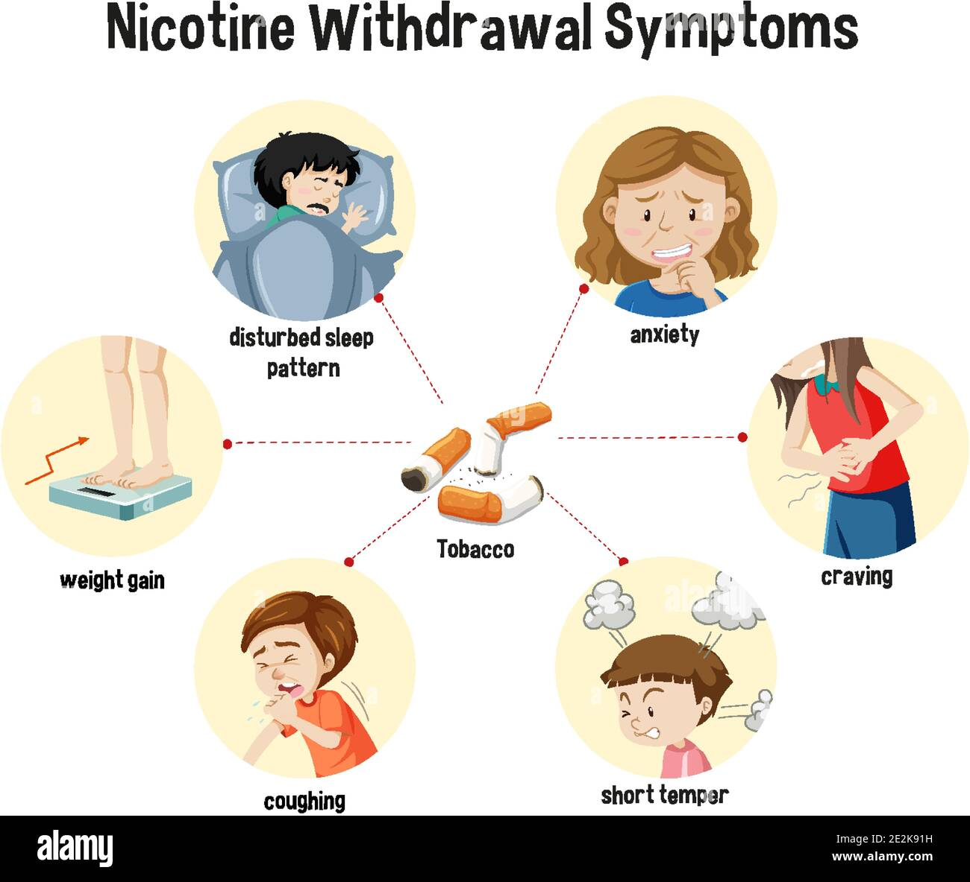
How Tobacco and Nicotine Affect Emotions
Nicotine alters how the brain regulates emotion and stress. Common effects include:
Mood swings: sudden changes between calmness and irritability.
Anxiety: nicotine raises adrenaline and heart rate, increasing tension.
Depression: long-term use disrupts the brain’s natural reward system.
Sleep problems: nicotine keeps the brain alert and disturbs rest.
Poor focus: cravings distract from tasks and affect concentration.
Low confidence or guilt: dependence may reduce self-esteem.
These emotional impacts can feel stronger during withdrawal but gradually ease after quitting.

Slide 7

Smoking and Mental Health
People with mental health conditions are more likely to smoke - often as a way to manage stress or low mood.
In Wales, people living with mental health problems are twice as likely to smoke compared to the general population.
Nicotine dependence can worsen anxiety, depression and stress symptoms over time. It can also interfere with medications for mental health by changing how the body processes them.
Quitting smoking benefits both physical and mental health, even for those with long-term conditions.

Slide 8
The Myth of Stress Relief
Many people believe smoking helps them relax - but this is a myth.
What Really Happens | True Stress relief
Smoking briefly eases withdrawal symptoms, creating a false sense of calm. Nicotine actually increases cortisol, the body’s stress hormone. Heart rate and blood pressure rise, mimicking stress rather than relieving it. | Deep breathing or mindfulness. Talking with supportive people. Physical activity or relaxation exercises. Quitting allows the body to regulate stress naturally again.

Slide 9
Nicotine and Specific Mental Health Conditions
Mental Health Condition | Impact of Nicotine | Benefits After Quitting
Anxiety | Increases adrenaline and tension, causing jitteriness. | Reduced anxiety levels and calmer mood.
Depression | Disrupts dopamine and emotional stability. | Improved mood and motivation.
ADHD | Temporary focus boost followed by distraction and irritability. | Steadier attention and energy.
Schizophrenia/Bipolar Disorder | May interfere with medications and mood regulation. | Better treatment balance and overall well-being.

Slide 10
Benefits of Quitting for Emotional Well-Being
Stopping nicotine use restores the brain’s natural balance.
After quitting:
Mood becomes more stable and positive.
Stress levels decrease over time.
Sleep and concentration improve.
Energy and confidence increase.
People report greater self-control and satisfaction.
Research shows people who quit smoking experience lower anxiety and depression and better quality of life than those who continue.

Slide 11

Quitting Support for Mental and Emotional Health (Wales)
Help Me Quit Wales — Free NHS service offering expert, professional help:
One-to-one or group sessions (in person, on the phone or online).
Free nicotine replacement therapies and medications.
Bilingual support in English and Welsh.
0800 085 2219 or text “HMQ” to 80818
helpmequit.wales
Additional Support:
Mind Cymru: information on mental well-being and smoking.
NHS 111 Wales: advice on coping strategies and local services.
GPs and community pharmacies: medical support for quitting safely.
Quitting support works best when emotional health is supported at the same time.

Slide 12
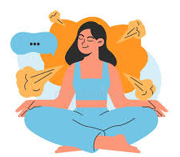
Building Positive Emotional Health After Quitting
Quitting can feel challenging at first, but emotional well-being improves with new routines.
Helpful strategies include:
Physical activity: reduces stress hormones and releases endorphins.
Relaxation: practice deep breathing, mindfulness or gentle stretching.
Healthy distractions: creative activities, reading, music or time outdoors.
Support networks: friends, family or quit groups for encouragement.
Celebrate progress: reward milestones to stay motivated.
"​Each smoke-free day strengthens confidence and emotional balance."
​

Slide 13
Communities and Mental Well-Being
Communities across Wales promote smoke-free spaces to protect everyone's well-being, the Welsh Government currently has the ambition of a smoke-free Wales by 2030, as part of this they have brought in smoke free legislation in places such as:
Parks
Playgrounds
Schools
Hospital grounds
Creating smoke-free environments helps change social norms, reduces triggers, and encourages positive mental and physical health. Collective action makes quitting easier and reinforces the message that well-being is a shared goal.

Slide 14
Summary
Tobacco and nicotine affect brain chemistry, mood and emotions.
Dependence creates a cycle of stress and relief that feels calming but maintains addiction.
Smoking and vaping are linked to higher anxiety, depression and irritability.
Quitting improves mental health, emotional stability and quality of life.
Support in Wales - such as Help Me Quit and Mind Cymru - makes quitting safer, easier and more effective.
Remember:
Every step towards quitting is a step towards better mental and emotional well-being.

Slide 15
References
The information provided in this slide uses the following sources:
Understanding the true impact of smoking - Better Health – NHS
https://www.helpmequit.wales/
https://www.gov.wales/tobacco-control-strategy-wales-html
Smoking and mental health | Mental Health Foundation
https://mecc.publichealthnetwork.cymru/
Smoking and vaping - Public Health Wales
Nicotine dependence - Symptoms and causes - Mayo Clinic

