Slide 1
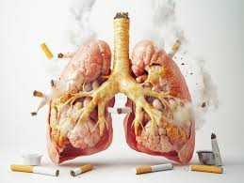
How Tobacco and Nicotine Use Affects Your Physical Well-Being

Slide 2
In this slide set we’ll explore:
The Short and Long-term Effects of Smoking
How tobacco and nicotine physically affect the smoker
The Effects on the Lungs and Breathing
The physiological changes to a smoker's lungs
The long-term exposure risks
The Effects on the Heart and Circulation
The impact of nicotine on the cardiovascular system
The risks over time
The Effects on the Brain and Body Systems
How nicotine affects the brain
How tobacco weakens the immune system
Second and Third-hand Exposure to Smoking Tobacco

Slide 3
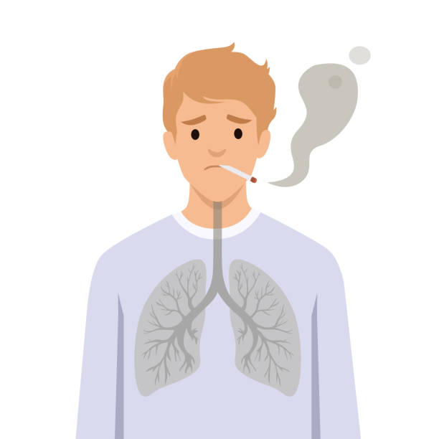
Physical Effects of Nicotine and Tobacco Overview
Tobacco and nicotine affect nearly every part of the body, not just the lungs.
While nicotine drives addiction, the chemicals in tobacco smoke cause long-term damage to organs, blood vessels and the immune system.
Even smokeless or “safer” products still carry physical risks.
Understanding these effects helps young people see how tobacco use impacts the body both now and in the future.

Slide 4
The Short and Long-Term Health Outcomes
Time frame | Health Impacts
Short- Term | Increased alertness and mild euphoria due to dopamine release Elevated heart rate and blood pressure Reduced taste and smell sensitivity Irritation of throat, eyes and airways More frequent colds and chest infections Temporary stress relief - often followed by rebound anxiety when nicotine wears off
Long- Term | Chronic diseases (lung cancer, COPD, heart disease) Weakened immune system and repeated infections Premature aging of skin and tissues Fertility issues and complications in pregnancy Persistent fatigue and reduced physical performance

Slide 5
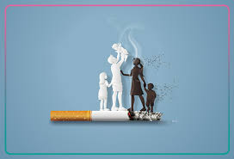
Smoking and Fertility (Men and Women)
Smoking can affect fertility in both men and women, making it harder to conceive.
In women:
Smoking can damage the ovaries and reduce the number and quality of eggs.
It can disrupt hormone levels and menstrual cycles.
Women who smoke may take longer to become pregnant and have a higher risk of infertility.
Smoking is also linked to an increased risk of ectopic pregnancy (pregnancy outside the womb).
In men:
Smoking can reduce sperm count and sperm quality.
It can affect sperm movement (the ability of sperm to swim effectively, move and navigate the female reproductive tract to fertilise an egg), making fertilisation more difficult.
Smoking may damage sperm DNA, which can affect embryo development.
Stopping smoking can improve fertility and increase the chances of a healthy pregnancy.

Slide 6
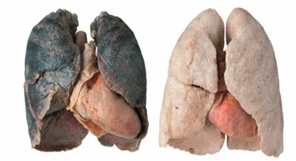
Effects on the Lungs and Breathing
Tobacco smoke contains thousands of chemicals that irritate and damage the lining of the airways. This makes it harder for the lungs to take in oxygen and remove waste gases. Over time, the tiny air sacs in the lungs can become weakened, inflamed or permanently scarred, reducing overall lung capacity.
Regular smoking can cause:
breathlessness
persistent coughing
wheezing
more frequent chest infections
These symptoms appear because the lungs are working much harder than they should and are less able to fight off germs.
Long-term exposure increases the risk of asthma attacks, chronic bronchitis, emphysema and lung cancer - conditions that can seriously affect quality of life.​
Children and young people exposed to smoke and second-hand smoke are also at higher risk of glue ear, repeated chest infections and breathing difficulties, as their smaller lungs and developing immune systems are more sensitive to harm.​

Slide 7
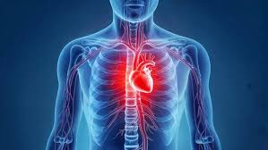
Effects on the Heart and Circulation
Nicotine has an immediate impact on the cardiovascular system. It speeds up the heart rate and causes blood vessels to narrow and stiffen, which means the heart has to pump harder to move blood around the body.
The chemicals in tobacco smoke also damage the inner lining of blood vessels (the endothelium). This damage makes it easier for fatty deposits to build up, increasing the risk of blood clots, high blood pressure and blocked arteries.
Even light or occasional smoking can harm the cardiovascular system, raising the risk of heart disease, stroke, heart attacks and poor circulation later in life.
These risks accumulate over time and the effects can begin early - even in teenage smokers, because their bodies and blood vessels are still developing.​
Smoking also reduces oxygen in the bloodstream, meaning the heart has to work harder during exercise, which can affect fitness and physical performance.​

Slide 8
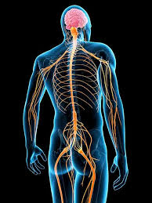
Effects on the Brain and Body Systems
Nicotine affects the developing teenage brain, especially areas involved in attention, decision-making and impulse control.
It changes the way the brain responds to stress and reward, increasing the risk of addiction.
Smoking also weakens the immune system, making it harder to fight illnesses and infections.
Smokers heal more slowly from injuries and are more likely to have:
gum disease
dental problems
reduced fitness

Slide 9
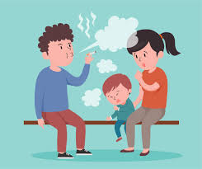
Second-hand Smoke and Passive Exposure
Second-hand smoke (SHS) is the combination of smoke from the burning end of a cigarette and smoke exhaled by the smoker.
Non-smokers exposed to SHS inhale many of the same toxic chemicals.
Health risks include:
  Increased risk of heart disease, stroke and lung cancer in adults.
  In children: asthma, ear infections, respiratory illnesses and sudden infant death syndrome (SIDS).
Third-hand smoke (residue that clings to clothing, furniture, and surfaces) can also expose people to harmful particles long after smoking has stopped.

Slide 10
Myths vs. Facts About Vaping and “Safer” Products
Myth | Fact
Nicotine itself causes cancer | Nicotine is not a carcinogen but it sustains addiction to cigarettes which contain many cancer-causing chemicals.
Smokeless products like snus or pouches are harmless | These products reduce some of the risks (and more research is needed to understand the long-term effects) but can still cause nicotine addiction, gum disease and cardiovascular strain.
Switching to low-tar or ‘light’ cigarettes makes smoking safer | “Light” cigarettes still expose users to harmful chemicals; smokers often inhale more deeply to compensate for reduced nicotine, negating the benefit.
Vaping is just harmless water vapour | Vaping aerosols are not just water vapour - they can contain nicotine, ultrafine particles, and chemicals that may harm the lungs and overall health.
Once you’ve smoked for years, quitting doesn’t help | Quitting improves health at any age - lung function starts to recover within weeks, and heart attack risk drops within a year.

Slide 11
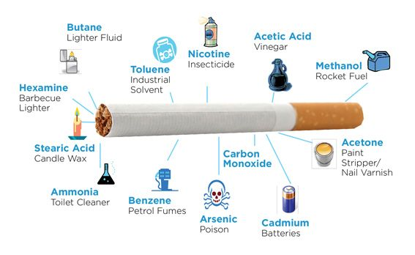
Summary
Tobacco and nicotine affect almost every organ in the body. While nicotine fuels addiction, the thousands of chemicals in tobacco smoke cause serious harm - including cancers, heart disease and lung damage.
Even smokeless or “safer” alternatives still carry health risks and can lead to long-term dependency.
Understanding these effects helps people make informed choices and highlights the clear health benefits of quitting.

Slide 12
References
The information provided in this slide set uses the following sources:
Understanding the true impact of smoking - Better Health – NHS
Smoking Cessation and Short- and Longer-Term Mortality | NEJM Evidence
Passive smoking – NHS
https://www.nhs.uk/smokefree/why-quit/smoking-health-problems
https://www.hhs.gov/surgeongeneral/reports-and-publications/tobacco

