Slide 1
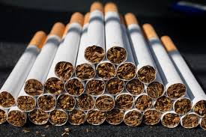
Understanding Tobacco and Nicotine: What these substances are and how they work

Slide 2
In this slide set, we’ll explore:
The Origins of Tobacco
  Where tobacco comes from and how it's processed
  The Differences Between Tobacco, Nicotine and Other Substances
  An introduction to the different tobacco and nicotine products
  Common Tobacco and Nicotine Products
  How Nicotine Affects the Body and Brain
  How nicotine enters the bloodstream and its action on the brain
  The long and short-term effects of nicotine
  Addiction and How Dependency Develops
  The physiological and physical dependence
  Withdrawal symptoms
  Cycle of addiction

Slide 3
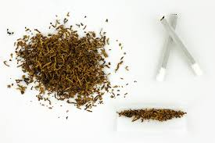
Origins of Tobacco and Nicotine
Tobacco comes from the Nicotiana plant family, primarily Nicotiana tabacum and Nicotiana rustica.
It is native to the Americas and has been used for centuries in cultural, medicinal and ceremonial contexts.
European colonisation in the 16th century led to its global spread, initially as pipe or chewing tobacco and later used in cigarettes and cigars.
Nicotine is a naturally occurring alkaloid chemical found mainly in tobacco leaves. It acts as a natural insecticide for the plant. Nicotine can also be manufactured synthetically.
When tobacco is processed or smoked, nicotine is released and absorbed into the bloodstream.
Source: Nicotine Chemistry, Metabolism, Kinetics andBiomarkers - PMC

Slide 4
The Differences Between Tobacco, Nicotine and Other Substances
Substance | What It Is | Key Characteristics
Tobacco | A plant product containing nicotine and other chemicals. | Used in smoking, chewing and snuff forms. When burned, releases thousands of compounds, many toxic or carcinogenic.
Nicotine | A stimulant drug found in tobacco. | The main addictive component; affects the brain’s reward system. Not a carcinogen on its own but reinforces use of tobacco products.
Other substances | e.g., caffeine, alcohol or THC. THC (tetrahydrocannabinol) is the primary psychoactive compound found in the cannabis plant. | May alter brain function but differ in their mechanisms, health risks and addiction profiles. Nicotine acts faster and has a distinct dependency cycle.

Slide 5
Common Tobacco and Nicotine Products
Category | Description | Nicotine Delivery
Cigarettes | Dried, shredded tobacco rolled in paper; burned and inhaled. | Rapid absorption through the lungs.
Cigars and cigarillos | Dried tobacco rolled in tobacco leaf; typically not inhaled deeply. | Absorbed through mouth lining and lungs.
Smokeless tobacco | Includes: chewing tobacco - placed between gum and lip; and snuff – either dry and snorted or moist and placed between gum and lip. | Absorbed through mouth or nasal lining.
Snus | Moist ground tobacco placed between the gum and lip; popular in Scandinavia. | Steady, slower nicotine absorption.
Nicotine pouches (tobacco-free) | Small pouches containing synthetic or plant-derived nicotine without tobacco leaf; placed between gum and lip. | Absorbed through the mouth lining.

Slide 6
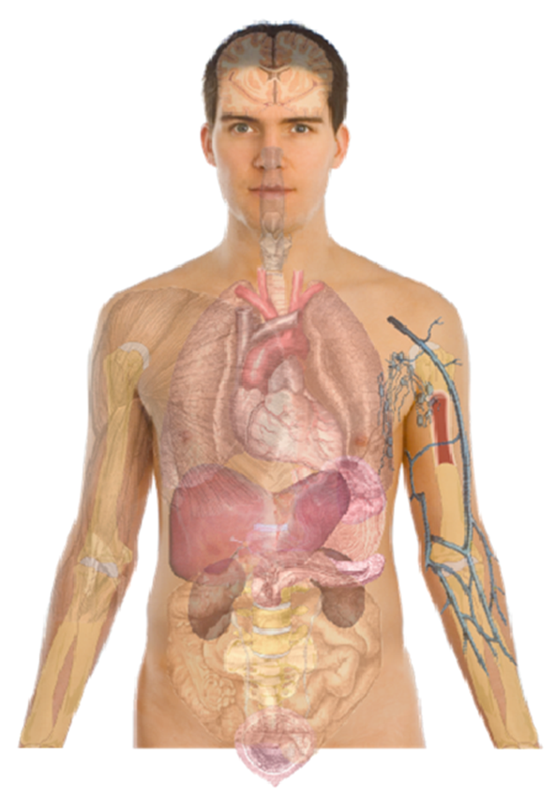
Nicotine's Relationship with the Body and Brain
Absorption: Nicotine enters the bloodstream through the lungs (smoking), mouth or nasal membranes (chewing/snuffing).
Action on the Brain:
Reaches the brain in 10–20 seconds.
Stimulates the release of dopamine, the “pleasure” neurotransmitter.
Also increases norepinephrine and acetylcholine (both neurotransmitters) leading to heightened alertness and concentration.
Short-term effects:
Elevated heart rate and blood pressure.
Temporary feelings of focus, relaxation or reduced stress.
Long-term effects:
Chronic nicotine exposure changes neural pathways leading to dependency.
Withdrawal causes irritability, cravings and difficulty concentrating.

Slide 7
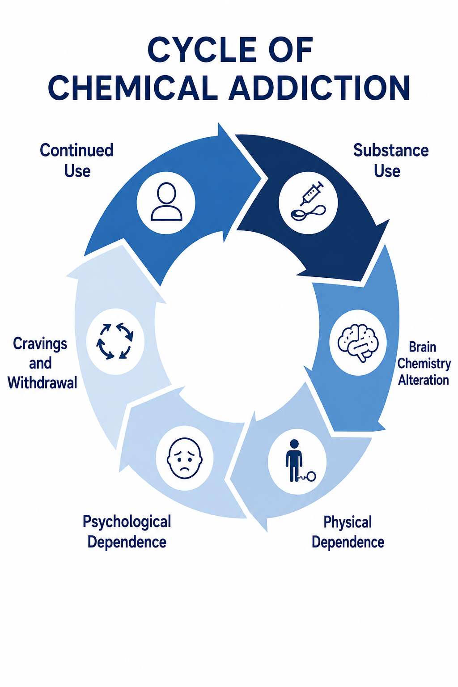
Addiction and How Dependency Develops
Psychological Dependence: Nicotine’s dopamine release creates positive reinforcement - users crave the “reward” sensation.
Physical Dependence: The body adapts to nicotine, requiring more to achieve the same effect.
Withdrawal Symptoms: Include irritability, anxiety, restlessness and intense cravings when nicotine levels drop.
Cycle of Addiction:
  Use → Nicotine enters bloodstream.
  Pleasure/relief → Dopamine release.
  Decline → Nicotine levels drop.
  Craving → Urge to use again.
Over time this cycle strengthens neural pathways that sustain addiction, making quitting difficult despite awareness of harm.
Chemical Addiction: Types, Causes, Symptoms, and Treatment

Slide 8
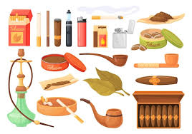
Summary
Tobacco and nicotine are closely linked but not identical: tobacco is the plant product, and nicotine is the addictive chemical it contains. Nicotine can also be manufactured synthetically.
While nicotine itself primarily drives addiction, tobacco products expose users to many other harmful substances that contribute to disease and death.
Understanding how nicotine works in the body is the first step toward reducing harm and supporting cessation.

Slide 9
References
The information provided in this slide set used the following sources:
Tobacco: Its historical, cultural, oral, and periodontal health association – PMC
Nicotine Chemistry, Metabolism, Kinetics and Biomarkers - PMC
Nicotine Is Why Tobacco Products Are Addictive | FDA
Cognitive Effects of Nicotine: Recent Progress – PMC
Chemical Addiction: Types, Causes, Symptoms, and Treatment
Chapter 11: smoking and tobacco use - GOV.UK
Drug Misuse and Addiction | National Institute on Drug Abuse (NIDA)
Tobacco | NHS inform

