Slide 1
Meningococcal B (MenB) vaccination programme: urgent time-limited response to recent outbreaks
Vaccine Preventable Disease Programme
Public Health Wales
Version 1 - June 24 2026
Notes:
Material contained in this document may be reproduced without prior permission provided it is done so accurately and is not used in a misleading context.
Acknowledgement to Public Health Wales NHS Trust to be stated.
© 2026 Public Health Wales NHS Trust.

Slide 2
Acknowledgements
Vaccine Preventable Disease Programme
Vaccine Programme Wales
Welsh Government
UK Health Security Agency

Slide 3
Meningococcal B (MenB) vaccination programme: urgent time-limited response to recent outbreaks
It is important that all immunisers delivering this MenB vaccination programme and/ or those who are providing immunisation advice familiarise themselves with the most up to date clinical evidence and guidance, this can be found in the following key documents:
Green Book: Meningococcal: the green book, chapter 22 - GOV.UK
Welsh Health Circular: Meningococcal B (MenB) vaccination programme: urgent time-limited response to recent outbreaks (WHC/2026/026) | GOV.WALES
Information for healthcare practitioners: Awaiting this information. Will be available from MenB vaccine for young people – information for health professionals - Public Health Wales
VPDP webpage is available here: MenB vaccine for young people – information for health professionals - Public Health Wales
This template training slide set is version controlled; the information contained within this resource is accurate at the time of publication. Any necessary amendments will be reflected in an updated version.

Slide 4
Contents
Contents | Slide numbers
Aims and objectives | 5 & 6
Background | 7
Invasive meningococcal disease | 13
Epidemiology | 18
Delivery model in Wales | 24
The Meningococcal B vaccine Bexsero® | 30
Resources | 45

Slide 5
Aims
To provide information for healthcare practitioners involved in advising on and delivering the urgent time-limited MenB vaccination programme
To raise awareness of the current epidemiology and background to the urgent time-limited MenB programme
To describe the vaccination programme details including administration of the vaccine, eligibility, recommended dosage and schedule, contraindications, precautions and potential adverse reactions
To highlight resources that support the urgent time-limited MenB vaccination programme

Slide 6
Objectives
After completing this resource, immunisers will be able to:
Describe the aetiology and epidemiology of Meningococcal B disease
Understand the reasoning behind the urgent time-limited Meningococcal group B (MenB) vaccination programme
Discuss the benefits of vaccination against (MenB) to the identified eligible groups
Identify relevant resources and additional information in relation to the urgent time-limited MenB vaccination programme

Slide 7
Background to the Meningococcal B (MenB) vaccination programme: urgent time-limited response to recent outbreaks

Slide 8
Background (1)
The outbreak in Kent in March 2026 was the fastest growing and largest cluster of MenB seen in the UK to date. Genomic analysis of the bacteria that caused the outbreak showed changes from previous strains
The rapid spread of cases early on was unusual compared to previous outbreaks: 15 cases emerged within the first 48 hours. There were 21 cases in total, sadly two of which were fatal
The size and pace of this outbreak may be a result of reduced exposure (and thus immunity) to these bacteria as a result of COVID-19 control measures, left greater numbers of young people at risk of disease along with the exposure setting (a busy nightclub, popular with students)
So far in the 2025/26 season there have been 7 clusters of 3 or more cases in England, which demonstrates an increase in number of cases per cluster. These have all occurred outside the usual highest period of meningococcal activity between September and January
Notes:
https://www.gov.uk/government/publications/invasive-meningococcal-disease-statistical-releases/notified-cases-of-invasive-meningococcal-disease#notified-cases-of-invasive-meningococcal-disease-linked-to-canterbury-kent

Slide 9
Background (2)
Although the MenB vaccine has been available as part of the routine NHS infant immunisation schedule since 2015, individuals aged over 10 years will not have been offered it
They should already have been offered the MenACWY vaccine at age 13/14 years, as part of the adolescent school immunisation programme, which will not protect against MenB
A UK ministerial decision has approved a time-limited MenB vaccination programme based on evidence that young people in their first year of university have a substantially higher risk of invasive MenB disease than their peers who are not attending higher education
Notes:
https://www.gov.uk/government/publications/invasive-meningococcal-disease-statistical-releases/notified-cases-of-invasive-meningococcal-disease#notified-cases-of-invasive-meningococcal-disease-linked-to-canterbury-kent

Slide 10
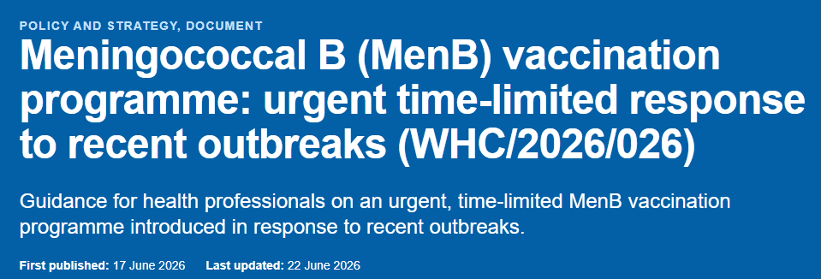
Welsh Health Circular first published 17th June 2026, last updated 22 June 2026
Following the unprecedented outbreak of Meningococcal Group B (MenB) in Kent in March, and more recent smaller outbreaks in Weymouth and Reading, an urgent time - limited MenB vaccination programme is being advised as a precautionary measure to help protect the young people at highest immediate risk this year.
Further information is available in the Welsh Health Circular: Meningococcal B (MenB) vaccination programme: urgent time-limited response to recent outbreaks (WHC/2026/026) [HTML] | GOV.WALES

Slide 11
Eligibility (1)
Older teenagers and students aged less than 25 years of age who are entering higher and residential further educational settings for the first time are at higher risk of infection with meningococcus B.
Therefore, there will be a time limited offer of two doses of Bexsero® (4CMenB) vaccine starting from 20 July 2026 to the following cohorts:
Young people currently in the Year 13 age group (born between 01/09/2007 and 31/08/2008) and anyone aged up to 25 years who will be attending higher education or residential further education for the first time in autumn 2026, including students from other UK nations and international students.
Eligible cohorts
  Cohort 1: all individuals born between 01/09/2007 and 31/08/2008 (17 to 18 years old)
  Cohort 2: individuals born on or after 21/07/2001 (turning 25 on or after 21/07/2026) and are due to start undergraduate higher education OR residential further education*, for the first time in autumn 2026, including international students and those from the UK Devolved Administrations and Crown Dependencies.
First doses must continue to be available until 31 December 2026 and second doses available until 31 March 2027.The aim is to offer protection to the above individuals before the start of the 2026 to 2027 academic year and the peak season for MenB in the autumn.
Meningococcal B (MenB) vaccination programme: urgent time-limited response to recent outbreaks (WHC/2026/026) | GOV.WALES
Notes:
* Full list of eligible residential educational settings are available from Annex 2 WHC/2026/26

Slide 12
Eligibility (2)
  Based on WHC/2026/26: Who is not eligible:
  Those born before 21/07/2001
  Those aged less than 25 years continuing their studies (not first-time entrants)
  Those in school level residential settings, for example sixth form boarding schools, unless they are eligible due to their age
  Those who completed a 2 dose course of Bexsero® within the last 5 years
  Those who completed a 2 or 3 dose course of Trumenba® within the last 5 years
Meningococcal B (MenB) vaccination programme: urgent time-limited response to recent outbreaks (WHC/2026/026) | GOV.WALES

Slide 13
Invasive Meningococcal Disease

Slide 14
What is invasive meningococcal disease (IMD)?
Meningococcal disease occurs as a result of an invasive bacterial infection caused by Neisseria meningitidis (also known as meningococcus)
All suspected cases of invasive meningococcal disease are notifiable by registered medical practitioners under Health Protection Wales Regulations (2010)
Invasive meningococcal disease (IMD) is rare but serious, resulting in significant mortality and morbidity
Invasive meningococcal disease most commonly presents as either meningitis or sepsis, or both
Notes:
Plural: meningococci. The organism is associated with both asymptomatic carriage and invasive disease
Each group has a distinct (i.e. group specific) outer polysaccharide (sugar) capsule
Disease onset is sudden and often dramatic
The overall case fatality rate is ~10% but varies with age, capsular group and clinical presentation and many survivors have long term complications which may include brain damage, deafness, epilepsy, limb/digit loss and cognitive deficit
Less commonly, individuals may present with pneumonia, myocarditis, endocarditis, pericarditis, arthritis, conjunctivitis, urethritis, pharyngitis and cervicitis.
Occasional outbreaks occur e.g. in families, schools, universities: onward transmission from cases to close contacts can rarely result in secondary cases, as well as clusters of infection but fewer than 2% of invasive meningococcal disease (IMD) cases, result from close contact with a primary IMD case.

Slide 15
Clinical presentation of IMD
high temperature
vomiting
severe headache
feeling unwell
limb/joint/muscle pain
stomach pain/diarrhoea
cold hands and feet
shivering
pale or mottled skin
fast breathing/breathlessness
rash
stiff neck
dislike of bright light
drowsiness/difficult to wake
confusion and/or irritability
seizures/fits
Symptoms can appear in any order. Some may not appear at all.
Notes:
Please note that some or all symptoms may appear, in any order, and this list is not exhaustive. Table contents are based on content from the Meningitis Trust http://www.meningitis-trust.org/meningitis-info/signs-and-symptoms/.
Onset of disease varies from fulminant with severe acute and overwhelming features, to insidious with mild prodromal symptoms.
Symptoms may be harder to identify in young infants particularly as the onset may be insidious and the signs may be non-specific without classical features of meningitis.
In young adults, early symptoms may often be confused with hangover or flu.

Slide 16
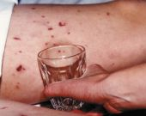
The meningococcal rash
Distinctive red rash can appear anywhere on the body
Formed of tiny ‘pinprick’ blood spots under the skin, also known as petechiae, and appears red in colour.
The rash may later develop into purple bruising of the skin
Distinguished from other rashes by pressing a glass tumbler against it: a meningococcal rash will not fade when a glass tumbler is rolled over it (non-blanching)
A febrile illness and rash that does not fade is a sign of meningococcal sepsis
The ‘tumbler’ test picture courtesy of Meningitis Research Foundation
http://www.meningitis.org/symptoms
Notes:
A non-blanching rash tends to be a late symptom and should be treated as a medical emergency.
It is important to note the absence of a rash does not preclude meningococcal disease.

Slide 17
Potential complications of IMD
The infection is fatal in 5%-10% of cases, and survivors may develop severe long-term complications
Complications can vary in severity and can either be temporary or permanent. The more severe the disease, the greater the risk of complications
Complications include loss of hearing, loss of vision, loss of memory and/ or concentration, difficulties in co-ordination and balance, epilepsy, cerebral palsy and limb amputations, and may result in death
Notes:
Less commonly, individuals may present with pneumonia, myocarditis, endocarditis, pericarditis, arthritis, conjunctivitis, urethritis, pharyngitis, and cervicitis (Rosenstein et al.,
2001) Meningococcal: the green book, chapter 22 - GOV.UK

Slide 18
Epidemiology

Slide 19
Carriage and transmission
The meningococcal bacteria colonises in the nasopharynx of humans
Transmission is through person-to-person by spread from respiratory aerosols, droplets or by direct close contact with the respiratory secretions of someone who is carrying the bacteria
Infectivity is relatively low and requires prolonged close contact, for example those living in the same household or through direct contact with nose and respiratory secretions such coughing, sneezing, kissing, sharing drinks or vapes and smoking
Incubation period ranges from 2 to 7 days with the onset of disease ranging from severe with overwhelming features to insidious mild prodromal symptoms
Asymptomatic carriage prevalence increases throughout childhood from around 5% in infants to a peak of 24% in 19-year-olds and subsequently decreases in adulthood to around 8%
Not fully understood why disease develops in some individuals but not in others
Over 95% of cases are sporadic but occasional outbreaks occur, e.g. in families, schools, universities

Slide 20
Risk Factors
Age
  Highest incidence in children under five years, with a peak incidence in those under one year of age. A second peak in incidence is noted in young people aged 15-19 years of age.
Season
  Seasonal variation, peak levels in winter, declining to low levels by late summer
Social
  Living in closed or semi – closed communities
Smoking
  Exposure to tobacco smoke increases the risk
Preceding viral infection
Notes:
Risk factors based on Green Book

Slide 21
Meningococcal capsular groups
There are 12 known meningococcal groups, each possessing a distinct outer polysaccharide (sugar) capsule.
The organism is associated with both asymptomatic carriage and invasive disease.
Capsule:
Group specific polysaccharide
12 known capsular groups
A, B, C, W and Y are most common
Cell wall
Outer membrane proteins
Serotype / sero-subtype

Slide 22
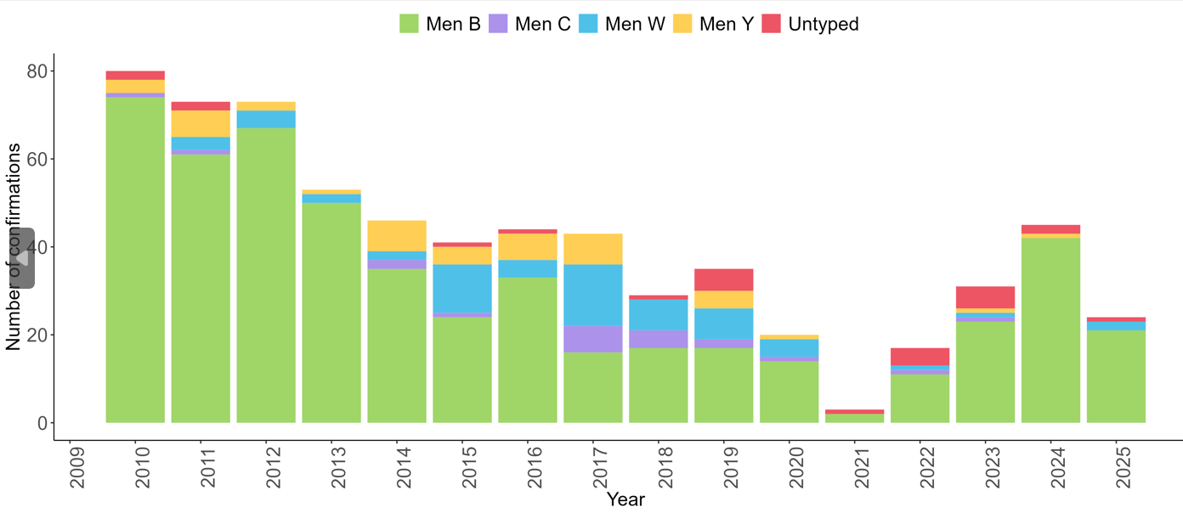
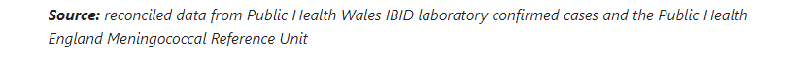
Number of laboratory reports of Neisseria meningitidis by serogroup in Wales 2010-2025
As at 22nd June there have been 9 confirmed cases in Wales during 2026. All serogroup B.

Slide 23
Meningococcal group B
Most common cause of IMD in UK.
Accounts for over 85% cases.
MenB disease mortality rate around 6%.
Nearly 1 in 10 MenB cases suffers major disabilities including amputations (1%).
The 2026 Kent outbreak was caused by subtype ST-485, P1.12-1,16-183 which has been present in England since 2020. However, the outbreak strain is distinct within this subtype and research is ongoing to understand its properties (Invasive Meningococcal Disease outbreak 2026: technical briefing 2 - GOV.UK). There were 23 confirmed or probable cases and two deaths.
Overall IMD incidence in Wales during 2025/2026 remains low.

Slide 24
Menigococall
Men B vaccine delivery model in Wales

Slide 25
How will the Men B programme be delivered? (1)
The vaccination programme will be delivered by local immunisation teams via designated health board vaccination clinics
Cohort 1 (born between 01/09/2007 and 31/08/2008 - 17 to 18 years old) : Health boards will be responsible for issuing invitations to all individuals to attend for a first dose vaccination appointment, with second letters sent for those who did not attend
Cohort 2 (individuals born on or after 21/07/2001- turning 25 on or after 21/07/2026 and attending higher education or residential further education for the first time) : Health boards are required to offer a walk-in service to deliver vaccination to the self-referring group For individuals from Cohort 2 who are self-referring, health professionals should use the criteria listed below to verify eligibility and then facilitate vaccination:
  confirm the individual falls within the relevant age group by date of birth
  verify documentary evidence, including electronic confirmation, of an offer for the 2026 to 2027 academic year confirming the individual is due to attend higher education or residential further education for the first time
  This should be an official email, letter or screenshot providing confirmation of their offer of a place at their chosen university or college from either the HE institution or the Universities and Colleges Admissions Service (UCAS). The relevant evidence should include the name of the *university or college that they are due to attend, the course code or title of the course of study, and confirmation of the offer of a place (either conditional or unconditional)
Notes:
*A list of UK wide relevant universities and residential further education establishments is available in Annex 2 of the Meningococcal B (MenB) vaccination programme: urgent time-limited response to recent outbreaks (WHC/2026/026) | GOV.WALES as a guide, but this list is not absolute and subject to updates. Young people may be planning to study abroad, and so proof of an offer may be provided, which does not appear on this list. Consequently, health professionals should use their best judgement in deciding whether both the above criteria are met.

Slide 26
How will the Men B programme be delivered? (2)
Key operational messages​
If students leave Wales before their 2nd dose is due, health boards should advise that they can receive it where they are studying elsewhere in UK
Delivery via health board immunisation teams – Making Every Contact Count (MECC)- using the opportunity to catch up on missed immunisations (MMR, HPV, TdIPV, MenACWY)
For those in cohort 1, health boards will send an invite letter, and a follow up letter if the young person fails to attend
Cohort 2 will self-present for vaccination and must provide evidence of eligibility when self-referring
Health boards are required to ensure web pages are up to date, and call centre lines are manned
An appointment date for the 2nd dose will be given at attendance to the 1st appointment

Slide 27
How will the Men B programme be delivered? (3)
Two doses are necessary for protection. Appointments should be made for individuals to attend for their second dose. This must be administered a minimum of 28 days after the first dose and individuals should be reminded of the importance of returning for this second dose
When checking an individual’s vaccination status, where a record is not held in CYPrIS, health board staff can access past immunisation history within the Welsh GP Record via Welsh Immunisation System (WIS)
Each time an immunisation history is accessed in this way, it is essential the following statement is recorded in the consent model box: “Vaccination History Check in line with WHC(2026)026”

Slide 28

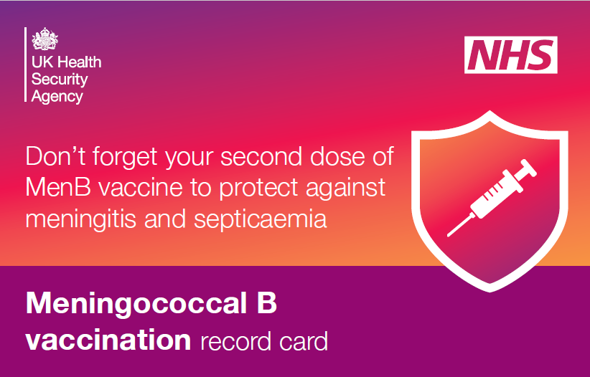
MenB vaccine recording
Cohort 1 can be identified (manual search) via Welsh Immunisation System (WIS), but health boards will not be able to send letters via WIS. Health boards to send letters by local arrangement
WIS is to be utilised to record the vaccination event
The consultation form will be the same version used for other vaccines on WIS
Consent forms will be available for recording consent and vaccine given where WIS is not used at time of vaccination
Write back from WIS to GP record will take place
Vaccination record cards for patients to hold will be available to record 1st and 2nd doses. Vaccinators should ensure they provide individuals with their record card to enable them to receive their second dose in other parts of the UK if needed. Order via Vaccination Record Card - Public Health Wales
There will be a requirement for second doses to be facilitated in Wales for students from other UK nations and internationally.

Slide 29
Delivery through local health board vaccination teams
Eligible individuals, their parents or guardians may have questions about the programme delivery in each health board area
All queries regarding the programme should be directed to the local health board - Vaccine contacts - Public Health Wales
The delivery of this programme is via local health board vaccination teams and not through general practitioners or pharmacies. Therefore, if queries are mistakenly directed to GPs or pharmacies about the programme, individual queries should be signposted to their local health board
Whilst there are no plans for primary care to be involved in the delivery of this programme, the National enhanced service specification for non-routine immunisations for adults and children at risk’ will provide cover, if the situation arises where GP practices need to give meningococcal vaccines to eligible persons included in this time-limited vaccination outbreak response.

Slide 30
The Meningococcal B vaccine - Bexsero®

Slide 31
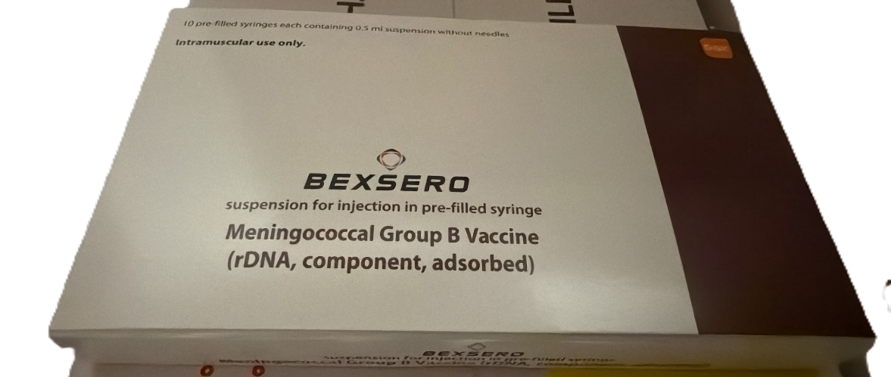
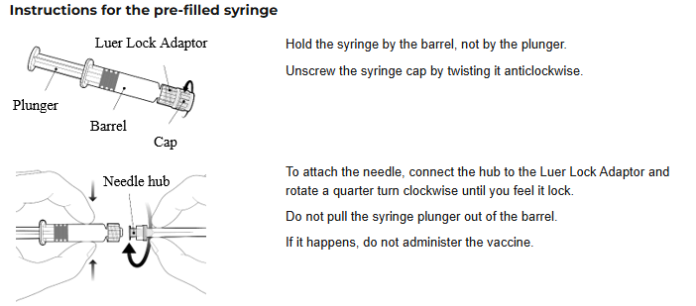
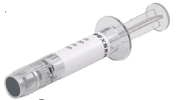
Bexsero®
Bexsero Meningococcal Group B vaccine for injection in pre-filled syringe - Summary of Product Characteristics (SmPC) - (emc) | 5168

Slide 32
MenB Vaccine - Bexsero®
Weekly ordering will be available for health boards
Bexsero ® will be 10-dose packs of pre - filled syringes
Needles will not be delivered with the Bexsero – health boards will need to order locally via usual routes
Select the correct Bexsero ® product on ImmForm – ‘ BEXSERO-10-ADOLESC’
Health boards to order stock conservatively
Avoid overordering / stockpiling of stock
Monitor stock levels and adjust to demand when ordering
Ordering of ‘BEXSERO-10-ADOLESC’ will open w/c 6th July

Slide 33
Composition of Bexsero®
Bexsero is a four-component protein-based meningococcal B vaccine (also referred to as 4CMenB)
It is made from three main N. meningitidis proteins produced by recombinant DNA technology and a preparation of N. meningitidis group B outer membrane vesicles
Composition
1.Recombinant Neisseria meningitidis group B NHBA fusion protein
2.Recombinant Neisseria meningitidis group B NadA protein
3.Recombinant Neisseria meningitidis group B fHbp fusion protein
4.Outer membrane vesicles (OMV) from Neisseria meningitidis group B strain NZ98/254
Excipients
  Sodium chloride
  Histidine
  Sucrose
  Water for injection
Notes:
Bexsero Meningococcal Group B vaccine for injection in pre-filled syringe - Summary of Product Characteristics (SmPC) - (emc) | 5168

Slide 34
Bexsero® presentation and preparation
The vaccines are supplied in packs containing ten pre-filled syringes, each with a volume of 0.5mls of suspension per syringe
During storage, the contents of the syringe may settle with fine off-white deposits being noticeable
Before use, the pre-filled syringe must be shaken well to form a homogenous suspension, that should be administered immediately
The vaccine should not be administered where there are variations in physical appearance (for example, not a homogenous suspension) or signs of foreign particulate are observed after shaking
Bexsero should be stored in its original packaging in a refrigerator between +2ºC and +8ºC
* The vial rubber stopper and tip cap are made with synthetic rubber which does not contain natural rubber latex
Notes:
*The tip cap and plunger stopper in Bexsero pre‑filled syringes are made from synthetic rubber, not natural rubber latex. Synthetic rubber does not contain natural latex proteins (the usual allergen), so the syringe components are considered latex‑free. Individuals with latex allergy generally do not need to worry about Bexsero’s tip cap or stopper triggering a reaction Bexsero Meningococcal Group B vaccine for injection in pre-filled syringe - Summary of Product Ch…

Slide 35
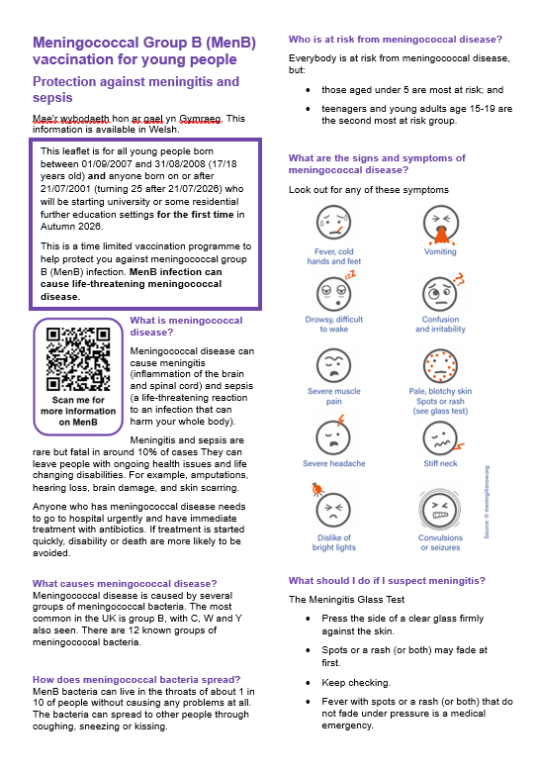
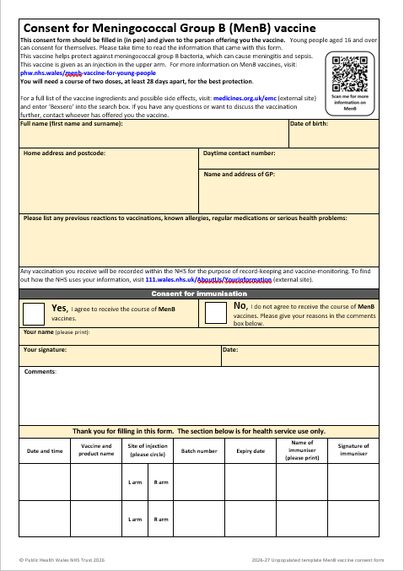
Consent
Consent should be obtained before the MenB vaccine is given
The Green Book Consent chapter sets out how consent should be obtained, and vaccinators should ensure they are familiar with this
Resources to support consent process are available from MenB vaccine for young people – information for health professionals - Public Health Wales including:
  an information leaflet for individuals considering vaccination
  a specific meningitis B vaccination consent form
Meningococcal B (MenB) vaccination programme: urgent time-limited response to recent outbreaks ​ ​

Slide 36
Further information about Bexsero®
Bexsero® has been routinely given to infants in the UK since 2015 and to adolescents and adults who are deemed to be at increased risk because of underlying medical conditions
Studies have shown Bexsero® is immunogenic in adolescents and adults
The strain identified as causing recent cases of MenB in Kent is likely covered by both MenB vaccines (Bexsero and Trumenba)
Bexsero® is a non-live vaccine made using recombinant vaccine technology
It can be given at the same time as, or at any interval from, any other vaccines
It may be given to pregnant or breastfeeding women when clinically indicated
It can also be given to individuals with immunosuppression and human immunodeficiency virus (HIV) infection

Slide 37
Contraindications
Bexsero® should not be administered to those who have had:
Ø a confirmed anaphylactic reaction to a previous dose of the vaccine OR
Ø a confirmed anaphylactic reaction to any constituent, excipient or residue from the manufacturing process
There are very few individuals who cannot receive meningococcal vaccines
Where there is doubt, appropriate advice from an expert should be sought rather than withholding vaccination

Slide 38
Possible adverse reactions
In clinical trials in adolescents and adults, the most common local and systemic adverse reactions observed were pain, swelling and redness at the injection site, malaise and headache
Nausea, myalgia (muscle pain) and arthralgia (joint pain) were also commonly reported
Although high fever was commonly reported in infants following MenB vaccination in trials, it was not common in adolescents and adults (mild fever may occur)
Prophylactic paracetamol following vaccination is not recommended but paracetamol can be taken to alleviate symptoms if required
No increase in the incidence or severity of adverse reactions was seen with subsequent doses of MenB vaccine
It is important to highlight potential side effects and offer reassurance on the importance of the second dose
Bexsero Meningococcal Group B vaccine for injection in pre-filled syringe - Summary of Product Characteristics (SmPC) - (emc) | 5168

Slide 39
Prescription only medication (POM)
Men B vaccine for this campaign should only be administered using a:
  Prescription written manually or electronically by a registered medical practitioner or other authorised prescriber
  Patient specific direction (PSD)
  Patient group direction (PGD)
UKHSA will offer a PGD template for MenB as a reference resource for health boards to develop and authorise for use locally
Templates can be found on the Welsh Medicines Advice Service's page for Patient Group Directions (PGD): Patient Group Directions (PGD) - Welsh Medicines Advice Service
Notes:
Current timeframe 29/6-3/7 according to Project board plan

Slide 40
MenB vaccine (Bexsero®) administration
Two doses are necessary for protection.
  Aim to offer first doses as early as possible
    to allow sufficient time for second dose to be offered a minimum of 28 days after the first dose
    and completion of the 2 - dose course ideally 2 weeks prior to the start of the 2026/27 academic year
First dose often results in pain around site of injection
  Young people need to be informed to ensure they return for the second dose
Some young people may have received 1 or 2 doses
  Privately
  As part of outbreak responses
  In other UK countries
  Overseas (International student)
Notes:
Start of the academic year for those going to Scottish establishments 1st Sept
Clarify learning so far from Kent outbreak, even at time of heightened demand and requests for vaccine due to outbreak that only 60% returned for 2nd doses

Slide 41
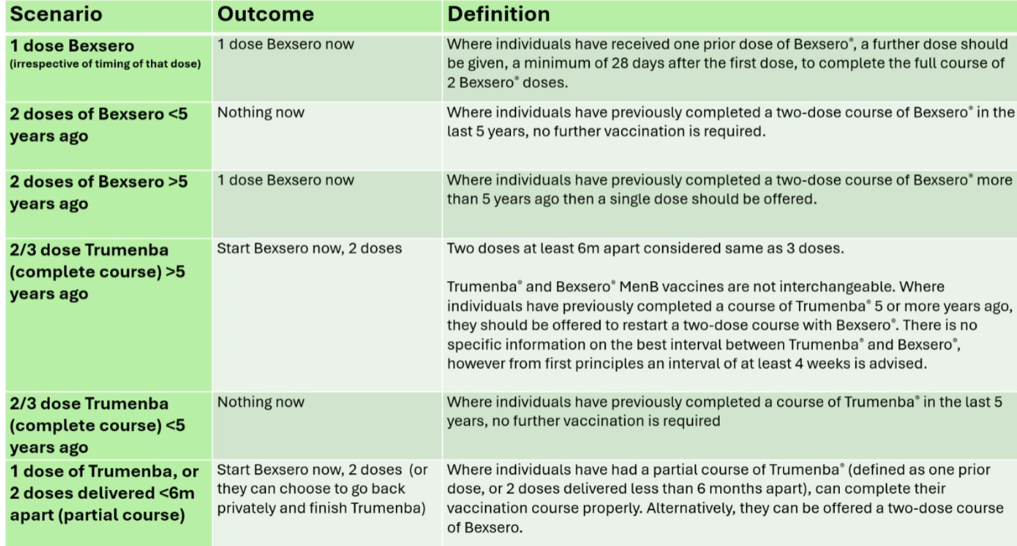
This information is contained in the WHC/2026/26 or available from MenB vaccine for young people – information for health professionals - Public Health Wales ​

Slide 42
Inadvertent early administration of the second dose
The recommended schedule for Bexsero® vaccine is 2 doses, with the second dose given a minimum of 28 days after the first dose
Vaccinators should adhere to the recommended 28-day interval. If the second dose is inadvertently given from 21 days after the first dose, this will count as a valid dose
Second doses given earlier than 21 days after the first dose, should be discounted as this may lead to a reduced immune response. The dose should be repeated, ensuring an interval of at least 28 days from the dose that was inadvertently given early
Doses given at 21 days are off label

Slide 43
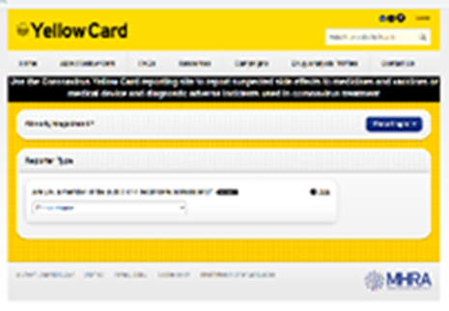
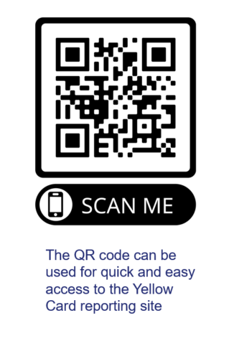
Reporting suspected adverse reactions
Vaccines should be advised that they can report any adverse reactions or suspected side effects to the MHRA through the online yellow card scheme website or the Yellow Card app
Any suspected side effects following vaccine administration should be reported to the MHRA Yellow Card Scheme.
Anyone can report even if uncertain about whether vaccine caused condition:
  www.mhra.gov.uk/yellowcard or call 0800 731 6789 (9am to 5pm Monday to Friday)
  Green Book Chapter 9 for detailed guidance on reporting vaccine reactions
Notes:
Healthcare professionals and patients are encouraged to report suspected adverse reactions to the Medicines and Healthcare Products Regulatory Agency (MHRA) using the yellow card reporting scheme
Green Book chapter 9: https://www.gov.uk/government/publications/surveillance-and-monitoring-for-vaccine-safety-the-green-book-chapter-9

Slide 44
Need for continued vigilance following vaccination
The MenB vaccines have been developed to protect against as many common MenB strains as possible, but they do not protect against all MenB strains
Response to vaccination is also not immediate. It takes time for immune response to be made (at least 2 weeks from 2nd dose to produce antibodies to give a good level of protection)
Continued awareness and vigilance is therefore essential, even after vaccination
Those who have been vaccinated should remain alert for symptoms of meningococcal disease and seek medical attention if unwell or concerned
Information on signs and symptoms of meningococcal disease are available from Meningitis and sepsis symptoms - Meningitis Research Foundation
Unlike many other vaccines, MenB vaccines do not prevent acquisition or carriage of the bacteria, so cannot interrupt transmission of the infection within a community or provide indirect (herd) protection to others

Slide 45
Resources
Influenza

Slide 46
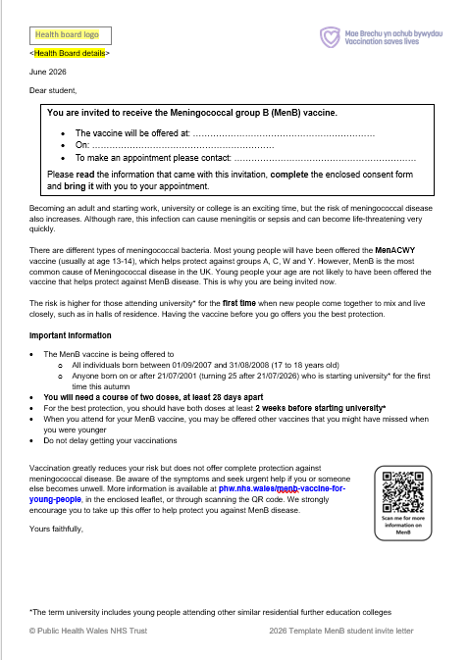

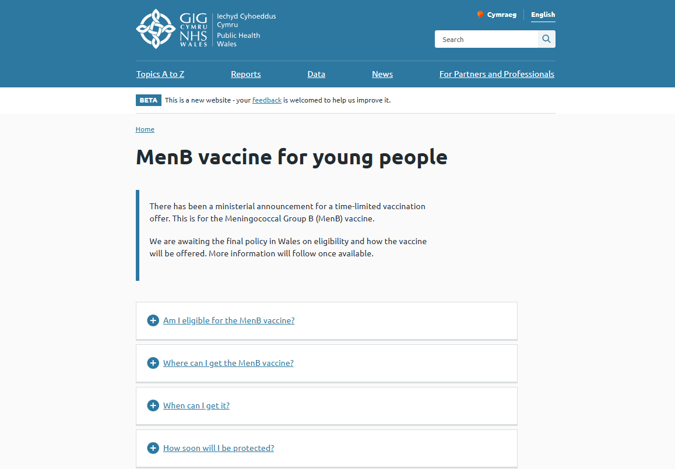
Information materials
Invitation letter
Consent form
Poster (in development)
MenB plain leaflet
Vaccine record card
Public facing webpage
HCP webpage
Digital assets
MenB vaccine for young people – information for health professionals - Public Health Wales

Slide 47
Resources to support administration of Men B vaccine
Before administering a Men B vaccine, it is recommended that:
*Those new to immunisation should receive comprehensive foundation immunisation training. Both knowledge and clinical competence should be assessed before new immunisers start to give and/or advise about the Men B vaccine Immunisation training standards for healthcare practitioner UK Health Security Agency - UKHSA)
Experienced immunisers have completed relevant training to ensure they are competent in the preparation, administration and appropriate recording of the MenB vaccine
​Training in the management of anaphylaxis and Basic Life Support is undertaken, as specified by policy for your local area and are familiar with Resuscitation Council UK (RCUK) guidance on Management of Anaphylaxis in the Vaccination Setting
Those involved in immunisation and vaccination understand the process of consent and how this applies when giving vaccines. Information on consent can be viewed here: Consent: the green book, chapter 2 - GOV.UK
Immunisers and those giving immunisation advice access and familiarise themselves with the following key documents:
    Meningococcal: the green book, chapter 22 - GOV.UK
    Information for healthcare practitioners: Awaiting this information. Will be available from MenB vaccine for young people – information for health professionals - Public Health Wales
    The vaccine product information in the Summary of Product Characteristics (Electronic Medicines Compendium website)
Notes:
*This should be either through a face to face taught course or a blended approach of both e-learning and a face to face taught course. New immunisers should also have a period of supervised practice and support with a registered healthcare practitioner who is experienced, up to date and competent in immunisation.
Practitioners should always ensure they are accessing the most up to date information and guidance.

Slide 48


Health care professional are trusted voices
  Evidence shows that healthcare staff are extremely important and highly trusted as communicators of vaccination information
  Both this trust, and the advice given by healthcare staff, are key factors influencing personal and parental decisions about vaccination
  A high level of knowledge and a positive attitude to vaccination in healthcare staff are widely acknowledged as being important determinants in achieving and maintaining high vaccine uptake
  It is therefore vital that vaccinators are confident, knowledgeable, and up to date
National Minimum Standards and Core Curriculum for Vaccination Training - GOV.UK

Slide 49

This eLearning module supports staff to feel more confident starting conversations about vaccination, particularly where there may be hesitancy or concern
Using practical Motivational Interviewing (MI) techniques, helps staff navigate sensitive discussions i.e., vaccine misinformation, reduce resistance, and build trust in a respectful, non-judgmental way
The skills developed are designed for real-world settings and are transferable to a wide range of conversations across healthcare roles.
The eLearning module is available for free on ESR and Learning@Wales. Information and registration support will be available here: Immunisation eLearning - Public Health Wales

Slide 50
Contacts for queries
In the first instance, please contact your local vaccine health board contact. They should be able to help you.
Vaccine contacts - Public Health Wales
Contact the Vaccine Preventable Disease Programme at phw.vaccines@wales.nhs.uk
The delivery of this programme is via local health board vaccination teams and not through general practitioners or pharmacies. Therefore, if queries are mistakenly directed to GPs or pharmacies about the programme, individual queries should be signposted to their local health board
39

Slide 51
Summary of eligibility
  Based on WHC/2026/26
  Who is eligible:
  Cohort 1: all individuals born between 01/09/2007 and 31/08/2008 (17 to 18 years old)
  Cohort 2: individuals born on or after 21/07/2001 (turning 25 on or after 21/07/2026) and are due to start undergraduate higher education OR residential further education, for the first time in autumn 2026, including international students and those from the UK Devolved Administrations and Crown Dependencies
  Who is not eligible:
  those born before 21/07/2001
  those aged less than 25 years continuing their studies (not first-time entrants)
  those in school level residential settings, for example sixth form boarding schools, unless they are eligible due to their age
  those who completed a 2 dose course of Bexsero® within the last 5 years
  those who completed a 2 or 3 dose course of Trumenba® within the last 5 years

Slide 52
Summary and Future considerations
Evidence shows:
  Students in their first year of university have a risk that is about 7 times higher than young people of a similar age who do not go to university.
  Risk is linked to close contact and shared living environments
In response:
  A UK ministerial decision approved a time-limited MenB vaccination programme
  Targeted at young people entering higher education
The Joint Committee on Vaccination and Immunisation (JCVI) will continue to review the epidemiology of MenB disease and evidence for vaccination
Notes:
Who is eligible for the new one-off MenB vaccine programme? – UK Health Security Agency

