Slide 1
Update on Change Management Portfolio for assurance
July 2026

Slide 2
Recommendation:
The Committee is asked to:
Take assurance on the change management portfolio and the management of change across the organisation

Slide 3
Context
Ambitious change portfolio developed as part of 26/27 planning cycle, with number of programmes at scoping/initiation stage
Continuing work to implement our programme and project management standards across the portfolio, including development of organisational frameworks for business cases and benefits.
New strategic risk 5 identified to reflect broader view of change management maturity

Slide 4
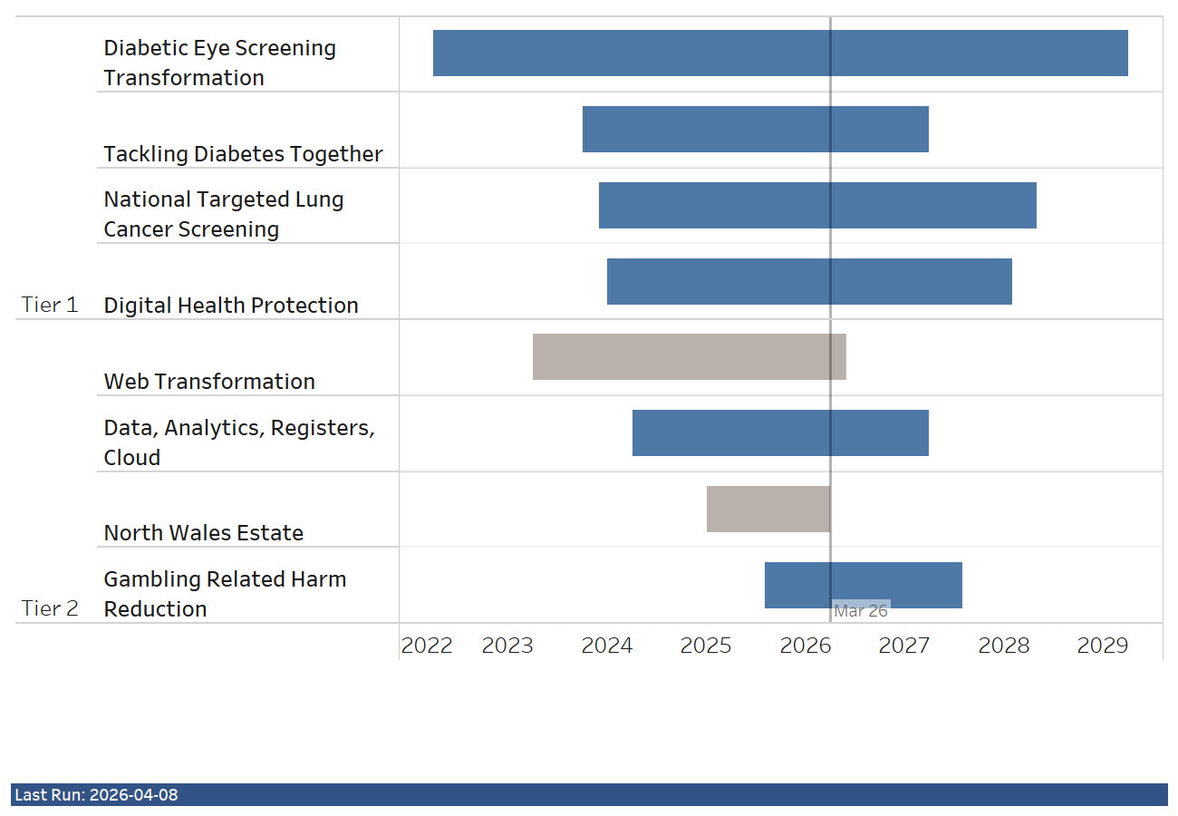
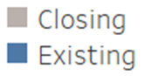
Change Portfolio for 26/27
Key changes to the portfolio for 26/27:
Programme closure: Web and North Wales
Programme initiation: My Path Cymru (Obesity Prevention) and Gambling Harm Reduction.
Programme scoping: Screening Transformation and Future Workforce Solution
All the programmes have people implications, including workforce restructuring, relocation, recruitment, upskilling, changes to ways of working.

Slide 5
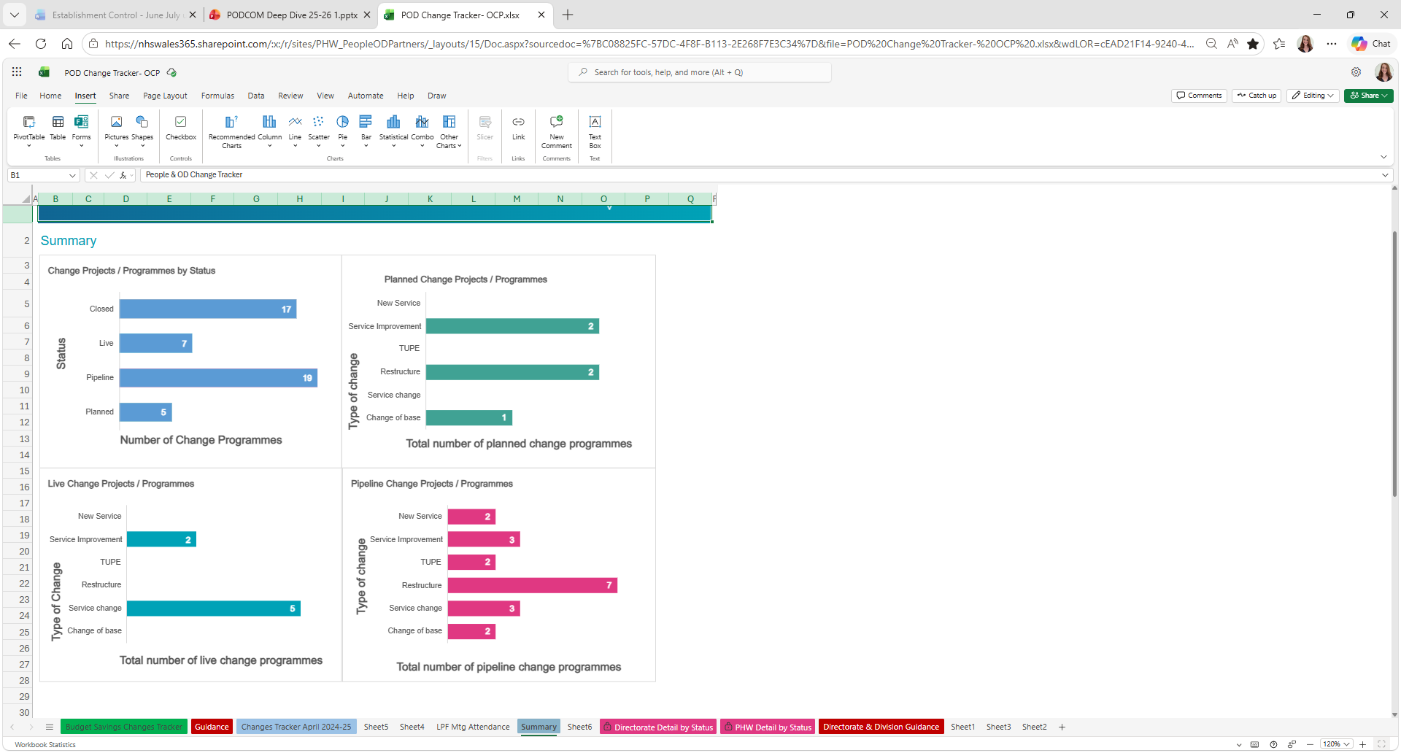
PEOPLE CHANGE PROGRAMME OVERVIEW
June 2026
P
Pl
L
C
STAGE 1
STAGE 2
STAGE 3
STAGE 4
Pipeline
Planned
Live
Closed
Early conversations. Details may or may not change. Still waiting for further information.
In planning stage. May or may not yet have a confirmed start date.
Programme is live and actively running now.
Closed. Shown on a rolling 12-month basis.

Slide 6
41
PEOPLE CHANGE PROGRAMME OVERVIEW
June 2026
TOTAL PROGRAMMES
17
2
7
15
PIPELINE
PLANNED
LIVE
CLOSED
Employee numbers TBC
Employee numbers TBC
294+ employees
227 employees (rolling year)
Peak Change Period (Forecast)
Types of Change Processes
High volume expected over the next 3–12 months, driven by planned and pipeline mobilisation.
Formal consultation restructures
Service / operating model redesign
Strategic transformation programmes
Workforce planning and pipeline development
Pipeline Consideration
Lack of confirmed dates creates uncertainty in forecasting peak demand.
This provides an opportunity for PHW to review and align programmes with organisational priorities before mobilisation.
KEY MESSAGE: Sustained high volume of concurrent organisational change, with continued pipeline pressure and workforce impact.

