Slide 1
Respiratory syncytial virus (RSV)
vaccination programme for older adults and people at risk
These slides are version controlled and subject to revision
Vaccine Preventable Disease Programme
Public Health Wales
Version 8: July 2026
Notes:
Material contained in this document may be reproduced without prior permission provided it is done so accurately and is not used in a misleading context.
Acknowledgement to Public Health Wales NHS Trust to be stated.
© 2026 Public Health Wales NHS Trust.
Change History:
Version 2
Slide 5: Updated links
Slide 6: Content updated to reflect catch-up
Slide 7: Added ®to the vaccine names and content updated based on JCVI advice (RSV immunisation programme: JCVI advice, 16 July 2025 - GOV.UK)
Slide 8: Added Green Book reference and updated WHC
Slide 11: Amended bullet point 4
Slide 13: Symptoms updated in line with Green Book RSV Chapter
Slide 14: The word ‘suitable’ has been removed from the first bullet point: There is no specific treatment suitable for RSV and treatment is therefore aimed at supporting the patient and relieving symptoms
Slide 15: Added: with a catch-up programme for those already past 28 weeks gestation, but that have not yet given birth. This information added to notes section:*Pregnant women will remain eligible until discharge from maternity services and should be actively offered vaccination at each opportunity. Introduction of RSV Vaccination Programme 2024 (WHC/2024/032). Updated to reflected extended catch-up.
Slide 18: Added following bullet point - individuals should be invited within 12 weeks of their 75th birthday, moved generic content to notes field.
Slide 19: Amended bullet point 3. Information added to notes section
Slide 20: Updated to reflect extended catch-up including eligibility table
Slide 21: Content added to notes field
Slide 24: Content updated to reflect recent MHRA Drug Safety Alert on Guillain-Barre syndrome (GBS) and updated Green Book chapter content
Slide 25: Content updated to reflect recent MHRA Drug Safety Alert on Guillain-Barre syndrome (GBS) and updated Green Book chapter content
Slide 30: Added following text ‘As we get older, we all experience age related reduction in immune response to vaccination, this is a natural part of ageing and is called immunosenescence’.
Slide 32: New slide added with co-administration table
Slide 33: More detailed information added to this slide and image of vaccine pack
Slide 34: Added first 5 bullet points as additional information
Slide 41: Linked SmPC to EMC webpage
Slide 58: Removed link to recorded slide set
Slide 59: New slide
Version 3
Slide 5: redrafted the lay out, to ensure a consistent approach across the training slides
Slides 24 and 25: updated with the latest incidence data on Guillain-Barré syndrome (GBS) in surveillance trials of older adults. Respiratory syncytial virus: the green book, chapter 27a - GOV.UK [ updated 5 Feb 2025]
Version 4
Slide 24: Text changed in last bullet point: This compares to a background rate of GBS which is 20 per million per year in those aged 70-79 years (Sejvar et al., 2011). Respiratory syncytial virus: the green book, chapter 27a - GOV.UK [ updated 25 Feb 2025]
Version 5
Slides 43-44: New slides outlining the updated advice on vaccine preparation and use of the vial adapter: Abrysvo powder and solvent for solution for injection - Summary of Product Characteristics (SmPC) - (emc) [updated 27 February]
Version 6
Amendments made to the slide deck v5.0 inline with updated policy (CEM/CMO/2025/04 Respiratory Syncytial Virus (RSV) 2025: Amendment to WHC/2024/032) and updated Green Book RSV Chapter (Dated: 14/07/2025)
CEM/CMO/2025/04: Public Health Alerts
Green Book RSV Chapter: https://assets.publishing.service.gov.uk/media/686fbfcf2557debd867cbf9d/Green_Book_Chapter27a_RSV_14July2025.pdf
Version 7
Amendments made to the slide deck v6.0 in line with updated policy (Update on RSV vaccination programme 2026 (WHC/2025/053) [HTML] | GOV.WALES) and updated Green Book RSV Chapter (Dated: 02/02/2026)
WHC/2025/053: Update on RSV vaccination programme 2026 (WHC/2025/053) [HTML] | GOV.WALES
Green Book RSV Chapter: Respiratory syncytial virus: the green book - GOV.UK
Version 8
Amendments made based on policy change to include an expansion to the RSV programme:
WHC Vaccination in adults at higher risk of respiratory syncytial virus (RSV) disease: JCVI advice, 18 March 2026 - GOV.UK
GB Respiratory syncytial virus: the green book - GOV.UK (3 June 2026)
Epi slides updated with data from VPDP Epidemiology colleagues

Slide 2
Vaccination against RSV
The information contained within this slide set is up to date as of July 2026.
It is important that all immunisers delivering the RSV vaccination programme and/ or those who are providing immunisation advice familiarise themselves with the most up to date clinical evidence and guidance, this can be found in the following key documents:
The Green Book: Green Book: Respiratory syncytial virus chapter - GOV.UK
UKHSA Guidance for Healthcare Professionals: Respiratory syncytial virus (RSV) programme: information for healthcare professionals - GOV.UK
Welsh Health Circular: Update on RSV vaccination programme 2026 (WHC/2026/020) [HTML] | GOV.WALES
Joint Committee on Vaccination and Immunisation: Vaccination in adults at higher risk of respiratory syncytial virus (RSV) disease: JCVI advice, 18 March 2026 - GOV.UK
VPDP Information for health professionals webpage will be available here: Respiratory syncytial virus (RSV) vaccination information - Public Health Wales (currently being updated)
The content of this training slide set is subject to review. This resource will be version controlled.
This is version 8 (July, 2026)

Slide 3
Acknowledgements
Vaccine Preventable Disease Programme (VPDP), Public Health Wales: Immunisation and Vaccines - Public Health Wales
Vaccine Programme Wales (VPW)
UK Health Security Agency: www.gov.uk/government/topics/public-health
Welsh Government

Slide 4
Notes to users
This slide set contains a collection of core slides for both individual use and for use or adaptation during the delivery of RSV vaccination training
Trainers should select the slides required depending on the background and experience of the healthcare practitioners they are training and according to the role they will have in delivering the RSV vaccine programme
The information in this slide set (version 8) was correct at time of publication
Updates to the slide set may be required in the future, for example in response to changing epidemiology or vaccination recommendations - please check online to ensure you are using the latest version of these slides

Slide 5
Contents
Section | Slide number
Aims | 6
Objectives | 7
Respiratory Syncytial Virus (RSV) | 8
Epidemiology | 13
Eligibility | 20
The RSV vaccine | 23
Vaccine administration | 37
Summary & resources | 56

Slide 6
Aims
To provide information for healthcare practitioners involved in advising on and delivering the RSV vaccination programme
To raise awareness of the current epidemiology of RSV and the impact on older adults
To describe the RSV vaccination programme details including eligibility, administration of the vaccine, recommended dosage and schedule, contraindications, precautions and potential adverse reactions
To raise awareness of the impact of the RSV vaccination programme
To highlight resources that support the RSV vaccination programme

Slide 7
Objectives
After completing this resource immunisers will be able to:
Describe the aetiology and epidemiology of RSV
Understand the rationale and evidence base for the RSV vaccination programme
Discuss the benefits of vaccination against RSV
Gain essential knowledge to administer the RSV vaccine safely
Identify relevant resources and additional information in relation to the RSV vaccination programme

Slide 8
Respiratory syncytial virus (RSV)
Influenza

Slide 9
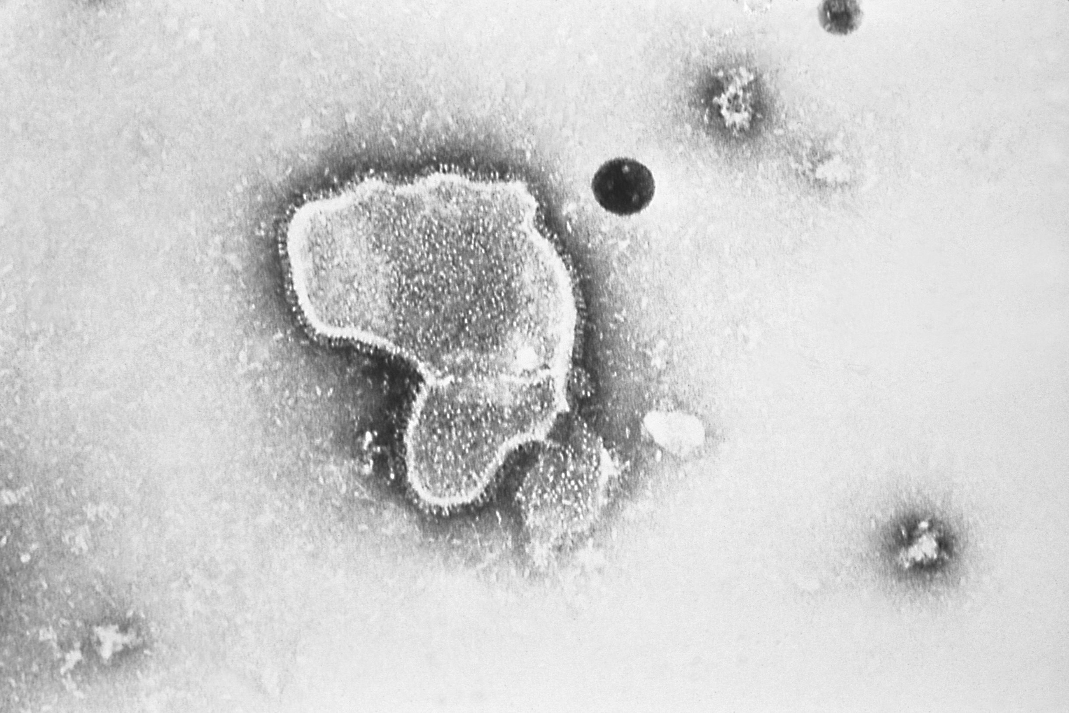
What is RSV?
Respiratory syncytial virus (RSV) is an enveloped, single-stranded RNA virus that belongs to the Orthopneumovirus genus of the Pneumoviridae family
RSV is a common cause of respiratory tract infections
It usually causes a mild self-limiting respiratory infection in adults and children but can be severe in infants and older adults who are at increased risk of acute lower respiratory tract infection
RSV is best known for causing bronchiolitis in infants. RSV disease may be under-recognised in older adults
Previous infection by RSV may only confer partial immunity to RSV and so individuals may be infected repeatedly with the same or different strains of RSV
Older adults may become vulnerable to RSV due to age-related decline of parts of their immune system (T-cell immunosenescence)
RSV virion highly magnified by transmission electron microscopic​
Image courtesy of the CDC

Slide 10
Clinical presentation
For most people RSV infection causes a mild respiratory illness
RSV can cause a range of symptoms such as rhinitis (runny nose, sneezing or nasal congestion), cough, shortness of breath, wheeze, lethargy and sometimes fever
Symptoms can progress to acute lower respiratory tract infection
Short or long-term complications may include respiratory complications (e.g. pneumonia)
RSV may manifest as exacerbations of underlying COPD or cardiovascular disease
In immunocompromised patients, RSV can cause severe infections with mortality rates as high as 80%. Immunosenescence of T-cell responses may be a factor in vulnerability to severe RSV infection in older adults
Notes:
A decreased appetite, croup and otitis media may also be symptoms in children.
RSV LRTI can include bronchiolitis in children.
Immunosenescence: age related reduction in immune response to vaccination.
Respiratory syncytial virus: the green book - GOV.UK
Respiratory syncytial virus (RSV) vaccination programme - GOV.UK [Accessed 08/07/2026]

Slide 11
Carriage, transmission, and infection (1)
There is no specific treatment for RSV and treatment is therefore aimed at supporting the patient and relieving symptoms
Transmission can be reduced through standard infection control practices such as respiratory hygiene, hand washing with soap and warm water, and cleaning of surfaces
Ideally, people with colds should avoid close contact with individuals with weakened immune systems, newborn babies, premature infants (before 37 weeks) and children under 2 born with heart or lung conditions
Notes:
Respiratory syncytial virus (RSV): symptoms, transmission, prevention, treatment - GOV.UK

Slide 12
Carriage, transmission, and infection (2)
RSV is highly communicable, but humans are the only known reservoir
The incubation period (time between infection and appearance of symptoms) varies from 2 to 8 days and the infectious period from 3 to 8 days
The virus is spread from respiratory secretions following close contact with an infected person via respiratory droplets or contact with contaminated surfaces or objects
The virus can survive on surfaces or objects for about 4 to 7 hours
12
Notes:
https://www.gov.uk/government/publications/respiratory-syncytial-virus-rsv-symptoms-transmission-prevention-treatment/respiratory-syncytial-virus-rsv-symptoms-transmission-prevention-treatment

Slide 13
Epidemiology
Influenza

Slide 14
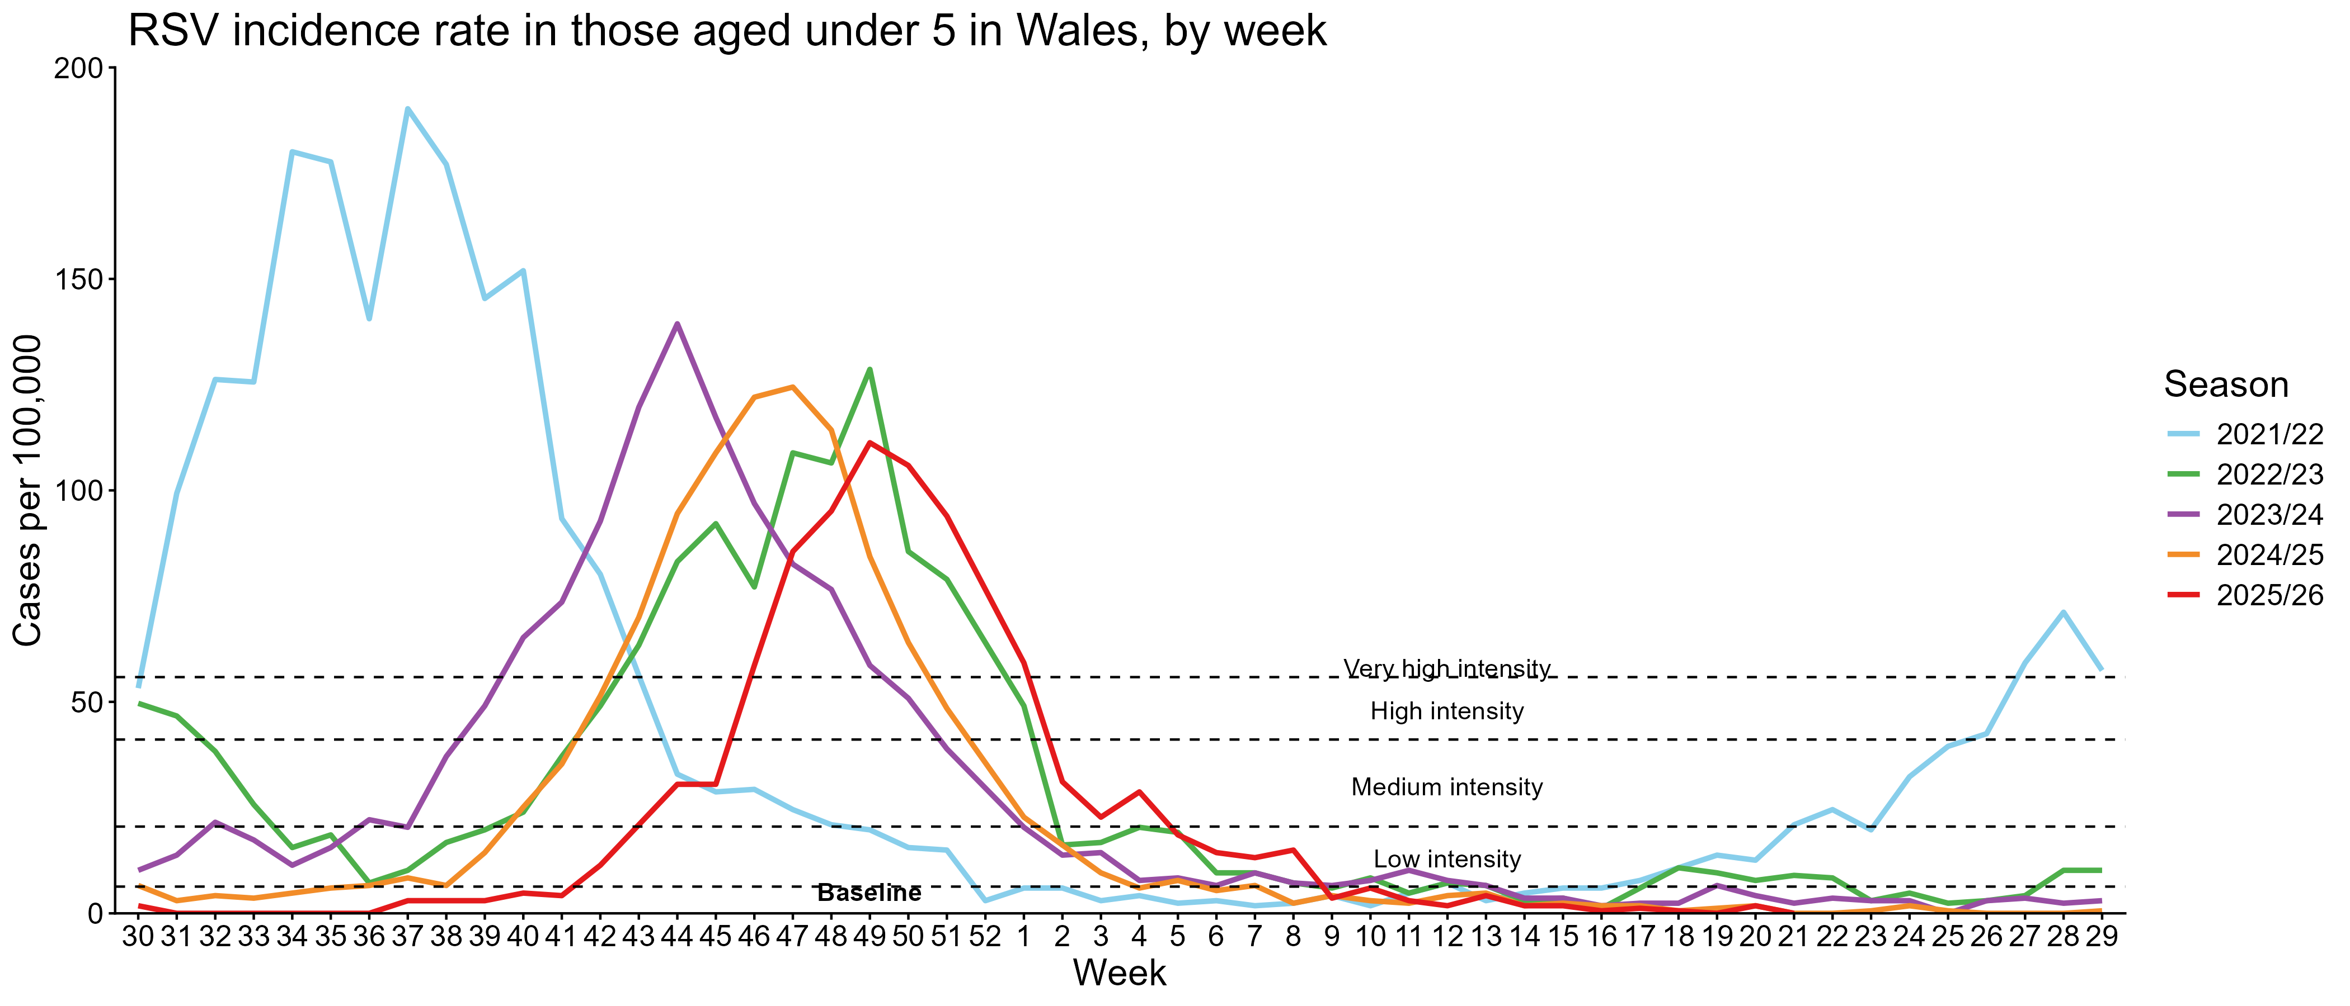
RSV epidemiology
Activity is highest in autumn and winter, with RSV season in the UK usually starting from October and declining by March
The peak of the RSV season varies from year to year
At least half of children experience an RSV infection in the first year of life and almost all will by the age of two. It frequently reinfects older children and adults
Confirmed case burden is highest in children aged up to 5y. In Wales, there are more than 1,000 babies (<1y) in hospital with RSV annually.
It is a leading cause of infant mortality globally, and results in 20 to 30 deaths per year in the UK
For further information on RSV in Wales please go to Public Health Wales Weekly Influenza and Acute Respiratory Infection Surveillance Report
Notes:
In recent years, the RSV season has been interrupted by control measures against the COVID-19 pandemic which has resulted in unseasonal RSV activity; this included significant rebound activity in summer 2021 and summer 2022 and a very prolonged period of virus activity in 2022.
RSV is a leading cause of infant mortality globally, resulting in 20 to 30 deaths per year in the UK. RSV-related mortality in low-income countries is considerably higher, and in some analyses is the second most common cause of death (after malaria) in infancy.
https://www2.nphs.wales.nhs.uk/CommunitySurveillanceDocs.nsf/($All)/FAC3B97E96996B2C80258CE500606BCC/$File/Weekly%20Acute%20Respiratory%20Infection%20Summary.pdf

Slide 15
RSV epidemiology in adults
Whilst the burden of RSV is well understood in infants and children, the burden of RSV in older adults is comparatively poorly understood and considered to be underestimated by existing routine surveillance
Only a minority of adult infections are diagnosed as RSV is not widely recognised as a cause of respiratory infections in adults
RSV can lead to serious health complications for adults aged over 75
Every winter in England and Wales, RSV is thought to cause 5,000 to 7,500 deaths in older adults
Most of these deaths are in adults over 75 years
Notes:
Hardelid, P., Pebody, R. and Andrews, N. (2013), Mortality caused by influenza and respiratory syncytial virus by age group in England and Wales 1999–2010. Influenza and Other Respiratory Viruses, 7: 35-45. https://doi.org/10.1111/j.1750-2659.2012.00345.x (first published 09 March 2012)
Fleming DM and others. Modelling estimates of the burden of respiratory syncytial virus infection in adults and the elderly in the United Kingdom. BMC Infectious Diseases 2015: 15, 443.
RSV vaccination of older adults: information for healthcare practitioners - GOV.UK

Slide 16
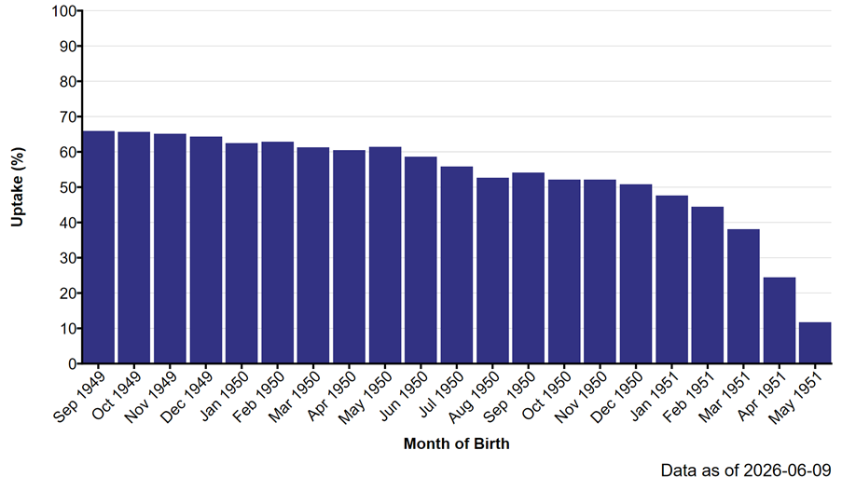
RSV vaccination coverage
Routine cohort (Adults reaching 75 years of age after 1st Sep 2024)
Uptake of RSV immunisation in resident population by month of birth.
Latest uptake report can be found here (NHS Internal Site):
Surveillance of Vaccines, Vaccine Preventable Diseases and Respiratory Infections

Slide 17
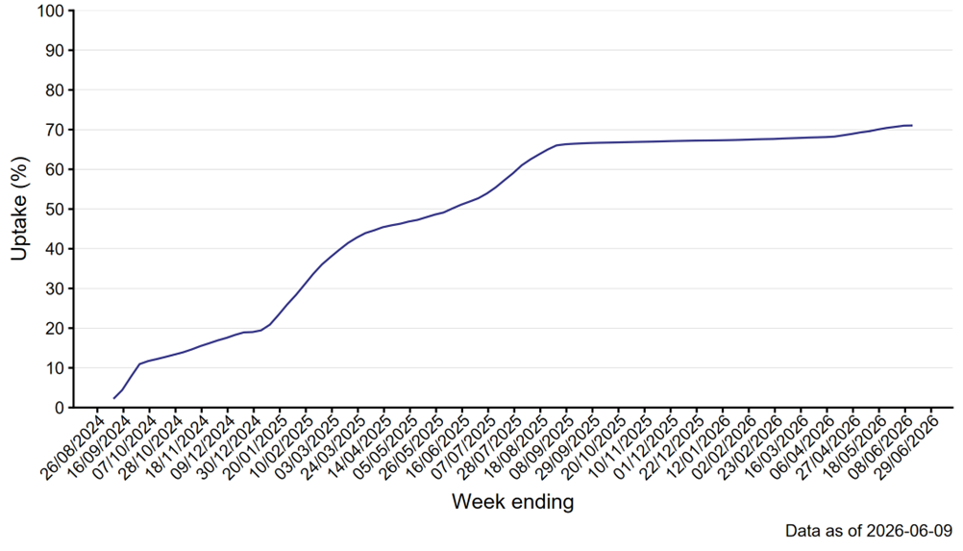
RSV vaccination coverage
Catch-up cohort (aged 75 to 79 as at 1st September 2024)
Weekly trends in uptake of RSV immunisation in resident population aged 75 to 79y as at 1st September 2024.
Latest uptake report can be found here (NHS Internal Site):
Surveillance of Vaccines, Vaccine Preventable Diseases and Respiratory Infections

Slide 18
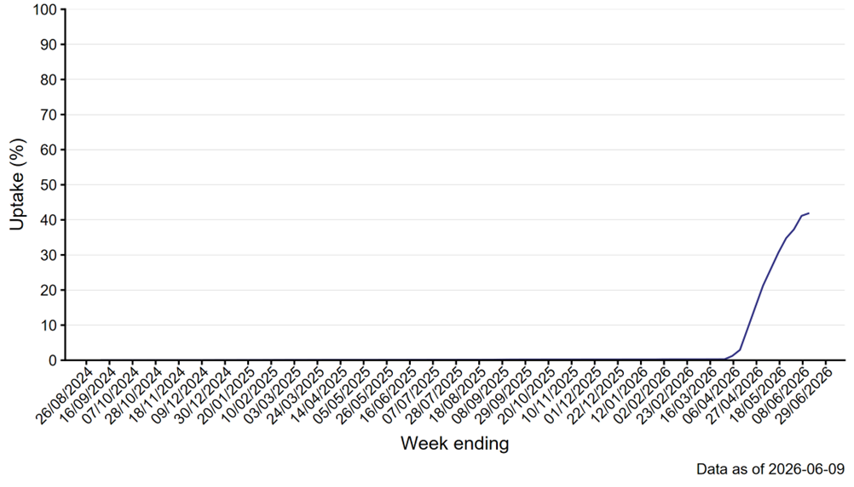
RSV vaccination coverage
Older adults aged 80+ as at 1st September 2024
Weekly trends in uptake of RSV immunisation in resident population aged 80y and older as at 1st September 2024.
Latest uptake report can be found here (NHS Internal Site):
Surveillance of Vaccines, Vaccine Preventable Diseases and Respiratory Infections

Slide 19
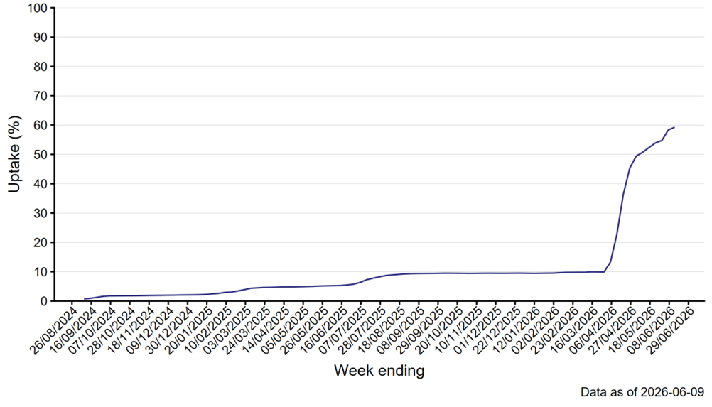
RSV vaccination coverage
Residents in a care home for older adults
Weekly trends in uptake of RSV immunisation in those resident in a care home for older adults.
Latest uptake report can be found here (NHS Internal Site):
Surveillance of Vaccines, Vaccine Preventable Diseases and Respiratory Infections

Slide 20
Eligibility

Slide 21
Background
The RSV programme is based on Joint Committee on Vaccination and Immunisation (JCVI) advice. Welsh Government issue vaccination policy for the public of Wales, based on advice from the JCVI.
Below is a summary of the RSV vaccination programme in Wales:
On 1 September 2024, NHS Wales introduced a routine RSV vaccination programme for adults turning 75 years. An initial catch-up offer was also introduced for those aged 75-79.
From 1 April 2026, the one-off catch-up offer expanded to include adults aged 80 years and over and residents in care homes for older adults.
From 1 September 2026, the programme will expand to adults aged 65-74 years in specified clinical risk groups.
Notes:
Joint Committee on Vaccination and Immunisation - GOV.UK
Update on RSV vaccination programme 2026 (WHC/2026/020) | GOV.WALES

Slide 22
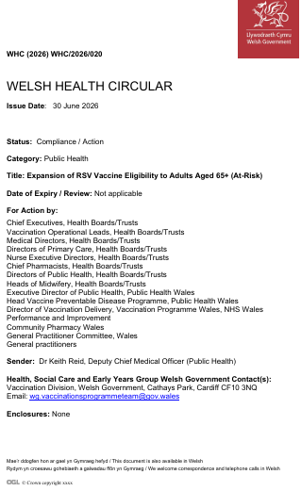
Eligibility
The RSV vaccination programme for older adults and people at risk will be offered, as per the WHC/2026/020, to those who are:
aged 75 or over,
resident in a care home for older adults, or
aged 65 to 74 years and have one of the health conditions listed below:
  poorly controlled asthma*
  chronic obstructive pulmonary disease (COPD)
  bronchiectasis
  cystic fibrosis
  interstitial lung fibrosis
  pneumoconiosis
  bronchopulmonary dysplasia
  a weakened immune system
Notes:
*Poorly controlled asthma is defined as: ≥2 courses of oral corticosteroids in the preceding 24 months, OR on maintenance oral corticosteroids, OR ≥1 hospital admission for asthma in the preceding 24 months
Respiratory syncytial virus: the green book - GOV.UK

Slide 23
The RSV vaccine
Influenza

Slide 24
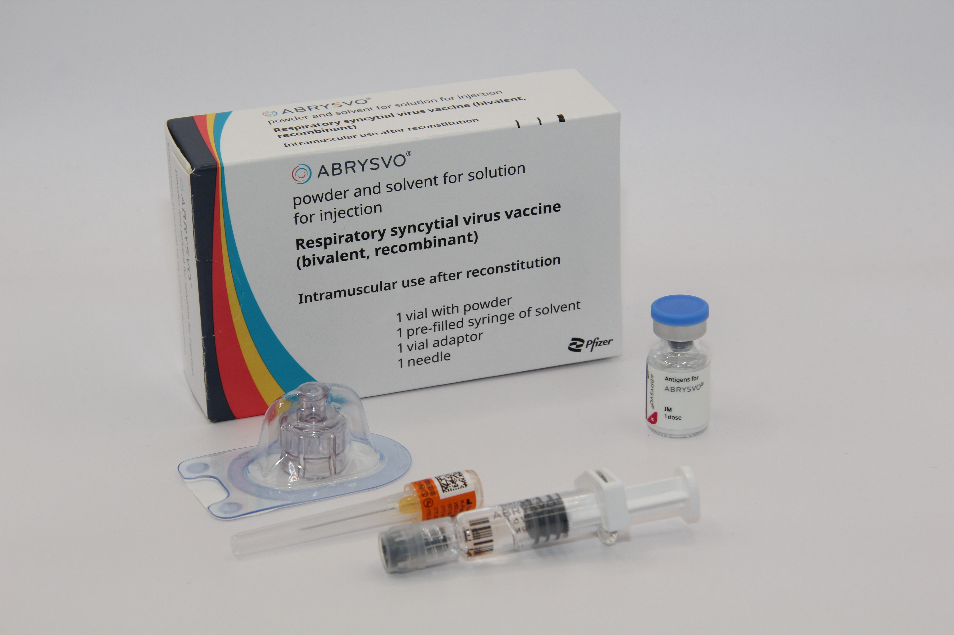
Abrysvo® vaccine: pharmaceutical information
Abrysvo® is the recommended vaccine for RSV vaccination of older adults and is the only vaccine currently available for use within the national programme in the UK
It is a non-live, bivalent recombinant vaccine
As it does not contain any live organisms, it cannot cause the disease against which it protects and can be given to immunosuppressed individuals
Abrysvo® requires reconstitution prior to administration
After reconstitution, one 0.5mL dose of Abrysvo® contains:
  RSV subgroup A stabilised prefusion F antigen 60 micrograms
  RSV subgroup B stabilised prefusion F antigen 60 micrograms
  Abrysvo® is licensed for active immunisation of individuals 60 years of age and older for the prevention of lower respiratory tract disease caused by RSV* and for
  the prevention of lower respiratory tract disease caused by RSV in individuals 18 through 59 years of age who are at increased risk for lower respiratory tract disease caused by RSVˆ.
  (ˆNote: individuals aged 18 to 64 are not included in the national routine programme for older adults (see slide 18 for further information)
Image source: UKHSA
Notes:
*NB. Abrysvo® is also licensed to protect infants from RSV LRTI through vaccination of pregnant women. The maternal indication is licensed by the Medical and Healthcare products Regulatory Agency (MHRA) as between 28 and 36 weeks gestation (see Green Book, Chapter 27a Respiratory syncytial virus: the green book, chapter 27a - GOV.UK for off-label use).
Abrysvo powder and solvent for solution for injection - Summary of Product Characteristics (SmPC) - (emc) | 15309

Slide 25
How Abrysvo® vaccine works
The RSV vaccine Abrysvo® is a non-live bivalent recombinant vaccine
Recombinant means a small piece of DNA from the protein of the virus is taken and inserted into a manufactured cell. As these cells grow the protein is made too. This protein is then purified and put into the vaccine which, when introduced into the body via IM injection, activates the immune system
It is referred to as bivalent because Abrysvo® contains versions of two proteins found on the surface of the virus called ‘RSV subgroup A stabilised prefusion F’ and ‘RSV subgroup B stabilised prefusion F’
The vaccine antigen (prefusion F proteins) stimulates the immune system to produce antibodies. When the individual encounters RSV virus, the antibodies neutralise the prefusion F proteins thus preventing the virus particle from fusing with and entering the host’s cells and causing an RSV infection
The vaccine is sometimes called pre-F because it is based on the prefusion form of the fusion (F) protein which the virus uses to invade human cells
Notes:
How RSV causes infection:
any virus particle consists of a protein shell (capsid) inside which is the nucleic acid (DNA or RNA) – the genome or the genetic code for that virus; RSV is an RNA virus
when a virus particle enters the host’s cells it is able to reproduce and release more virus particles which in turn infect other cells – establishing an infection
RSV virus particles use a special type of protein on the surface of the virus called a fusion (F) glycoprotein to pass through the cell membrane
the F proteins does this by fusing the virus cell membrane and the host’s cell membrane together; this allows the virus to move through the host’s cell membrane and enter the cells
the F protein changes shape as it fuses the RSV virus and human cell membranes together: while on the virus surface before infection, the protein is in a “prefusion” form, but as it interacts with the cell membrane it rearranges into an inactive, “postfusion” form
the prefusion form is antigenic – it stimulates an immune response; the immune system is able to recognise and respond to the presence RSV virus particles with prefusion F proteins on their surface by producing antibodies to combat the infection; the postfusion form is not antigenic
there are two subgroups of the prefusion form: A and B
Recombinant vaccine technology
different cells (for example bacteria, yeast, other established laboratory cell culture lines) are used to manufacture the vaccine
a small piece of genetic material (DNA) is taken from the microorganism (virus or bacterium) against which we want to protect and inserted into the manufacturing cells: this results in a “recombinant” version of those cells
the role of these recombinant cells is to help transport the DNA instructions for making the antigen into a host cell
once the recombinant cell enters the host cell line it instructs the host cells to rapidly produce the antigen
this antigen is grown in bulk, collected, purified, and then packaged as recombinant vaccine (the cell line used to manufacture the cells is not in the vaccine)
when the vaccine is injected, the antigen in it triggers the immune system to create antibodies that specifically target that antigen
recombinant vaccines are non-live so they cannot cause disease in the vaccine recipient

Slide 26
Abrysvo® vaccine: effectiveness
In 2026 a meta-analysis of case-controlled studies across the four UK nations found that RSVpreF vaccination was associated with a significant reduction in the odds of RSV-related hospitalisation among older adults with a pooled fixed-effect estimate of 75%.
Furthermore, adjusted vaccine effectiveness against RSV-related hospitalisation was 82% in Wales.
There is currently no data to support revaccination (second doses) of older adults after a first dose
Notes:
Lancet (2026) Bivalent RSV prefusion vaccine effectiveness against hospitalisation in older adults: meta-analysis of case–control studies in England, Wales, Scotland, and Northern Ireland: https://www.thelancet.com/journals/lanepe/article/PIIS2666-7762(26)00032-3/fulltext
Refer to the Green Book, RSV Chapter for further information: (https://www.gov.uk/government/publications/respiratory-syncytial-virus-the-green-book-chapter-27a)

Slide 27
Abrysvo® Vaccine safety (1)
Guillain-Barre syndrome
  A small number of cases of Guillain-Barré syndrome (GBS) were detected in phase 3 clinical trials and in post-marketing surveillance of older adults
  Surveillance studies over the first seasons of vaccination in the USA, England and Scotland suggested that RSV vaccines were associated with an increased risk of GBS in the six weeks following administration
  The risk is estimated at around 10 to 25 cases of GBS for every million doses of the vaccine administered to older people. This compares to a background rate of GBS which is 20 per million per year in those aged 70-79 years
  The MHRA have advised health professionals to be attentive to signs and symptoms of GBS in all recipients of Abrysvo® and Arexvy® to ensure early and correct diagnosis, and to initiate treatment and supportive care; noting that early medical care can reduce severity and improve outcomes
  The risk of experiencing Guillain-Barré syndrome following Abrysvo® in older adults remains rare.
Green Book: RSV Chapter
Respiratory syncytial virus (RSV) vaccination programme for older adults
Notes:
Green Book Chapter 27a RSV
Abrysvo▼ (Pfizer RSV vaccine) and Arexvy▼ (GSK RSV vaccine): be alert to a small risk of Guillain-Barré syndrome following vaccination in older adults - GOV.UK
Bullet #1: Schwarz et al., 2023, Walsh et al., 2023, Lloyd et al., 2025 (Refer to Respiratory syncytial virus: the green book, chapter 27a - GOV.UK)
Bullet #2: Lloyd et al., 2025, Stowe et al., 2025, Cullen et al., 2025 (Refer to Respiratory syncytial virus: the green book, chapter 27a - GOV.UK)
Bullet #3: Sejvar et al., 2011 (Refer to Respiratory syncytial virus: the green book, chapter 27a - GOV.UK)

Slide 28
Abrysvo® Vaccine safety (2)
Guillain-Barre syndrome continued
  The Commission on Human Medicines advises that overall, the benefit of vaccination in preventing hospitalisation and death from remains highly favorable relative to the risk of older adults developing GBS
  Healthcare professionals should advise all recipients of Abrysvo® and Arexvy® that they should be alert to signs and symptoms of Guillain-Barré syndrome and, if they occur, to seek immediate medical attention as it requires urgent treatment in hospital.
28
Respiratory syncytial virus (RSV) vaccination programme for older adults
Notes:
Reference: Respiratory syncytial virus: the green book, chapter 27a - GOV.UK
Reference: Respiratory syncytial virus (RSV) programme: information for healthcare professionals - GOV.UK (Older Adult HTML)

Slide 29
Abrysvo® contraindications and precautions
Abrysvo® is contraindicated following:
confirmed anaphylactic reaction to a previous dose of an RSV vaccine or
confirmed anaphylactic reaction to any of the components excipients in the vaccine
Precautions:
immunisation of individuals who are acutely unwell with fever should be postponed until they have recovered fully to avoid confusing the diagnosis of any acute illness by wrongly attributing any sign or symptoms to the adverse effects of the vaccine
minor illness, such as a common cold, without fever or systemic upset are not valid reasons to postpone immunisation
individuals with a history of GBS can be vaccinated as recommended for their age. There is evidence to suggest that having had a prior diagnosis of GBS does not predispose an individual to further episodes of GBS when immunised with other vaccines. Although there is no current indication for revaccination, those who are diagnosed with GBS within six weeks of a dose of RSV vaccine, should be advised to seek medical advice before accepting a future offer of revaccination, on a precautionary basis.
Refer to the Green Book RSV Chapter, Abrysvo® Patient Group Direction (PGD) and Abrysvo® SmPC for full details
Notes:
Bullet#5: Baxter et al 2012 and Respiratory syncytial virus: the green book - GOV.UK​

Slide 30
Abrysvo® vaccine excipients
Polysorbate 80
Rarely, people may be allergic to polysorbate 80. However, polysorbate 80 is widely used in medicines and foods, and is present in many medicines including monoclonal antibody preparations.
Some vaccines (such as the main injected influenza vaccines for individuals aged 65 years and above) contain polysorbate 80. It is also in foods such as ice cream, and other frozen desserts. It is likely that people will know if they are allergic to it and individuals who have tolerated injections that contain polysorbate 80 are likely to tolerate the Abrysvo® vaccine.
Additional information
There is no animal content in the vaccine
Abrysvo® has been certified Halal by The Islamic Food and Nutrition Council of America (IFANCA)
Abrysvo® contains the following excipients:
Powder vial
trometamol
trometamol hydrochloride
sucrose
Mannitol (E421)
polysorbate 80 (E433)
sodium chloride
hydrochloric acid
(for pH adjustment)
Solvent
water for injections
Notes:
Abrysvo powder and solvent for solution for injection - Summary of Product Characteristics (SmPC) - (emc) | 15309
RSV vaccination of older adults: information for healthcare practitioners - GOV.UK

Slide 31
Administering Abrysvo® at the same time as other vaccines
Advice for co-administration is different for different vaccines. (Please see the following slides for specific scenarios)
Where more than one vaccine can be administered at the same time, the vaccines should be given at a separate site, preferably in a different limb
If more than one vaccine is given in the same limb, they should be given at least 2.5cm apart
The sites at which each vaccine is given should be noted in the individual’s health records
When co-administered, any reactions experienced are expected to be the same as those experienced when receiving the vaccines separately

Slide 32
Administering Abrysvo® at the same time as seasonal influenza vaccine
There is some data which shows that in older adults administering Abrysvo® at the same time as seasonal influenza vaccine may reduce the immune response to the RSV vaccine
There is also data that suggests that the response to the influenza A(H3N2) component of seasonal influenza vaccine (the influenza subtype which most severely affects older adults) may be diminished when RSV and seasonal influenza vaccine are co-administered to older adults
The clinical significance of any reduced response is unknown, but influenza immune response is known to correlate with protection against infection, and there is emerging data that RSV immune response also correlates with clinical protection
It is therefore recommended that RSV vaccine is not routinely scheduled to be given to an older adult at the same appointment or on the same day as an influenza vaccine
No specific interval is required between administering the vaccines
However, if it is thought that the individual is unlikely to return for a second appointment or immediate protection is necessary, Abrysvo® can be administered at the same time as the influenza vaccine
NB. Please note that the SmPC states that Abrysvo can be administered concomitantly with seasonal influenza vaccines, either standard dose adjuvanted or high dose unadjuvanted. The information in the Green Book: RSV Chapter supersedes the SmPC
Notes:
Reactogenicity for co-administered vaccines is expected to be consistent with the profiles of the individual products.
Green Book: Respiratory syncytial virus chapter - GOV.UK

Slide 33
Administering Abrysvo® at the same time as other vaccines
Co-administration with pneumococcal, Shingrix® (shingles), COVID-19 and other inactivated or non-live vaccines
  in line with general advice about co-administration of inactivated and non-live vaccines, Abrysvo® can be safely given concomitantly with pneumococcal, Shingrix (shingles) and COVID-19 vaccines
  Abrysvo® can be given at any interval before or after these vaccines or other inactivated or non-live vaccines
Co-administration with a live vaccine
  although live vaccines are not commonly indicated in older adults, Abrysvo® is an inactivated or non-live vaccine so can be given at the same time as any live vaccines
Notes:
Reactogenicity for co-administered vaccines is expected to be consistent with the profiles of the individual products.
Green Book: Respiratory syncytial virus Chapter - GOV.UK

Slide 34
Co-administration:
Vaccines commonly administered to older adults | Can they be administered together?
Abrysvo® and Shingrix® | ✔
Abrysvo® and Prevenar 20® or Pneumovax 23® | ✔
Abrysvo® and COVID-19 vaccine | ✔
Abrysvo® and influenza vaccine | ✔*
*Abrysvo® should not be routinely scheduled on the same day as the influenza vaccine in older adults. Giving Abrysvo® with the seasonal influenza vaccine may reduce the immune response to both the RSV and influenza (H3N2) components. However, if it is thought that the individual is unlikely to return for their influenza vaccine, they can be given at the same time.

Slide 35
Ordering Considerations
Abrysvo® vaccine
Considerations when ordering Abrysvo®
Vaccines for the national RSV vaccination programmes in Wales should be ordered via ImmForm
Abrysvo® stocks should be monitored to avoid over-ordering or stockpiling.
Current expiry and quantity of Abrysvo® should be checked before ordering.
Only order stock sufficient for two weeks' worth of clinics.
One pack contains one vial of vaccine, diluent for reconstitution and patient information leaflet (PIL). Each pack will also contain one 25 G x 25 mm (1") needle.
Ensure the correct Abrysvo® is ordered for the required cohort (eg. maternal vaccine for infant protection or for older adult protection).
Abrysvo® vaccine packaging is physically larger than most other vaccines supplied via ImmForm. Each single dose pack measures 73mm x 35mm x 116mm (H x W x D). Please ensure you have enough fridge capacity before placing large orders.
Image source: UKHSA
Notes:
Vaccines required for individuals who are not in the eligible cohort, for example where a clinician has decided that it is clinically appropriate to vaccinate the individual, but they are not within the eligible age cohorts for the national vaccination programme, would require the GP practice to purchase the vaccine directly from the manufacturer and then reclaim the cost of the vaccine

Slide 36
Storage Considerations: Abrysvo® vaccine
Store vaccines in a validated fridge specifically designed for pharmaceutical products. Do not use a domestic fridge
Should be stored in the original packaging in a refrigerator at +2°C to +8°C
Keep the vaccine fridge secure. It should only be accessible to authorised staff. Therefore, keep it locked or in a locked room
Good practice is to have a data logger in the fridge to monitor internal temperatures
Reduce the possibility of accidentally interrupting the electricity supply. For example, install a switchless socket or clearly label the plug with a cautionary notice: ’Do not unplug/switch off’.
Use a large enough fridge to allow enough space around the vaccine packages for air to circulate
Do not freeze. Discard if the carton has been frozen
Notes:
Further information on vaccine storage and stability is available in the Summary of Product Characteristics (SPC), the Patient Group Direction and from the manufacturer
Vaccines should be ordered, stored and monitored as described in the Green Book: Storage, distribution and disposal of vaccines chapter. Storage, distribution and disposal of vaccines: the green book, chapter 3 - GOV.UK

Slide 37
Vaccine administration

Slide 38
Pre-requisites to administering RSV vaccine
Before administering the RSV vaccine, it is recommended that:
*Those new to immunisation should receive comprehensive foundation immunisation training. Both knowledge and clinical competence should be assessed before new immunisers start to give and/or advise about the RSV vaccine Immunisation training standards for healthcare practitioner UK Health Security Agency - UKHSA)
Immunisers have received RSV vaccine training through attending a taught session and/or eLearning Immunisation eLearning - Public Health Wales (nhs.wales)​
Immunisers have received practical training in RSV vaccine preparation and administration (if required)
​Training in the management of anaphylaxis and Basic Life Support is undertaken, as specified by policy for your local area and are familiar with Resuscitation Council UK (RCUK) guidance on Management of Anaphylaxis in the Vaccination Setting
Any additional statutory and mandatory training as required by your employer is completed
An appropriate legal framework to supply and administer RSV vaccine is in place e.g. Written prescription, Patient Specific Direction (PSD), or Patient Group Direction (PGD). Visit here for Wales National PGD template
Those involved in immunisation and vaccination understand the process of consent and how this applies when giving vaccines. Information on consent can be viewed here: Consent: the green book, chapter 2 - GOV.UK
Immunisers and those giving immunisation advice access and familiarise themselves with the following key documents: Green Book: RSV Chapter, UKHSA: RSV vaccination of older adults: information for healthcare professionals . The vaccine product information in the Summary of Product Characteristics (Electronic Medicines Compendium website).
Notes:
*This should be either through a face-to-face taught course or a blended approach of both e-learning and a face-to-face taught course. New immunisers should also have a period of supervised practice and support with a registered healthcare practitioner who is experienced, up to date and competent in immunisation.
Practitioners should always ensure they are accessing the most up to date information and guidance.

Slide 39
Before administering a vaccine
Before administering a vaccine, the individual should be assessed to ensure that:
there are no contraindications to the vaccine being given
they have not experienced any serious reactions to a previous dose or component of the vaccine
they or their carer is fully informed about the vaccine to be given and understand the vaccination procedure
they or their carer are aware of possible adverse reactions to the vaccine and how to treat them
they have consented to having the vaccine
Immunisers should ensure that:
they have the appropriate knowledge and legal authority to administer the vaccine (refer to slide 35 and 37)
the vaccine has been stored and prepared following guidance in the SmPC and that they know where and how to administer it

Slide 40
Consent
Before vaccinating, ‘informed’ consent must be obtained.
Informed consent is a legal requirement, and the individual’s views must be respected
Informed consent must be obtained by a registered HCP (Green book: Consent chapter [GOV.UK])
Sufficient evidence-based information must be provided to enable the person to make a balanced and informed decision about their care and treatment
As well as a general explanation of the procedure, there is also a duty to explain the risks inherent in the procedure and the risks inherent in refusing the procedure
Consent can be given verbally, in writing or it can be implied, but however it is given, the person must understand what they are consenting to
If there are any issues or uncertainties with seeking or gaining consent, ask for advice from an experienced colleague rather than abandon the offer of immunisation
Consent is a process and can be withdrawn
Notes:
Before giving RSV vaccine , immunisers must ensure that they have obtained informed consent from the individual or that a best interest decision has been made if the individual does not have mental capacity at the time of vaccination.
In order to be able to consent to vaccination, the vaccinee should receive an explanation of the treatment and its benefits and risks, either verbally from a clinician, or in the form of a leaflet and letter.
When assessing capacity to consent, the immuniser should be guided by the principles of the Mental Capacity Act (2005). This Act applies to those aged 16 years and over and is designed to protect and empower people who may lack the mental capacity to make their own decisions about their care and treatment.

Slide 41
Informed consent
How much information should you give?
this will be personal to the individual at the time and will depend on their previous knowledge and discussions with others
give people as much information as they need and/or want to make an informed decision
some people will just ‘trust’ what you say while others want lots of information; either is fine
how much each individual needs is up to them, no one is obliged to seek full information
Information to be given includes:
which vaccine is being offered and the disease against which it protects
benefits/risks of immunisation versus risks of the disease​
any possible vaccine reactions and what to do if these occur
Consent is a process, not a one-off discussion and must consider 3 factors:
the person giving consent must be appropriately informed: they must have the necessary information in order to make the decision
consent must be voluntary by the individual without undue pressure or coercion
the person consenting must have the capacity to make the decision
Green book: Consent chapter [GOV.UK]
Mental capacity Act 2005 https://www.legislation.gov.uk/ukpga/2005/9/contents

Slide 42
Legal requirements for the supply and administration of vaccines
The regulation of medicines is defined under the Human Medicines Regulations 2012
All vaccines are classified as Prescription Only Medicines (POMs)
Vaccines are subject to legal restrictions and to give them, there needs to be an appropriate legal framework in place before they can be supplied and/or administered to eligible people i.e. PGD or PSD
Additionally, any person who supplies and administers a vaccine must have a legal authority to do so

Slide 43
Legal requirements for the supply and administration of vaccines
As vaccines are Prescription Only Medicines (POMs), there must be a legal framework to supply and/or administer the vaccine in place. This can be in the form of a written patient specific prescription, patient specific direction (PSD) or patient group direction (PGD).
  PSD: a written instruction, signed by a doctor, dentist, or non-medical prescriber for medicines to be supplied and/or administered to a named patient after the prescriber has assessed the patient on an individual basis
  PGD: allows some registered specified health care professionals to supply and/or administer a POM directly to a patient with an identified clinical condition rather than needing an individual prescription or an instruction from a prescriber. PGDs are often used for the administration of vaccines
There is a Patient Group Direction eLearning module available here: Immunisation eLearning - Public Health Wales
Notes:
PGDs set out the core requisites of those people who can have the medicine under the direction and those who should not:
The document will also include details of any additional training that should have been undertaken, actions to be taken if the individual is excluded or declines the medicine, a description of the medicine(s), route of administration, doses, frequency, reporting of adverse reactions, recording, storage and disposal
The Healthcare Practitioner working under a PGD is responsible for assessing that the individual fits the criteria set out in the PGD. The healthcare professional operating under the PGD may not delegate the role to others
Those using a PGD must ensure that it is authorised by the organisation in which they are operating and signed in section 2 by an appropriate authorising person, relating to the class of person by whom the product is to be supplied, in accordance with the Human Medicines Regulations 2012 (HMR2012)
There is a Wales PGD Template for the Older adult RSV programme. An updated version will be available to download for local authorisation and use from PGD webpage
Healthcare practitioners who will be using the PGD must be named and authorised before they use it to provide care

Slide 44
Pack contents
Each pack of Abrysvo® RSV vaccine contains:
powder for 1 dose in a vial
solvent (water for injection) in a pre-filled glass syringe with a stopper (synthetic chlorobutyl rubber), luer lock adaptor and tip cap (synthetic isoprene/bromobutyl blend rubber)
vial adaptor
25G 25mm needle (suitable alternatives can be used if required)
Image source: UKHSA
Abrysvo powder and solvent for solution for injection - Summary of Product Characteristics (SmPC) - (emc)

Slide 45
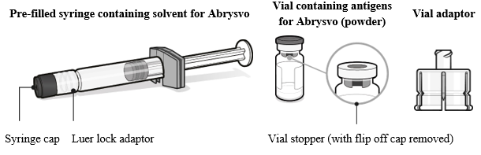
Preparing the Abrysvo® vaccine
Abrysvo® must be reconstituted prior to the administration by adding the entire contents of the pre-filled syringe of solvent to the vial containing the powder using the vial adaptor
the vaccine must be reconstituted only with the solvent provided
Clear instructions on how to prepare the vaccine for administration can be found in the SmPC and the manufacturer's video. Immunisers are strongly encouraged to watch the video in its entirety before preparing the vaccine for the first time.
Image from Abrysvo® vaccine
SmPC

Slide 46
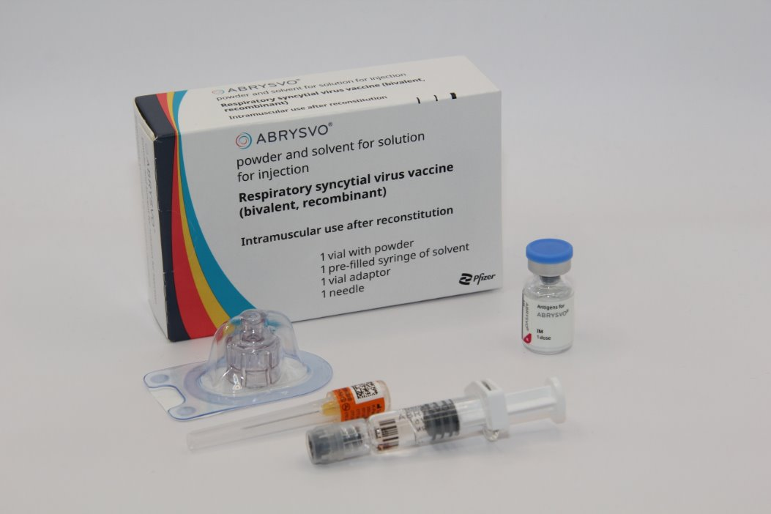
Preparation for administration
The prepared vaccine is a clear and colourless solution. Visually inspect the vaccine for large particulate matter and discolouration prior to administration
Do not use if large particulate matter or discolouration is found
Disposal
Any unused medicinal product or waste material should be disposed of in accordance with local requirements
*For further information please visit: Respiratory syncytial virus (RSV) programme: information for healthcare professionals - GOV.UK
Image source: UKHSA
Abrysvo powder and solvent for solution for injection - Summary of Product Characteristics (SmPC) - (emc)
Notes:
* The UKHSA guidance for healthcare practitioners has a section on what do in the event of reconstitution errors

Slide 47
Vaccination intramuscular administration
Giving vaccine into the muscle:
leads to a better immune response to the vaccine (as the muscle contains the appropriate cells necessary to initiate the immune response)
is less likely to cause local reactions than if the vaccine is given under the skin (subcutaneously)
The needle needs to be long enough to ensure vaccine is injected into the muscle. For this reason, a 25mm needle is being provided for administration of the RSV vaccine. In larger adults, a longer length (for example, 38mm) may be required, and an individual assessment should be made. Abrysvo® packs contain a 25mm 25G needle
Abrysvo® is given by intramuscular injection, preferably in the deltoid muscle
If there is insufficient muscle mass in the deltoid or a particular reason the deltoid muscle is unsuitable, the vaccine should be given into the vastus lateralis muscle in the anterolateral aspect of the thigh

Slide 48
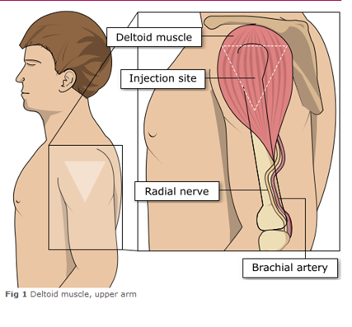
Administering vaccine into the deltoid muscle
It is essential that the correct site and injection technique is used to administer vaccines.
Injecting too high into the upper arm might result in a shoulder injury or a frozen shoulder. This leads to pain, weakness and a limited range of motion that can last for months.
Injecting too low or too far to the side of the arm risks injecting into the axillary nerve or the radial nerve.
To avoid shoulder injury, always assess the limb before administering the vaccine to identify the correct site for injection.
Image adapted from the Australian Immunisation Handbook

Slide 49
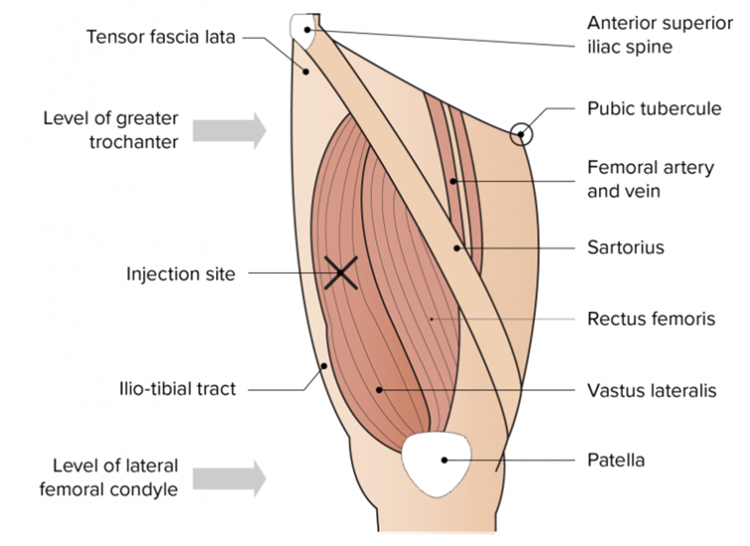
The vastus lateralis muscle (anterolateral aspect of the thigh)
Although the deltoid muscle is more commonly used in older children and adults as it is quicker and easier to access, the vastus lateralis muscle in the thigh can be used in these age groups if necessary.
Image from the Australian Immunisation Handbook

Slide 50
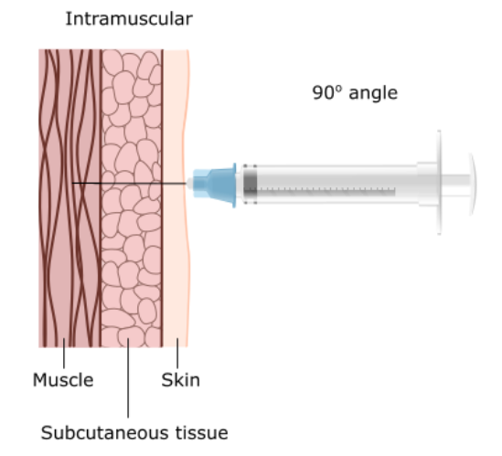
Vaccine administration
Skin does not need to be specially cleaned prior to vaccination. If it is visibly dirty, then water is sufficient to clean it.
Intramuscular process:
identify the correct site for IM injection
stretch the skin at the site
insert the needle at a 90 degrees angle far enough to ensure vaccine is delivered into muscle
depress the plunger
gently remove the needle
apply light pressure using gauze or cotton wool if bleeding occurs
Notes:
https://assets.publishing.service.gov.uk/government/uploads/system/uploads/attachment_data/file/147915/Green-Book-Chapter-4.pdf

Slide 51
Individuals with bleeding disorders or taking anticoagulation therapy
Individuals with bleeding disorders may be vaccinated intramuscularly if, in the opinion of a doctor familiar with the individual’s bleeding risk, vaccines or similar small volume intramuscular injections can be administered with reasonable safety by this route
If the individual receives medication/ treatment to reduce bleeding, for example treatment for haemophilia, intramuscular vaccination can be scheduled shortly after such medication or treatment is administered
Individuals on stable anticoagulation therapy, including individuals on warfarin who are up-to-date with their scheduled INR testing and whose latest INR is below the upper level of the therapeutic range, can receive intramuscular vaccination
A fine needle (23 or 25 gauge) should be used for the vaccination, followed by firm pressure applied to the site without rubbing for at least 2 minutes
The individual or their carer should be informed about the risk of haematoma from the injection

Slide 52
Post vaccination
Following RSV vaccine administration, individuals should be observed for any immediate reactions whilst they are receiving any verbal post vaccination information
Vaccinees should be given a copy of the patient information leaflet for the vaccine that they have received and any other relevant written information
They should be given information about possible vaccine reactions, how to treat these, and when and from whom to seek further advice if required
Generally, symptoms post vaccination resolve within 1 to 2 days without treatment, but antipyretics and/or analgesics can be taken if necessary to relieve any symptoms
If individuals are concerned about any symptoms following vaccination, they should seek advice from their GP or NHS 111
Facilities for management of anaphylaxis should be available at all vaccination sites and staff should have undertaken BLS and anaphylaxis training

Slide 53
Possible adverse reactions
The Abrysvo® SmPC reports the following possible adverse reactions in individuals aged 18 years and over:
Very common (1:10 of people vaccinated)
Vaccination site pain, headache, muscle pain, fatigue
Common (≥1/100 to <1/10)
Vaccination site redness and swelling, joint pain
Uncommon (≥1/1000 to <1/100)
Fever
Rare (≥1/10,000 to <1/1,000)
Guillain-Barre syndrome¹ , hypersensitivity (includes rash, urticaria), swollen lymph nodes, vaccination site itch, bruising and haematoma
Very rare (≥1/10,000)
    Anaphylaxis
Driving and using machines
  Abrysvo® has no or negligible influence on the ability to drive and use machines.
Notes:
¹ Frequency reported in individuals 60 years of age and older
The full list of side effects can be found in the Abrysvo® summary of product characteristics:​
Abrysvo powder and solvent for solution for injection - Summary of Product Characteristics (SmPC) - (emc) | 15309

Slide 54
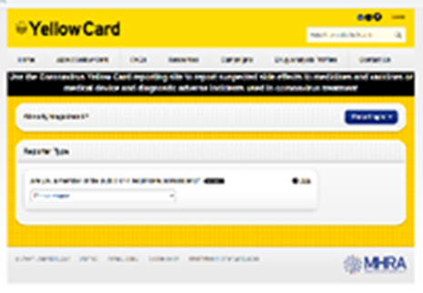
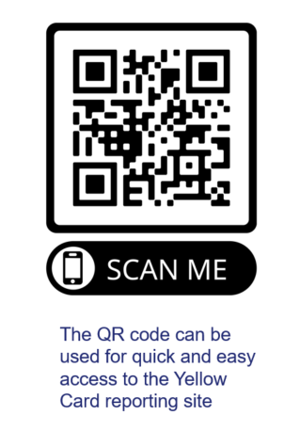
Reporting suspected adverse reactions
Vaccines should be advised that they can report any adverse reactions or suspected side effects to the MHRA through the online yellow card scheme website or the Yellow Card app
Any suspected side effects following vaccine administration should be reported to the MHRA Yellow Card Scheme.
Anyone can report even if uncertain about whether vaccine caused condition:
  www.mhra.gov.uk/yellowcard or call 0800 731 6789 (9am to 5pm Monday to Friday)
  Green Book: Surveillance and monitoring for vaccine safety chapter for detailed guidance on reporting vaccine reactions
Notes:
Healthcare professionals and patients are encouraged to report suspected adverse reactions to the Medicines and Healthcare Products Regulatory Agency (MHRA) using the yellow card reporting scheme
Green Book chapter 9: https://www.gov.uk/government/publications/surveillance-and-monitoring-for-vaccine-safety-the-green-book-chapter-9

Slide 55
Documentation and record keeping
It is essential that the information in Box 1 is recorded for all doses of vaccine given to ensure complete and accurate patient vaccination records* and to enable extraction of the correct data for surveillance and vaccine coverage purposes.
Box 1. Following vaccination, the following information should be recorded:
vaccine name
product name
batch number
expiry date
dose administered
date immunisation given
route/site used
name and signature of vaccinator
The engaged provider must use the Welsh Immunisation System (WIS) for documenting RSV vaccination.
Including:
consent for vaccination
noting any contraindications
recording immediate adverse events
recording the refrigerator temperature(s) where vaccines are stored, twice daily (start and end of the day) on all working days, as per national guidance
Clinical services may wish to update their own clinical records by entering vaccination on local systems/paper notes.
Notes:
*Also refer to the relevant PGD Section 5 Description of treatment: Records requirements to ensure these requirements in relation to record keeping are met.

Slide 56
Summary & Resources

Slide 57
Summary
RSV is a common cause of respiratory tract infections across the UK, predominantly in autumn and winter
The RSV vaccination programme should be offered year-round
Abrysvo® is the recommended vaccine for RSV vaccination of older adults, and is the only vaccine currently available for use within the national programme in the UK
Abrysvo® offers protection for at least two years (studies are ongoing) and there is no data currently to support a second doses in older adults
Those with a role in delivering the RSV vaccination programme need to be knowledgeable, confident and competent in order to promote the vaccination programme and deliver the vaccine safely

Slide 58
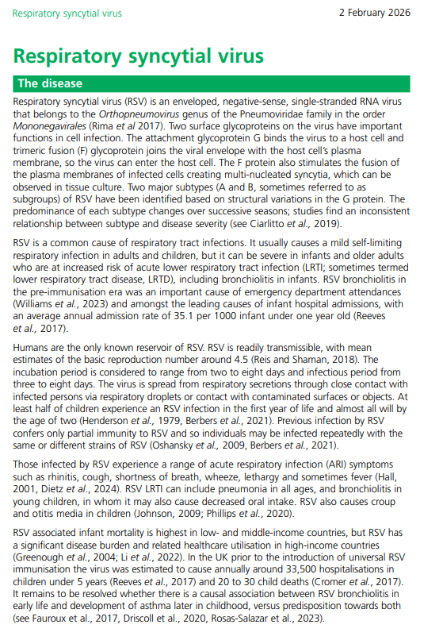
Key publications
Welsh Government issued a health circular on 30 June 2026 Update on RSV vaccination programme 2026 (WHC/2026/020) [HTML] | GOV.WALES
The Green Book RSV chapter has been updated and is available to view here: Respiratory syncytial virus: the green book, chapter 27a - GOV.UK (www.gov.uk) (03/06/2026)
UKHSA RSV vaccination of older adults: information for healthcare practitioners. This guidance is for healthcare practitioners implementing the vaccination programme to protect older adults from RSV.
For previous WHC's, see Vaccination | Sub-topic | GOV.WALES and search RSV

Slide 59
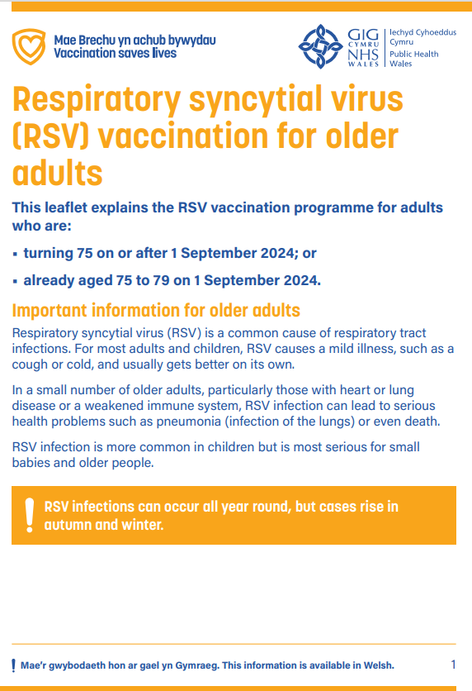
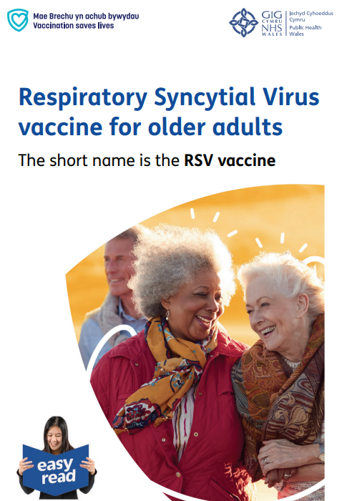
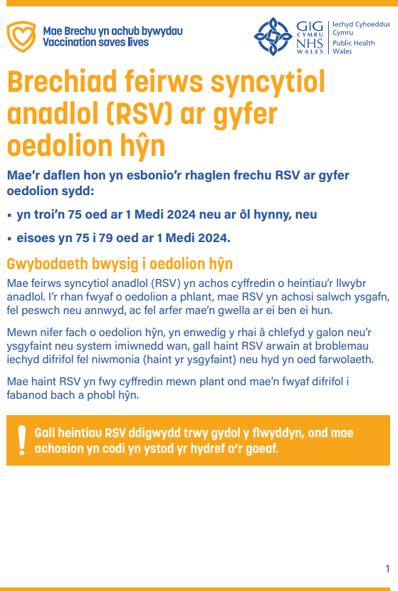



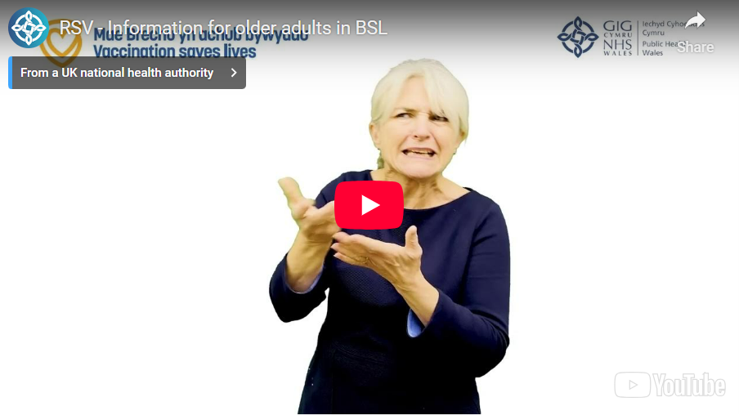
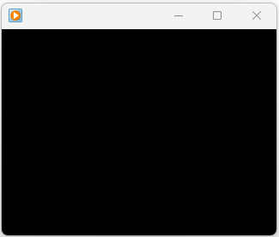
Public Resources (1)
Resources are available to order for free on Health Information Resources website
(Note: please contact phw.vaccines@wales.nhs.uk if you wish to place a large order
Accessible resources are also available online here
Currently being updated
Currently being updated
Currently being updated
Large print booklet CYM/ENG
Easy read booklet CYM/ENG
Patient information leaflet
Bilingual digital version available on PHW vaccines website:
English website page (English presents first on the leaflet)
Welsh website page (Welsh presents first on the leaflet)
Currently being updated
Currently being updated
BSL
Audio file CYM/ENG

Slide 60
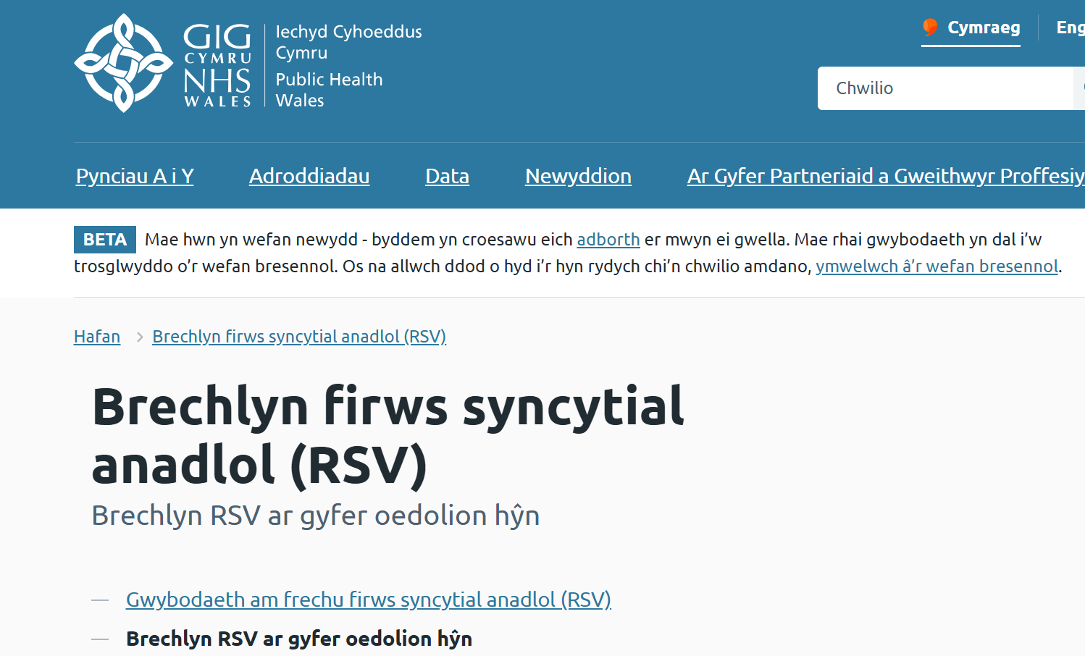
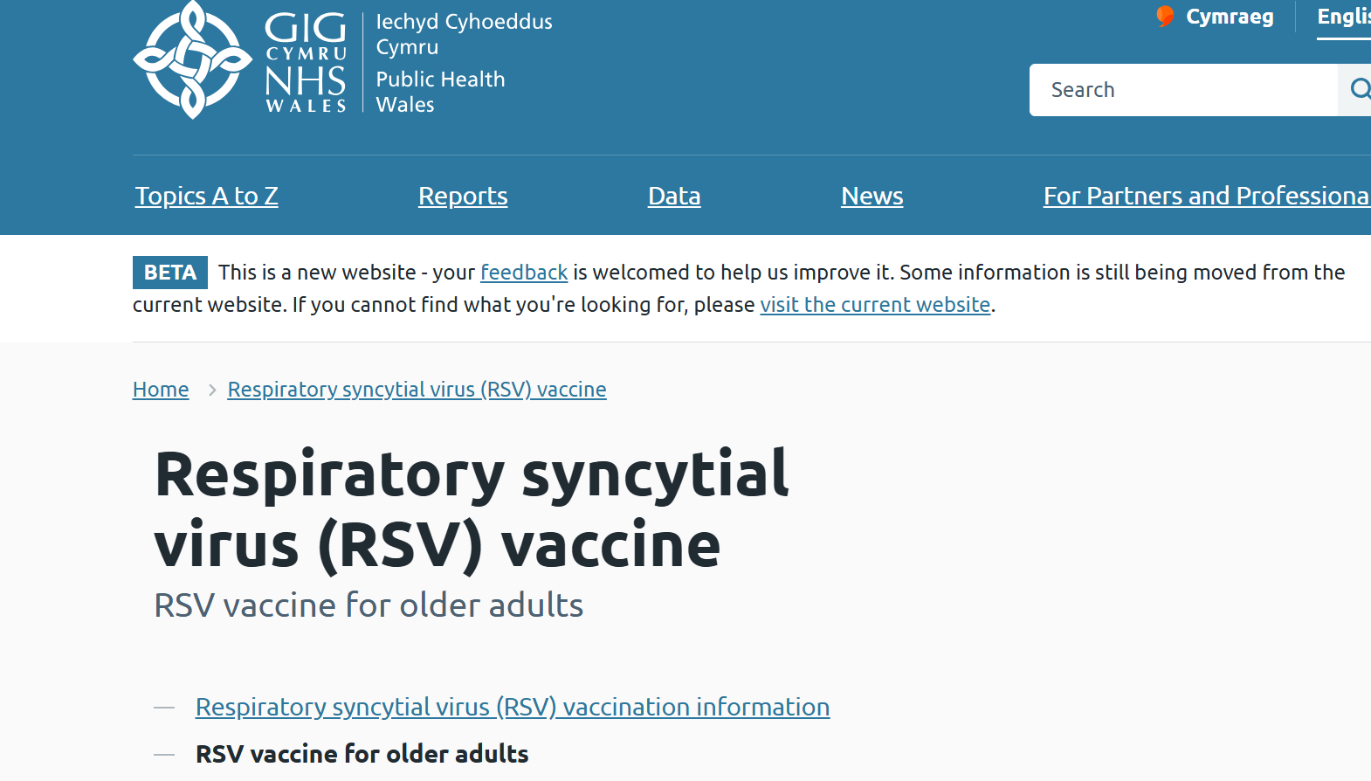
Public Resources (2)
Currently being updated
Currently being updated
Public Health Wales bilingual public website

Slide 61
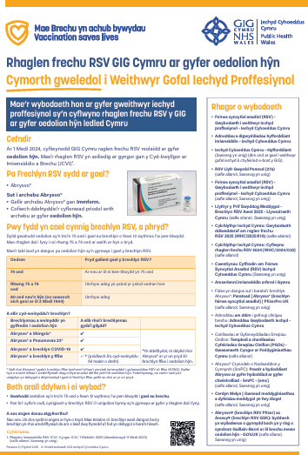
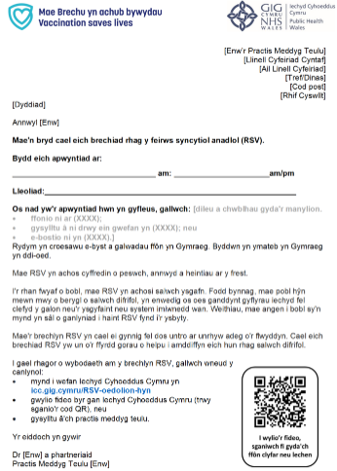
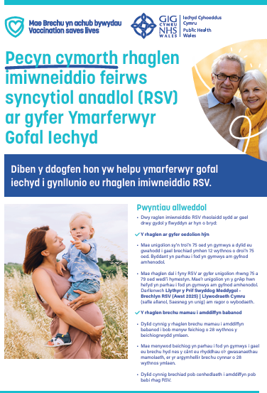
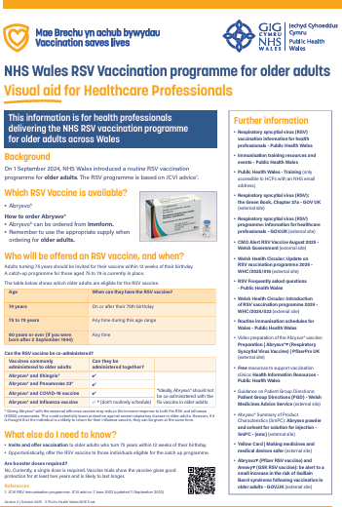
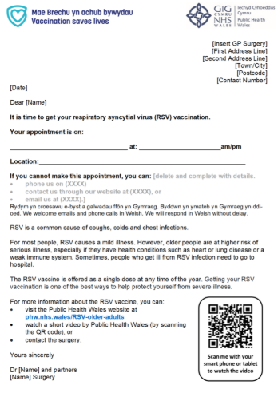
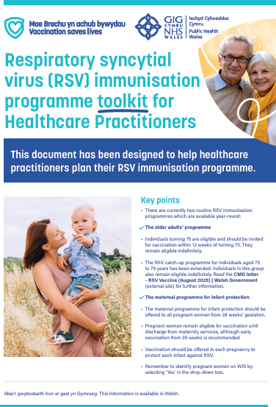
Healthcare professional resources (1)
Resources are available to order for free on Health Information Resources website
Or download from the RSV HCP webpage
Currently being updated
Currently being updated
RSV Toolkit CYM/ENG
RSV Template invite
letter CYM/ENG
RSV Visual Aid CYM/ENG

Slide 62
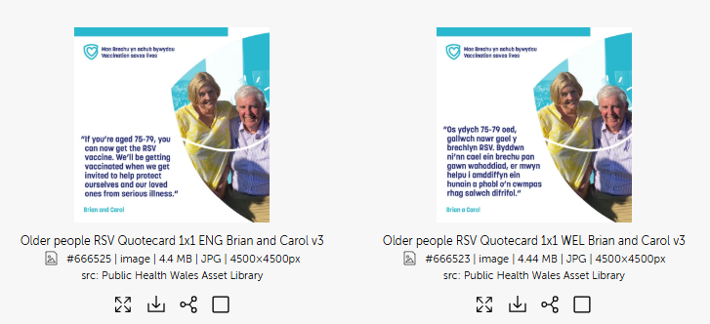
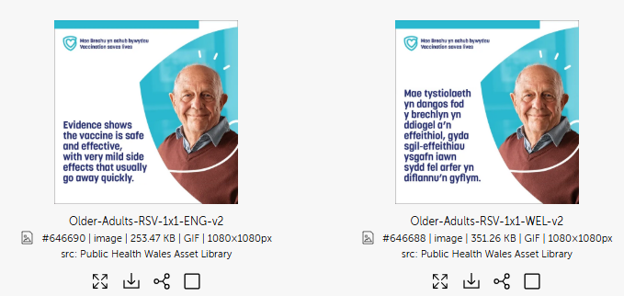
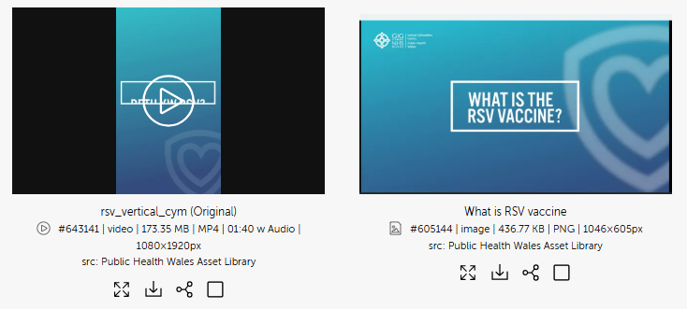
Healthcare professional resources (2)
PHW Asset library
  A range of bilingual assets to support the RSV Campaign for older adults are available here
Currently being updated
Currently being updated
Currently being updated
You will need to log in without a password when you first use

Slide 63
Resources: Information for healthcare practitioner guidance
The UKHSA information for healthcare practitioners' guidance Respiratory syncytial virus (RSV) programme: information for healthcare professionals - GOV.UK (www.gov.uk) is recommended reading for anyone involved in RSV immunisation
This is a practical document for healthcare practitioners administering or providing advice about RSV vaccination of older adults. It includes the vaccination programme recommendations, contraindications, precautions and examples of scenarios that staff may experience when immunising

Slide 64
Further information
Marketing authorisation holder’s Summary of product characteristics
Medicines and Healthcare products Regulatory Agency (MHRA): reporting adverse reactions
National Patient Group Direction (PGD): RSV vaccine
Pfizer Abrysvo® vaccine preparation instructional video
Public Health Wales public webpage: Respiratory syncytial virus (RSV) vaccination information - Public Health Wales (nhs.wales)
For information: A separate training slide set and information for healthcare practitioners document is also available for the RSV vaccination of pregnant women for infant protection

