Slide 1
COVID-19 Vaccination – Spring 2026
Vaccinations recommended for adults
Moderna Spikevax® LP.8.1 (0.1 mg/mL)
&
Sanofi Nuvaxovid ® JN.1 ​(5 microgram/dose) ​
VPDP update: Respiratory Planning and Delivery Meeting
Vaccine Preventable Disease Programme
Public Health Wales
Version 2
March 2026
Notes:
Material contained in this document may be reproduced without prior permission provided it is done so accurately and is not used in a misleading context.
Acknowledgement to Public Health Wales NHS Trust to be stated.
© 2026 Public Health Wales NHS Trust.
Change history:
Version 2
Slide 1: Removed ages from title slide
Slide 2: Removed slide with caveats about Green Book Chapter publication and consumables
Slide 33: Added information on Nuvaxovid for children and young people
Slide 37: Updated information on contra-indications

Slide 2
Acknowledgements
Vaccine Preventable Disease Programme
Vaccine Programme Wales
Welsh Medicines Advice Service
Welsh Government
JCVI
UKHSA Green Book

Slide 3
Contents
Section | Slide number
Aims and objectives | 5
Pre-requisites to administering COVID-19 vaccines: training, policy and guidance | 6
Moderna Spikevax LP.8.1 (0.1mg/mL for individuals aged 18 years and over) | 19
Sanofi Nuvaxovid ® JN.1 5 microgrammes/dose | 27
Additional slides outlining key principles for Moderna Spikevax® LP.8.1 & Sanofi Nuvaxovid® JN.1 COVID-19 vaccines | 34
Summary & resources | 54

Slide 4
Aims
To provide information for healthcare practitioners involved in advising on and delivering the COVID-19 spring 2026 vaccination programme
To describe the vaccination programme details including administration of the Moderna Spikevax® LP.8.1 and Sanofi Nuvaxovid® JN.1 COVID-19 ​ vaccines, eligibility, recommended dosage and schedule, contraindications, precautions and potential adverse reactions
To highlight resources that support the COVID-19 spring 2026 vaccination programme
Objectives
After completing this resource immunisers will be able to:
Understand the rationale and evidence base for the COVID-19 spring 2026 vaccination programme
Gain essential knowledge to administer the Moderna Spikevax® LP.8.1 and Sanofi Nuvaxovid® JN.1 COVID-19 vaccines safely
Identify relevant resources and additional information in relation to the COVID-19 spring 2026 vaccination programme

Slide 5
Pre-requisites to administering COVID-19 vaccines: training, policy and guidance and guidance

Slide 6
Notes to users
This slide set contains a collection of core slides for both individual use and for use or adaptation during the delivery of COVID-19 vaccination training
Trainers should select the slides required depending on the background and experience of the healthcare practitioners they are training and according to the role they will have in delivering the COVID-19 vaccine programme
Updates to the slide set may be required in the future, for example in response to changing epidemiology or vaccination recommendations - please check online to ensure you are using the latest version of these slides
It is important that COVID-19 immunisers and/or those who are providing COVID-19 immunisation advice, ensure they are accessing the most up to date information and refer to the Green Book COVID-19 chapter and other authoritative sources when administering vaccines.
The information contained in these slides is accurate at the time of publication (11March 2026) These slides are version controlled and subject to revision; this is version 1.

Slide 7
Pre-requisites to administering COVID-19 vaccine
Before administering COVID-19 vaccine, it is recommended that:
Those new to immunisation should receive comprehensive foundation immunisation training. Both knowledge and clinical competence should be assessed before new immunisers start to give and/or advise the COVID-19 vaccine Immunisation training standards for healthcare practitioner UK Health Security Agency - UKHSA)
Received COVID-19 vaccine training through attending a taught session and/or eLearning. COVID-19 core eLearning module and vaccine specific modules are available to access here: Immunisation eLearning - Public Health Wales (nhs.wales)
Received practical training in COVID-19 vaccine preparation and administration
Training in the management of anaphylaxis and Basic Life Support is undertaken, as specified by policy for your local area and are familiar with Resuscitation Council UK (RCUK) guidance on Management of Anaphylaxis in the Vaccination Setting
Any additional statutory and mandatory training as required by your employer is completed
An appropriate legal framework to supply and administer COVID-19 vaccine is in place e.g. patient specific prescription, Patient Specific Direction (PSD), Patient Group Direction (PGD) Vaccine Specific Direction (VGD). Visit here for Wales PGD and VGD template
Those involved in immunisation and vaccination understand the process of consent and how this applies when giving vaccines. Information on consent can be viewed here: Consent: the green book, chapter 2 - GOV.UK
Immunisers and those giving immunisation advice access and familiarise themselves with the following key documents: COVID-19: the green book chapter, COVID-19 vaccination: information for healthcare practitioners - GOV.UK. The vaccine product information in the Summary of Product Characteristics (Electronic Medicines Compendium website)
Notes:
*This should be either through a face to face taught course or a blended approach of both e-learning and a face to face taught course. New immunisers should also have a period of supervised practice and support with a registered healthcare practitioner who is experienced, up to date and competent in immunisation.
Practitioners should always ensure they are accessing the most up to date information and guidance.

Slide 8
JCVI statement on the COVID-19 vaccination in 2025 and Spring 2026 [published 13 November 2024] (1)
In Spring 2026, JCVI advises that a COVID-19 vaccine should be offered to:
residents in a care home for older adults
adults aged 75 years and over
individuals aged 6 months and over who are immunosuppressed (as defined in ‘immunosuppression’ sections of tables 3 & 4 of the COVID-19 chapter of the Green Book)
Timing of vaccination
The vaccine should usually be offered no earlier than around 6 months after the last vaccine dose, although operational flexibility around the timing of vaccination in relation to the last vaccine dose is considered appropriate (with a minimum interval of 3 months between doses). More information on operational flexibility will be provided in the COVID-19 chapter of the Green Book.
JCVI statement on COVID-19 vaccination in 2025 and spring 2026 - GOV.UK

Slide 9
JCVI statement on the COVID-19 vaccination in 2025 and Spring 2026 [published 13 November 2024] (2)
This JCVI statement outlines the vaccine products for use during 2025 to Spring 2026:
Adults:
JCVI does not have a preference for a specific COVID-19 vaccine product in the adult population. However, JCVI advises a preference for having vaccine products based on more than one vaccine platform in the programme, such as mRNA and protein-based vaccines.
Children and young people:
For children and young people who are immunosuppressed, JCVI continues to advise the use of the Pfizer-BioNTech COVID-19 mRNA (Comirnaty) vaccine, with the vaccine dose appropriate to the child’s age:
  12 to 17 years: 30 micrograms
  5 to 11 years: 10 micrograms
  6 months to 4 years: 3 micrograms
JCVI statement on COVID-19 vaccination in 2025 and spring 2026 - GOV.UK

Slide 10
COVID-19 Spring Vaccination Programme 2026,
Welsh Health Circular (WHC/2025/052) published 15 January 2026 (1)
Groups eligible for a COVID-19 vaccine in spring 2026:
As advised by the JCVI:
residents in a care home for older adults
adults aged 75 years and over
individuals aged 6 months and over who are immunosuppressed (as defined in ‘immunosuppression’ sections of tables 3 & 4 of the Green Book: COVID-19 chapter)
Programme start and end date:
The COVID-19 spring programme will run between 13 April and 30 June 2026. There will be some limited flexibility into July for those who are unable to receive a vaccination within the main programme window due to illness.
COVID-19 spring vaccination programme 2026 (WHC/2025/052) [HTML] | GOV.WALES
Notes:
This vaccination should be offered around 6 months after the last vaccine dose, although operational flexibility around the timing of the spring dose in relation to the last vaccine dose is considered appropriate (with a minimum interval of three months between doses). More information on operational flexibility will be provided in COVID-19: the green book chapter.

Slide 11
COVID-19 Spring Vaccination Programme 2026,
Welsh Health Circular (WHC/2025/052) published 15 January 2026 (1)
Programme ambitions:
All those eligible for a spring booster to receive a written invite for vaccination;
Health boards should make every effort to maximise uptake across all cohorts ensuring that;
    i. uptake levels are maintained or improved for those over 75 years of age and those resident in a care home for older adults, and that every effort is made to achieve 75% uptake for these cohorts;
    ii. all possible interventions which could improve uptake for the immunosuppressed cohort are explored and acted on, including removing any barriers to vaccination;
    iii. the gap is reduced between uptake rates in the least and most deprived areas of the health board.
COVID-19 spring vaccination programme 2026 (WHC/2025/052) [HTML] | GOV.WALES
Notes:
In terms of uptake rates this should be compared to the 2025 spring programme.

Slide 12
Dose recommendation by age
Recent UKHSA seroprevalence studies suggest that most children under 5 in the UK have had COVID-19 infection. However, the immunity profile of these children is less certain and may change for future birth cohorts. The JCVI advises that these children aged under 5 should be offered two doses of vaccine.
JCVI has advised that eligible individuals aged 5 years and above only require a single dose of vaccine, irrespective of prior vaccination status.
The only exception to this will be individuals with severe immunosuppression who may require additional doses (see slides below).

Slide 13
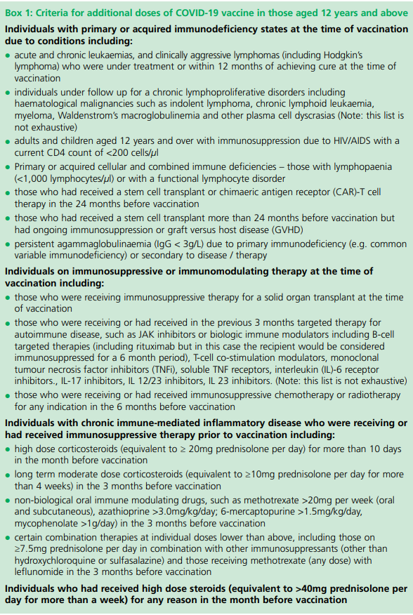
Individuals who are severely immunosuppressed
Individuals aged 12 years and above who have severe immunosuppression, are defined in Box 1 of the Green Book: COVID-19 chapter [GOV.UK].
Most individuals who receive brief immunosuppression (≥40mg prednisolone per day or equivalent for children) for an acute episode (for example, asthma / COPD / COVID-19) and individuals on replacement corticosteroids for adrenal insufficiency are not considered severely immunosuppressed sufficient to prevent response to vaccination
Notes:
Green Book COVID-19 chapter

Slide 14
Vaccine dose intervals for individuals who become or have recently become immunosuppressed
Individuals previously unvaccinated aged 5 years and over :
should be considered for a first dose of vaccination regardless of the time of year with consideration of an additional dose as outlined in subsequent slides
Individuals previously vaccinated aged 5 years and over:
should be considered for an additional dose of the vaccine regardless of their past vaccination history and time of year. Timing of the additional dose outlined in subsequent slides.
Notes:
In contrast to other eligible risk groups, those who are eligible for a vaccination due to severe immunosuppression but miss vaccination during the campaign period, may be considered for an additional dose at a later date based on individual clinical judgement, balancing their immediate level of risk against the advantages of waiting till the next seasonal campaign.

Slide 15
Additional Doses
Individuals aged six months and above with severe immunosuppression may be considered for additional doses ideally at an interval of 8 to12 weeks from the previous dose.
Exception to this ideal interval may be advised based on specialist clinical judgement, for example for those about to receive or increase the intensity of an immunosuppressive treatment, where a better response would be made if immunised prior to that treatment commencing. Where the specialist has advised an exception, then the interval may be reduced to a minimum of three weeks for any of the vaccine products.
Assessment of individuals is recommended on a case by case basis, in conjunction with their treating specialist.
More information on dosing intervals for additional doses and optimal timing of doses may be found in Green Book: COVID-19 Chapter.

Slide 16
Timing of additional doses
Vaccines administered during periods of minimum immunosuppression are more likely to generate better immune responses. Therefore, any planned additional doses should ideally be given with special attention paid to current or planned immunosuppressive therapies. For example:
For the small number of patients who are about to receive planned immunosuppressive therapy, vaccination may be brought forward to before commencing that therapy (ideally at least two weeks before), when their immune system is better able to make a response.
To maximise the benefit, the vaccine should not be given within three weeks of a previous dose
Where possible, additional booster doses should be delayed until two weeks after the period of immunosuppression, in addition to the time period for clearance of the therapeutic agent
Alternatively, consideration should be given to vaccination during a treatment ‘holiday’ or when the degree of immunosuppression is at a minimum
Any decision to defer immunosuppressive therapy or to delay possible benefit from vaccination until after therapy should only be taken with due consideration of the risks of exacerbating their underlying condition, as well as the risks from COVID-19.
Green Book COVID-19 chapter

Slide 17
Individuals who receive bone marrow transplant and CAR-T therapy
These individuals may lose immunological memory from vaccination received prior to the treatment and the development of the underlying condition.
After treatment and recovery, these individuals should be considered for a full course of revaccination for all vaccines used in the routine programme (see Green Book: Immunisation of individuals with underlying medical conditions Chapter) under specialist advice.
Individuals who have recovered from a bone marrow transplant should be considered for a first dose of COVID-19 vaccine, regardless of the time of year.
A subsequent dose should then be offered ideally at an interval of 8 to 12 weeks, to extend the duration of protection. This interval may be reduced to a minimum of three weeks on specialist clinical advice.
Those who remain immunosuppressed will then continue to be eligible for seasonal campaigns.
Notes:
After treatment and recovery, these individuals should be considered for a full course of revaccination for all vaccines used in the routine programme (https://www.gov.uk/government/publications/immunisation-of-individuals-with-underlying-medical-conditions-the-green-book-chapter-7) under specialist advice.

Slide 18
Moderna Spikevax LP.8.1 (0.1mg/mL for individuals aged 18 years and over)
​
COVID-19 spring campaign 2026

Slide 19
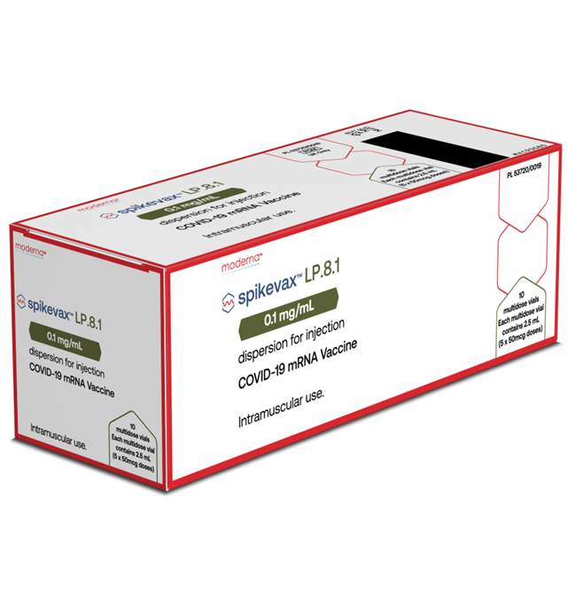
Moderna Spikevax® LP.8.1 0.1mg/mL dispersion for injection for individuals aged 18 years* and over.
SmPC Moderna Spikevax® LP.8.1 0.1mg/mL dispersion for injection
14
Notes:
Spikevax LP.8.1 0.1 mg/mL dispersion for injection - Summary of Product Characteristics (SmPC) - (emc) | 101925
*Moderna Spikevax is licenced for the immunisation of individuals aged 6 months and over. However as recommended by the JCVI and in the COVID-19: the green book chapter - GOV.UK, Spikevax is not recommended for individuals below 18 years.
JCVI statement on COVID-19 vaccination in 2025 and spring 2026 - GOV.UK

Slide 20
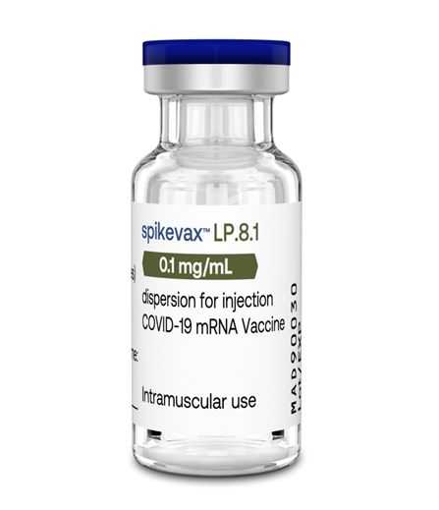
Presentation: Moderna Spikevax LP.8.1 0.1mg/mL dispersion for injection
Moderna Spikevax LP.8.1 0.1mg/mL dispersion for injection is a multi-dose vial with a blue flip-off plastic cap. NO dilution is required.
Vials of Spikevax LP.8.1 0.1mg/mL contain 5 doses of 0.5 mL (50 microgram/dose) of vaccine. Each vial contains 2.5mL of liquid.
Each dose must contain 0.5 mL of vaccine.
If the amount of vaccine remaining in the vial cannot provide a full dose of 0.5 mL, discard the vial and any excess volume.
Do not pool excess vaccine from multiple vials.
The vaccine should be prepared and administered by a trained healthcare professional using aseptic technique to ensure sterility of the dispersion.
Swirl the vial gently after thawing and before each withdrawal, do not shake
Pierce the stopper preferably at a different site each time to minimise the chances of dislodging a fragment of the bung.
Spikevax LP.8.1 0.1 mg/mL dispersion for injection - Summary of Product Characteristics (SmPC) - (emc) | 101925

Slide 21
Instructions once thawed
Unpunctured vial
After first dose has been withdrawn
Maximum times
Maximum time
30
Days
^ 6 Hours
Refrigerate
or room temperature
Refrigerated
+2°C to +8°C
24
Hours
Vial should be held between +2°C to +25°C.
Record the date and time of discard on the vial label. Once the vial has been punctured to withdraw the initial dose, the vaccine should be used immediately and be discarded after 6 hours.
Cool storage up to room temperature
+8°C to +25°C
Spikevax LP.8.1 0.1 mg/mL dispersion for injection - Summary of Product Characteristics (SmPC) - (emc) | 101925

Slide 22
List of excipients
Moderna Spikevax® LP.8.1 COVID-19 vaccine contains:
Polyethylene glycol/macrogol (PEG) as part of PEG2000- DMG.
SM-102 (heptadecan-9-yl 8-{(2-hydroxyethyl)[6-oxo-6-(undecyloxy)hexyl]amino} octanoate)
Cholesterol
1,2-distearoyl-sn-glycero-3-phosphocholine (DSPC)
1,2-Dimyristoyl-rac-glycero-3-methoxypolyethylene glycol-2000 (PEG2000-DMG)
Trometamol
Trometamol hydrochloride
Acetic acid
Sodium acetate trihydrate
Sucrose
Water for injections
Spikevax LP.8.1 0.1 mg/mL dispersion for injection - Summary of Product Characteristics (SmPC) - (emc) | 101925

Slide 23
Polyethylene glycol (PEG)
The Moderna Spikevax® LP.8.1 COVID-19 vaccine contains polyethylene glycol (PEG).
PEGs (also known as macrogols) are a group of known allergens commonly found in medicines, many household products and cosmetics.
Medicines containing PEG include some tablets, laxatives, depot steroid injections, and some bowel preparations used for colonoscopy.
Patients with undiagnosed PEG allergy often have a history of immediate onset-unexplained anaphylaxis or anaphylaxis to multiple classes of drugs or an unexplained anaphylaxis. Such individuals should not be vaccinated with any COVID-19 vaccine containing polyethylene glycol (PEG)) except on the expert advice of an allergy specialist.
Known allergy to PEG is rare but has been implicated in a minority of allergic reactions reported.
For further information see: Table 5: Management of patients with a history of allergy in Green Book COVID-19 chapter

Slide 24
Consumables for use with Moderna Spikevax® LP.8.1 0.1mg/mL dispersion for injection
Safety Needles:
GBUK Healthcare Safety Combined Needle and Syringe 1ml 25G x 25mm with needle cover will be supplied with Moderna Spikevax® LP.8.1 0.1mg/mL dispersion for injection
Yangzhou Medicine Safety Retractable Needle 25G x 38mm and 1ml Syringe (morbidly obese needle) for Spikevax
*Please note: the IPC measures in external resources may not align with the national IPC requirements in Wales. See here for NHS Wales guidance: NIPCM - Public Health Wales

Slide 25
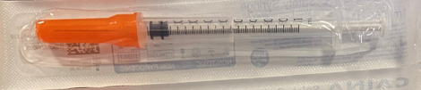
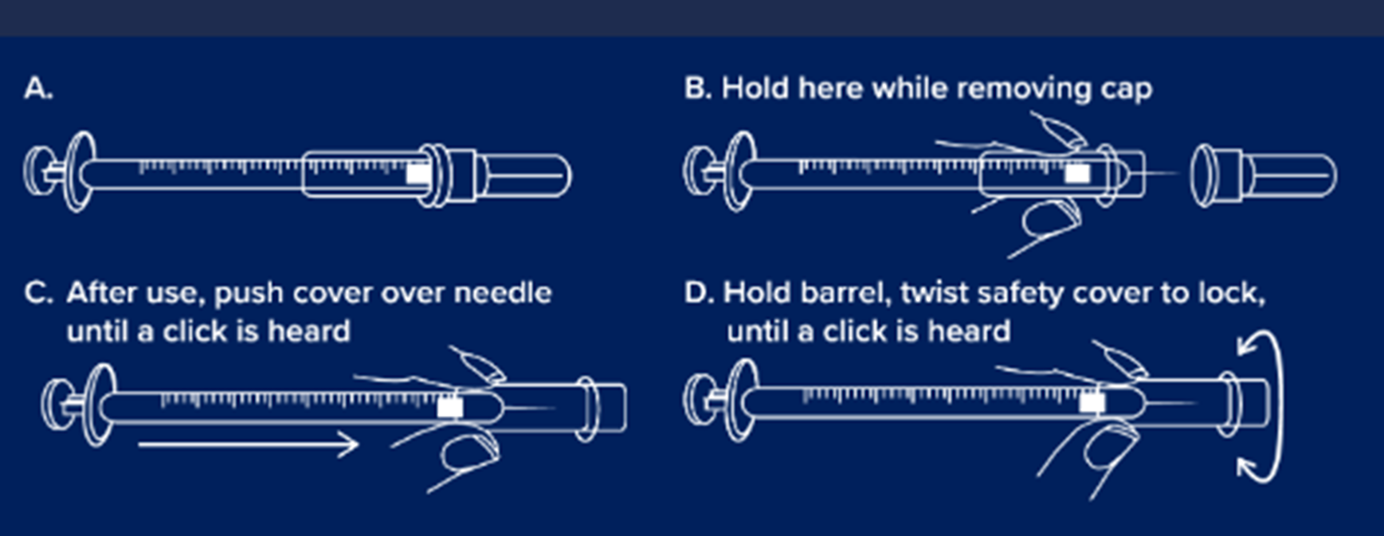
GBUK Healthcare Safety Combined Needle and Syringe 1ml 25G x 25mm with needle cover

Slide 26
Sanofi Nuvaxovid ® JN.1 5 microgrammes/dose
COVID-19 spring campaign 2026

Slide 27
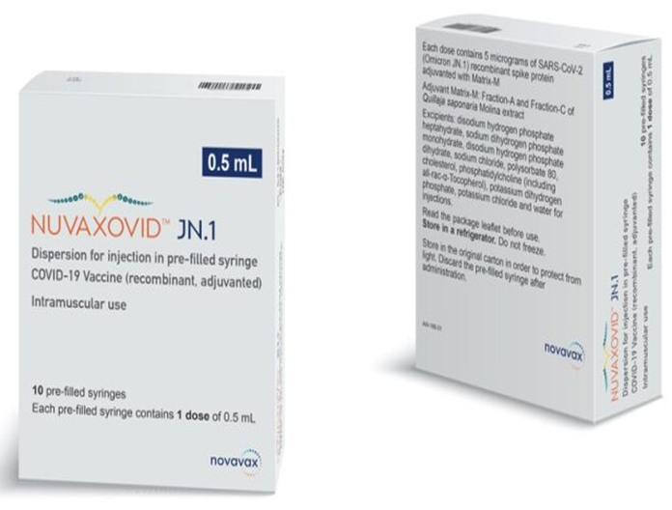
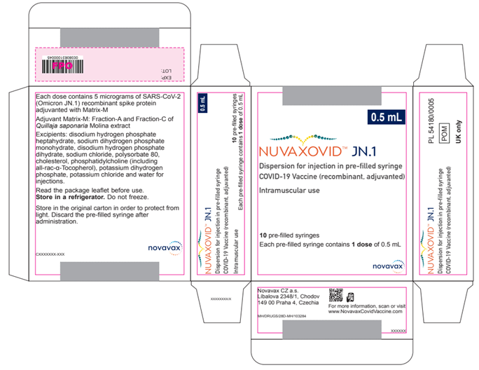
Sanofi Nuvaxovid ® JN.1 5 microgrammes/dose pre-filled syringe
Nuvaxovid ® JN.1 5 microgrammes/dose
Nuvaxovid JN.1 dispersion for injection, COVID-19 Vaccine (recombinant, adjuvanted) - Summary of Product Characteristics (SmPC) - (emc) | 100216

Slide 28
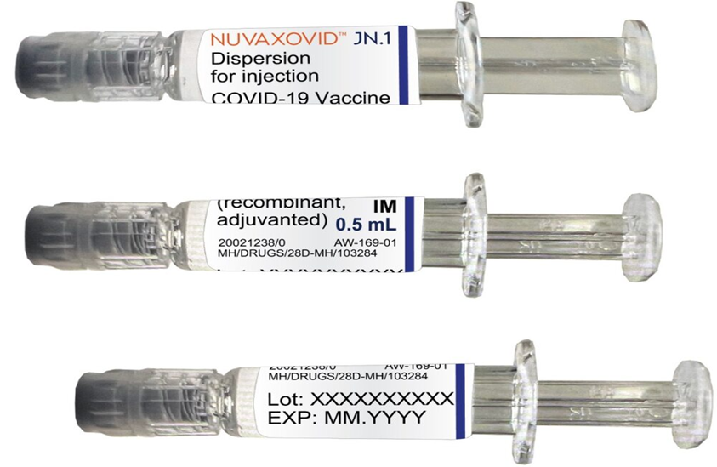
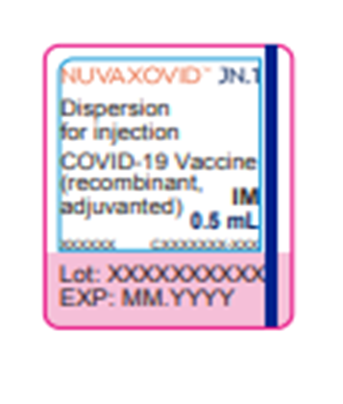
Sanofi Nuvaxovid ® JN.1 5 microgrammes/dose pre-filled syringe
Nuvaxovid JN.1 dispersion for injection, COVID-19 Vaccine (recombinant, adjuvanted) - Summary of Product Characteristics (SmPC) - (emc) | 100216

Slide 29
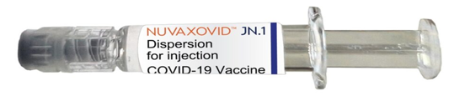
Presentation: Sanofi Nuvaxovid ® JN.1 5 microgrammes/dose pre-filled syringe
Sanofi Nuvaxovid ® JN.1 COVID-19 vaccines are single dose pre-filled syringes.
One pre-filled syringe contains 1 dose of 0.5mL of vaccine (recombinant, adjuvanted).
One dose (0.5 mL) contains 5 micrograms of the SARS-CoV-2 (Omicron JN.1) spike protein and is adjuvanted with Matrix-M.
The dispersion is colourless to slightly yellow, clear to mildly opalescent
Store in a refrigerator (+2°C - +8°C).
Do not freeze.
Keep the pre-filled syringes in the outer carton in order to protect from light.
Nuvaxovid JN.1 is for intramuscular injection only, preferably into the deltoid muscle of the upper arm.
The vaccine should not be mixed in the same syringe with any other vaccines or medicinal products.
Spikevax LP.8.1 0.1 mg/mL dispersion for injection - Summary of Product Characteristics (SmPC) - (emc) | 101925

Slide 30

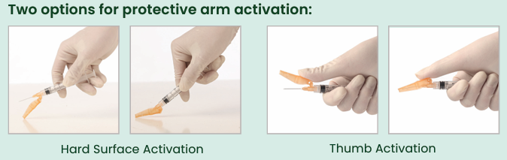
Hypodermic Sol-Care Safety Needle 23G X 1mm for use with Novaxovid pre-filled syringe
Sol-Care™ Safety Needle is used in conjunction with a standard syringe.
Features:
Two options for protective arm activation: hard surface activation and thumb activation
Simple one-handed safety shield mechanism
Audible click indicates that the safety mechanism is secured and locked in place
Hubs, protective shields, and packaging are color-coded for facilitating the identification of needles gauges (ISO 6009)
Protective arm designed not to obstruct visualization of injection site
Compatible with all standard Luer Lock and Luer Slip Tip syringes
Not manufactured with Latex, PVC and DEHP
Please note: the IPC measures in external resources may not align with the national IPC requirements in Wales.
See here for NHS Wales guidance: NIPCM - Public Health Wales: https://phw.nhs.wales/services-and-teams/antibiotics-and-infections/nipcm/

Slide 31
List of excipients
Disodium hydrogen phosphate heptahydrate
Sodium dihydrogen phosphate monohydrate
Sodium chloride
Polysorbate 80
Sodium hydroxide (for adjustment of pH)
Hydrochloric acid (for adjustment of pH)
Water for injections
Adjuvant (Matrix-M)
Cholesterol
Phosphatidylcholine (including all-rac-α-Tocopherol)
Potassium dihydrogen phosphate
Potassium chloride
Disodium hydrogen phosphate dihydrate
Sodium chloride
Water for injections

Slide 32
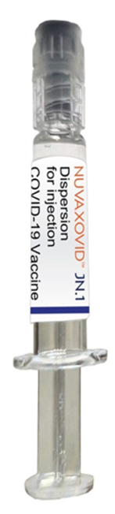

 | Presentation: Moderna Spikevax® LP.8.1 0.1mg/mL dispersion for injection | Sanofi Nuvaxovid ® JN.1 5 microgrammes/dose pre-filled syringe
Doses | 5 doses per vial of 0.5ml | 1 dose pre-filled syringe
Age | 18 years + | 18 years + (Please refer to notes section in relation to children and young people)
Image
Notes:
Children and young people:
For children and young people who are immunosuppressed, JCVI continues to advise the use of the Pfizer-BioNTech COVID-19 mRNA (Comirnaty) vaccine, with the vaccine dose appropriate to the child’s age:
6 months to 4 years: 3 micrograms
5 to 11 years: 10 micrograms
12 to 17 years: 30 micrograms - If not deemed suitable for an mRNA vaccine, then Nuvaxovid JN.1* can be given Green book on Immunisation COVID-19 chapter 14a
Nuvaxovid JN.1 dispersion for injection in pre-filled syringe - Summary of Product Characteristics (SmPC) - (emc) | 101554

Slide 33
Additional slides outlining key principles for Moderna Spikevax® LP.8.1 & Sanofi Nuvaxovid ® JN.1 COVID-19 vaccines

Slide 34
Patient Group Direction (PGD) and Vaccine Group Direction (VGD)
Moderna Spikevax® LP.8.1 & Sanofi Nuvaxovid ® JN.1 COVID-19 vaccines can be administered under a PGD or VGD.
Templates are available to view here: Patient Group Directions (PGD) - Welsh Medicines Advice Service (wales.nhs.uk)
Further information about VGD's is available here: NHS SPS - Specialist Pharmacy Service – The first stop for professional medicines advice
NB: Local authorisation is required before PGD or VGD templates can be used.

Slide 35
Prior to giving COVID-19 vaccines
Before giving the vaccine, you need to check whether the person to be vaccinated:
is eligible to receive the COVID-19 vaccine.
has any contraindications or precautions to either COVID-19 vaccine.
has not received any COVID-19 vaccination in the previous 3 months. The Green Book COVID-19 chapter states, for those eligible for vaccination during seasonal campaigns, a single dose is offered at least 3 months after any previous dose. This interval applies to any vaccine, regardless of the product given for the previous doses. Timing should follow the JCVI advice for that campaign, which aims to provide protection to the most vulnerable at the optimal time.
The only exceptions to the 3 month interval would be individuals who are immunosuppressed, these individuals would be recommended a second dose and in some circumstances may need to complete vaccinations within a treatment window. In this situation the minimum interval could be reduced to 3 weeks Green Book COVID-19 chapter
Operational flexibility is permitted to offer the seasonal dose to eligible individuals expected to reach the target age during campaign windows.

Slide 36
Contraindications: Moderna Spikevax® LP.8.1. and Sanofi Nuvaxovid® JN.1 COVID-19 Vaccines
Vaccination should be postponed in individuals suffering from acute severe febrile illness or acute infection. The presence of a minor infection and/or low-grade fever should not delay vaccination.
The vaccine is contraindicated in those who have had a previous systemic allergic reaction (including immediate-onset anaphylaxis) to:
  a previous dose of a COVID-19 vaccine
  any component (excipient) of the COVID-19 vaccine
People with a history of allergy: A very small number of individuals have experienced anaphylaxis when receiving a COVID-19 vaccine. Anyone with a history of allergic reaction to an excipient in the COVID-19 vaccine should not receive that vaccine (except with expert advice), but those with any other allergies (such as a food allergy) – including those with prior anaphylaxis – can have the vaccine. Guidance about the management of individuals with a history of allergy should be followed (summarised in Table 5) Green Book: COVID-19 chapter
Notes:
Before administering a COVID-19 vaccine, it is important to check for any relevant medical history including allergies and any previous history of severe reaction to a vaccine. Facilities for management of paediatric anaphylaxis should be available at all vaccination sites. (See Chapter 8 of the Green Book: https://www.gov.uk/government/publications/vaccine-safety-and-adverse-events-following-immunisation-the-green-book-chapter-8 ) and advice issued by the Resuscitation Council (https://www.resus.org.uk/).

Slide 37
Pregnancy
Note: Only pregnant women who fall into the immunosuppressed category, (as defined in ‘immunosuppression’ sections of tables 3 & 4 of the Green Book COVID-19 chapter) are eligible for a COVID-19 vaccination.
There is no known risk associated with giving inactivated vaccines during pregnancy. Since inactivated vaccines cannot cause infection in either the mother of the fetus.
As with most pharmaceutical products, large clinical trials of COVID-19 vaccine in pregnancy have not been carried out.
However, a large amount of observational data from women vaccinated in pregnancy have not shown any increase in adverse pregnancy outcomes.
Animal studies do not indicate direct or indirect harmful effects with respect to pregnancy, embryo/foetal development, parturition (childbirth) or post-natal development.

Slide 38
Breastfeeding
There is no known risk associated with being given a non-live vaccine whilst breastfeeding.
JCVI advises that breastfeeding women should be offered any suitable COVID-19 vaccine (if eligible).
Protective antibodies have been detected in breast milk (Gray et al, 2021). The developmental and health benefits of breastfeeding are clear and should be discussed with the woman, along with her clinical need for immunisation against COVID-19. COVID-19: the green book chapter - GOV.UK
Moderna Spikevax® LP.8.1 and Sanofi Nuvaxovid ® JN.1 COVID-19 vaccines can be used during breast-feeding.
Spikevax LP.8.1 0.1 mg/mL dispersion for injection - Summary of Product Characteristics (SmPC) - (emc) | 101925
Nuvaxovid JN.1 dispersion for injection in pre-filled syringe - Summary of Product Characteristics (SmPC) - (emc) | 101554

Slide 39
Vaccinating Individuals with bleeding disorders
Individuals with bleeding disorders may be vaccinated intramuscularly if, in the opinion of a doctor familiar with the individual’s bleeding risk, vaccines or similar small volume intramuscular injections can be administered with reasonable safety by this route.
If the individual receives medication/treatment to reduce bleeding, for example treatment for haemophilia, intramuscular vaccination can be scheduled shortly after such medication/ treatment is administered. Individuals on stable anticoagulation therapy, including individuals on warfarin who are up-to-date with their scheduled INR testing and whose latest INR is below the upper level of the therapeutic range, can receive intramuscular vaccination.
A fine needle (23 or 25 gauge) should be used for the vaccination, followed by firm pressure applied to the site without rubbing for at least 2 minutes (Advisory Committee on Immunization Practices 2019). The individual/parent/carer should be informed about the risk of haematoma from the injection Green Book COVID-19 chapter
Notes:
Thrombocytopenia and coagulation disorders
As with other intramuscular injections, the vaccine should be given with caution in individuals receiving anticoagulant therapy or those with thrombocytopenia or any coagulation disorder (such as haemophilia) because bleeding or bruising may occur following an intramuscular administration in these individuals.

Slide 40
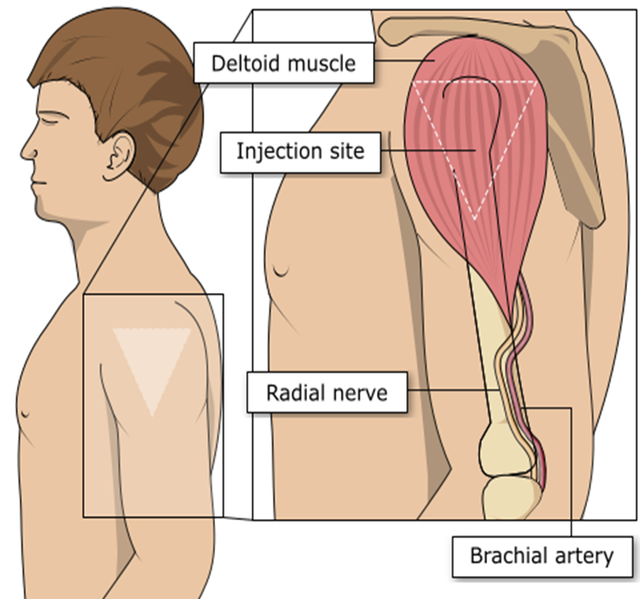
Vaccination site
The COVID-19 vaccine should be administered intramuscularly.
The preferred site is the deltoid muscle of the upper arm.
The needle needs to be long enough to ensure vaccine is injected into the muscle. For this reason, a 25mm needle is being provided for administration of the COVID-19 vaccine. A 38mm length needle is available if required for adults with a high BMI.
If there is insufficient muscle mass in the deltoid or a particular reason the deltoid muscle is unsuitable, the vaccine should be given into the vastus lateralis muscle in the anterolateral aspect of the thigh.
Image source: The Australian Immunisation Handbook (health.gov.au)
Notes:
Giving vaccine into the muscle:
leads to a better immune response to the vaccine (as the muscle contains the appropriate cells necessary to initiate the immune response)
is less likely to cause local reactions than if the vaccine is given into the skin (subcutaneously)

Slide 41
Disposal:
COVID-19 Vaccines
Any unused product or waste material should be disposed of in accordance with local policy
Equipment used for immunisation, including used vials, ampoules, or discharged vaccines in a syringe or applicator, should be disposed of at the end of a session by sealing in an UN-approved puncture-resistant ‘sharps’ box, according to local authority regulations and guidance in the Welsh Health Technical Memorandum 07-01 Safe management of healthcare waste

Slide 42
Adverse reactions
Like all vaccines, Moderna Spikevax® LP.8.1 and Sanofi Nuvaxovid ® JN.1 COVID-19 vaccines can cause side effects, although not everybody gets them
A detailed list of adverse reactions is available in the Summary of Product Characteristics.
The most frequently reported adverse effects (affecting between 1 in 10 people) include:
headache
diarrhoea nausea, vomiting
muscle, joint pain and or stiffness
pain, redness or swelling at the injection site
enlarged lymph nodes
feeling weak, lethargic, tiredness, chills and fever
rash
pain in the extremity
Spikevax LP.8.1 0.1 mg/mL dispersion for injection - Summary of Product Characteristics (SmPC) - (emc) | 101925
Nuvaxovid JN.1 dispersion for injection in pre-filled syringe - Summary of Product Characteristics (SmPC) - (emc) | 101554

Slide 43
Myocarditis and pericarditis
Cases of myocarditis and pericarditis have been reported rarely after COVID-19 vaccination. Cases have been observed more often after the second vaccination, and more often in younger males
Although now licensed from 6 months of age, Moderna Spikevax COVID-19 vaccines are not recommended for use in individuals of less than 18 years of age because of the slightly higher risk of myocarditis/pericarditis compared to Pfizer vaccines COVID-19: the green book chapter
If an individual develops myocarditis or pericarditis following the first COVID-19 vaccination they should be assessed by an appropriate clinician to determine whether it is likely to be vaccine related
https://www.gov.uk/government/publications/myocarditis-and-pericarditis-after-covid-19-vaccination/myocarditis-and-pericarditis-after-covid-19-vaccination-guidance-for-healthcare-professionals
Healthcare professionals should be alert to the signs and symptoms of myocarditis and pericarditis. Vaccinees (including parents or caregivers) should be instructed to seek immediate medical attention if they develop symptoms indicative of myocarditis or pericarditis such as (acute and persisting) chest pain, shortness of breath, or palpitations following vaccination. Healthcare professionals should consult guidance and/or specialists to diagnose and treat this condition. COVID-19: the green book chapter
As the mechanism of action and risk of recurrence of myocarditis and pericarditis are being investigated, the current advice is that an individual’s second or subsequent doses should be deferred pending further investigation and careful consideration of the risks and benefits

Slide 44
Guillain-Barré syndrome (GBS)
Very rare reports have been received of GBS following COVID-19 vaccination, so healthcare professionals should be alert to the signs and symptoms of GBS to ensure correct diagnosis and to rule out other causes, in order to initiate adequate supportive care and treatment
Individuals who have a history of GBS should be vaccinated as recommended for their age and underlying risk status. Cases of GBS reported following vaccination may occur by chance (the background rate of GBS is 2 per 100,000 per year in the population) and no causal mechanism with COVID-19 vaccination has been proven
There is evidence to suggest that having had a prior diagnosis of GBS does not predispose an individual to further episodes of GBS when immunised with other vaccines (Baxter et al, 2012) and for the Pfizer BioNTech COVID-19 vaccine (Shapiro Ben David et al, 2021)
In those who are diagnosed with GBS after the first dose of vaccine, the balance of risk benefit is in favour of completing a full COVID-19 vaccination schedule. Green Book: COVID-19 chapter

Slide 45
Individuals with a history of immune thrombocytopenia
Individuals with a history of immune thrombocytopenia (ITP) may experience a fall in their platelet count.
Previous ITP is not a contra-indication for vaccination.
Although evidence suggests a raised risk of ITP after the AstraZeneca vaccine (Simpson et al, 2021), ITP has also been reported with other COVID-19 vaccines (Lee et al, 2021).
Given these reports, monitoring of platelets 2-5 days post COVID-19 vaccination in patients with a history of ITP should be considered. Green Book COVID-19 chapter

Slide 46
Erythema multiforme
A number of cases of erythema multiforme (EM) have been reported after Moderna and Pfizer mRNA vaccinations.
These reports appear to be consistent with EM minor, with no fatalities.
MHRA have consulted dermatology experts who consider EM an uncommon, benign and self-limiting condition which could plausibly be triggered by COVID-19 vaccination; although overreporting due to misdiagnosis was possible.
A past history of EM is not a contraindication for vaccination.
Green Book: COVID-19 chapter

Slide 47
Capillary Leak Syndrome
Extremely rare reports of capillary leak syndrome have been reported after AstraZeneca and Moderna vaccines in individuals with a prior history of this condition.
Individuals with a history of capillary leak syndrome, should be carefully counselled about the risks and benefits of vaccination and advice from a specialist should be sought.

Slide 48
Individuals with history of COVID-19 infection
There are no safety concerns from vaccinating individuals with a past history of COVID-19 infection, or with detectable COVID-19 antibody.
Vaccination of individuals who may be infected or asymptomatic or incubating COVID-19 infection is unlikely to have a detrimental effect on the illness, although individuals with suspected COVID-19 infection should not attend vaccination sessions to avoid infecting others.
There is no need to defer immunisation in individuals after recovery from a recent episode with compatible symptoms, whether or not they are tested for COVID-19.
During care home outbreaks, vaccination of residents with confirmed COVID-19 may go ahead, provided the residents are clinically stable and infection control procedures can be maintained. These populations are likely to be highly vulnerable and this policy should help to maximise vaccination coverage without the need for multiple visits.
Having prolonged COVID-19 symptoms is not a contraindication to receiving COVID-19 vaccine but if the patient is seriously debilitated, still under active investigation, or has evidence of recent deterioration, deferral of vaccination may be considered to avoid incorrect attribution of any change in the person’s underlying condition to the vaccine. Green Book COVID-19 chapter

Slide 49
Co-administration with other vaccines
Based on recent evidence, and, as COVID-19 vaccines are considered inactivated (including the non-replicating adenovirus vaccine), where individuals in an eligible cohort present having recently received one or more inactivated or another live vaccine, COVID-19 vaccination should still be given.
The same applies for other live and inactivated vaccines where COVID-19 vaccination has been received first or where a patient presents requiring two or more vaccines. It is generally better for vaccination to proceed to avoid any further delay in protection and to avoid the risk of the patient not returning for a later appointment.
This includes but is not limited to vaccines commonly administered around the same time or in the same settings, including pneumococcal polysaccharide vaccine, shingles vaccine and RSV vaccine Green Book COVID-19 chapter.

Slide 50
Post vaccination waiting times
For people with a history of allergy, as described in the Green Book, the 15 minute observation period remains. Further information is available here: Table 5 Green Book: COVID-19 chapter.
For those without a history of allergies (as described in the Green Book: COVID-19 Chapter), observation times are as follows:
  After COVID-19 vaccine administration, individuals should be observed for any immediate reactions whilst they are receiving any verbal post vaccination information and exiting the centre.
  Facilities for management of anaphylaxis should be available at all vaccination sites.
  The advice to suspend the 15 minute observation period applies to all COVID-19 vaccines.
  Vaccinated individuals should be informed about how to access immediate healthcare advice in the event of displaying any symptoms.
  In some settings, for example domiciliary vaccination, this may require a responsible adult to be present for at least 15 minutes after vaccination.
  No specific management is required for patients with a family history of allergies.
As fainting can occur following vaccination, all those vaccinated with any of the COVID-19 vaccines should not drive for 15 minutes after vaccination.

Slide 51
Informed consent
How much information should you give?
this will be personal to the individual at the time and will depend on their previous knowledge and discussions with others
give people as much information as they need and/or want to make an informed decision
some people will just ‘trust’ what you say while others want lots of information; either is fine
how much each individual needs is up to them, no one is obliged to seek full information
Information to be given includes:
which vaccine is being offered and the disease against which it protects
benefits/risks of immunisation versus risks of the disease​
any possible vaccine reactions and what to do if these occur
Consent is a process, not a one-off discussion and must consider 3 factors:
the person giving consent must be appropriately informed: they must have the necessary information in order to make the decision
consent must be voluntary by the individual without undue pressure or coercion
the person consenting must have the capacity to make the decision
Consent: the green book, chapter 2 - GOV.UK (www.gov.uk)
Mental capacity Act 2005 https://www.legislation.gov.uk/ukpga/2005/9/contents

Slide 52
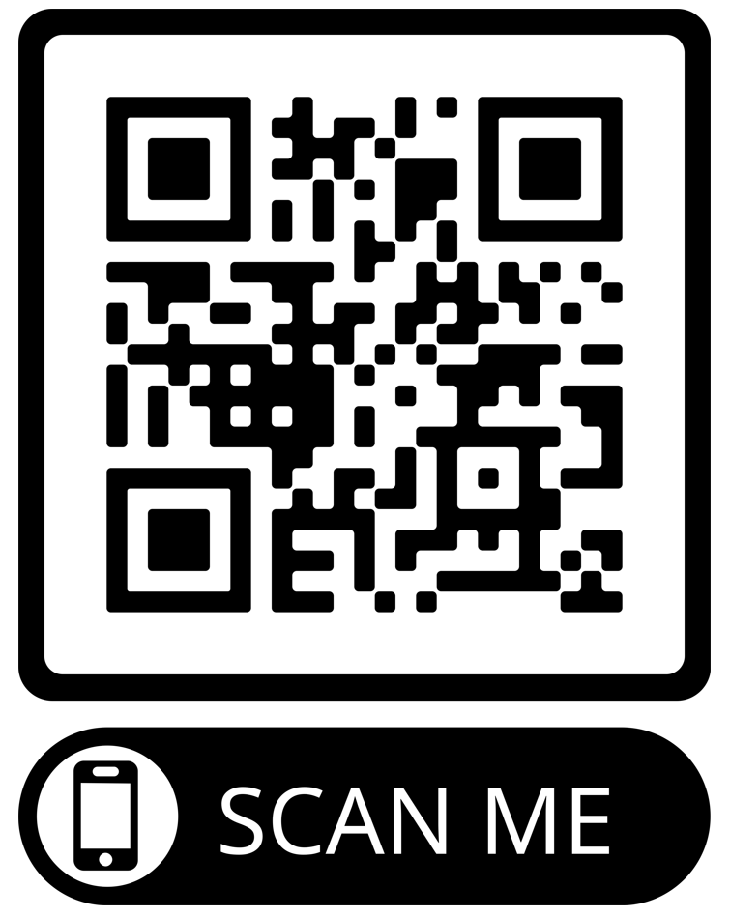
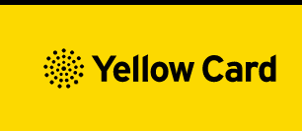
Reporting Adverse Events
Vaccinees should be advised that they can report any adverse reactions or suspected side effects to the MHRA through the online yellow card scheme website or the Yellow Card app
Anyone (patients and HCWs) can make a Yellow Card report, even if they are uncertain as to whether a vaccine caused the condition
▼ This medicinal product is subject to additional monitoring. This will allow quick identification of new safety information. Healthcare professionals are asked to report any suspected adverse reactions.
The QR code can be used for quick and easy access to the Yellow Card reporting site.
www.mhra.gov.uk/yellowcard

Slide 53
Summary and resources

Slide 54
Key messages
COVID-19 is now a relatively mild disease for the vast majority of people. This ongoing increase in population immunity permits the development of a more targeted programme aimed at those at higher risk of developing serious COVID-19 disease.
Individuals aged six months and above with severe immunosuppression may be considered for additional doses ideally at an interval of 8 to 12 weeks from the previous dose.
Exception to this ideal interval may be advised based on specialist clinical judgement, for example for those about to receive or increase the intensity of an immunosuppressive treatment, where a better response would be made if immunised prior to that treatment commencing.
Where the specialist has advised an exception, then the interval may be reduced to a minimum of three weeks for any of the vaccine products.
Previously unvaccinated Individuals who become or have recently become severely immunosuppressed, should be considered for a first dose of vaccination and the second dose given ideally at an interval of 8-12 weeks from the previous dose. Including individuals who receive bone marrow transplants or CAR-T therapy as they may have lost immunological memory of previous vaccination
For individuals about to receive planned immunosuppressive treatment, a minimum interval of 3 weeks between COVID-19 doses may be followed, to enable the vaccine to be given whilst the individual’s immune system is better able to respond

Slide 55
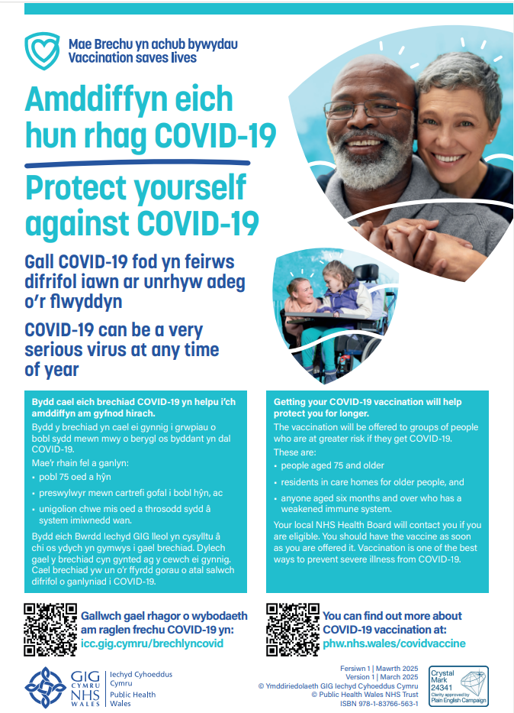


Public resources
Immunisation and Vaccines - Public Health Wales (nhs.wales)
Order for FREE here: https://phw.nhs.wales/services-and-teams/health-information-resources/
COVID-19 Poster
COVID-19 Information Leaflet

Slide 56
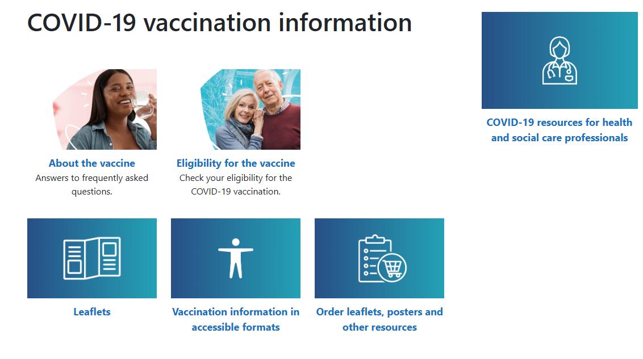
Further information to support the COVID-19 Vaccination Programme
Information for health care professionals here
COVID-19 Information for the public here
Notes:
Resources for health and social care professionals - Public Health Wales (nhs.wales)
About the vaccine - Public Health Wales (nhs.wales)

Slide 57

Confident vaccine conversations - Behavioural Science Motivational Interviewing approach eLearning module
This eLearning module has been developed as a collaborative project between:​
Public health Wales - Health Protection Division -Training Guidance and Behavioral Science Team ​
Public health Wales - Behavioral Science Unit​
Public health Wales - Health Protection Division - Vaccine Preventable Disease Programme
The module will be available to view here shortly: Immunisation eLearning - Public Health Wales

Slide 58
Further information
Immunisation against infectious disease "Green Book"
JCVI statement on COVID-19 vaccination in 2025 and spring 2026 - GOV.UK
COVID-19 spring vaccination programme 2026 (WHC/2025/052) [HTML] | GOV.WALES
PHW professional information resources:
COVID-19 resources for health and social care professionals - Public Health Wales (nhs.wales)
Vaccine resources for health and social care professionals - Public Health Wales (nhs.wales)
PHW training:
Immunisation training resources and events - Public Health Wales (nhs.wales)
Immunisation eLearning - Public Health Wales (nhs.wales)
UKHSA COVID-19 vaccination resources:
COVID-19 vaccination programme - GOV.UK (www.gov.uk)
UKHSA COVID-19 Immunisation programme Information for healthcare practitioners
This document provides additional information, answers to frequently asked questions and actions to take in the event of inadvertent errors.
Oxford Knowledge Project: COVID-19 vaccines
MHRA: Guidance on coronavirus (COVID-19)
Notes:
The Green Book has the latest information on vaccines and vaccination procedures, for vaccine preventable infectious diseases in the UK. It also includes UK vaccine policy.
Green Book recommendations are based upon JCVI’s expert opinion and should always be followed, even when they differ from those made by the vaccine
manufacturer. (Note: sometimes vaccine policy in Wales differs to England)

